Slide 1

Prediction and Research about future Environment Protection , Climate Change and Economy
Yedong Liu
Shaalmali Raychaudhury

Slide 2

Introduction
Tackling the problem of future climate change is one of the most challenging issues of this century and has major implications for policies of development and environmental management.
In order to determine, if climate change is good or bad or more precisely how good or bad, indicators are needed. So far, measurements of the value of climate as a direct input to human welfare were mainly derived by using environmental valuation techniques such as the hedonic price approach or the household production function approach.

Slide 3
Predictors for human behavior to climate change
Energy consumption
Agriculture land
CO2 emission
Scientists have concluded that most of the observed warming is very likely due to the burning of coal, oil, and gas. This conclusion is based on a detailed understanding of the atmospheric greenhouse effect and how human activities have been tweaking it. At the same time, other reasonable explanations, most notably changes in the Sun, have been ruled out.

Slide 4
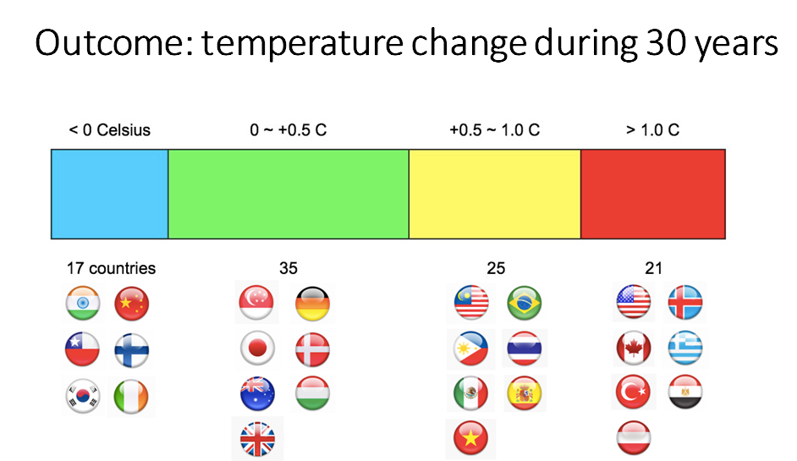
Temperature change around the World

Slide 5
Climate change to happiness
Temp differences
Precipitation differences
GDP per capita
Since Jan. 1, the United States has set more than 40,000 hot temperature records, but fewer than 6,000 cold temperature records, according to the National Oceanic and Atmospheric Administration.
Global warming could affect storm formation by decreasing the temperature difference between the poles and the equator.

Slide 6
Outcomes for climate change to human happiness
With rapid climate change, one-fourth of Earth’s species could be headed for extinction by 2050.
Climate change is already beginning to transform life on Earth. Around the globe, seasons are shifting, temperatures are climbing and sea levels are rising. And meanwhile, our planet must still supply us – and all living things – with air, water, food and safe places to live. If we don't act now, climate change will rapidly alter the lands and waters we all depend upon for survival, leaving our children and grandchildren with a very different world.

Slide 7

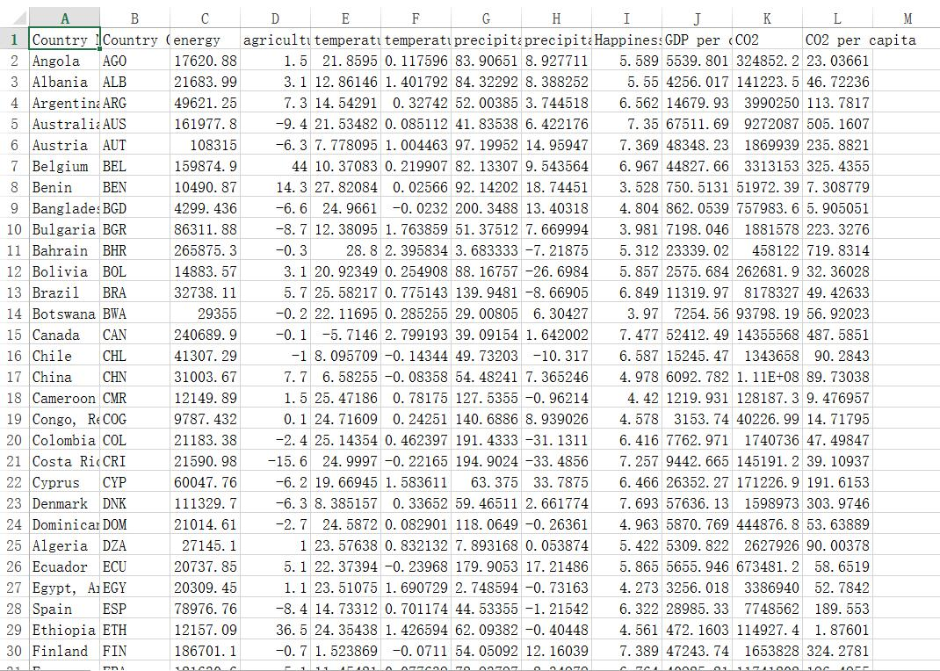
Data Source

Slide 8

Models
Neural Networks
Neural networks are powerful nonlinear regression techniques inspired by theories about how the brain works
Linear Regression
Linear regression is an approach for modeling the relationship between a scalar dependent variable y and one or more explanatory variables (or independent variables) denoted X.
Single Trees
Single trees partition the data into smaller groups that are more homogenous with respect to the response.

Slide 9
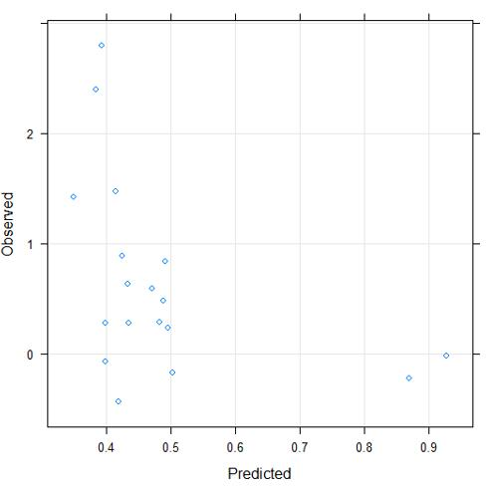
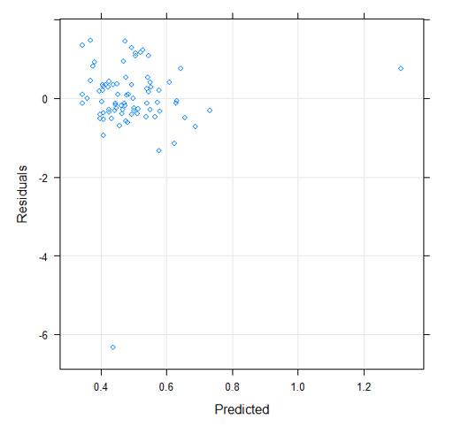
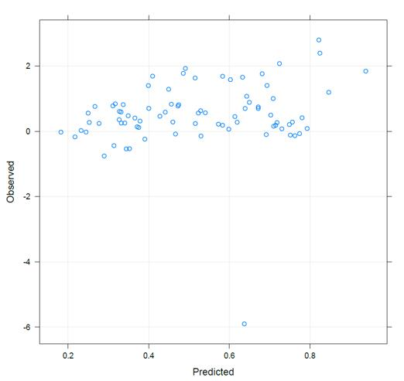
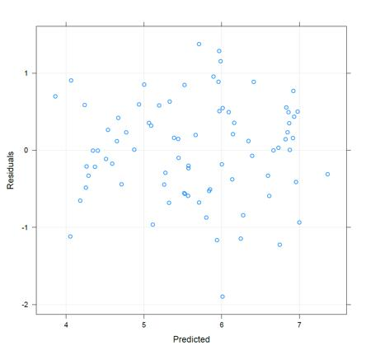
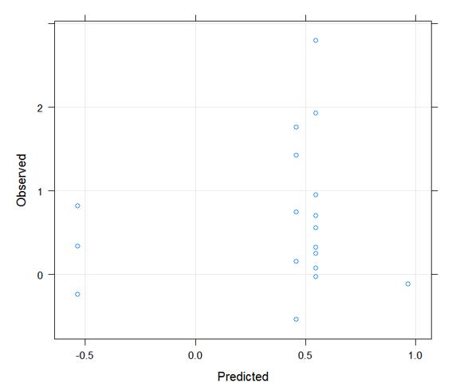
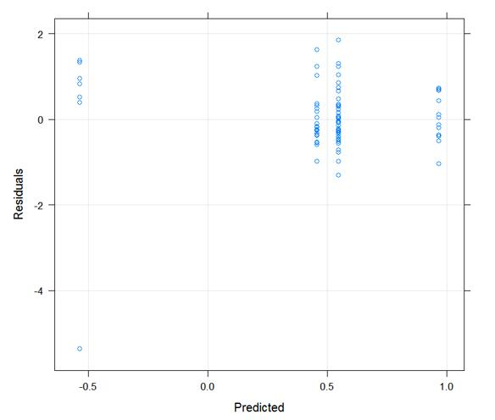
Human behavior to climate
Neural Networks RMSE=0.95 ; Rsqured=0.19
Linear Regression RMSE=0.56; Rsqured=0.05
Single Trees is the best
Model among them with RMSE
=0.89 and Rsquared=0.19
Single Trees RMSE=0.89; Rsqured=0.19

Slide 10
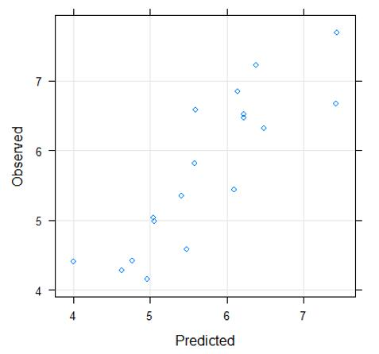
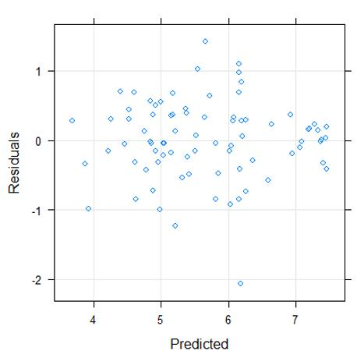
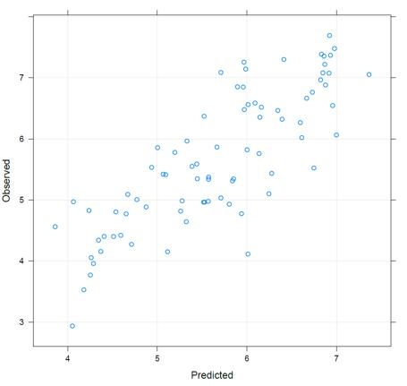
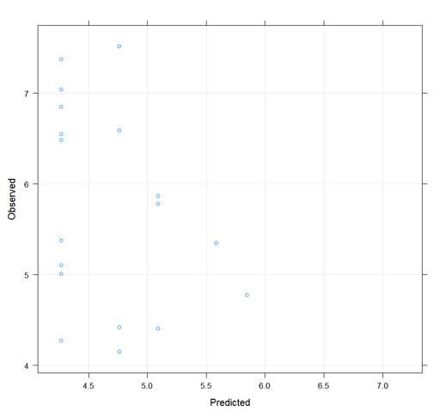
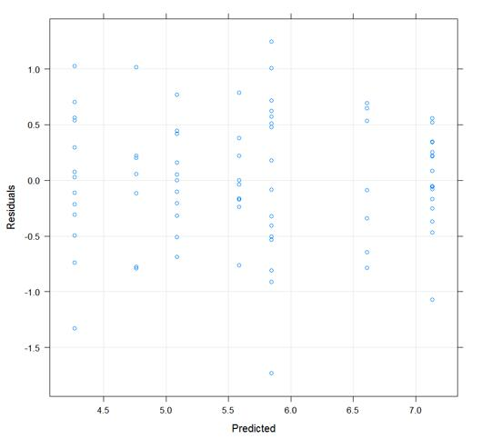
Climate & Economy to Happiness
Neural Networks RMSE=0.55 ; Rsqured=0.75
Linear Regression RMSE=0.72; Rsqured=0.62
Neural Networks is the best
Model among them with RMSE
=0.55 and Rsquared=0.75
Single Trees RMSE=0.77; Rsqured=0.60

Slide 11
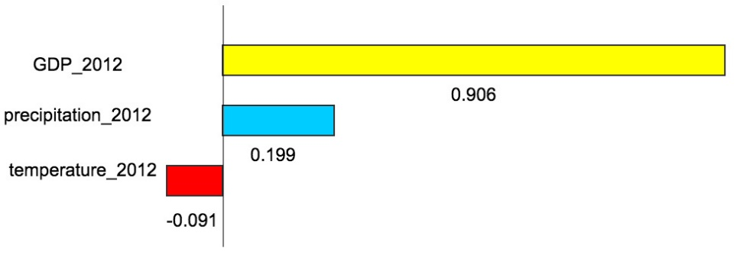
Conclusion & Future development
Human behavior to climate change
No obvious correlation
Climate & Economy to Happiness
GDP has high influence on happiness, precipitation has a medium influence, while temperature has low influence.
Future development
Coefficients of Linear Regression Model

Slide 12
Q & A

