Slide 1
Project: Scheduling Algorithms
Lubomir Bic

Slide 2
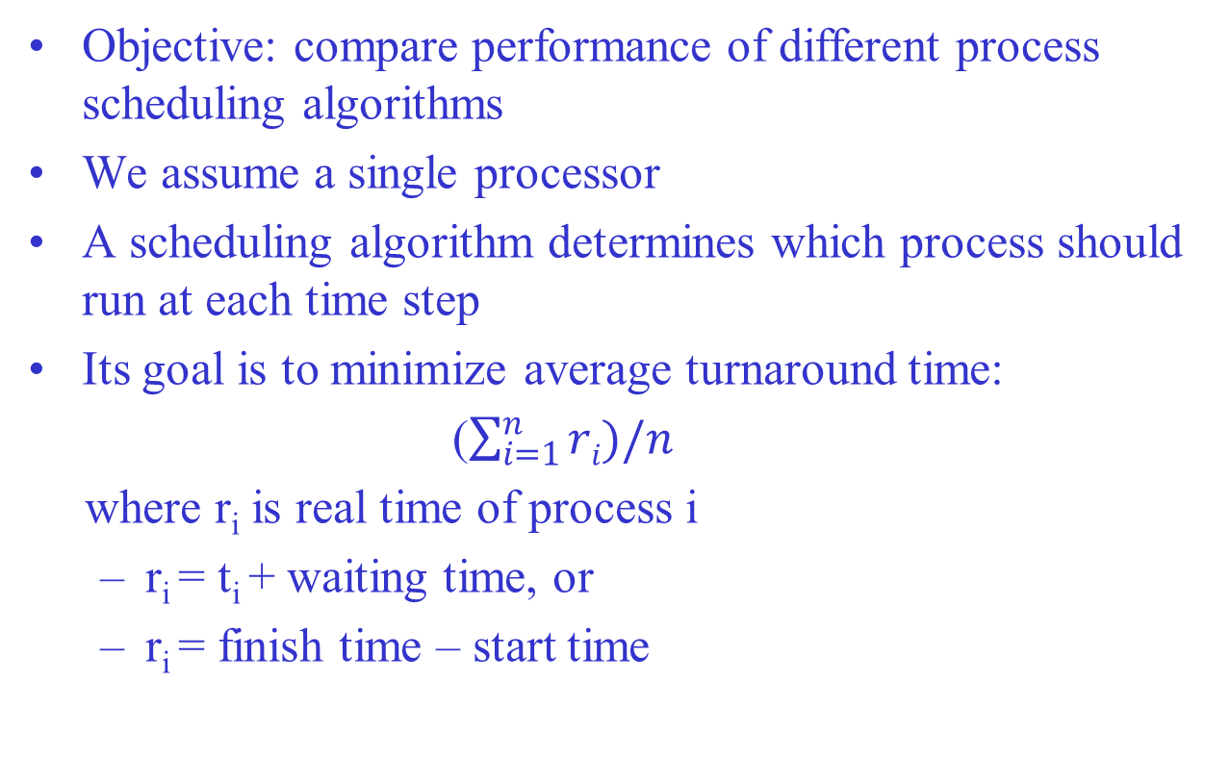
Project Description
Objective: compare performance of different process scheduling algorithms
We assume a single processor
A scheduling algorithm determines which process should run at each time step
Its goal is to minimize average turnaround time:
($\sum_{i=1}^{n}{ri)/n}$
where r_{i} is real time of process i
r_{i} = t_{i} + waiting time, or
r_{i} = finish time – start time

Slide 3
Project Description
Assignment: implement and compare
FIFO, SJF, SRT, MLF
You will be given a series of arrival and total service times
Your program must determine (for each algorithm):
the real times r_{i} of each process
average turnaround time
Output format: T r₁ r₂ … r_{n}
T: average turnaround time
each r_{i} is the real time of process i

Slide 4
Protocol for Testing
See lab assistant on due date
Bring your own laptop (or use a lab computer)
Your program must be able to
read text files (.txt extension) from a USB memory
write text files to the same memory stick

Slide 5
Protocol for Testing
During test:
for each algorithm:
read pairs ar_{i} t_{i} from file input.txt on memory stick
output results into a file nnn.txt, where nnn is your matriculation number, to the same memory stick
output file should contain 4 separate lines of the form
T r₁ r₂ … r_{n}

Slide 6
Example
Input file: 0 4 0 2 3 1
Output file:
4.66 4 6 4
4.00 6 2 4
3.33 7 2 1
4.66 7 6 1

