Slide 1
Hospital System Management
BY: LYDEN CHAI

Slide 2
Agenda
UML - Diagram demonstration
Demonstration some code and functions

Slide 3
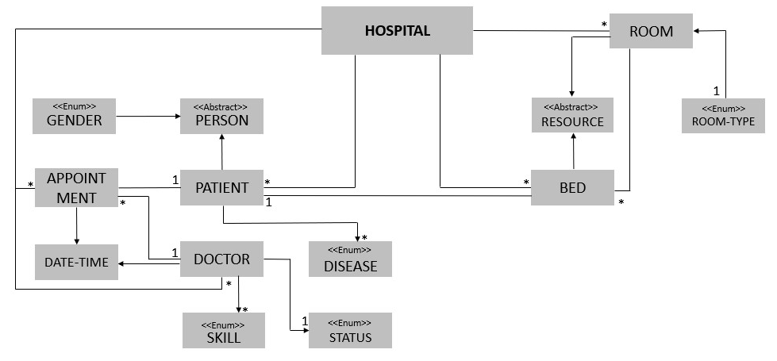
UML-DIAGRAM

Slide 4
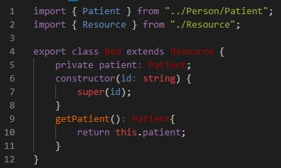
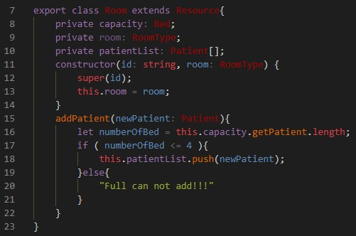
MANAGE PATIENT IN ROOM
IN BED
IN ROOM

Slide 5


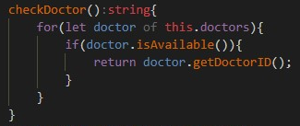
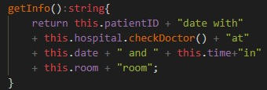
Check Doctor Appointment
IN STATUS
IN HOSPITAL
IN DOCTOR
IN APPOINTMENT

Slide 6





Thank you !
www.passerellesnumeriques.org

