Slide 1
Chapter 2
Routing

Slide 2
Outline
Create route
Create route with name
Use route with href
Create route with parameters
Understand error
Route list

Slide 3
What is Routing in Laravel?

Slide 4
Routing
Routing is a way to create a request URL for your application.
Entering the url in the browser
Click on link
Form submit
The response to the request could be
Returning a View
Returning Data (text, json,...)
Calling to controller

Slide 5
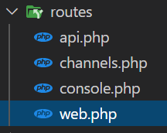
Routing

Slide 6
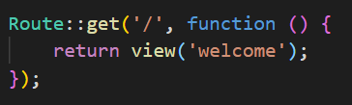
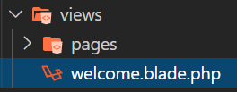
Basic Routing: return view as response
web.php
view

Slide 7

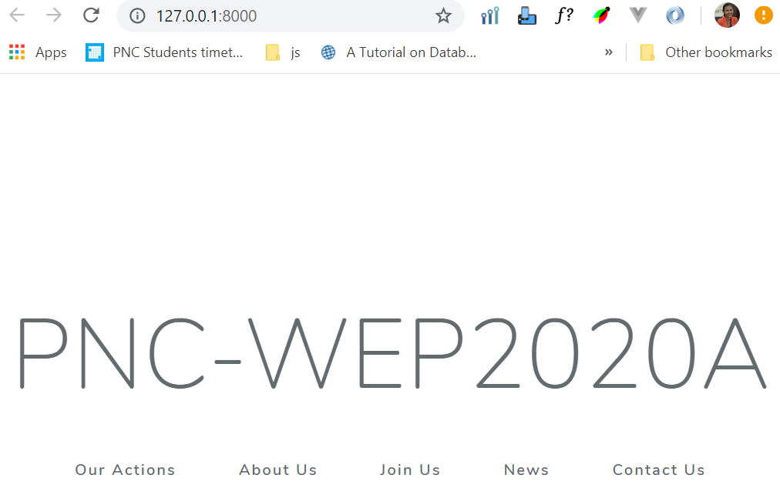
Basic Routing: return view as response
web.php
Enter url request in the browser
view
Return view welcome
to user as response

Slide 8
What happen when we request to a Routing that doesn’t Exist?

Slide 9
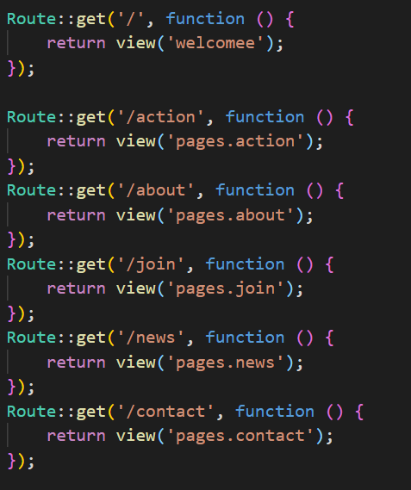
web.php

Slide 10
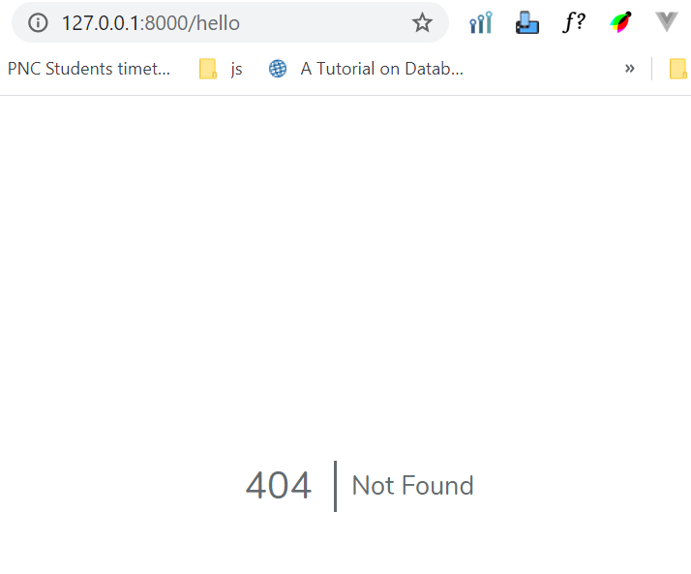

Slide 11
What happen when we request to Routing that returns view doesn’t Exist?

Slide 12

web.php
view

Slide 13
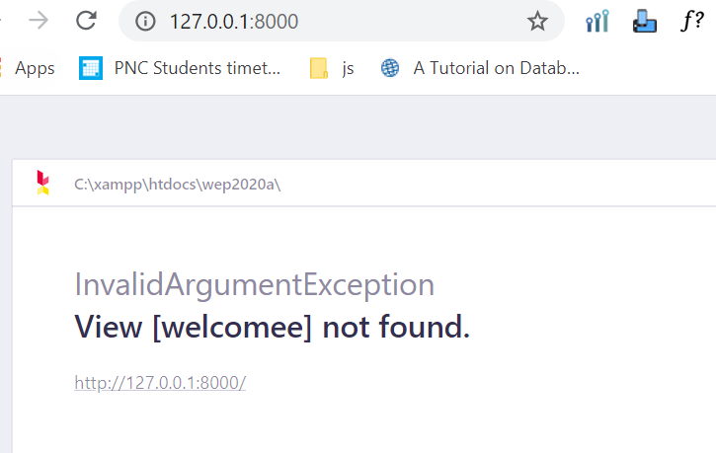

Slide 14
Activity [10mn]
Type php artisan route:list in your command. It will show all the routes exist your application
Try to request to the route calls notexist that isn’t in your route list and see what happen
Try to create a new route calls noview that return view that doesn’t exist in your application then see what happen

Slide 15

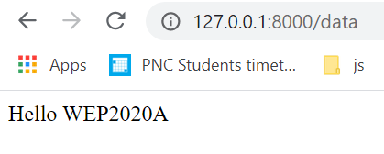
Basic Routing: return data as response
web.php

Slide 16

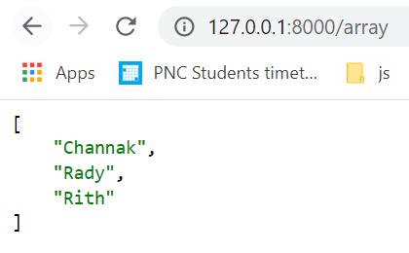
Basic Routing: return data as response
web.php

Slide 17

Basic Routing: request route via link
web.php
view
Route URI

Slide 18

Basic Routing: request route via link with name
web.php
view
Route name

Slide 19

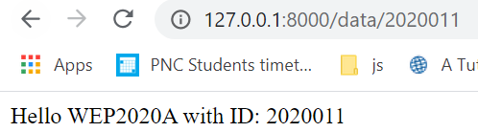
Basic Routing: route with parameter
web.php

Slide 20

Basic Routing: route with parameter request with link
web.php
view
Route name with parameter value assigned

Slide 21
Activity [15mn]
Create route calls student with name show.student that return string “Hello Student WEP2020A”
Try to request this route with href link (student) using route name
Try to add parameter id to this route
Try to request this route with href link (student) using route name with parameter with 202011 as value and return string “Hello Student 202011 of WEP2020A”

