Slide 1
Chapter 3
Basic Controller

Slide 2
Outline
Create controller
Call controller function from route request
Passing value to view

Slide 3
What is Controller in Laravel?

Slide 4
Controller
Controllers can group related HTTP request handling logic into a class.
Controllers are typically stored in the app/Http/Controllers directory.
Notes:
•Instead of defining all of your request handling logic in a single web.php file, you may wish to organize this behavior using Controller classes.
•
•Controllers can group related HTTP request handling logic into a class. Controllers are typically stored in the app/Http/Controllers directory.

Slide 5
Create Controller
php artisan make:controller ControllerName
Notes:
•Instead of defining all of your request handling logic in a single web.php file, you may wish to organize this behavior using Controller classes.
•
•Controllers can group related HTTP request handling logic into a class. Controllers are typically stored in the app/Http/Controllers directory.

Slide 6
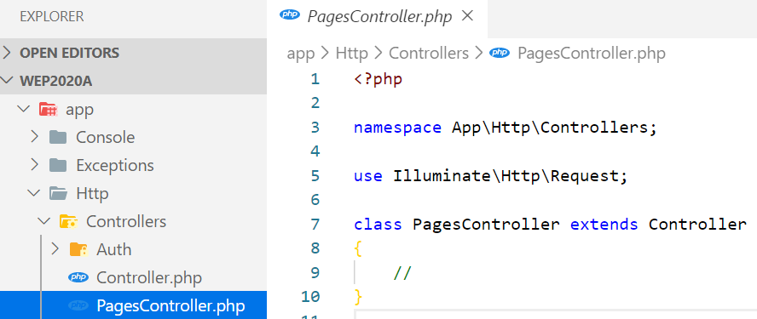
Example: Create PagesController
php artisan make:controller PagesController
Notes:
•Instead of defining all of your request handling logic in a single web.php file, you may wish to organize this behavior using Controller classes.
•
•Controllers can group related HTTP request handling logic into a class. Controllers are typically stored in the app/Http/Controllers directory.

Slide 7
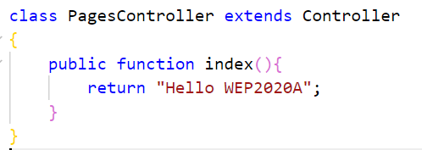
Create function inside PagesController
Notes:
•Instead of defining all of your request handling logic in a single web.php file, you may wish to organize this behavior using Controller classes.
•
•Controllers can group related HTTP request handling logic into a class. Controllers are typically stored in the app/Http/Controllers directory.

Slide 8

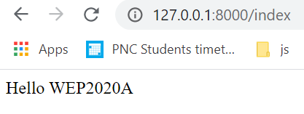
Call function from route request
web.php
Notes:
•Instead of defining all of your request handling logic in a single web.php file, you may wish to organize this behavior using Controller classes.
•
•Controllers can group related HTTP request handling logic into a class. Controllers are typically stored in the app/Http/Controllers directory.

Slide 9
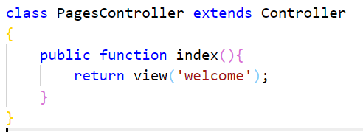
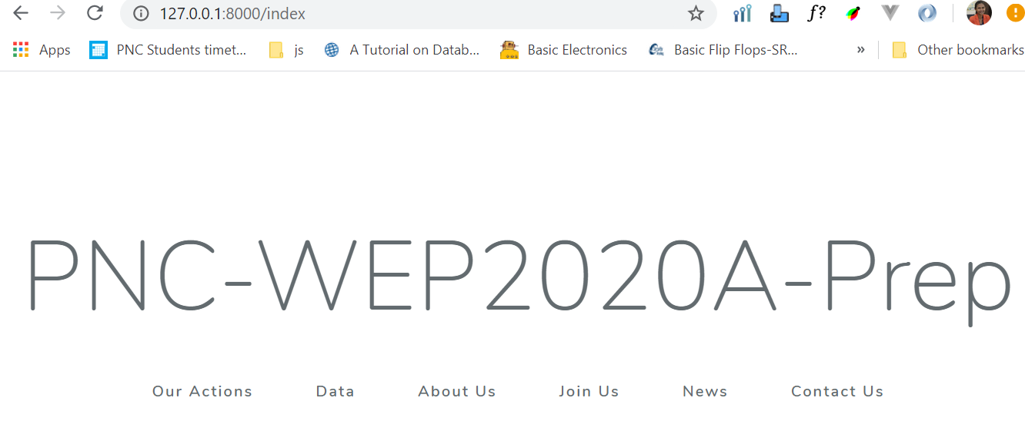
Return/load view from controller function
web.php
Notes:
•Instead of defining all of your request handling logic in a single web.php file, you may wish to organize this behavior using Controller classes.
•
•Controllers can group related HTTP request handling logic into a class. Controllers are typically stored in the app/Http/Controllers directory.

Slide 10
Activity[15mn]
Create PagesController
Create 5 functions inside this controller:
action(): return view action
about(): return view about
join(): return view join
news(): return view news
contact(): return view contact
Change your previous route to call all these 5 functions

Slide 11
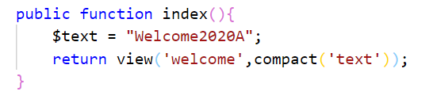
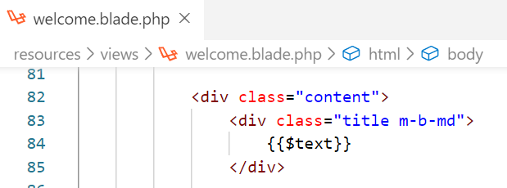
Passing value to view
1st way

Slide 12
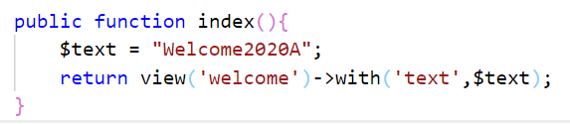
Passing value to view
2nd way

Slide 13
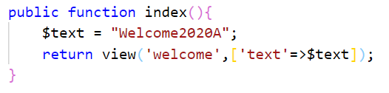
Passing value to view
3rd way

Slide 14
Activity[15mn]
Continue from the previous activity
Inside the following functions try to:
action(): passing “action” as title to view action
about(): passing “about” as title to view about
join(): passing “join” as title to view join
news(): passing “news” as title to view news
contact(): passing “contact” as title to view contact
You should see the title of each view set when appropriate route is requested

Slide 15
HTTP Requests

Slide 16
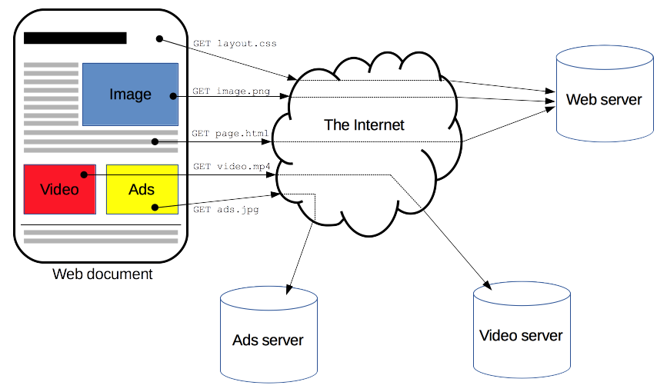
HTTP Request
Notes:
HTTP is a protocol which allows the fetching of resources, such as HTML documents. It is the foundation of any data exchange on the Web and it is a client-server protocol, which means requests are initiated by the recipient, usually the Web browser. A complete document is reconstructed from the different sub-documents fetched, for instance text, layout description, images, videos, scripts, and more.
Clients and servers communicate by exchanging individual messages (as opposed to a stream of data). The messages sent by the client, usually a Web browser, are called requests and the messages sent by the server as an answer are called responses.

Slide 17
HTTP Requests
There are 4 basic HTTP verb we use in requests to interact with resources in laravel:
GET — retrieve a specific resource (by id) or a collection of resources
POST — create a new resource
PUT/PATCH — update a specific resource (by id)
DELETE — remove a specific resource by id

