Slide 1
Chapter 5
Migration

Slide 2
Outline
Connect to Database
Create migration
Rollback
Fresh

Slide 3
Connect to Database

Slide 4
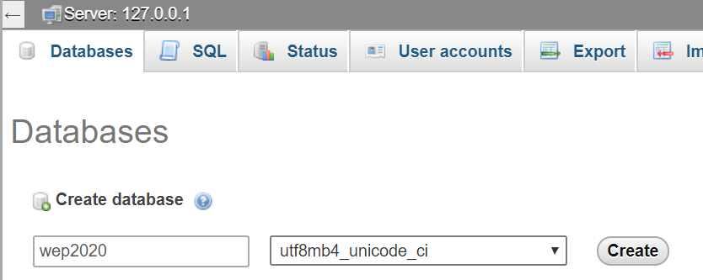
Create Database

Slide 5
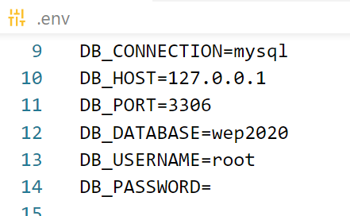
Connect to Database
Open .env file

Slide 6
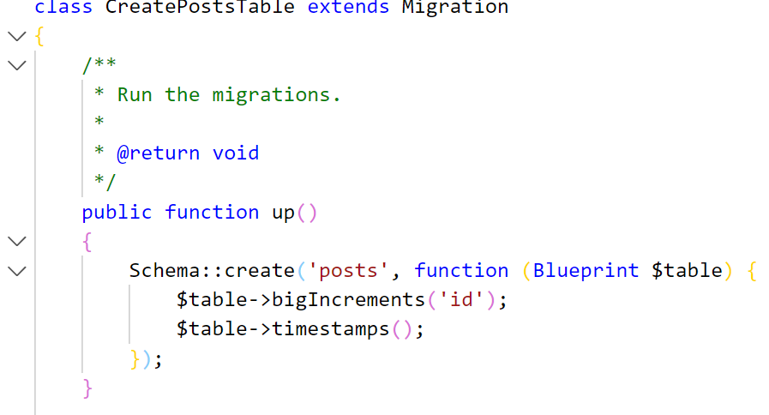
Create Migration
Create posts migration

Slide 7
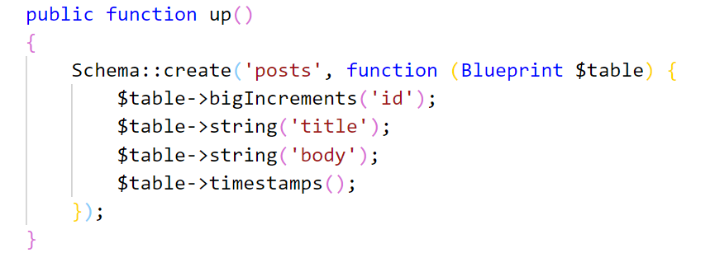
Add fields to Migration file
In the up function

Slide 8

Run migrate command
Run the migrate command to create table into database

Slide 9


Migrate command
Rollback the latest migration operation
Drop All Tables & Migrate
https://laravel.com/docs/6.x/migrations

Slide 10
Activity[15mn]
Create database name laravel2020
Add students table into this database by migration
Students table has fields as
Firstname (string)
Lastname (string)
Age (int)

