Slide 1
Chapter 11
Relationship

Slide 2
Outline
One to one
One to many
Many to many

Slide 3
One to one

Slide 4
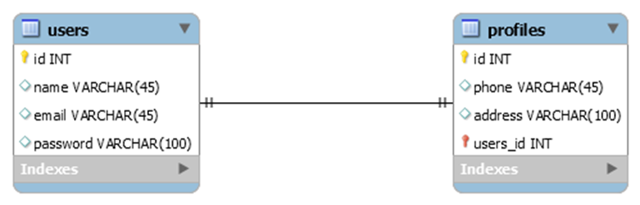
1:1
User has a profile which means a profile belongs to a user

Slide 5
What should we do?
Create profile table
Create relationship between profile and user table
Define relationship between the two models

Slide 6
Create profile table

Slide 7
Create profile table
Create profile model and migration file
php artisan make:model Profile -m

Slide 8
Create relationship between profile and user table

Slide 9
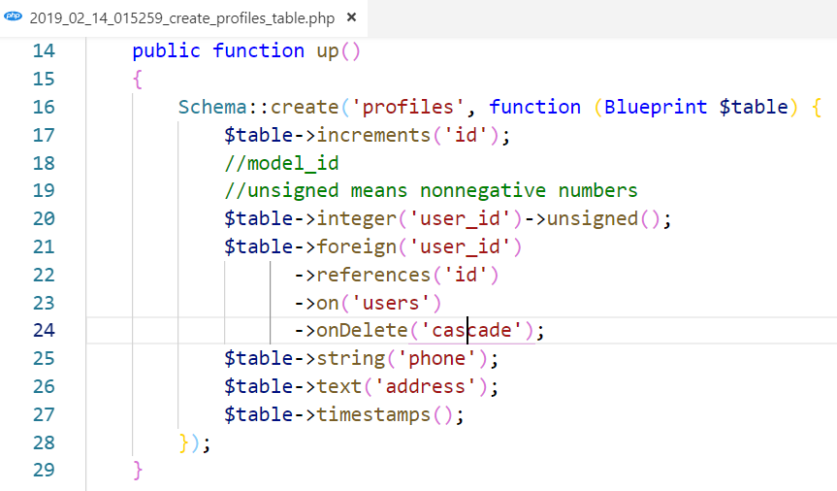
Relationship between table

Slide 10
Define relationship between the two models

Slide 11
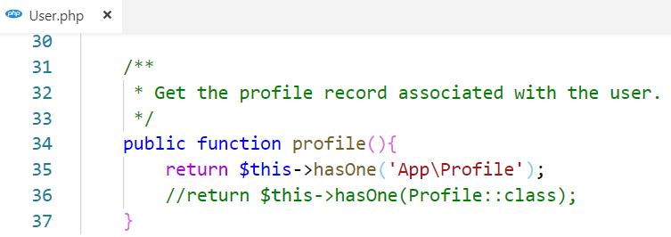
Relationship between models
A user has one profile so we place the profile method inside the user model.
The profile method should call the hasOne method and return its relationship

Slide 12
How to call this method?
Notes:
First have user
Then add the profile with corresponding user
Then we could call this method

Slide 13
First we need to have user OR know which user
2. Then add the profile with corresponding user
3. Then we could call this method

Slide 14
First have user OR know which user

Slide 15
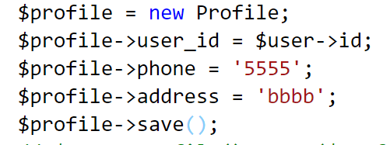
Then add the profile with corresponding user

Slide 16

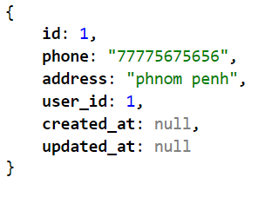

Then we could call this method
To get profile of this user

Slide 17
Activity [20mn]
Try to register two users into your system
Try to add a profile to these two users as below with url request (/addprofile)
1st user: phone:010 999 888, address: Kampot
2nd user: phone: 012 777 666, address: Phnom Penh
Show all users profile with url request (/showprofiles): user id, name, email, phone and address

Slide 18
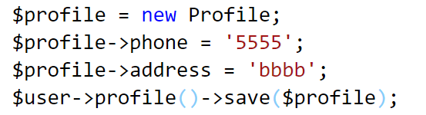
Other way to add profile
Using profile relationship to save profile

Slide 19
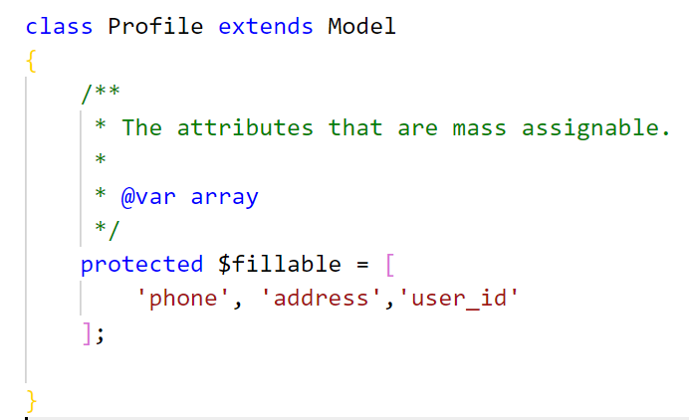
Other way to add profile
But need mass assignment

Slide 20
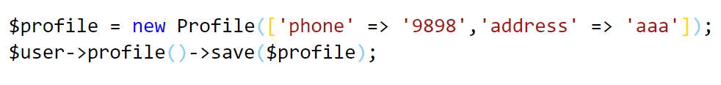
Other way to add profile
But need mass assignment

Slide 21
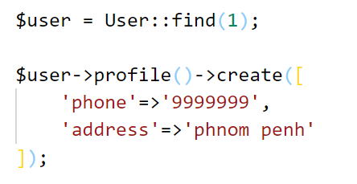
Other way to add profile
But need mass assignment

Slide 22
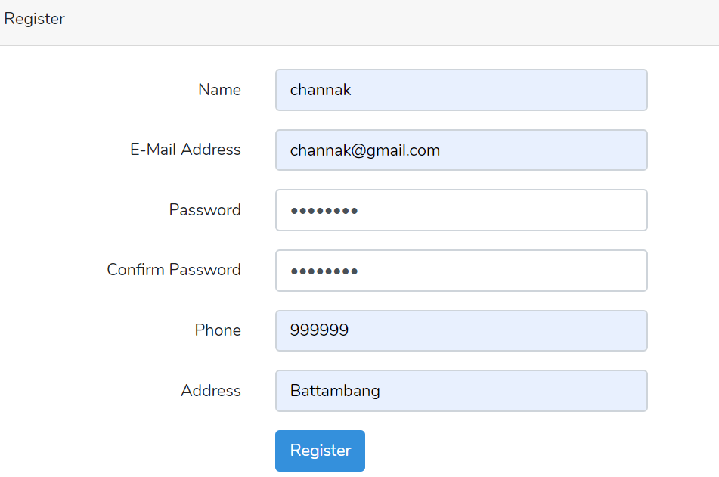
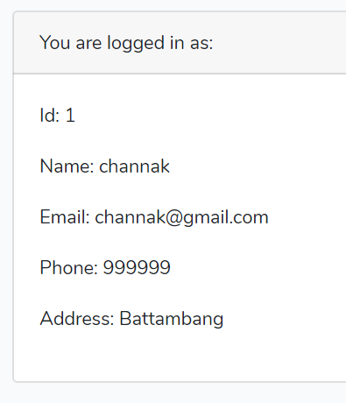
Activity [10mn]
home view

Slide 23
Update Profile
Notes:
First have user
Then add the profile with corresponding user
Then we could call this method

Slide 24
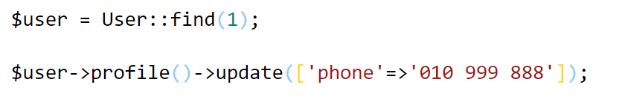
Update profile
Ex: we want to update the phone number of user who has id=1

Slide 25
Delete Profile
Notes:
First have user
Then add the profile with corresponding user
Then we could call this method

Slide 26
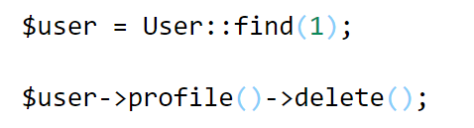
Delete profile
Ex: we want to delete profile of user who has id=1

Slide 27
Activity [20mn]
Continue from the previous activity
Inside your show all profiles view, add edit and delete button for edit and delete the corresponding profile

Slide 28
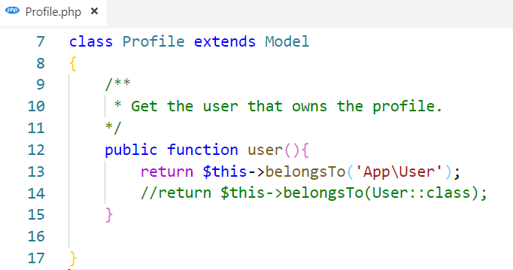
Reverse Relationship
A profile belongs to a user so we place the user method inside the profile model.
The user method should call the belognsTo method and return its relationship

Slide 29
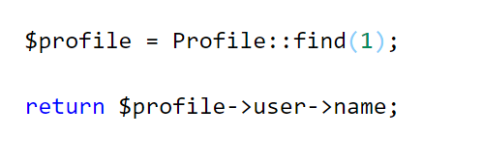
Example
We want to know user name of profile which has id =1

Slide 30
One to many

Slide 31
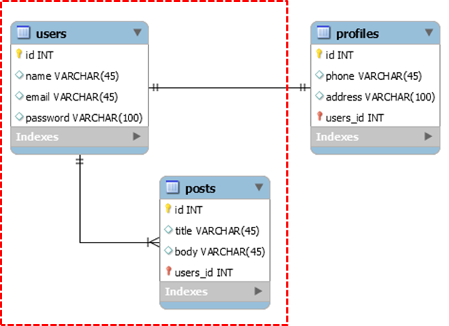
Example
A user could have many posts and a post belongs to a user

Slide 32
Remark
We already have Post and User model and table
So we need to add another column to posts in order to make relationship between posts and users

Slide 33
add column migration
php artisan make:migration add_user_id_to_posts_table

Slide 34
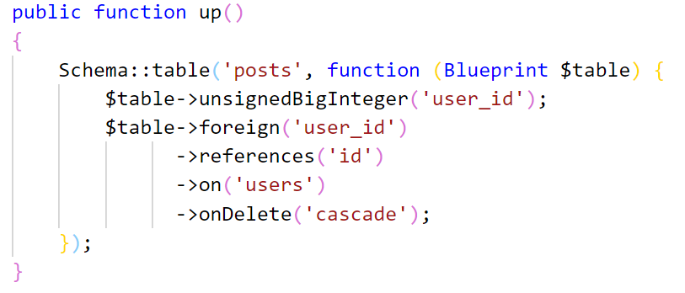
Add column and foreign key in up method
In the up() method

Slide 35
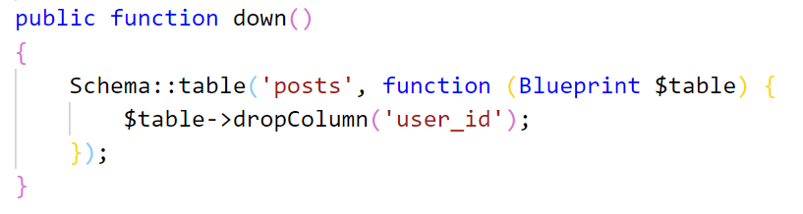
Drop column in down method
In the down() method
Run command: php artisan migrate
Notes:
If there are exists some data already inside the post it will throw exception on fk constraint

Slide 36
Relationship between Model User and Post

Slide 37
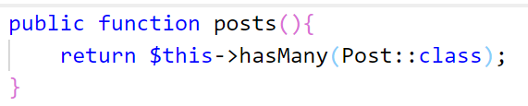
From User to Post
A user has many posts so we place the posts method inside the user model.
The posts method should call the hasMany method relationship

Slide 38
How to add posts to user
Do the same as adding profile to user

Slide 39
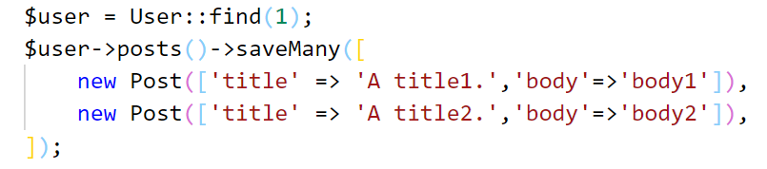
saveMany()
To save multiple records

Slide 40
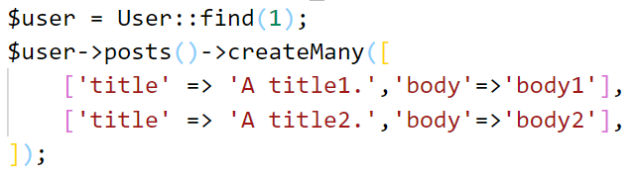
createMany()
To save multiple records

Slide 41


To get all posts of specific user
Get a specific user
Get all his/her posts

Slide 42
To get all posts title of specific user
Get a specific user
Get all his/her posts title
Method of collection

Slide 43
Activity[20mn]
After user log in
Add the add post button to allow the authenticated user to create any post
Add show all posts button to allow the authenticated user to see all his/her posts

Slide 44
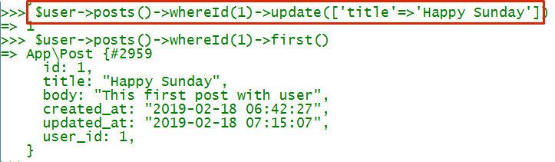
Update Post from User

Slide 45
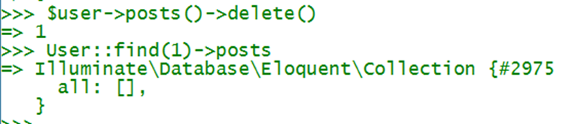
Delete Post from User

Slide 46
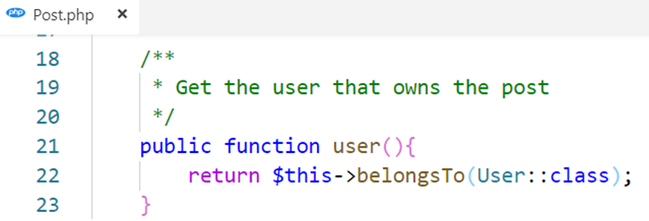
From Post to User
A post belongs to a user so we place the user method inside the post model.
The user method should call the belongsTo method and return its relationship

Slide 47


From Post to User Example
What is the user name of the post id = 2?

Slide 48
Activity[20mn]
After user log in
Continue from the last activity try to add edit and delete button for each post and delete all button

Slide 49
Many to Many

Slide 50
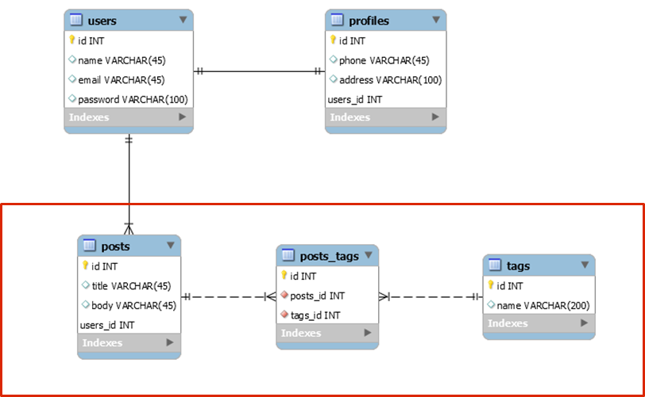
Post and Tag

Slide 51
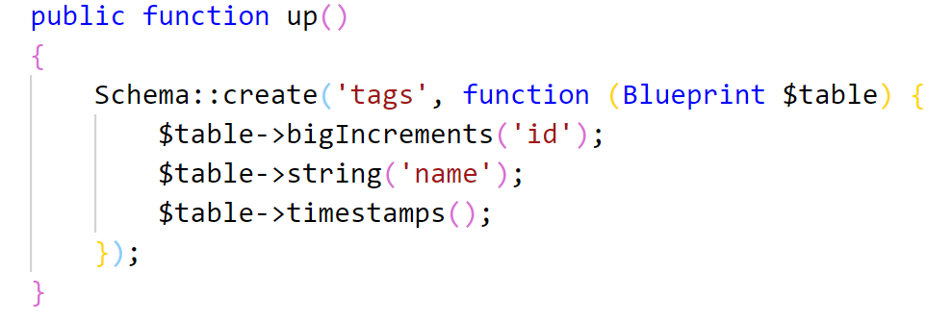
Tag migration file and model

Slide 52
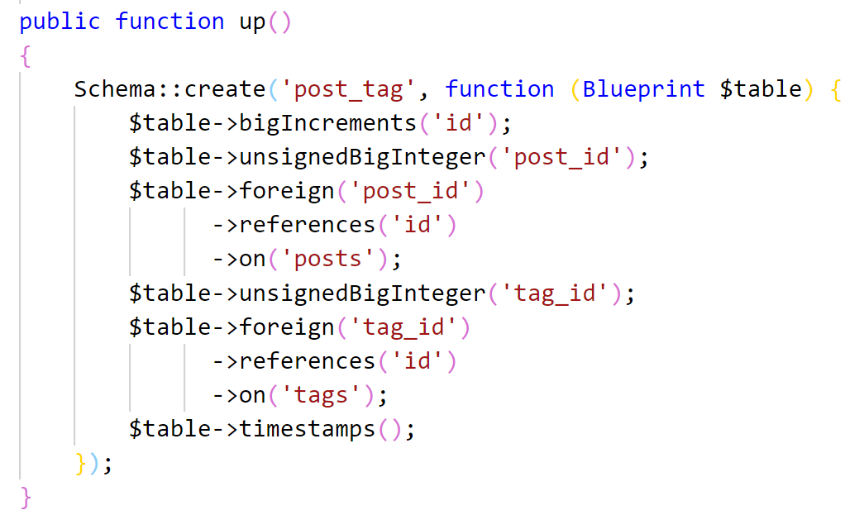
post_tag migration file

Slide 53
Relationship between Model Post and Tag

Slide 54
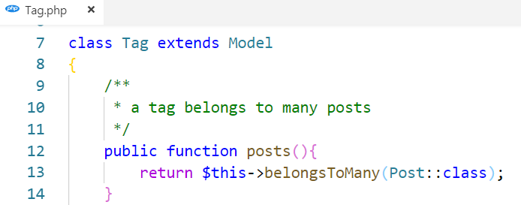
From Tag to Post
A tag belongs to many posts so we place the posts method inside the tag model.
The posts method should call the belongsToMany method and return its relationship

Slide 55
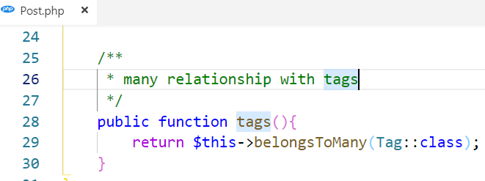
From Post to Tag
A Post belongs to many tags so we place the tags method inside the post model.
The tags method should call the belongsToMany method and return its relationship

Slide 56
Create tag and add it to post
Using tags() and create() or createMany()

Slide 57


Create tag and add it to post
2. Using tags() and attach()

Slide 58



Remove tag from post
Using detach()
Ex: remove tag id = 3 from post id=2

Slide 59
Activity[20mn]
Create tags
Assign tags to any posts
Then try to show any post with all its associated tags

