Slide 1
OWASP TOP 10 VULNERABILITIES

Slide 2
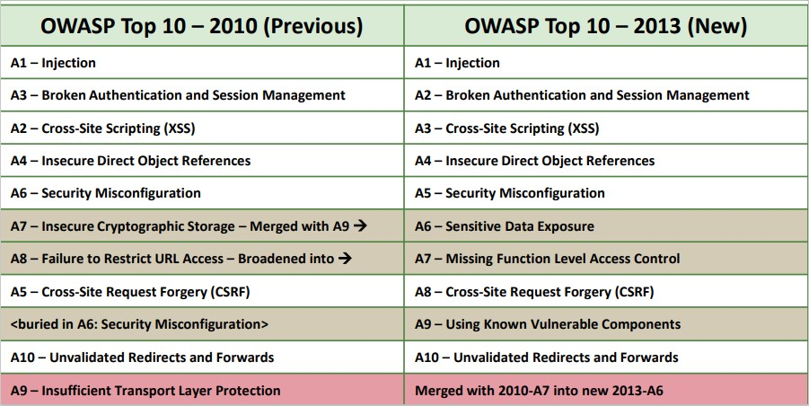
2010-2013

Slide 3
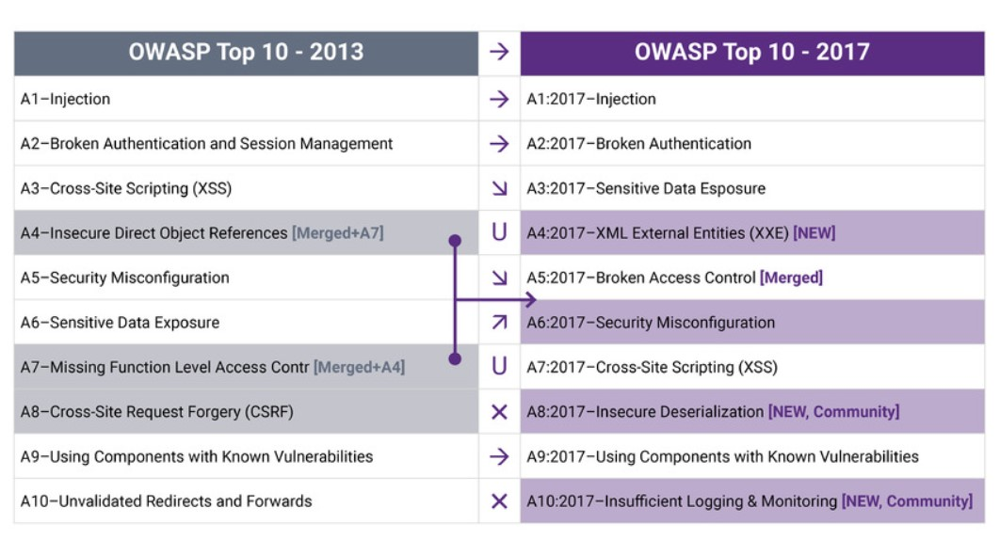
2013-2017

Slide 4
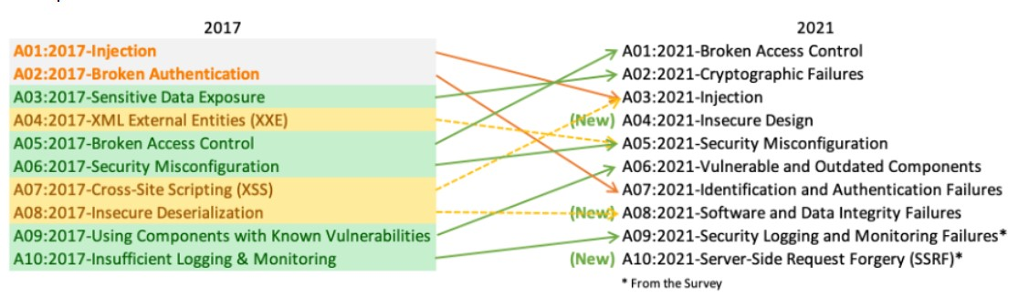
2017-2021

Slide 5
1. Injection Flaws + ΧSS → Injection (Λ)

Slide 6
1. Injection Flaws + ΧSS → Injection (Σ)

Slide 7
3.Sensitive Data Exposure → Cryptographic failures (Λ)

Slide 8
4. XML External Entities (XXE) → Security Misconfiguration (Λ)

Slide 9
Security Misconfiguration (Σ)

Slide 10
2.Broken Authentication and Session Management → Identification and Authentication Failures (Λ)

Slide 11
5. Broken Access Control (Λ)

Slide 12
Software and data integrity failures → insecure deserialization ++(Σ)

Slide 13
Using components with known vulnerabilities(Σ)

Slide 14
Insufficient logging and monitoring(Σ)

Slide 15
Βιβλιογραφικές Πηγές:
OWASP Top Ten Web Application Security Risks | OWASP
What Is the OWASP Top 10 and How Does It Work? | Synopsys
Table of Contents | OWASP
OWASP Top 10-2017 (en).pdf
OWASP Top 10 Security Vulnerabilities 2021 | Sucuri

Slide 16
Σας ευχαριστούμε πολύ για την προσοχή σας!

