Slide 1
CS 4215: Quantitative Performance Evaluation for Computing Systems
Lydia Y. Chen
y.chen-10@tudelft.nl

Slide 4

Last week
Characterization
Modeling
Predicting
Resource management

Slide 5
Simulation

Slide 6
Overview
Analysis of Simulation Results
Model Verification Techniques
Model Validation Techniques
Transient Removal
Terminating Simulations
Stopping Criteria: Variance Estimation
Variance Reduction

Slide 7
Model Verification vs. Validation
Verification ⇒ Debugging
Validation ⇒ Model = Real world
Four Possibilities:
Unverified, Invalid
Unverified, Valid
Verified, Invalid
Verified, Valid

Slide 8
Model Verification Techniques
Top Down Modular Design
Anti-bugging
Structured Walk-Through
Deterministic Models
Run Simplified Cases
Trace
On-Line Graphic Displays
Continuity Test
Degeneracy Tests
Consistency Tests
Seed Independence

Slide 9
Top Down Modular Design
Divide and Conquer
Modules = Subroutines, Subprograms, Procedures
Modules have well defined interfaces
Can be independently developed, debugged, and maintained
Top-down design ⇒ Hierarchical structure ⇒ Modules and sub-modules

Slide 10
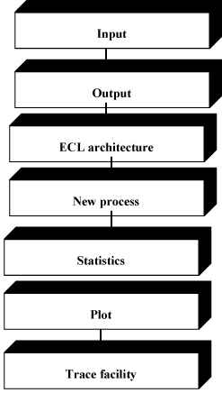
Top Down Modular Design (Cont)

Slide 11
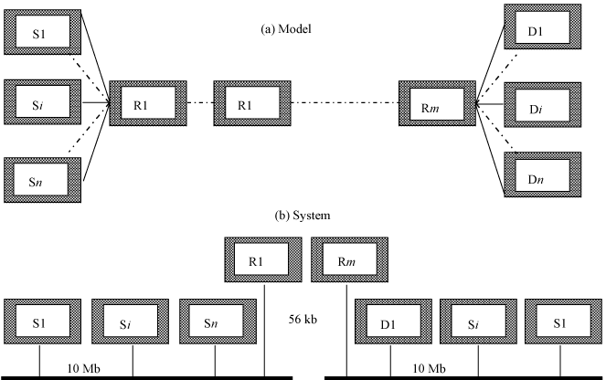
Top Down Modular Design (Cont)

Slide 12
Verification Techniques
Anti-bugging: Include self-checks:
∑ Probabilities = 1
Jobs left = Generated - Serviced
Structured Walk-Through:
Explain the code another person or group
Works even if the person is sleeping
Deterministic Models: Use constant values
Run Simplified Cases:
Only one packet
Only one source
Only one intermediate node

Slide 13
Trace
Trace = Time-ordered list of events and variables
Several levels of detail:
Events trace
Procedure trace
Variables trace
User selects the detail
Include on and off
See Fig 25.3 in the Text Book on page 418 for a sample trace

Slide 14
On-Line Graphic Displays
Make simulation interesting
Help selling the results
More comprehensive than trace

Slide 15
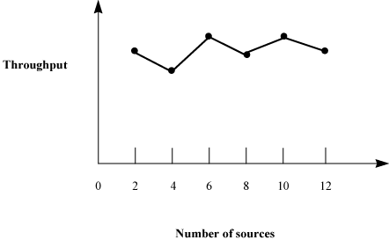
Continuity Test
Run for different values of input parameters
Slight change in input ⇒ slight change in output
Before:

Slide 16
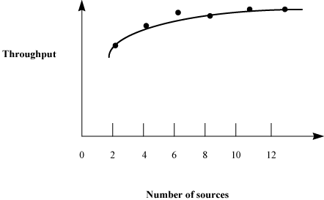
Continuity Test (Cont)
After:

Slide 17
More Verification Techniques
Degeneracy Tests: Try extreme configuration and workloads
One CPU, Zero disk
Consistency Tests:
Similar result for inputs that have same effect
Four users at 100 Mbps vs. Two at 200 Mbps
Build a test library of continuity, degeneracy and consistency tests
Seed Independence: Similar results for different seeds

Slide 18
Model Validation Techniques
Validation techniques for one problem may not apply to another problem.
Aspects to Validate:
1. Assumptions
2. Input parameter values and distributions
3. Output values and conclusions
Techniques:
1. Expert intuition
2. Real system measurements
3. Theoretical results
⇒ 3 £ 3 = 9 validation tests

Slide 19
Expert Intuition
Most practical and common way
Experts = Involved in design, architecture, implementation, analysis, marketing, or maintenance of the system
Selection = fn of Life cycle stage
Present assumption, input, output
Better to validate one at a time
See if the experts can distinguish simulation vs. measurement

Slide 20
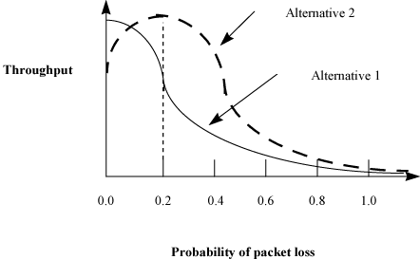
Expert Intuition (Cont)

Slide 21
Real System Measurements
Compare assumptions, input, output with the real world
Often infeasible or expensive
Even one or two measurements add to the validity

Slide 22
Theoretical Results
Analysis = Simulation
Used to validate analysis also
Both may be invalid
Use theory in conjunction with experts' intuition
E.g., Use theory for a large configuration
Can show that the model is not invalid

Slide 23
Transient Removal
Generally steady state performance is interesting
Remove the initial part
No exact definition ⇒ Heuristics:
1. Long Runs
2. Proper Initialization
3. Truncation
4. Initial Data Deletion
5. Moving Average of Independent Replications
6. Batch Means

Slide 24
Transient Removal Techniques
Long Runs:
Wastes resources
Difficult to insure that it is long enough
Proper Initialization:
Start in a state close to expected steady state ⇒ Reduces the length and effect of transient state

Slide 25

Truncation
Assumes variability is lower during steady state
Plot max-min of n-l observation for l =1, 2, ……….
When (l+1)th observation is neither the minimum nor maximum ⇒ transient state ended
At l = 9, Range = (9, 11), next observation = 10
Sometimes incorrect result.
12
Transient
interval
8
Value
4
0
4
8
12
16
20
Observation number i

Slide 26
Initial Data Deletion
Delete some initial observation
Compute average
No change ⇒ Steady state
Use several replications to smoothen the average
m replications of size n each x_{ij}= jth observation in the ith replication

Slide 27
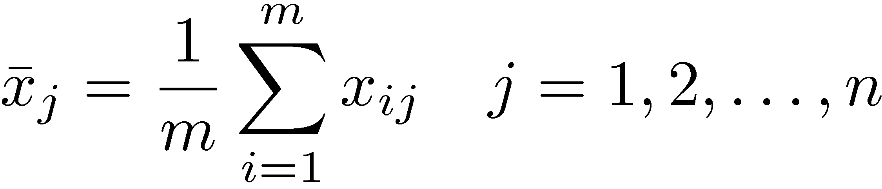
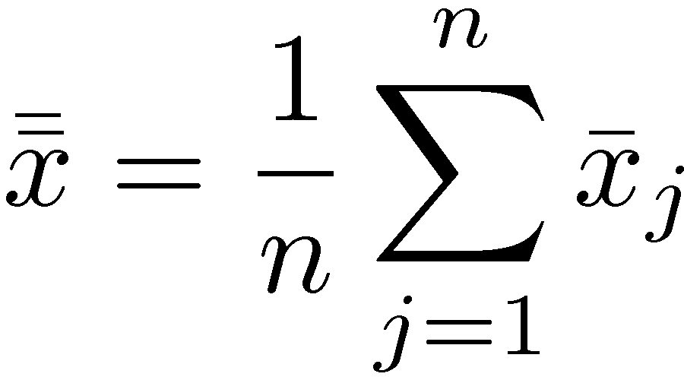
Initial Data Deletion (Cont)
Steps:
1. Get a mean trajectory by averaging across replications
2. Get the overall mean:
Set l=1 and proceed to the next step.

Slide 28
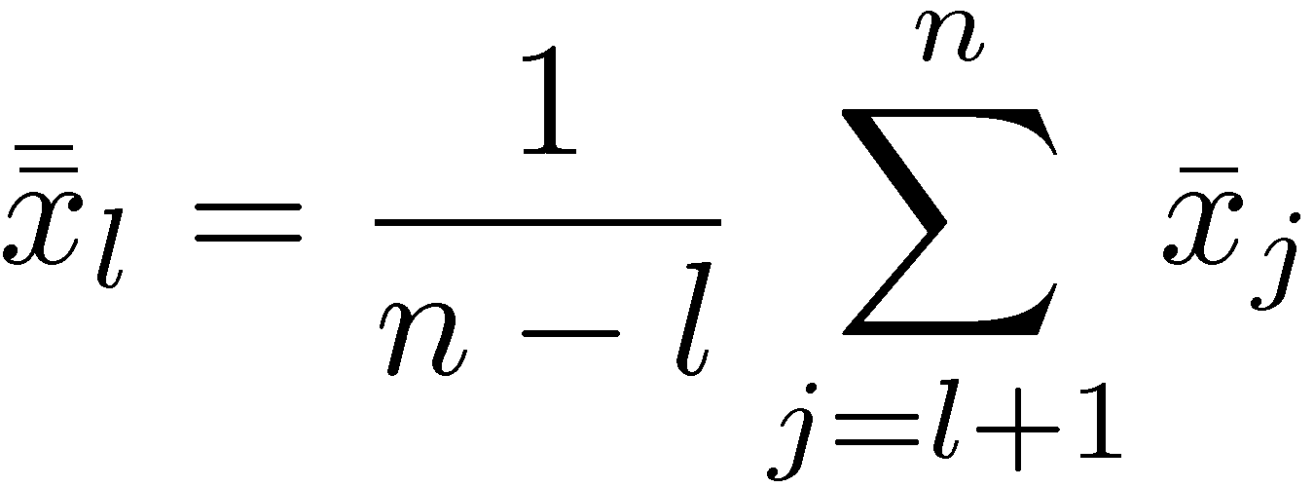
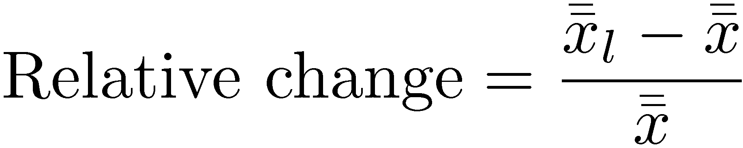
Initial Data Deletion (Cont)
3. Delete the first l observations and get an overall mean from the remaining n-l values:
4. Compute the relative change:
5. Repeat steps 3 and 4 by varying l from 1 to n-1.
6. Plot the overall mean and the relative change
7. l at knee = length of the transient interval.

Slide 29
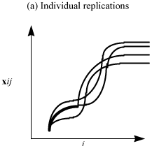
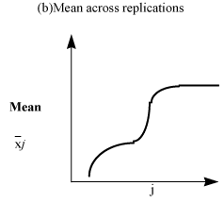
Initial Data Deletion (Cont)

Slide 30
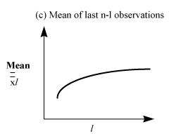
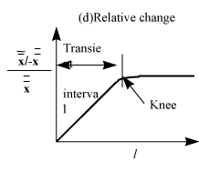
Initial Data Deletion (Cont)

Slide 31
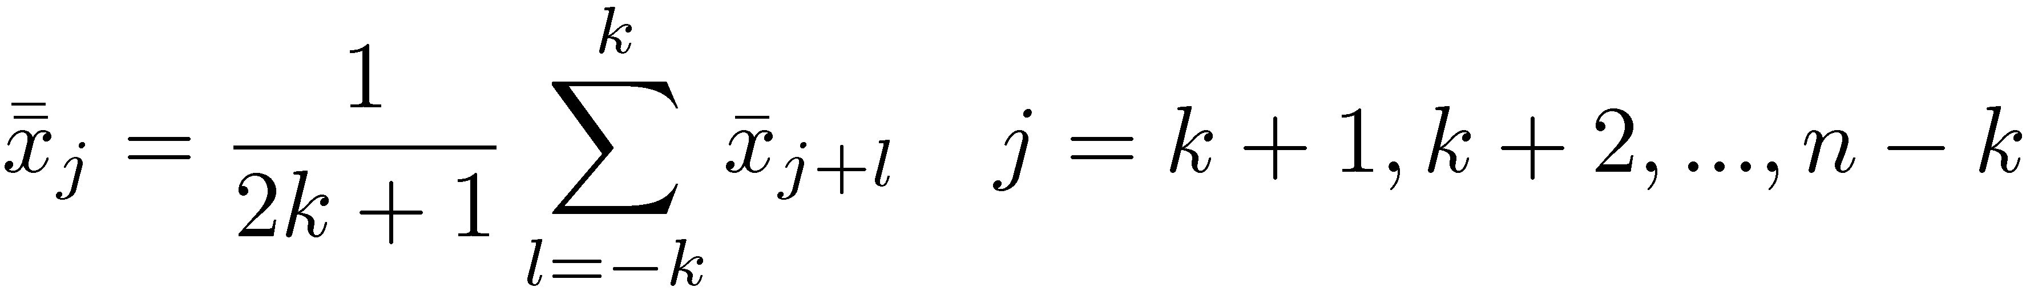
Moving Average of Independent Replications
Mean over a moving time interval window
1. Get a mean trajectory by averaging across replications:
Set k = 1 and proceed to the next step.
2. Plot a trajectory of the moving average of successive 2k+1 values:

Slide 32
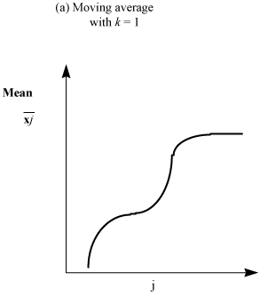
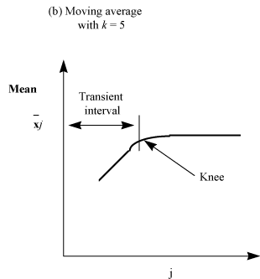
Moving Avg. of Independent Repl. (Cont)
3. Repeat step 2, with k=2, 3, and so on until the plot is smooth.
4. Value of j at the knee gives the length of the transient phase

Slide 33
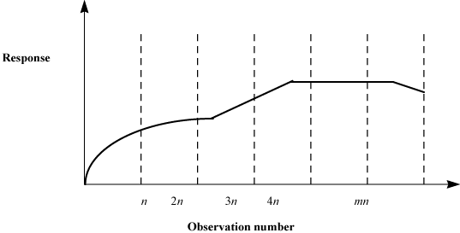
Batch Means
Run a long simulation and divide into equal duration part
Part = Batch = Sub-sample
Study variance of batch means as a function of the batch size

Slide 34
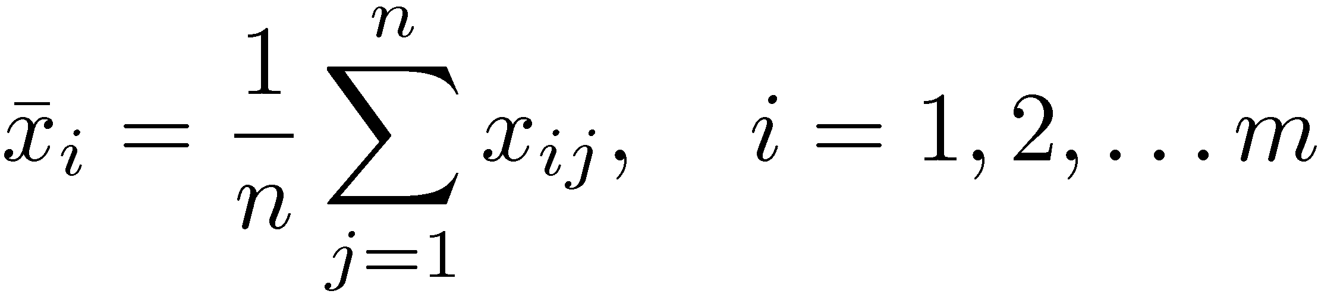
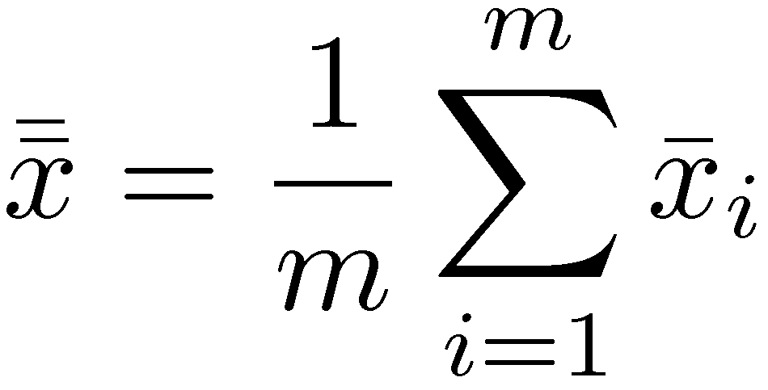
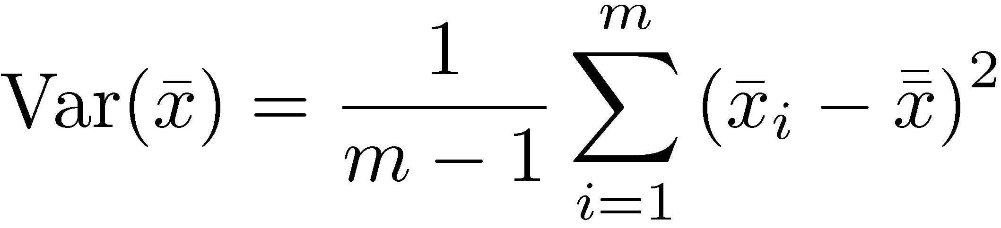
Batch Means (cont)
Steps:
1. For each batch, compute a batch mean:
2. Compute overall mean:
3. Compute the variance of the batch means:
4. Repeat steps 1 and 3, for n=3, 4, 5, and so on.

Slide 35
Batch Means (Cont)
5. Plot the variance as a function of batch size n.
6. Value of n at which the variance definitely starts decreasing gives transient interval
7. Rationale:
-Batch size ¿ transient ⇒ overall mean = initial mean ⇒ Higher variance
-Batch size À transient ⇒ Overall mean = steady state mean ⇒ Lower variance

Slide 36
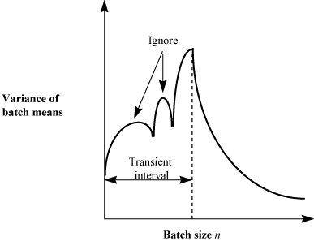
Batch Means (Cont)
Ignore peaks followed by an upswing

Slide 37
Terminating Simulations
Transient performance is of interest E.g., Network traffic
System shuts down ⇒ Do not need transient removal.
Final conditions:
May need to exclude the final portion from results
Techniques similar to transient removal

Slide 38
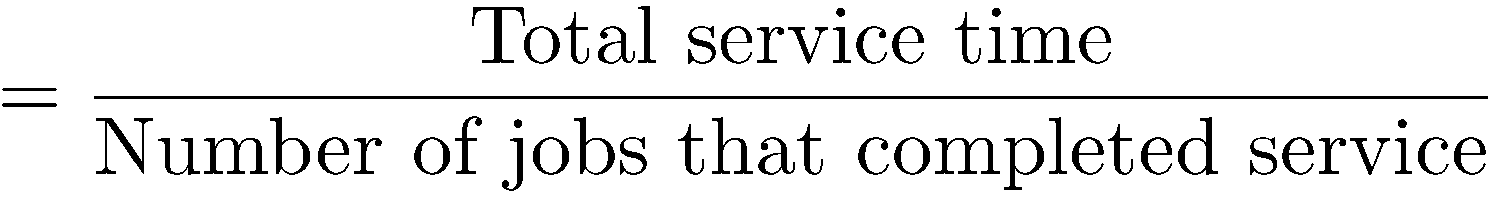
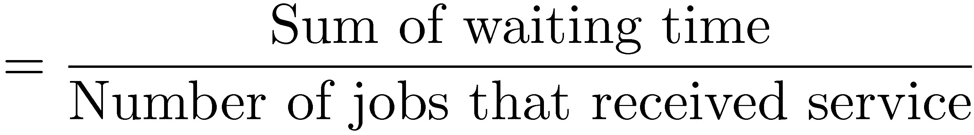
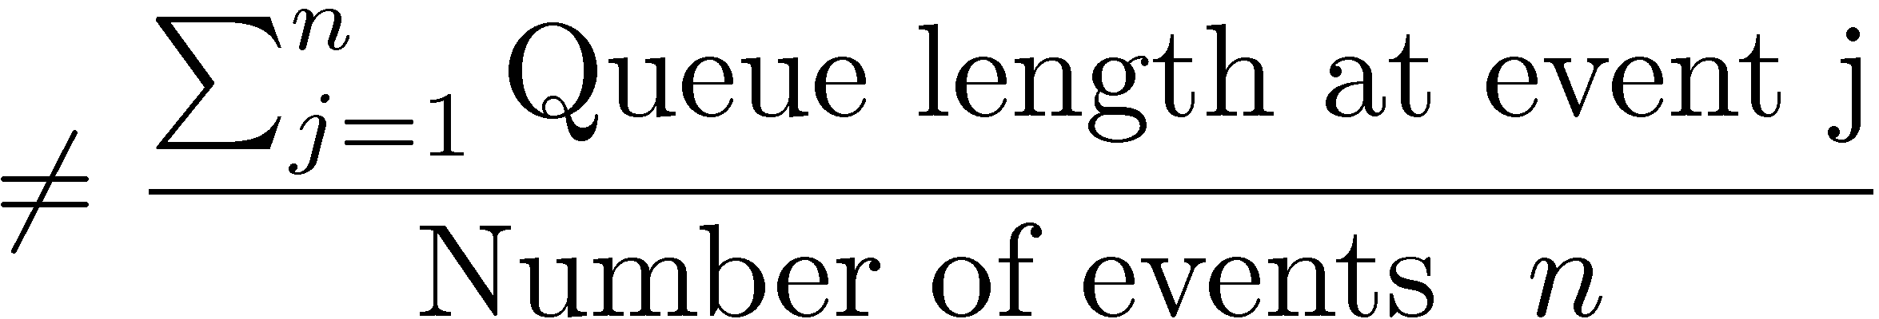
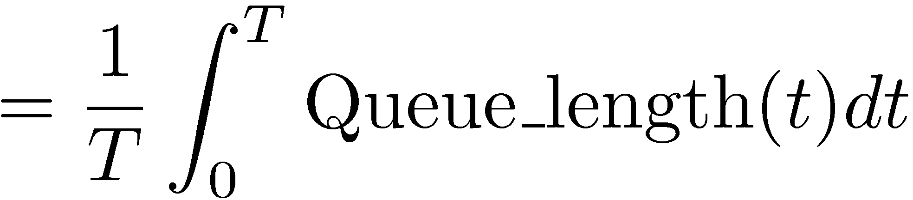
Treatment of Leftover Entities
Mean service time
Mean waiting time
Mean Queue Length

Slide 39
Example 25.3: Treatment of Leftover Entities
2
Queue
length
q(t)
1
0
0
1
2
3
4
Time t
Three events: Arrival at t=0, departures at t=1 and t=4
Q = 2, 1, 0 at these events. Avg Q ≠ (2+1+0)/3 = 1
Avg Q = Area/4 = 5/4

Slide 40
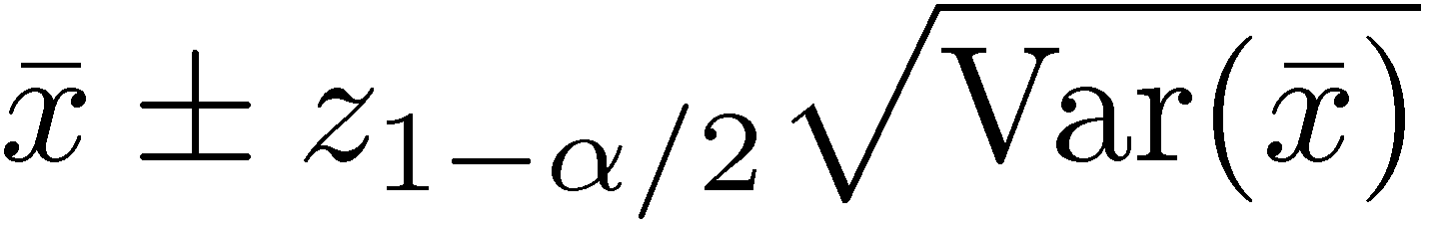
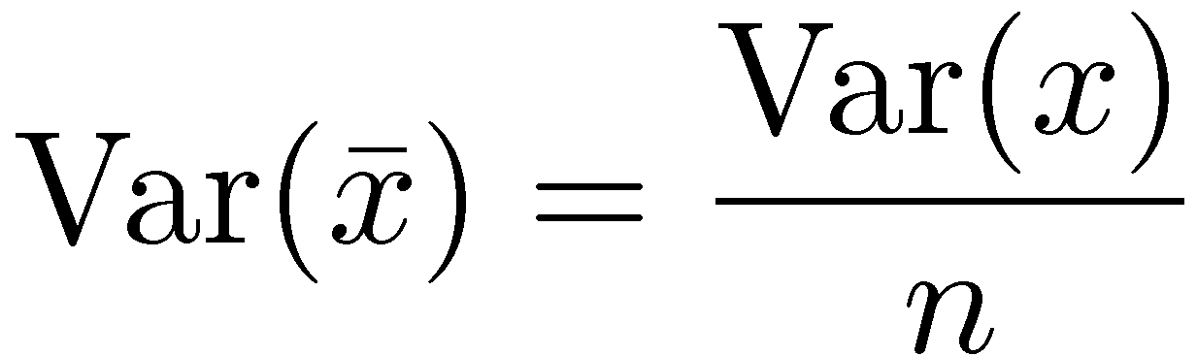
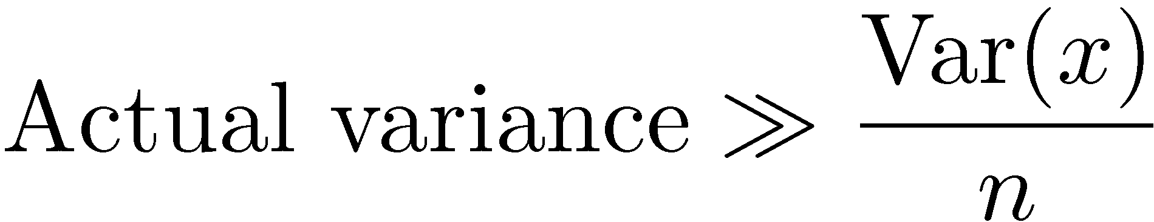
Stopping Criteria: Variance Estimation
Run until confidence interval is narrow enough
For Independent observations:
Independence not applicable to most simulations.
Large waiting time for ith job ⇒ Large waiting time for (i+1)th job
For correlated observations:

Slide 41
Variance Estimation Methods
1. Independent Replications
2. Batch Means
3. Method of Regeneration

Slide 42
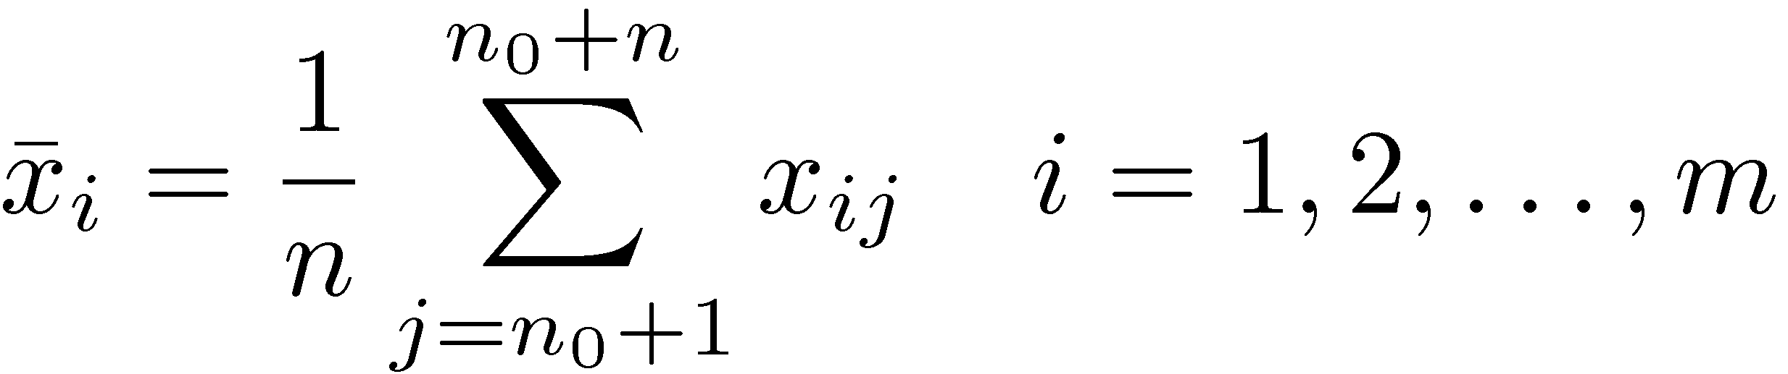
Independent Replications
Assumes that means of independent replications are independent
Conduct m replications of size n+n₀ each
1. Compute a mean for each replication:
2. Compute an overall mean for all replications:

Slide 43
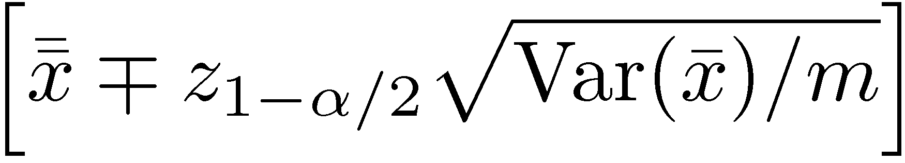
Independent Replications (Cont)
3. Calculate the variance of replicate means:
4. Confidence interval for the mean response is:
Keep replications large to avoid waste
Ten replications generally sufficient

Slide 44
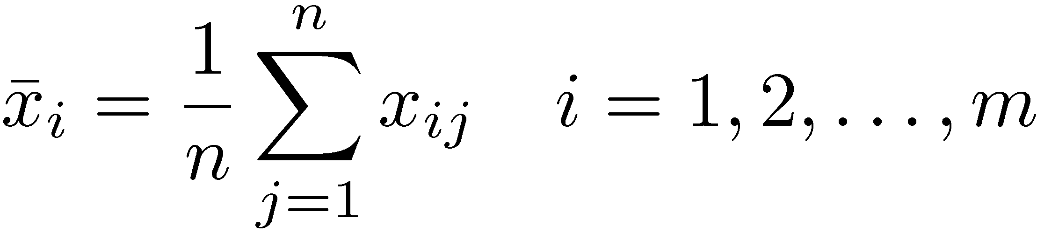
Batch Means
Also called method of sub-samples
Run a long simulation run
Discard initial transient interval, and Divide the remaining observations run into several batches or sub-samples.
1. Compute means for each batch:
2. Compute an overall mean:

Slide 45
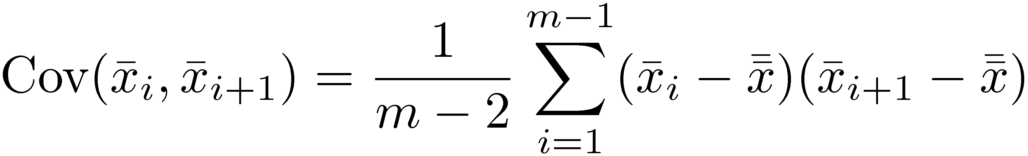
Batch Means (Cont)
3. Calculate the variance of batch means:
4. Confidence interval for the mean response is:
Less waste than independent replications
Keep batches long to avoid correlation
Check: Compute the auto-covariance of successive batch means:
Double n until autocovariance is small.

Slide 46
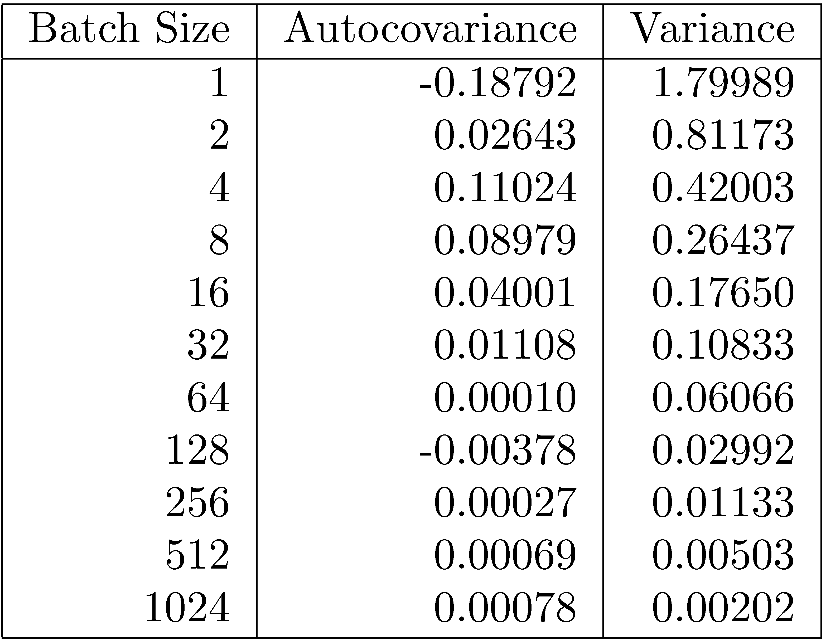
Case Study 25.1: Interconnection Networks
Indirect binary n-cube networks: Used for processor-memory interconnection
Two stage network with full fan out.
At 64, autocovariance < 1% of sample variance

Slide 47
Method of Regeneration
Regeneration Points
Queue Length
Behavior after idle period does not depend upon the past history ⇒ System takes a new birth ⇒ Regeneration point
Note: The regeneration point are the beginning of the idle interval. (not at the ends as shown in the book).

Slide 48
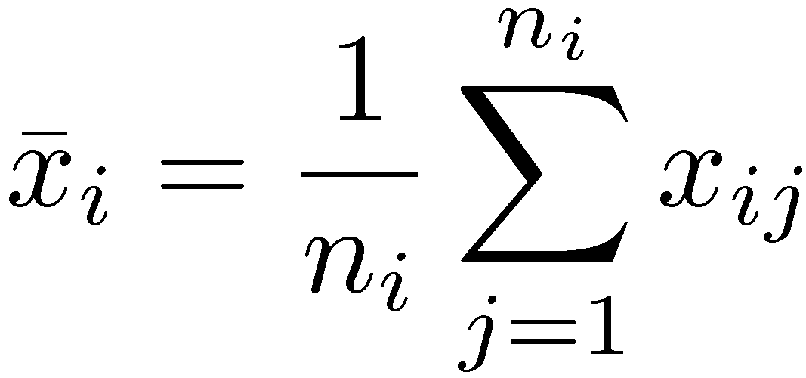
Method of Regeneration (Cont)
Regeneration cycle: Between two successive regeneration points
Use means of regeneration cycles
Problems:
Not all systems are regenerative
Different lengths ⇒ Computation complex
Overall mean ≠ Average of cycle means
Cycle means are given by:

Slide 49
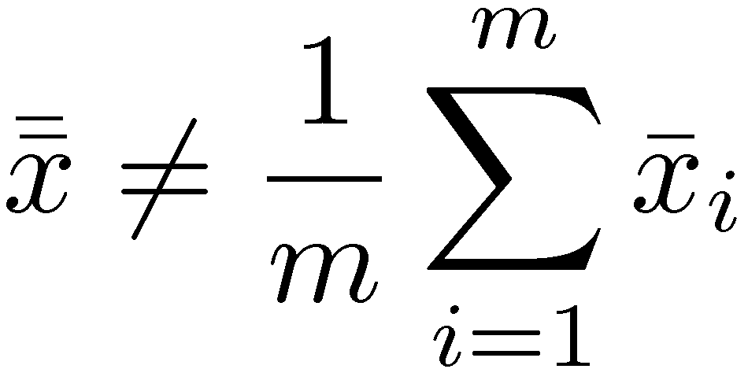
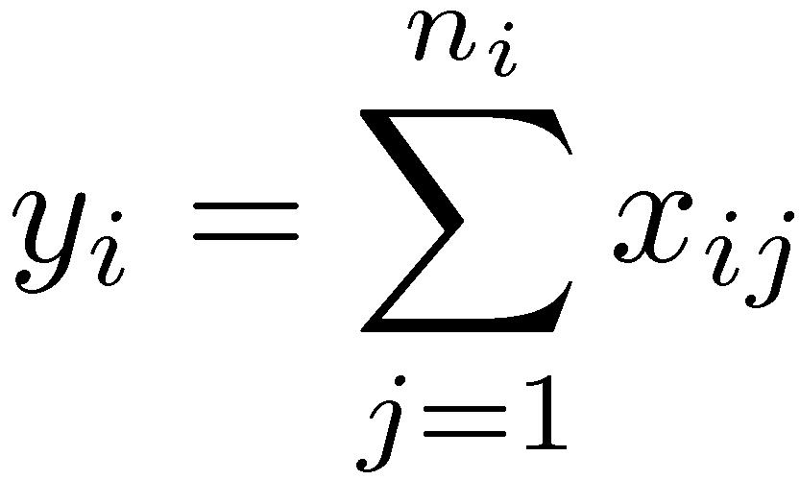
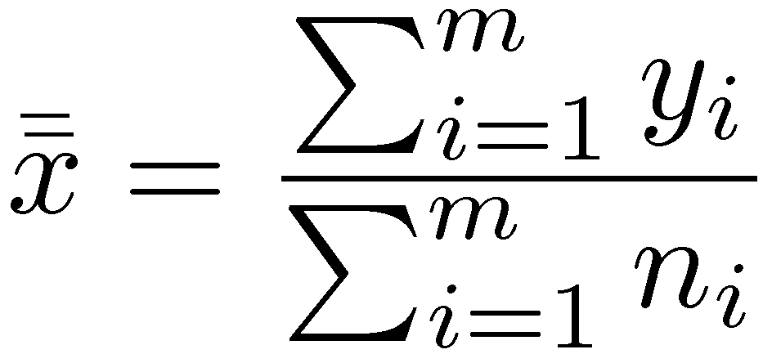
Method of Regeneration (Cont)
Overall mean:
1. Compute cycle sums:
2. Compute overall mean:
3. Calculate the difference between expected and observed cycle sums:

Slide 50
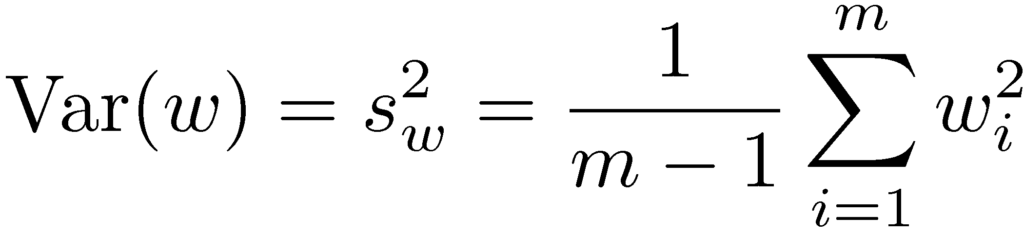
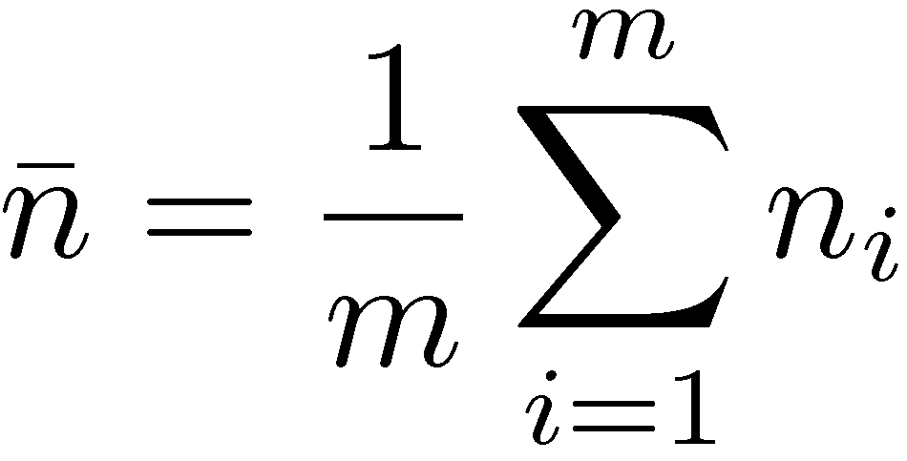
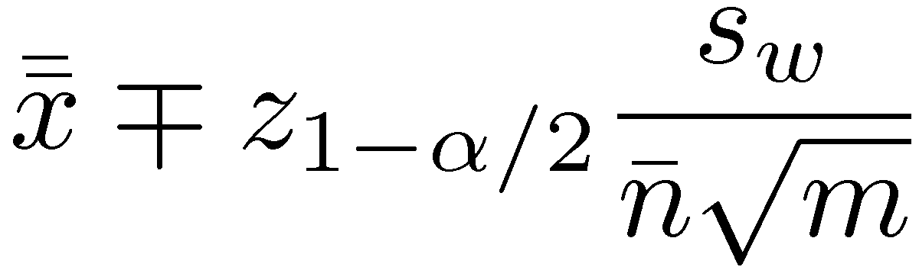
Method of Regeneration (Cont)
4. Calculate the variance of the differences:
5. Compute mean cycle length:
6. Confidence interval for the mean response is given by:
7. No need to remove transient observations

Slide 51
Method of Regeneration: Problems
1. The cycle lengths are unpredictable. Can't plan the simulation time beforehand.
2. Finding the regeneration point may require a lot of checking after every event.
3. Many of the variance reduction techniques can not be used due to variable length of the cycles.
4. The mean and variance estimators are biased

Slide 52
Variance Reduction
Reduce variance by controlling random number streams
Introduce correlation in successive observations
Problem: Careless use may backfire and lead to increased variance.
For statistically sophisticated analysts only
Not recommended for beginners

Slide 53
Summary
Verification = Debugging ⇒ Software development techniques
Validation ⇒ Simulation = Real ⇒ Experts involvement
Transient Removal: Initial data deletion, batch means
Terminating Simulations = Transients are of interest
Stopping Criteria: Independent replications, batch means, method of regeneration
Variance reduction is not for novice

Slide 54
Exercise 25.1
Imagine that you have been called as an expert to review a
simulation study. Which of the following simulation results would
you consider non-intuitive and would want it carefully validated:
1. The throughput of a system increases as its load increases.
2. The throughput of a system decreases as its load increases.
3. The response time increases as the load increases.
4. The response time of a system decreases as its load increases.
5. The loss rate of a system decreases as the load increases.

Slide 55
Exercise 25.2
Find the duration of the transient interval for the following sample: 11, 4, 2, 6, 5, 7, 10, 9, 10, 9, 10, 9, 10, …, Does the method of truncation give the correct result in this case?

Slide 56
Homework
The observed queue lengths at time t=0, 1, 2, …, 32 in a simulation are: 0, 1, 2, 4, 5, 6, 7, 7, 5, 3, 3, 2, 1, 0, 0, 0, 1, 1, 3, 5, 4, 5, 4, 4, 2, 0, 0, 0, 1, 2, 3, 2, 0. A plot of this data is shown below. Apply method of regeneration to compute the confidence interval for the mean queue length.
8
6
Q
4
2
0
0
5
10
15
20
25
30
35
t

Slide 57
Thanks!
Any questions?
You can find me at:
@username
user@mail.me

Slide 58
Credits
Special thanks to all the people who made and released these awesome resources for free:
Presentation template by SlidesCarnival
Photographs by Unsplash

Slide 59
Presentation design
This presentations uses the following typographies and colors:
Titles: Raleway
Body copy: Lato
You can download the fonts on these pages:
https://www.fontsquirrel.com/fonts/raleway
https://www.fontsquirrel.com/fonts/lato
Dark blue #2185c5
Light blue #7ecefd
Yellow #ff9715
Magenta #f20253
Dark gray #677480
Light gray #97abbc
You don’t need to keep this slide in your presentation. It’s only here to serve you as a design guide if you need to create new slides or download the fonts to edit the presentation in PowerPoint®

Slide 60
SlidesCarnival icons are editable shapes.
This means that you can:
Resize them without losing quality.
Change fill color and opacity.
Change line color, width and style.
Isn’t that nice? :)
Examples:

Slide 61
😉
Now you can use any emoji as an icon!
And of course it resizes without losing quality and you can change the color.
How? Follow Google instructions https://twitter.com/googledocs/status/730087240156643328
✋👆👉👍👤👦👧👨👩👪💃🏃💑❤😂😉😋😒😭👶😸🐟🍒🍔💣📌📖🔨🎃🎈🎨🏈🏰🌏🔌🔑 and many more...

