Slide 1

HR Analytics: Job Prediction for Data Scientists
Lydia Abou-Khamis

Slide 2
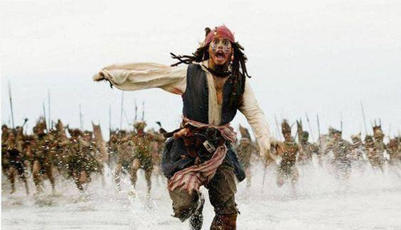
Background
Goal: Hiring data scientists among people who successfully pass courses which were conducted by the company
Question: Which of the candidates wants to work for the company after training or are looking for new employment?
Relevance : Reducing expenses and improving the quality of trainings

Slide 3
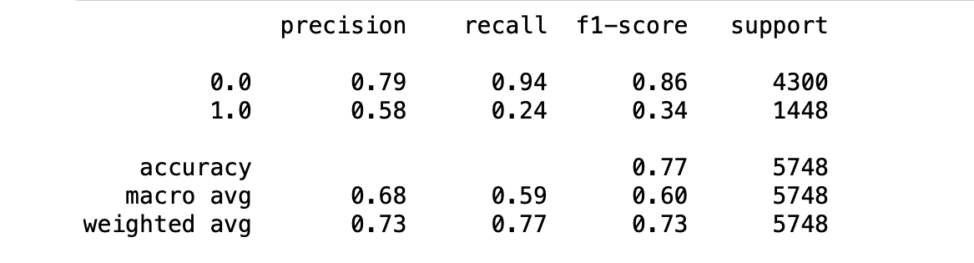
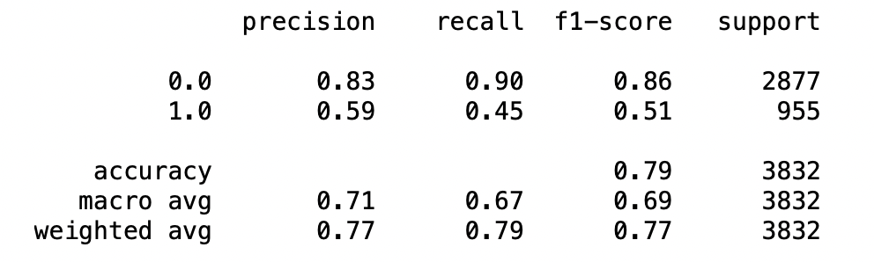
Results
LR
RFC
SVM

Slide 4
Limitations & Outlook
Improving the model by using more techniques to balance the data (over-sampling/up sampling)
Reducing missing values in the process of data collection
Including more features (salaries, duration of trainings by year/month, etc.)
Analyzing the value of training all candidates

Slide 5
The End

