Slide 1

Internet programming Theme: Local football championship app
Members:
Ana maria Băncilă a.m.:1119887
Lydia Georganta a.m.:1095484

Slide 2
Visitor of our app:
Explore the league table
1
Search for teams
2
View team details
3
Check players and coaches profiles
4
See match results and fixtures
5
View league statistics
6

Slide 3
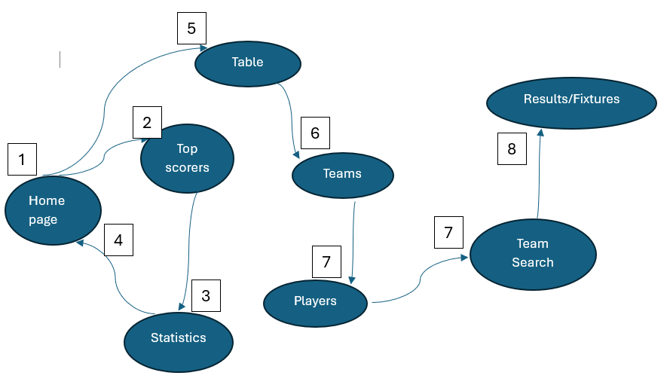
Navigation map
The user visits the site and explores its functionalities

Slide 4
Admin of our app
Secure Login/Registration
Admin dashboard
Team management
Matches and results management
Control league data

Slide 5
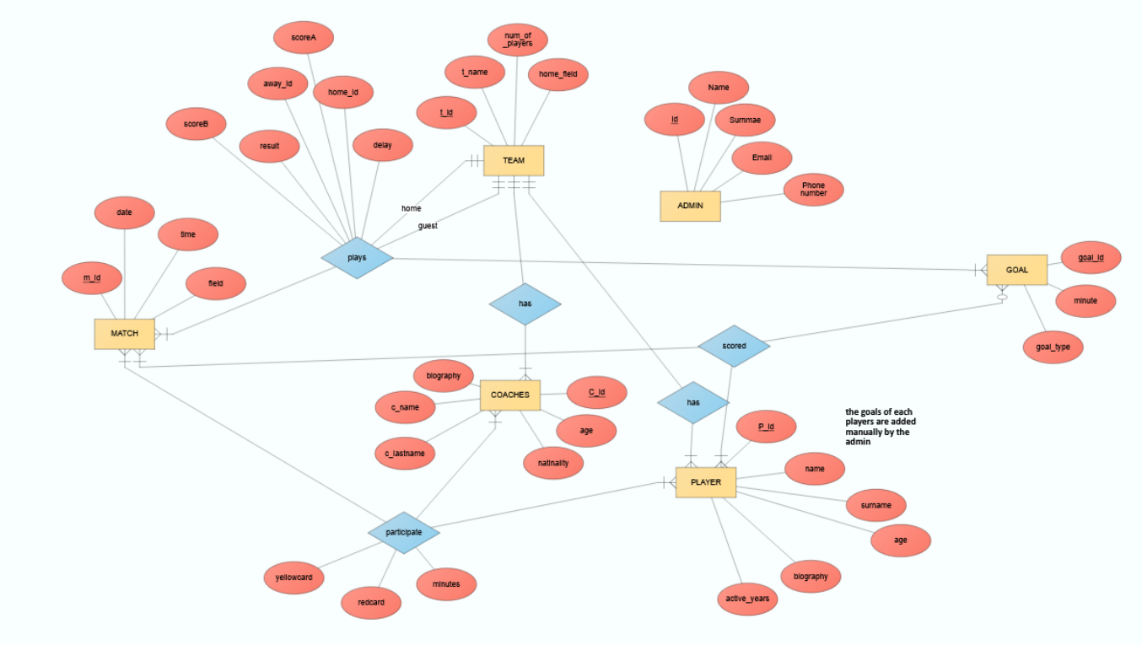
ERD

Slide 6
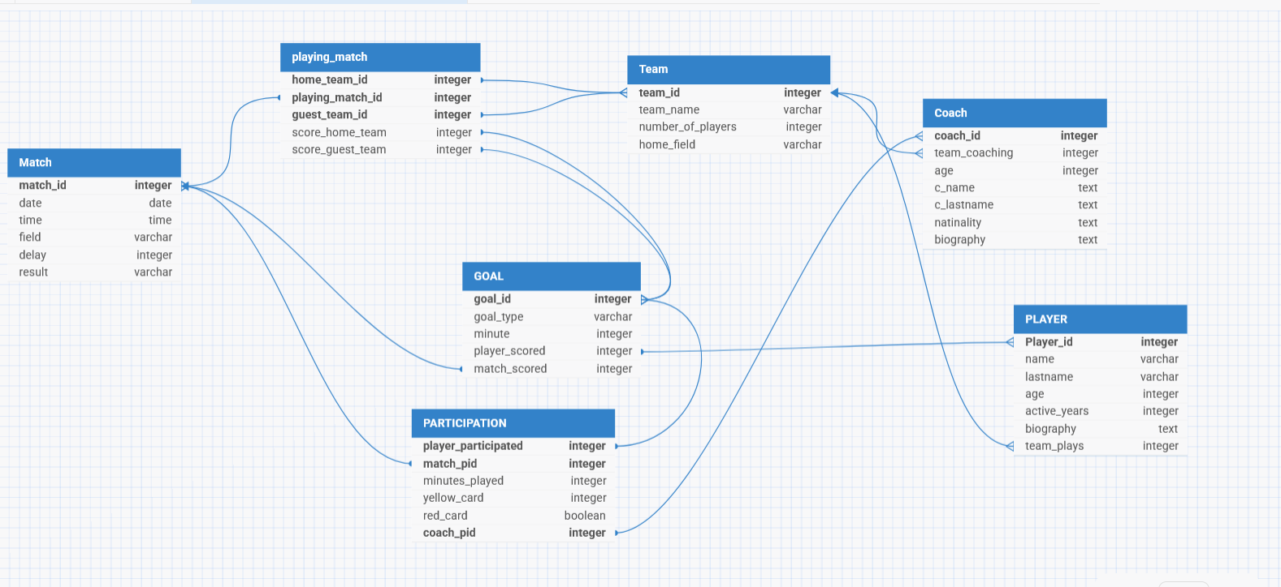
Schema

Slide 7
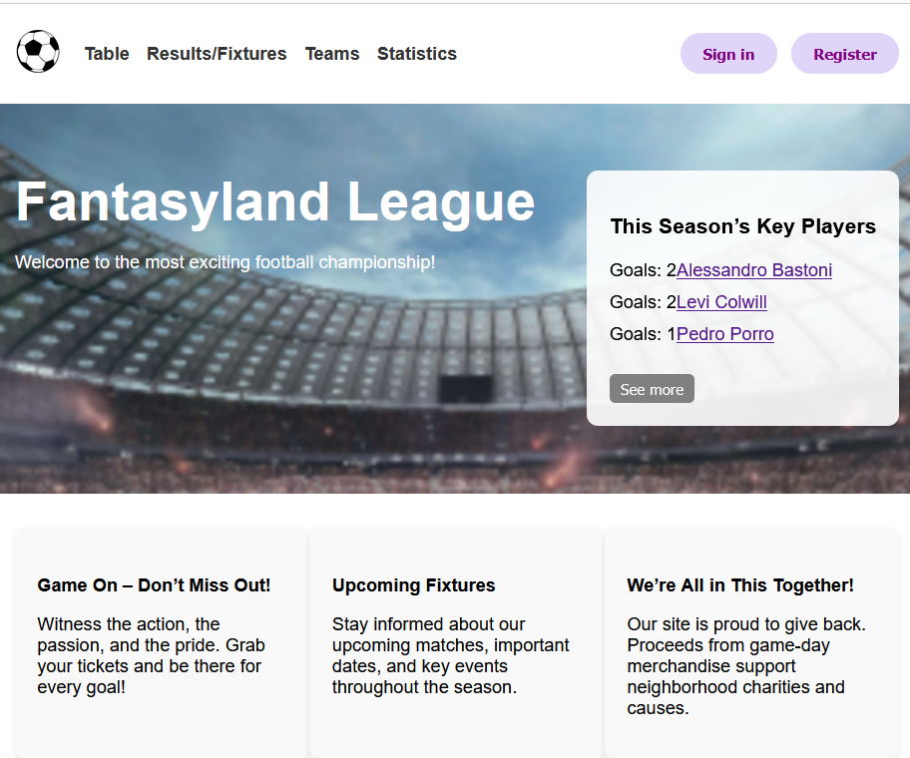
Fantasyland Football Championship
Home page

Slide 8
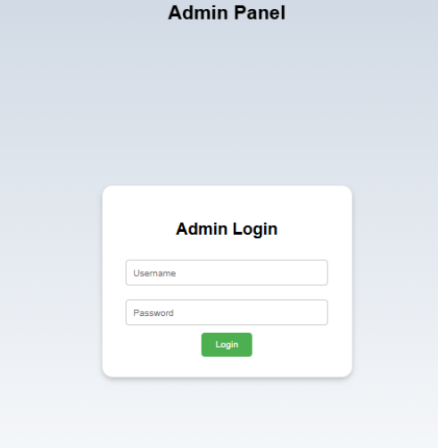
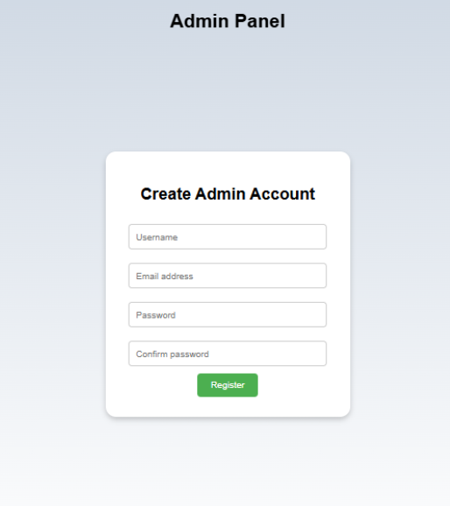
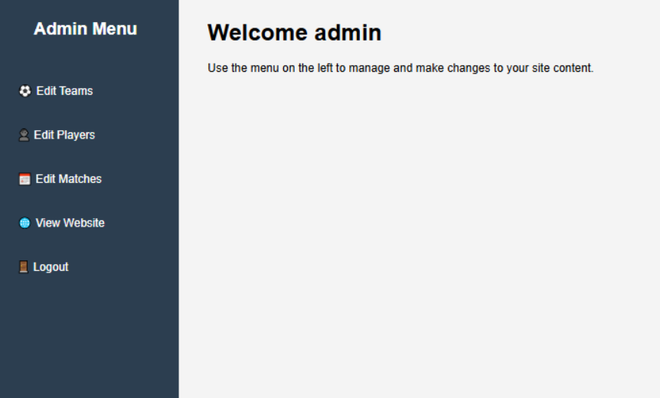
Admin
Login/registration

Slide 9
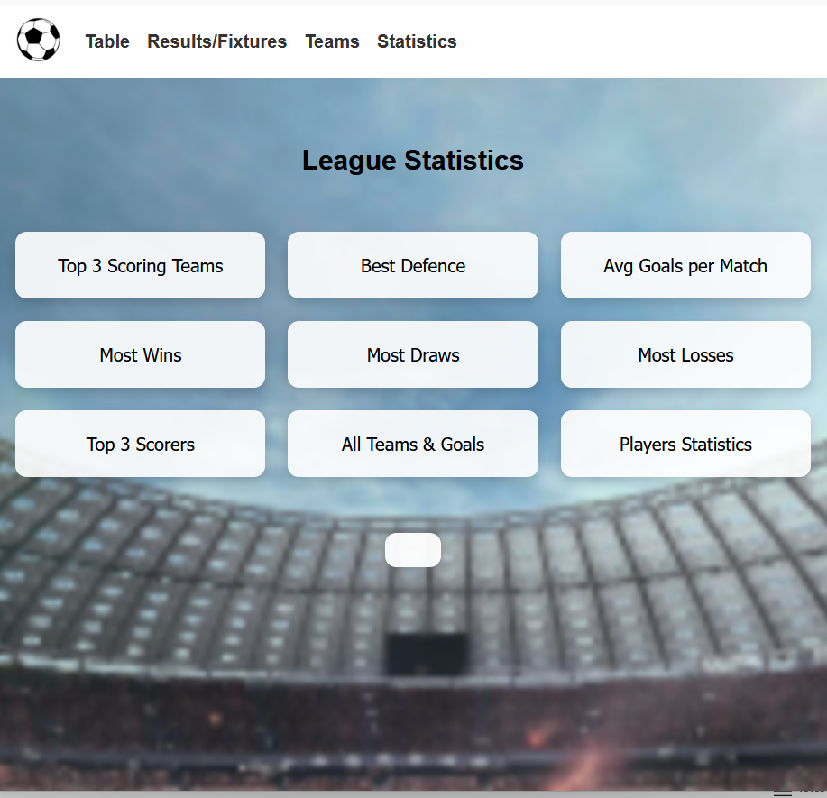
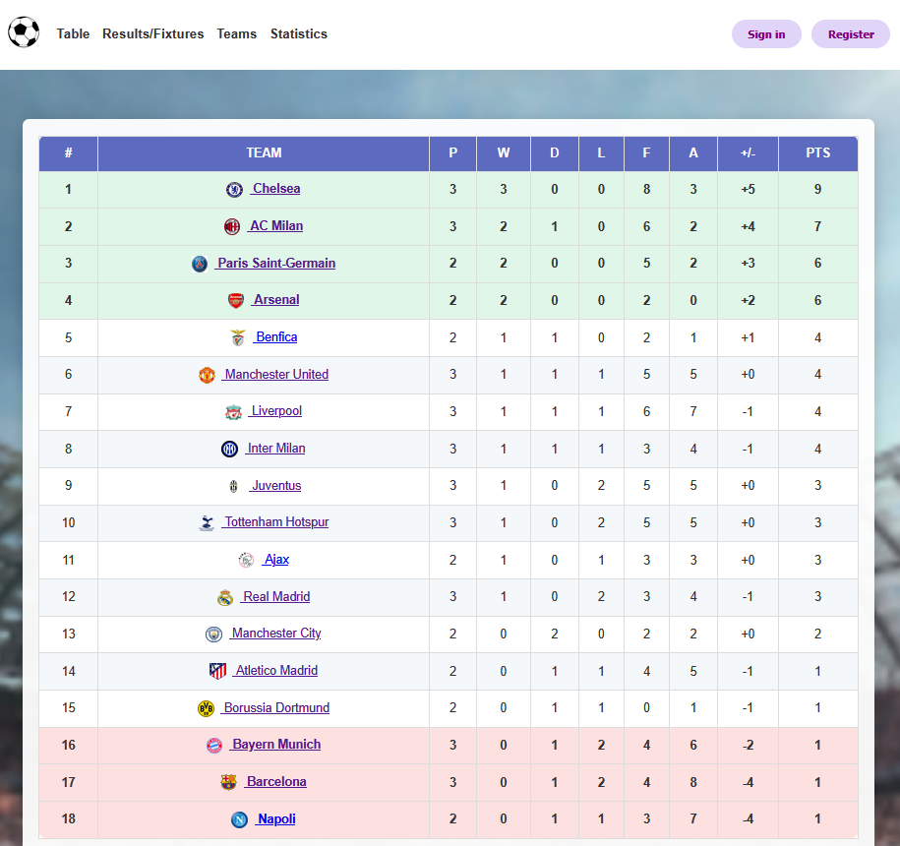
League statistics & Table page

