Slide 1




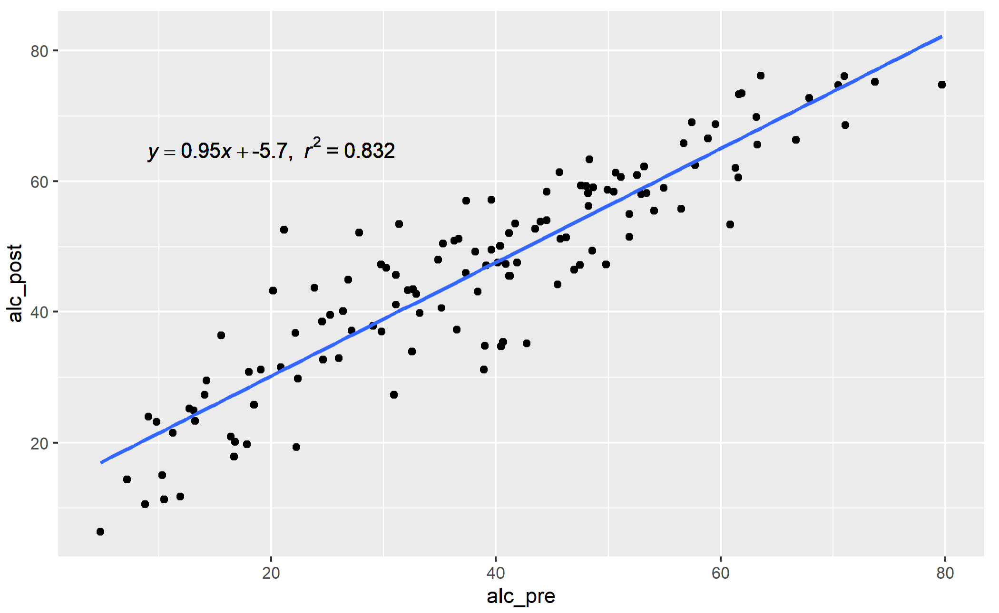
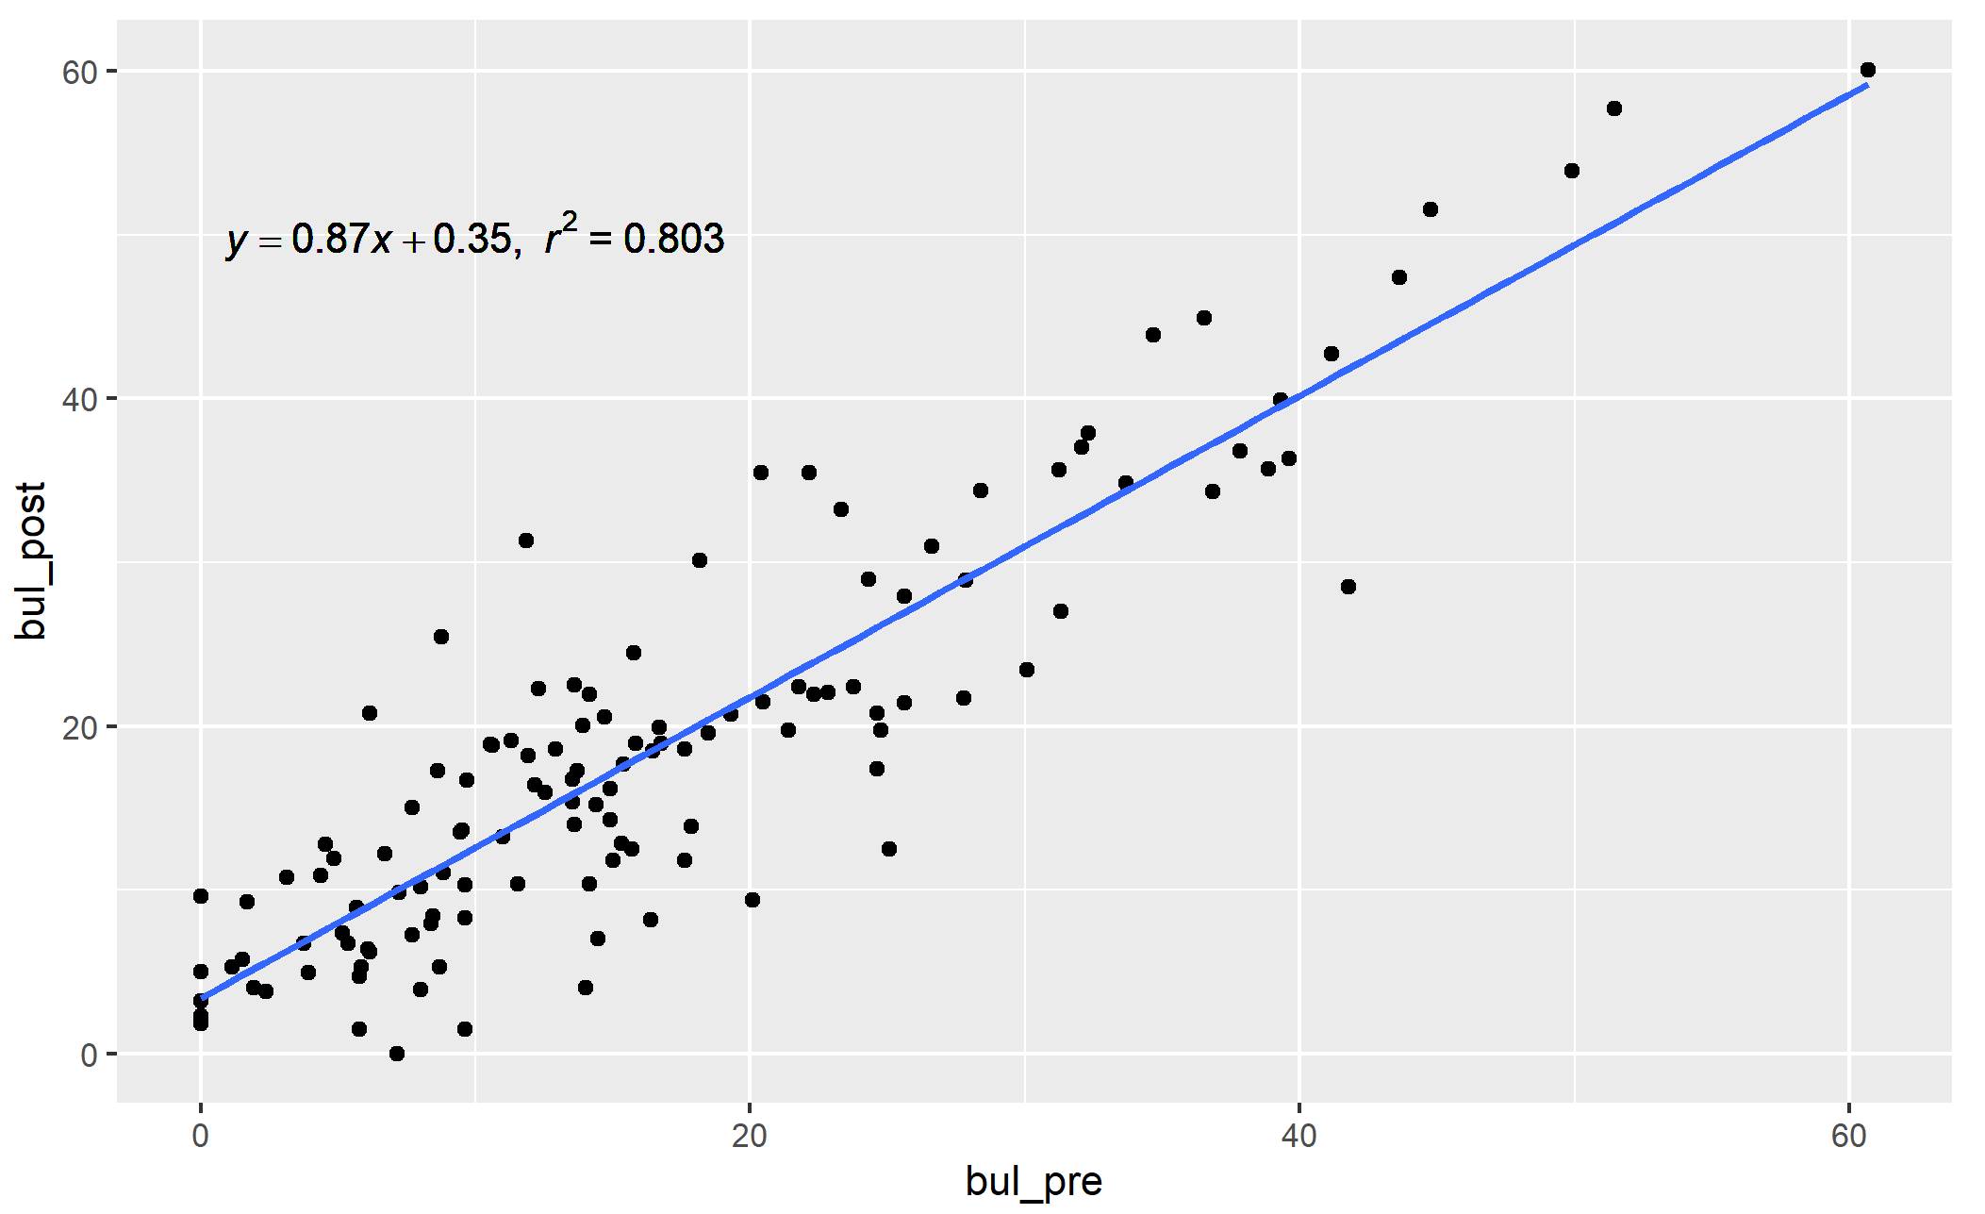
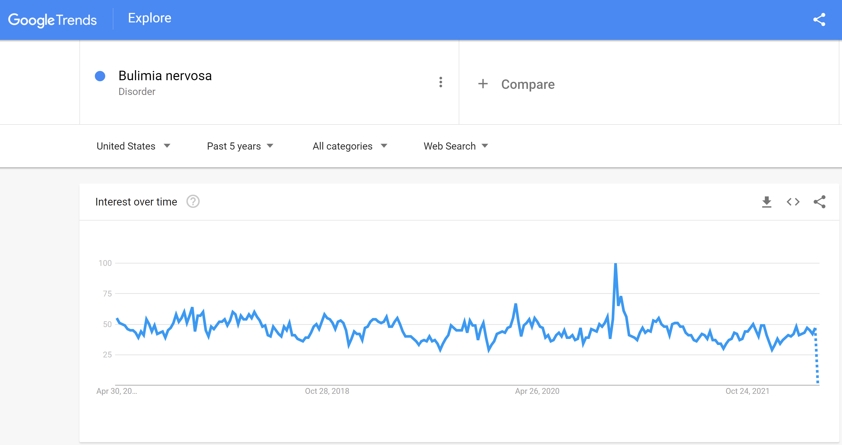
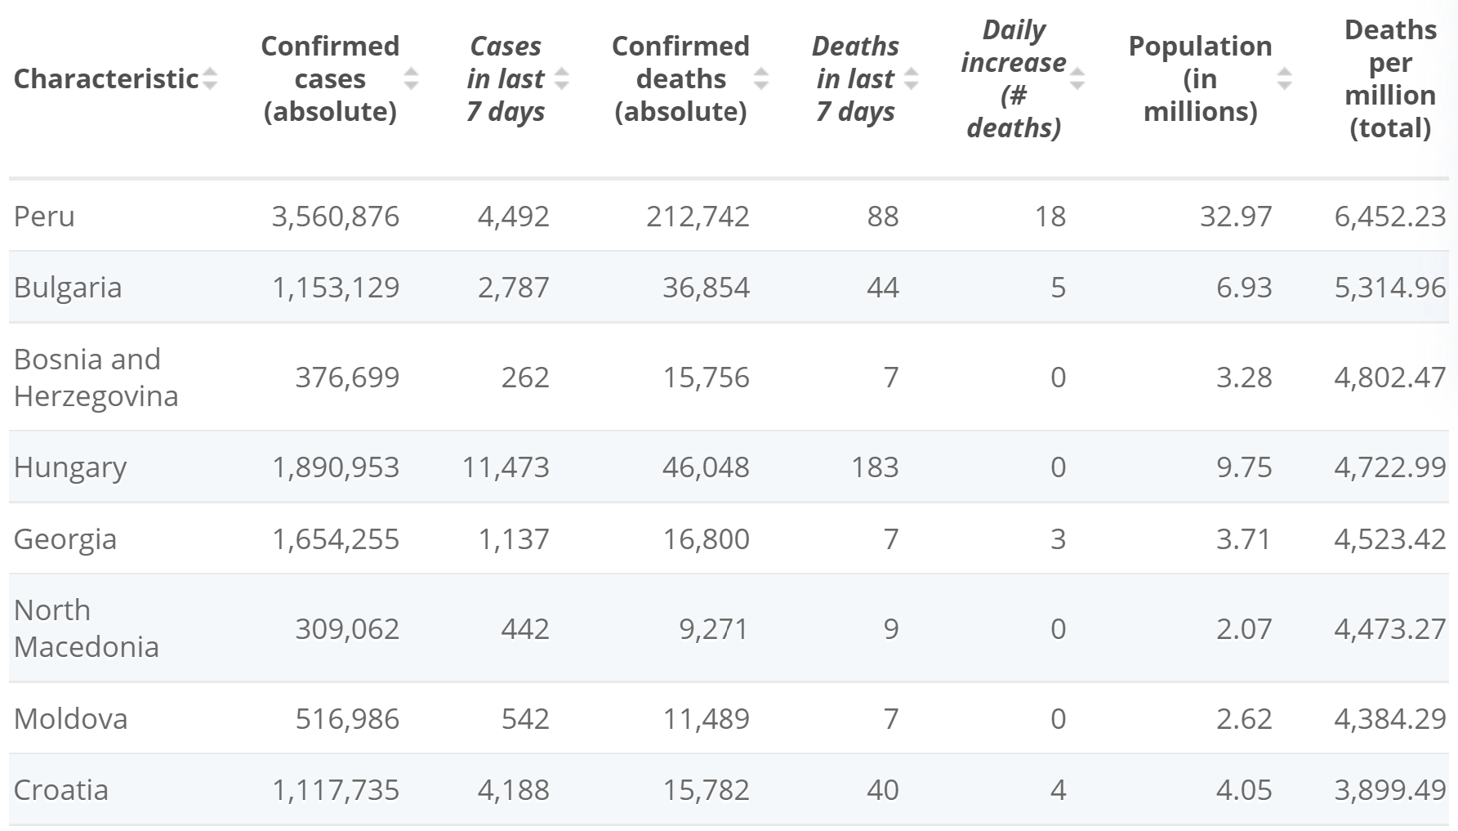
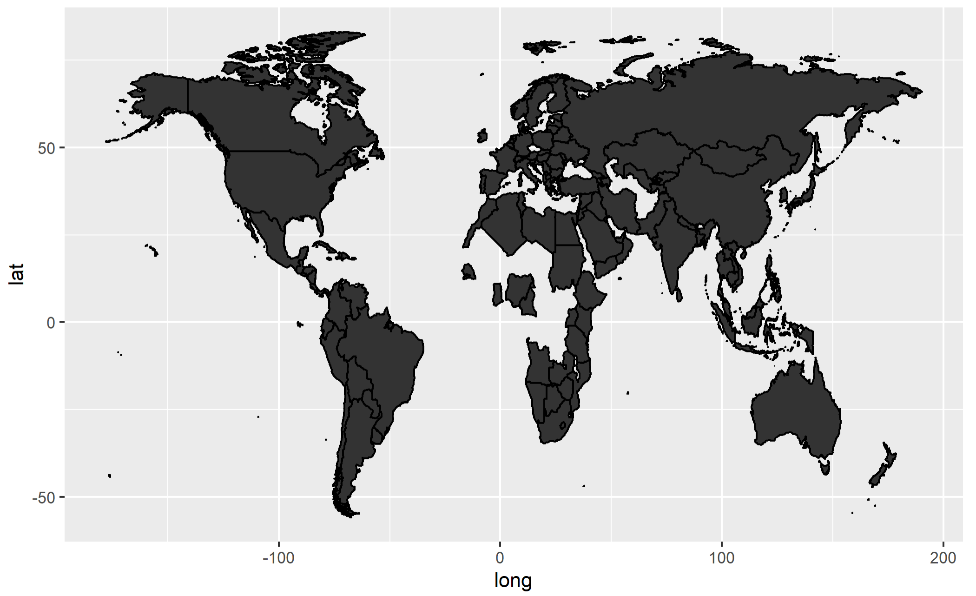
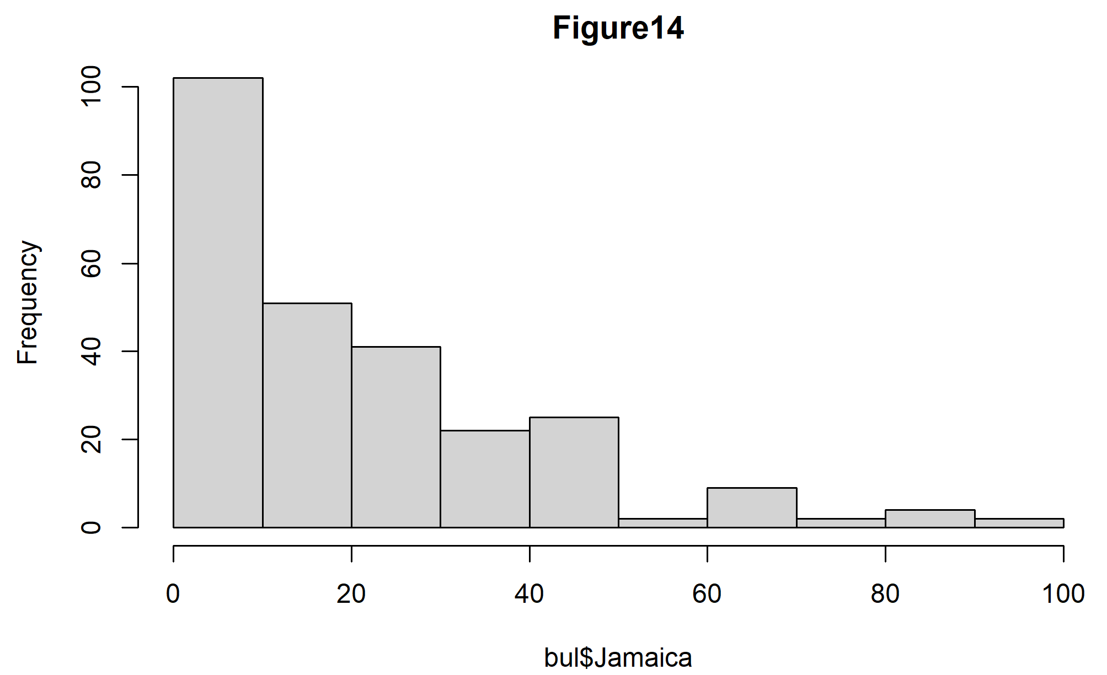
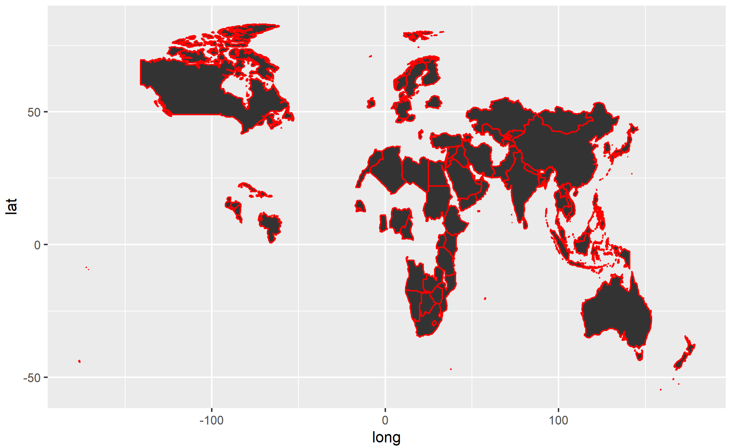
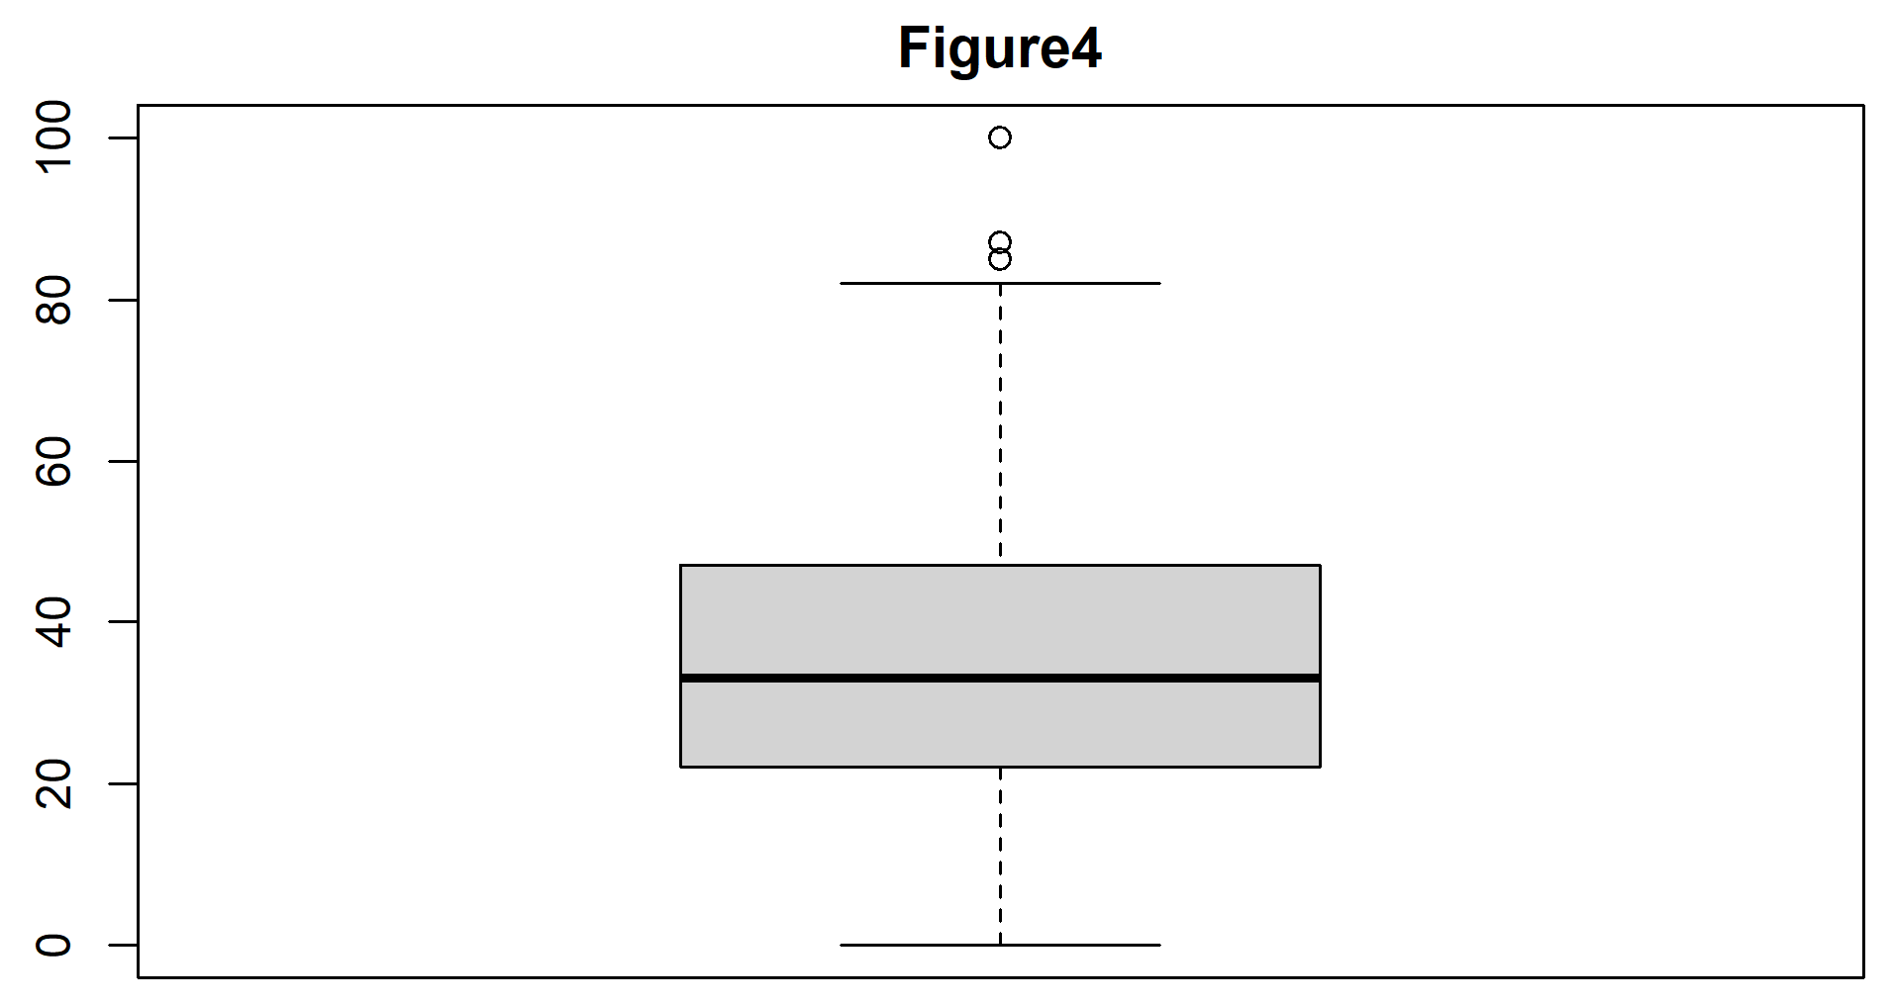
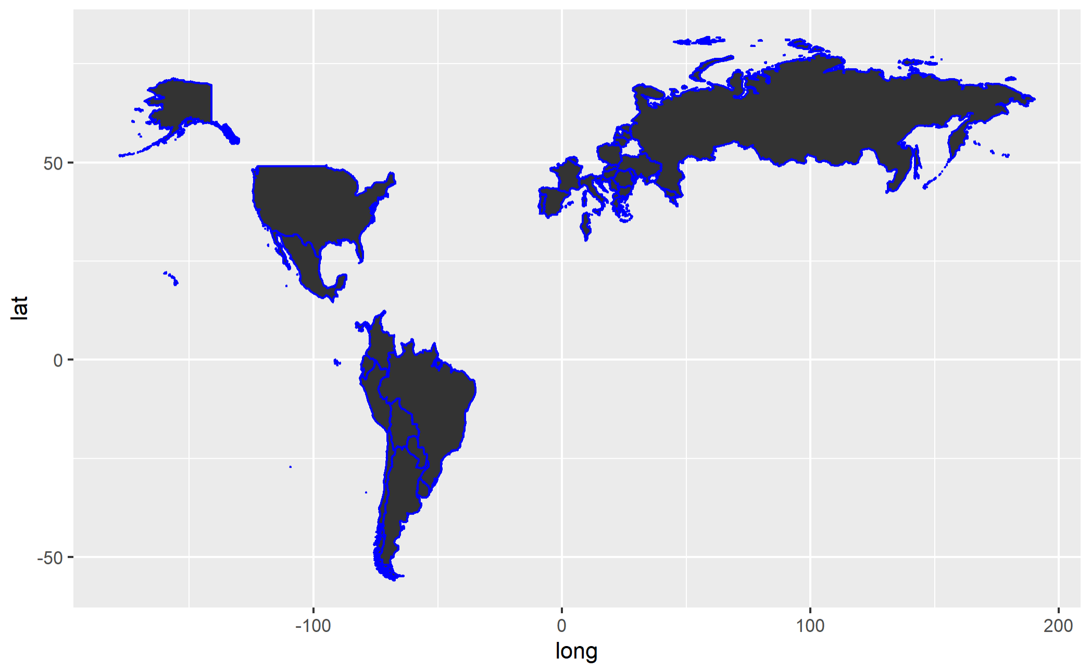
The Impact of Covid-19 on the Influx of Stress Relief Behavior
Lydia Halter haltel@rpi.edu
¹Rensselaer Polytechnic Institute, Tetherless World Constellation, Troy, NY, United States,
Abstract
Creating the Models
Eating disorders (or “EDs”) are extremely serious, and sometimes fatal, affecting tens of millions of Americans (mainly women). Most eating disorder onsets occur between the ages of 12 and 25 so the majority of people with some sort of ED are in high school or college. This makes sense as this is the time where major stressors such as social standard pressure, schoolwork, college applications, etc. are coming into a field of view. Being one such person within this age range, and the fact that myself and many other women I know have dealt with a variety of such disorders, this topic is of personal significance, the end goal of which is to hopefully propose a way to be more proactive in preventing, or at best lessening, ultimate spikes in ED cases.
Eating disorders are under the umbrella of emotional disorders and often go hand-in-hand with other such disorders, namely depression and anxiety, and is often a method of control. Understanding this helps us to realize why the onset of the Covid-19 pandemic has had the impact that it did on bulimia searches. Additionally, throughout my research, I’ve expanded my focus from not just bulimia but to the global search cases of alcohol due to their stress relieving nature, hypothesizing that the pandemic caused a spike in these searches as well.
Data Implementation and Analysis
Create the Models
Linear Regression
This first model shows the relationship between the average search rate of alcohol before Covid-19 versus the average search rate after Covid-19.
This second model shows the relationship between the average search rate of bulimia nervosa before Covid-19 versus the average search rate after Covid-19.
Both trends show strong, correlated, linear regressions, each with R-squared values greater than 0.8. Slopes and y-intercepts differ slightly, but we can generally conclude that all countries tend to act the same before versus after a large-scale, traumatic event.
K-Means Clustering
Through pca analysis, number of clusters was 2.
This first map details all of the countries included in my datasets.
This second map details only the countries in cluster 1. They’re grouped by Canada, some Caribbean states, northern Europe, Africa, Asia, and Oceania.
Cluster 2: USA, South America, central Europe (including Russia).
Search
From Google Trends
Explore
Exploratory analysis in R
Create
Subset and manipulate data
Analyze outcomes
Formulate graphs
From Excel csvs
Figure initial patterns/relations/trends
Exploring averages/models in Excel
Search for Data
Google Trends
Put in any topic (or multiple if you choose) and see the search rates over a select time period. Filter by country/state/region/city, category, and type of search (i.e. image, news, etc.). Provides a csv: column of dates and rate of searches by percentage over that period.
Alternative Source: Covid Statistics by Country
Focus is on last column, deaths per million (total). This is to be used in junction with Google Trends data on bulimia nervosa and alcohol over a roughly five-year period.
Motivation
We’re in the midst of a global pandemic. Why not take this time to pursue answers for reducing the harmful effects such an event has on the world?
Before determining what we need to target, we must first realize why we need to target them. The preemptive measures of preventing an influx of harmful behaviors across individuals in a population fall under targeting get-help services and hotlines- but where? First find a correlation to traumatic events, then find the tangent factors for a higher level of outreach.
Explore the Data
Figure 14 above displays an example of the preliminary data analysis. Comparing six of these resulted in the conclusion that first world countries have higher central statistics and less right-skew than second world countries, which in turn have higher central stats and even less right-skew than third worlds. Figure 4 to the right is one of eight boxplots showing that as deaths per million increases, mean rises, then falls.
Resources:
https://www.youtube.com/watch?v=lta5Mu1nryQ
https://www.statista.com/statistics/1104709/coronavirus-deaths-worldwide-per-million-inhabitants/
https://trends.google.com/trends/?geo=US
https://stackoverflow.com/questions/7549694/add-regression-line-equation-and-r2-on-graph
https://www.r-bloggers.com/2021/04/cluster-analysis-in-r/
https://r-spatial.org/r/2018/10/25/ggplot2-sf.html

