Slide 1

Algorithm/New Display
Proof of Concept
November 2015
Global Public Affairs
Internal

Slide 2
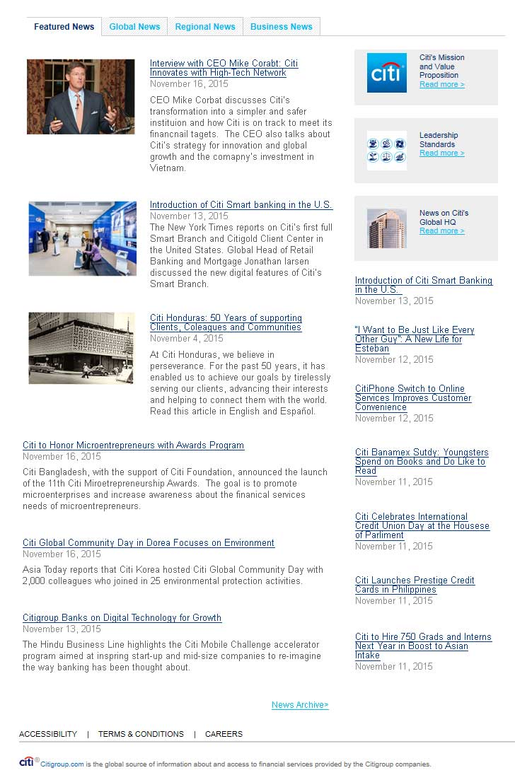
Change news display to 1 section sorted by algorithm
Stories are assigned scores based on rank, date, target and sorted in descending order based on score.
Date:
Today: + 2
Yesterday: + 1
Day before: 0
2 days ago: -1
3 days ago: -2
4 days ago: -3
Etc.
Rank:
Rank 1: +3
Rank 2: +2
Rank 3: +1
No Rank: 0
Target:
Global: + 2
Regional: + 1
< L4: +1
> L4: 0
This makes it so news from lower down the page doesn’t stay below the fold. Different sections don’t need to be updated. No stale content at top of news feed.
Should number of comments & likes be factored into algorithm as well? i.e > 5 comments: +1; >10 likes: +1
2
Notes:
Today, Rank 1, Global = 7
Yesterday, Rank 1, Global = 6
Today, Rank 2, Global = 6
Day Before, Rank 3, Global = 3
Today, Rank 1, Regional = 6
Yesterday, Rank 3, <L4 = 3
Last Week, NR Global = 0
Older, Rank 1, >L4 = 1
Older, NR, >L4 = -3
Elevate rank? *2? *1.5?
When articles have same score newest displays first (date/time)
Maybe we can try a few versions of a page that pulls based on these to fine-tune algorithm. Could maybe be played around with via RSS feeds? Check to make sure no duplicates due to “recommend”/syndication

Slide 3
Create a way to test and tweak algorithm and compare displays
File with headlines, abstracts, dates and ranks for last 3 months of articles published.
Select date, country and business for generated view.
Tweak algorithm
Show traditional view
Show new view

Slide 4
Sample Data
Rank would have to be editable since usually only the recent articles are ranked.
May need other colums for > 5 comments Y/N, over 10 likes Y/N
Headline | Abstract | Source Date | Target | Rank
India Advancing Financial Inclusion | Short description of this articles goes here. It can be one or two sentences | 11/18/2015 | USA | 1
Citi wins Cool Business Asards with Agent-Based Voice Authentication Initiative | Short description of this articles goes here. | 11/19/2015 | GLOBAL | 0
How Poland is Fast Becoming a Hub for Prime Investments | Short description of this articles goes here. | 11/18/2015 | GCB | 3
Know Your Value Livestream | Short description of this articles goes here. | 11/18/2015 | GCB | 0
Introduction of citi smart Banking in the US | Short description of this articles goes here. | 11/13/2015 | GCB O&T | 1
Citi Fourth Quarter 2015 Earnings Review Date Announced | Short description of this articles goes here. | 11/16/2015 | O&T | 2
citigold Private Client Model Taps Russian Top Clients | Short description of this articles goes here. | 11/19/2015 | China | 0
Citi Brazil at a Century: The Challenge of Being Traditionally Different | Short description of this articles goes here. | 11/19/2015 | Global | 0
Holiday Reminder -Giving and Receiving Gifts and Entertainment | Short description of this articles goes here. | 11/18/2015 | GLOBAL | 0
Know Your Value Livestream | Short description of this articles goes here. | 11/18/2015 | EI | 0
I want to be just like any other guy | Short description of this articles goes here. | 11/12/2015 | Mortgages | 1
message from CEO Mike Corbat Supporting our Vetrans | Short description of this articles goes here. | 11/11/2015 | LATAM | 2
Citi's Military Vetrans Networks: Serving Those Who Have served | Short description of this articles goes here. | 11/10/2015 | APAC | 3
Pathways to Progress: Uganda Women 'Mean Business' at Apprentice Program | Short description of this articles goes here. | 11/12/2015 | O&T | 0
Senior Executives Come Together for Citi Retail Sercies Annual Conference | Short description of this articles goes here. | 11/10/2015 | Cards | 0
Citi Foundation Announces Community Progress makers Fund | Short description of this articles goes here. | 11/9/2015 | GCB | 0
Progress Makers: Home for Heroes | Short description of this articles goes here. | 11/6/2015 | EI | 0
Citi Honduras: 50 Years of Supporting Clients, Colleagues and Communities | Short description of this articles goes here. | 11/4/2015 | GLOBAL | 3
Hello, Miami! | Short description of this articles goes here. | 10/22/2015 | LATAM | 0
Four Stories, Four Paths: The Road to Success | Short description of this articles goes here. | 10/21/2015 | GCB O&T | 0
Citi Sponsors NBC Universal Know Your value conference | Short description of this articles goes here. | 9/28/2015 | CPMC | 0
Citi North America CEO Bill Mills Introduces "City Profiles" Brochures | Short description of this articles goes here. | 9/24/2015 | GPA | 0
Bahamas: Back to School Jamboree Helps Kids | Short description of this articles goes here. | 9/22/2015 | GPA | 0
LEED Leader: Citi Focuses on the Enviornment in Belfast Gateway Development | Short description of this articles goes here. | 9/16/2015 | O&T | 0

Slide 5
Select Criteria & Tweak Algorithm
Date Picker
Dropdown of sample of organizations
Dropdown of sample of countries
Fields for each element of algorithm to boost
Select date
Month
Day
Year
Select Organization
GPA, Enterprise O&T, GCB, Retail Services, GCB O&T, CMPC, Enterprise Infrastructure
GPA
Select Country
UK, US, Canada, India, Malaysia, Hong Kong
USA
Tweak Algorithm Boosting
Higher Level of Managed Segment
Date
Rank
Global
Regional
Country
+1
+2.5
+1
+1
+2
-1
Old View
New View
Notes:
Parent child for orgs
GPA [L5] - 16803
Enterprise O&T [L4] - 5497
GCB [L4] - 4462
GCB > Cards [L5] > Retail Services [L6] - 9908839
Enterprise O&T > Enterprise Infrastructure [L5] – 16312
GCB > Retail Banking > Other Retail Banking > GCB O&T [L7] -20497
O&T > Enterprise Infrastructure > Citi shared services > Citi Global Program Management (CMPC) [L7] > 6808
Regions: EMEA, LATAM, NAM, APAC
The business targeted articles are usually represented by a number
The geographical target is usually represented by an abbreviation

Slide 6
Old View
Global
Asia Pacific
GCB
image
image
image
Headline goes here.
date
Abstract goes here.
Read More >
Headline goes here.
date
Abstract goes here.
Read More >
Headline goes here.
date
Abstract goes here.
Read More >
Headline goes here.
date
Headline goes here.
date
Headline goes here.
date
Headline goes here.
date
Headline goes here.
date
Headline goes here.
date
Global Archive>
APAC Archive>
GCB Archive>
India
Cards
image
image
Headline goes here.
date
Abstract goes here.
Read More >
Headline goes here.
date
Abstract goes here.
Read More >
Headline goes here.
date
Headline goes here.
date
Headline goes here.
date
Headline goes here.
date
India Archive>
Cards Archive>
Retail Services
image
Headline goes here.
date
Abstract goes here.
Read More >
Headline goes here.
date
Headline goes here.
date
Cards Archive>

Slide 7
New View
image
Headline goes here.
date
Abstract goes here. It can be longer or shorter..
IRead More >
Side banner
Headline goes here.
date
Abstract goes here. It can be longer or shorter..
IRead More >
Side banner
image
Side banner
image
Headline goes here.
date
Abstract goes here. It can be longer or shorter..
IRead More >
Headline goes here.
date
Headline goes here.
date
Abstract goes here. It can be longer or shorter..
IRead More >
Headline goes here.
date
Headline goes here.
date
Headline goes here.
date
Abstract goes here. It can be longer or shorter..
IRead More >
Headline goes here.
date
Headline goes here.
date
Abstract goes here. It can be longer or shorter..
IRead More >
Headline goes here.
date
Headline goes here.
date
Headline goes here.
date
Abstract goes here. It can be longer or shorter..
IRead More >
Headline goes here.
date
Archive>

