Slide 1
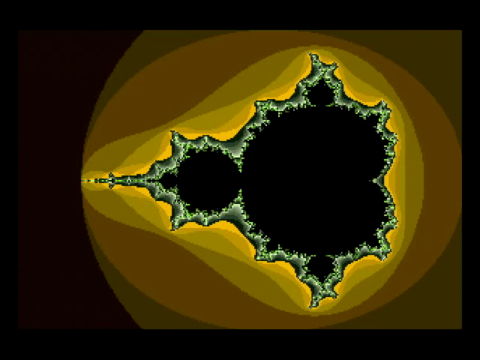
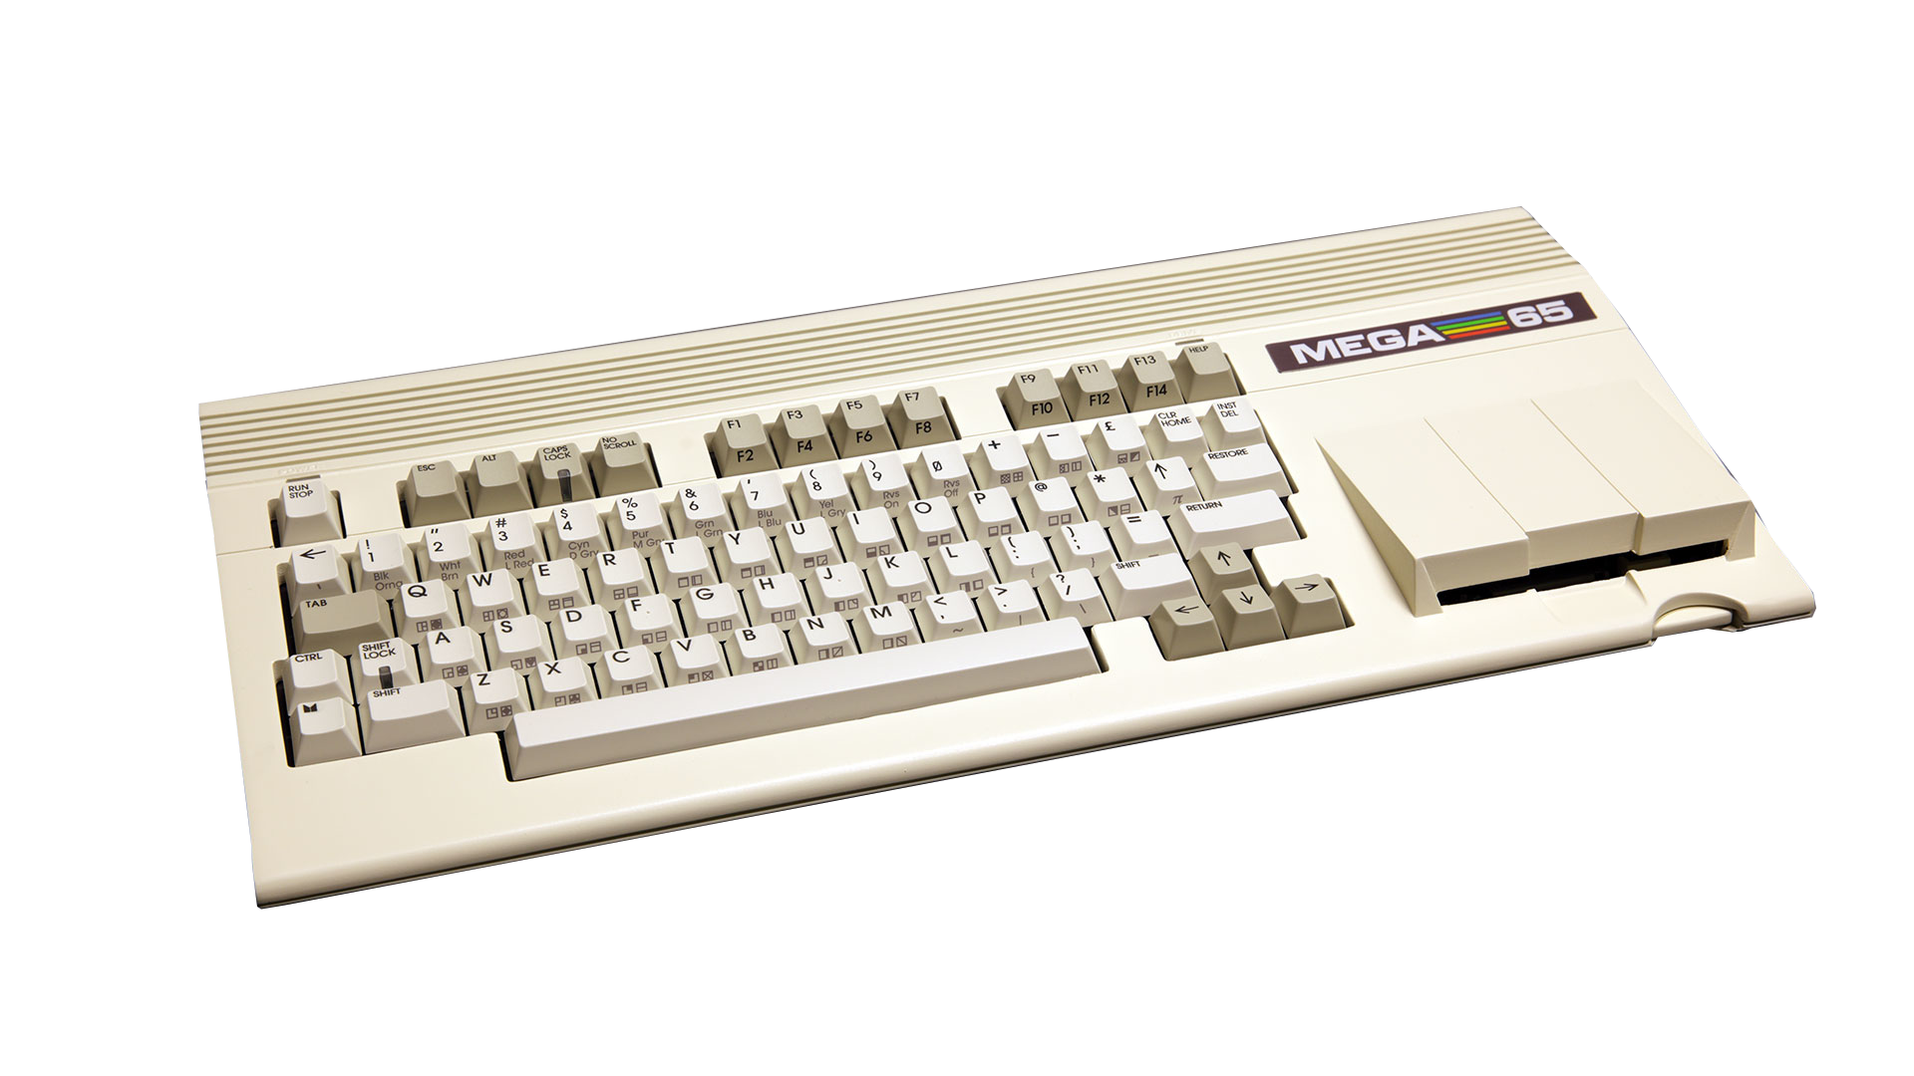

Mandelbrot Explorer 65
Episode 1:
Just use Q

Slide 2
Q Register Instructions
Use the 8 bit A, X, Y, Z Registers as a 32 bit pseudo Register
Q
Z
Y
X
A
0
1
1
0
1
0
0
1
1
0
1
0
0
1
0
1
0
0
0
1
1
1
0
1
1
0
1
0
0
0
1
0
Notes:
was designed to run on multiple 8bit platforms and used the lowest common festures

Slide 3
Q Register Instructions
Opcode is byte that tells the CPU what to do
6502 had lots of unused or illegal opcodes
4510 defined all of them
No space left for Q opcodes!
LDA $XXYY
$AD
$YY
$XX
Notes:
was designed to run on multiple 8bit platforms and used the lowest common festures

Slide 4
Q Register Instructions
Solution: Prefix opcodes
Should not break if executed by an unaware CPU
Double NEG is cheap and the state stays the same
NEG
NEG
LDA $XXYY
$42
$42
$AD
$YY
$XX
LDQ $XXYY
Notes:
was designed to run on multiple 8bit platforms and used the lowest common festures

Slide 5
Q Register Instructions
base page indirect Z indexed addressing uses Z
all opcodes need to ignore Z, as Z is part of Q
  we come back to this later...
NEG
NEG
LDA ($YY),Z
$42
$42
$B2
$YY
LDQ ($YY),Z
Notes:
was designed to run on multiple 8bit platforms and used the lowest common festures

Slide 6
Q Register Instructions
32 bit base page indirect Z indexed addressing is possible
Note: $EA is not really NOP but EOM in 45GS02 personality
NEG
NEG
NOP
LDA ($YY),Z
$42
$42
$EA
$B2
$YY
LDQ [$YY],Z
Notes:
was designed to run on multiple 8bit platforms and used the lowest common festures

Slide 7
Let’s try this!
xemu does not support Q Instructions
just implement them?
make Tests!
Core gives curious results...
Notes:
16 bit characters which are really pointers into flat memory
reduce multiplications

Slide 8
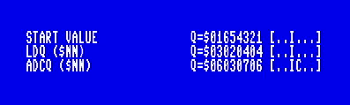
First Q Test
!address testptr1 = $30
start_val: !byte $21, $43, $65, $01
test1_str: !scr "ldq ($nn)", $00
test1_val: !byte $02, $04, $04, $02, $03, $01, $03, $01
test2_str: !scr "adcq ($nn)", $00
lda #<test1_val
sta test1ptr
lda #>test1_val
sta test1ptr+1
lda start_val
ldx start_val+1
ldy start_val+2
ldz start_val+3
cmp #0
clc
DisplayState()
ldq (testptr1),z
DisplayState()
adcq (testptr1)
DisplayState()
Start values are loaded with
legacy opcodes.
Using bitstream
development@c683362 build 138

Slide 9
First Q Test
!address testptr1 = $30
start_val: !byte $21, $43, $65, $01
test1_str: !scr "ldq ($nn)", $00
test1_val: !byte $02, $04, $04, $02, $03, $01, $03, $01
test2_str: !scr "adcq ($nn)", $00
lda #<test1_val
sta test1ptr
lda #>test1_val
sta test1ptr+1
lda start_val
ldx start_val+1
ldy start_val+2
ldz start_val+3
cmp #0
clc
DisplayState()
ldq (testptr1),z
DisplayState()
adcq (testptr1)
DisplayState()
Z should be ignored, but values
are loaded with offset 1.
Using bitstream
development@c683362 build 138

Slide 10
First Q Test
!address testptr1 = $30
start_val: !byte $21, $43, $65, $01
test1_str: !scr "ldq ($nn)", $00
test1_val: !byte $02, $04, $04, $02, $03, $01, $03, $01
test2_str: !scr "adcq ($nn)", $00
lda #<test1_val
sta test1ptr
lda #>test1_val
sta test1ptr+1
lda start_val
ldx start_val+1
ldy start_val+2
ldz start_val+3
cmp #0
clc
DisplayState()
ldq (testptr1),z
DisplayState()
adcq (testptr1)
DisplayState()
Z should be ignored again,
but it is used again. And why
is the Carry set?
Using bitstream
development@c683362 build 138

Slide 11
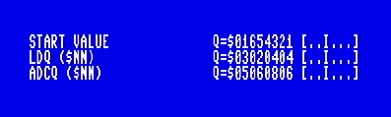
First Q Test
!address testptr1 = $30
start_val: !byte $21, $43, $65, $01
test1_str: !scr "ldq ($nn)", $00
test1_val: !byte $02, $04, $04, $02, $03, $01, $03, $01
test2_str: !scr "adcq ($nn)", $00
lda #<test1_val
sta test1ptr
lda #>test1_val
sta test1ptr+1
lda start_val
ldx start_val+1
ldy start_val+2
ldz start_val+3
cmp #0
clc
DisplayState()
ldq (testptr1),z
DisplayState()
adcq (testptr1)
DisplayState()
And this is the fixed version...
Using bitstream
development@9c91ece build 144

Slide 12
Q Unit Tests
Need a Nexys A7 Developer Board
First small steps
  #458 bp-indirect-z-indexed need to ignore Z
  #459 ADCQ, SBCQ, CMPQ - carry and overflow flags
Then the whole lot of them
  #468 Q Test Suite with 359 discrete Tests

Slide 13
Fixing the CPU
Base-Page indirect Z indexed Addressing
  only LDQ uses Z, all others assume 0
Carry, Overflow, Negative flags
LSRQ equals KILQ
Q register implied opcodes (DEQ Q, INQ Q, …) where not implemented
Notes:
basic is designed to use the mega65s advanced features

Slide 14
Let’s KickAss!
Mandelbrot Explorer65 currently uses ACME
Syntax of KickAss more to my liking
Combination with KickC interesting
Next step: separation of FCM graphics
Notes:
Enhancements:
timing via CIA
use 32bit Q-Register opcodes
math subroutine unrolling

Slide 15
Just use Q!
compile flag JUSTUSEQ to enable
change FP_ macros to use Q opcodes if flag is defined
add FP_ macros for fp_ subroutines
compile flag BENCHMARK to get timing

