Slide 1

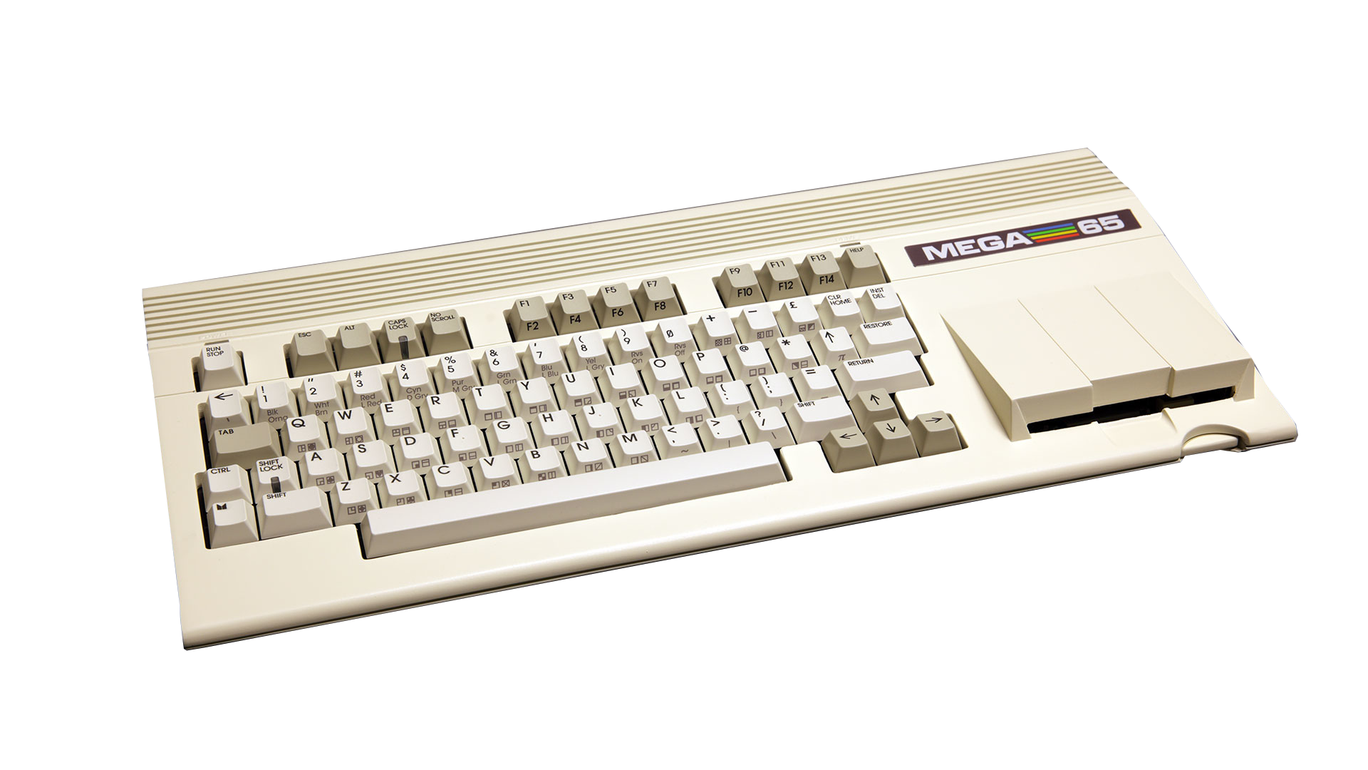
Computation
Power

Slide 2
Battle Royal Review
Small resolution 32x22 on text screen
Program based on Matt’s C64 version
only 16 iterations/colours
16 bit fixed point (8.8) numbers
BASIC65: 4.15 sec @40 MHz
Assembler: 0.40 sec @40 MHz
Notes:
was designed to run on multiple 8bit platforms and used the lowest common festures

Slide 3
High-Resolution
using MEGA65 VIC-IV FCM mode
320x200 with 256 colours
tile based graphics
48 iterations
common optimizations
Notes:
16 bit characters which are really pointers into flat memory
reduce multiplications

Slide 4
BASIC65
simple conversion of LowRes version
still uses floating point numbers
makes use of advanced capabilities:
  F018 DMA Controller for screen clear
  CPU Math Acceleration Registers
Notes:
basic is designed to use the mega65s advanced features

Slide 5
45GS02 Assembler
learning VIC-IV
32 bit fixed point (8.24) numbers
use of Math Acceleration Registers
base page for variables and pointers
Future enhancements
Notes:
Enhancements:
timing via CIA
use 32bit Q-Register opcodes
math subroutine unrolling

