Slide 1

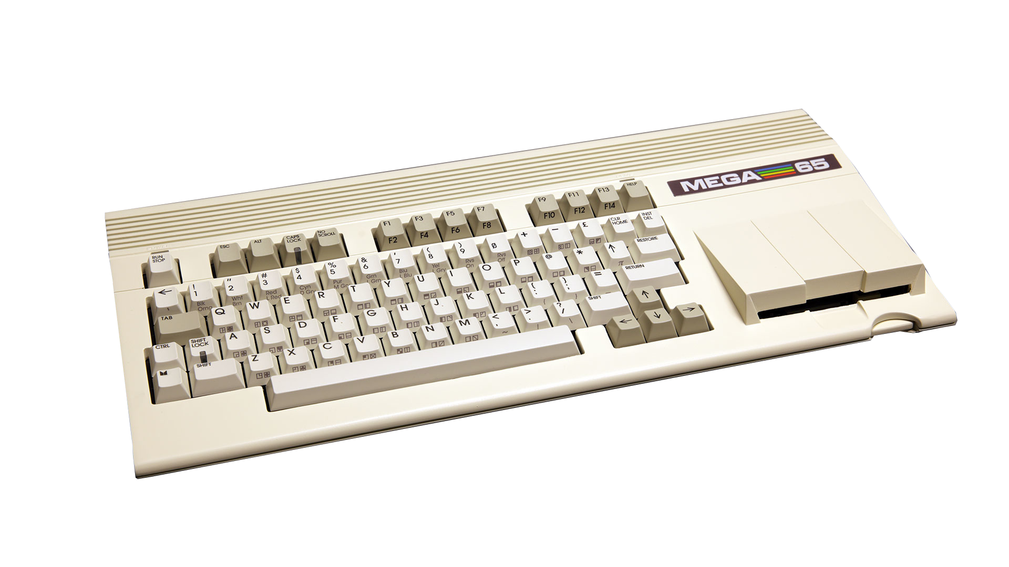

Mandelbrot Explorer 65
Episode 2:
It’s full of colour!

Slide 2
It’s full of VIC!
VIC-II trusty C64 companion, tile graphics
VIC-III C65 prototype, bitplane graphics
VIC-IV reimagined MEGA65 VIC with turbo charged tile graphics
can pose as any of those three

Slide 3
VIC-IV FCM
Full-Colour Text Mode
256* colours per pixel
8192* unique Characters possible
  16 bit character code is pointer into flat memory
  each character is 8x8 bytes
  lower 256 characters can use ‘default’ charset
* depending on configuration and memory

Slide 4
FCM Screen Layout
Screen RAM
00
10
19
10
…
40 rows of 16 byte characters in total = 320 pixel
01
10
1a
10
...
$1000 * $40 = $40000
$1019 * $40 = $40640
Vertical Stripe Offset = $640
02
10
1b
10
...
“Character” RAM
03
10
1c
10
...
400
00
400
01
400
02
400
03
400
04
400
05
400
06
400
07
406
40
406
41
406
42
406
43
406
44
406
45
406
46
406
47
...
...
...
...
400
08
400
09
400
0a
400
0b
400
0c
400
0d
400
0e
400
0f
406
48
406
49
406
4a
406
4b
406
4c
406
4d
406
4e
406
4f
18
10
31
10
...
...
...
...
...
...
...
...
...
...
...
...
...
...
...
...
...
25 lines in total
= 200 pixel
400
40
400
41
400
42
400
43
400
44
400
45
400
46
400
47
406
80
406
81
406
82
406
83
406
84
406
85
406
86
406
87
400
48
400
49
400
4a
400
4b
400
4c
400
4d
400
4e
400
4f
406
88
406
89
406
8a
406
8b
506
8c
406
8d
406
8e
406
8f
Colour of one Pixel

Slide 5
FCM Screen Layout (cont.)
Colour RAM
Follow the white rabbit...
40 rows of 16 byte characters
00
01
00
01
…
00
01
00
01
...
starting at $FF 8 0000
uses the same layout as the screen
V
FLIP
H
FLIP
ALP
HA
GOTO
X
WIDE
TRIM
TRIM#
00
01
00
01
...
UL
BOLD
REV
BLNK
COLOUR
00
01
00
01
...
different interpretations
depending on settings
...
...
...
...
00
01
00
01
...
25 lines in total

Slide 6
DMA Job Quick Ref
$D702 DMA JOB BANK
$D701 DMA JOB MSB
$D705 DMA JOB LSB ETRIG → Option List
$D700 DMA JOB LSB (no Option List)
$00 – end of option list
$0a – F018A 11 byte mode (no CMD MSB)
$81 $xx – Destination Address bits 20-27
$85 $xx – Destination skip rate (default $01)
Option List (variable)
Copy %000
Fill %011
Chain %1xx
CMD LSB
CMD LSB
COUNT (2 byte)
LSB of source address is fill value
SRC ADDR (20 bit)
SRC
FLGS
FILL BYTE
Bit 7
I/O
Bit 6
DIR
Bit 5
MOD
Bit 4
HOLD
DEST ADDRESS (20 bit)
DEST
FLGS
removed if F018 11 byte
mode is used
CMD MSB
(F018B)
MODULO
Speed: fill 40 MB per second, copy 20 MB per second

Slide 7
Possibilities
DMA supports FCM Layout
  Line drawing
  Texture scaling
  and more
Raster Rewrite Buffer
Tiled games with Full Colour Tiles

Slide 8

Episode 2:
It’s full of colour!

