Slide 1
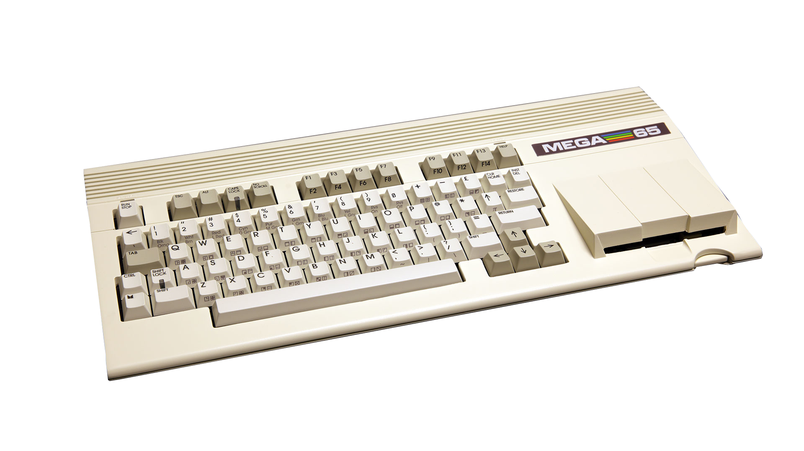

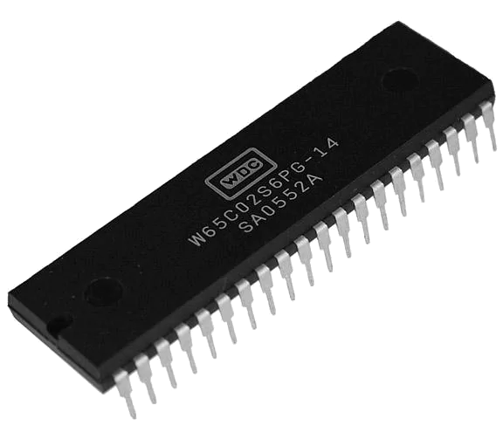


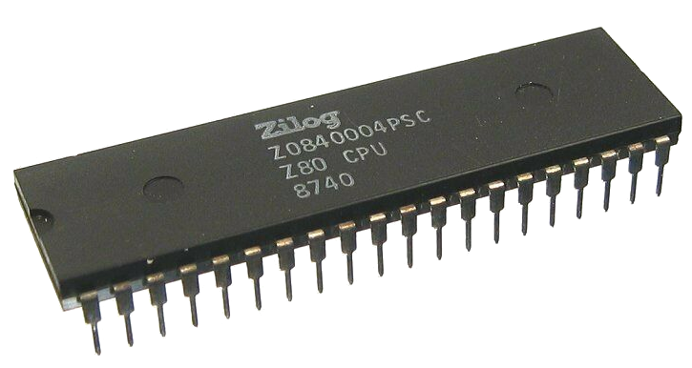
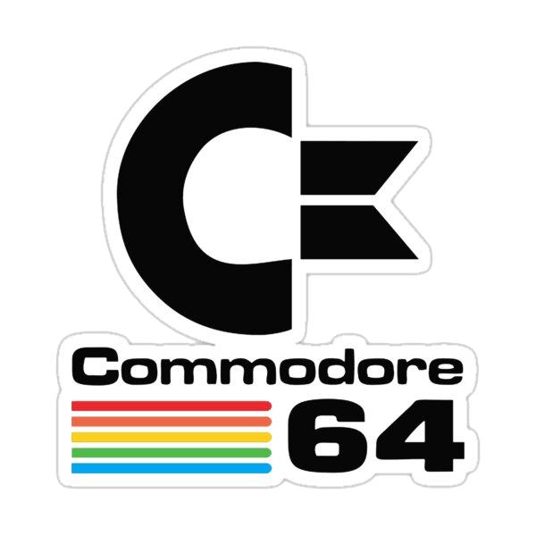

8-Bit Battle Royale
enters
the ring

Slide 2
New Contender - MEGA65
based on the Commodore C65 Prototype
ROM based on the Prototype, but much enhanced and completed
FPGA based hardware
45GS02 CPU, VIC-IV, 2 SIDs
real 3.5” Floppy Drive
Injection molded Case with Microswitch Keyboard
runs at 40 MHz

Slide 3
Round 1 - BASIC
uses 24bit POKEs to access screen and color RAM
avoid multiplication in screen access
use of the MEGA65 RTC to do the timing in BASIC
fancy CURSOR keyword to place cursor on screen

Slide 4
Round 2 - Assembler
45GS02 can map the base page (i.e. zero page)
  all memory pointers are stored in moved base page
  use of 32-bit Base Page Indirect Z-Indexed Mode to access screen and color ram without banking
can do anything the 65CE02 can do
use of integrated DMA Controller to erase screen
BASIC boilerplate to use RTC Timing

Slide 5
Final BASIC Leaderboard
Commander X16: 0:23
BBC Micro: 1:37
Amstrad CPC 464: 1:39
Atari 800: 2:16
Apple ][: 2:45
Commodore 64: 3:23
Sinclair ZX Spectrum: 4:33 (0:34 for Next @ 8x Turbo)

Slide 6
Final Assembly Leaderboard
Commander X16: 3.2
BBC Micro: 12.7
Amstrad CPC 464: 12.9
Sinclair ZX Spectrum: 13.5
Commodore 64: 26.4

