Slide 1


Why was kafka born ?

Slide 2


Back in 2014
They have 2 problems

Slide 3

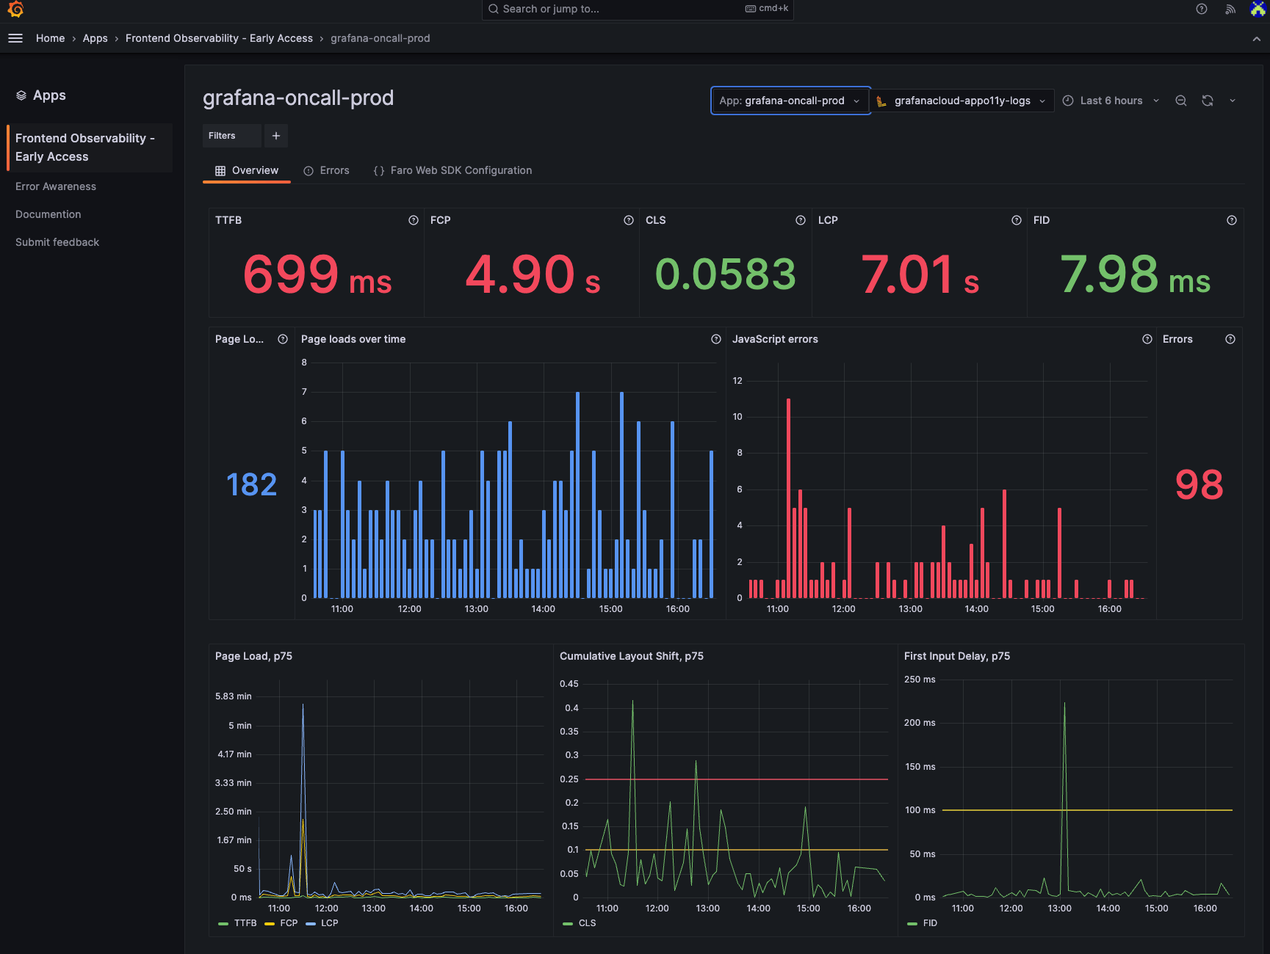
- User activity tracking system ( clicking profile, view jobs )
- Monitoring system ( cpu, ram usage )

Slide 4
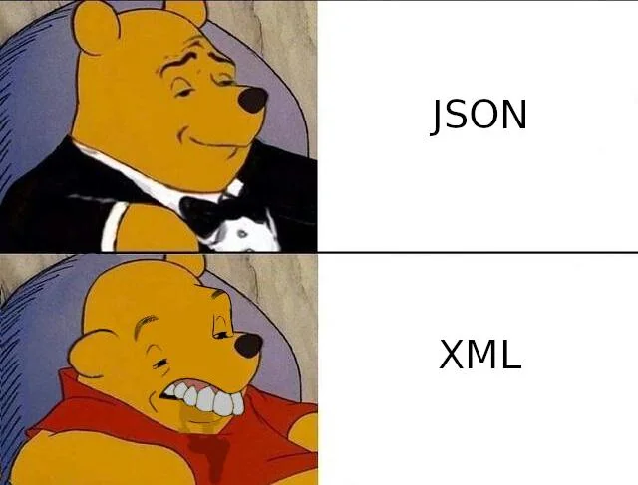

Pooling with delay ( while loop with interval – assumed 15’ )
Inconsistent metric names and formats, schema changes.
(HTTP batches with XML messages)
required manual handling
- Not support real time tracking ( Hourly batch )

Slide 5
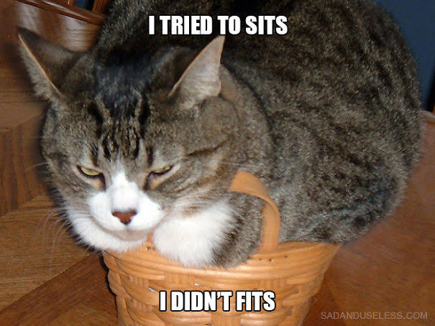

Existing ActiveMQ could not handle Linkend scale
(billions of messages per day ), today processes trillions of messages and petabytes of data daily, broker cause app disruptions

Slide 6

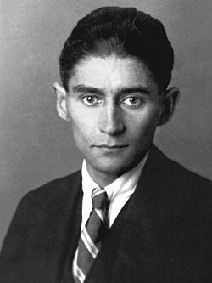

Then finally Kafka came!!!
I mean not him ☺

Slide 7



The team build kafka includes:
Before kafka
After kafka

Slide 8



The team build kafka includes:
Neha Narkhede
Jun Rao

