Slide 1
NHS North London Foundation Trust
Mental Health Referrals
Data Analysis & Insights Dashboard
Presented by: Lydia Akosah | Work Experience Placement | May 2026
Dataset: 100,558 referrals across 5 North London Boroughs | Power BI Dashboard
Notes:
SLIDE 1 – TITLE SLIDE
Good afternoon everyone. My name is Lydia Akosah Today I will be presenting a mental health referrals analysis dashboard that I built using Power BI.
The data covers over 100,000 referrals across five North London boroughs.
I hope this gives you some useful insight into referral patterns across the trust."
Time: ~30 seconds
Tip: Speak slowly, make eye contact, smile. You've worked hard on this — be proud!

Slide 2
What I Did & How I Did It
1 Raw Data
2 Power BI
Received a dataset of 100,558 NHS mental health referrals covering boroughs, urgency, referral source, waiting times and discharge information.
Imported the data into Power BI web (app.powerbi.com) and used Power Query to clean and prepare the data for analysis.
3 Dashboard
4 Insights
Built an interactive dashboard with charts, a KPI card, borough slicer, and monthly trend analysis — all updating in real time.
Analysed the visuals to identify patterns in referral volume, urgency distribution, referral sources and borough differences.
Notes:
SLIDE 2 – WHAT I DID
Before I show the dashboard, I want to briefly explain what I did this week.
I was given a raw dataset of over 100,000 mental health referrals. I imported this into Power BI, cleaned the data in Power Query, and built an interactive dashboard.
I then analysed the visuals to draw out key findings about referral patterns across North London."
Time: ~40 seconds
Tip: This shows you understand the full data analyst process — not just making charts but the whole workflow.

Slide 3
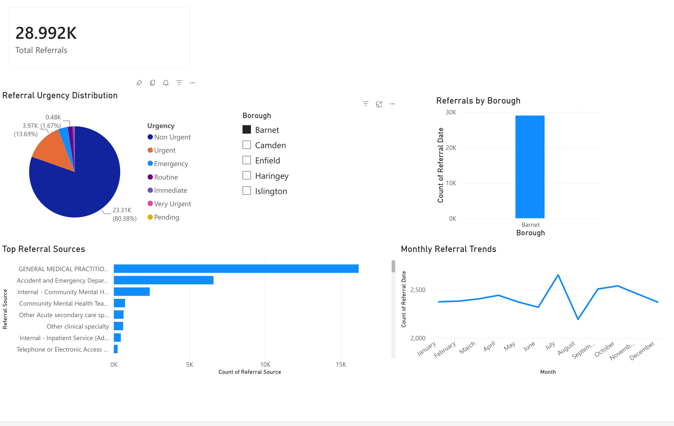
The Dashboard — Overview
Interactive Power BI Dashboard built from raw NHS referrals data
KPI Card
Shows total referrals for selected borough
Urgency Chart
Pie chart showing urgency split
Borough Filter
Interactive slicer — click to filter all visuals
Trend Line
Monthly referral trends over the year
Notes:
SLIDE 3 – DASHBOARD OVERVIEW
This is the dashboard I built in Power BI.
It has five main components.
At the top left is a KPI card showing the total number of referrals for whichever borough is selected.
Below that is a pie chart showing the urgency distribution.
In the centre is an interactive borough slicer — when you click a borough, every visual on the page updates automatically.
On the right is a bar chart showing referrals by borough, and at the bottom right is a monthly trend line showing how referrals fluctuate throughout the year."
[IF SCREEN SHARING]: "Let me show you this live — I'll click on different boroughs so you can see the interactivity."
Time: ~45 seconds

Slide 4
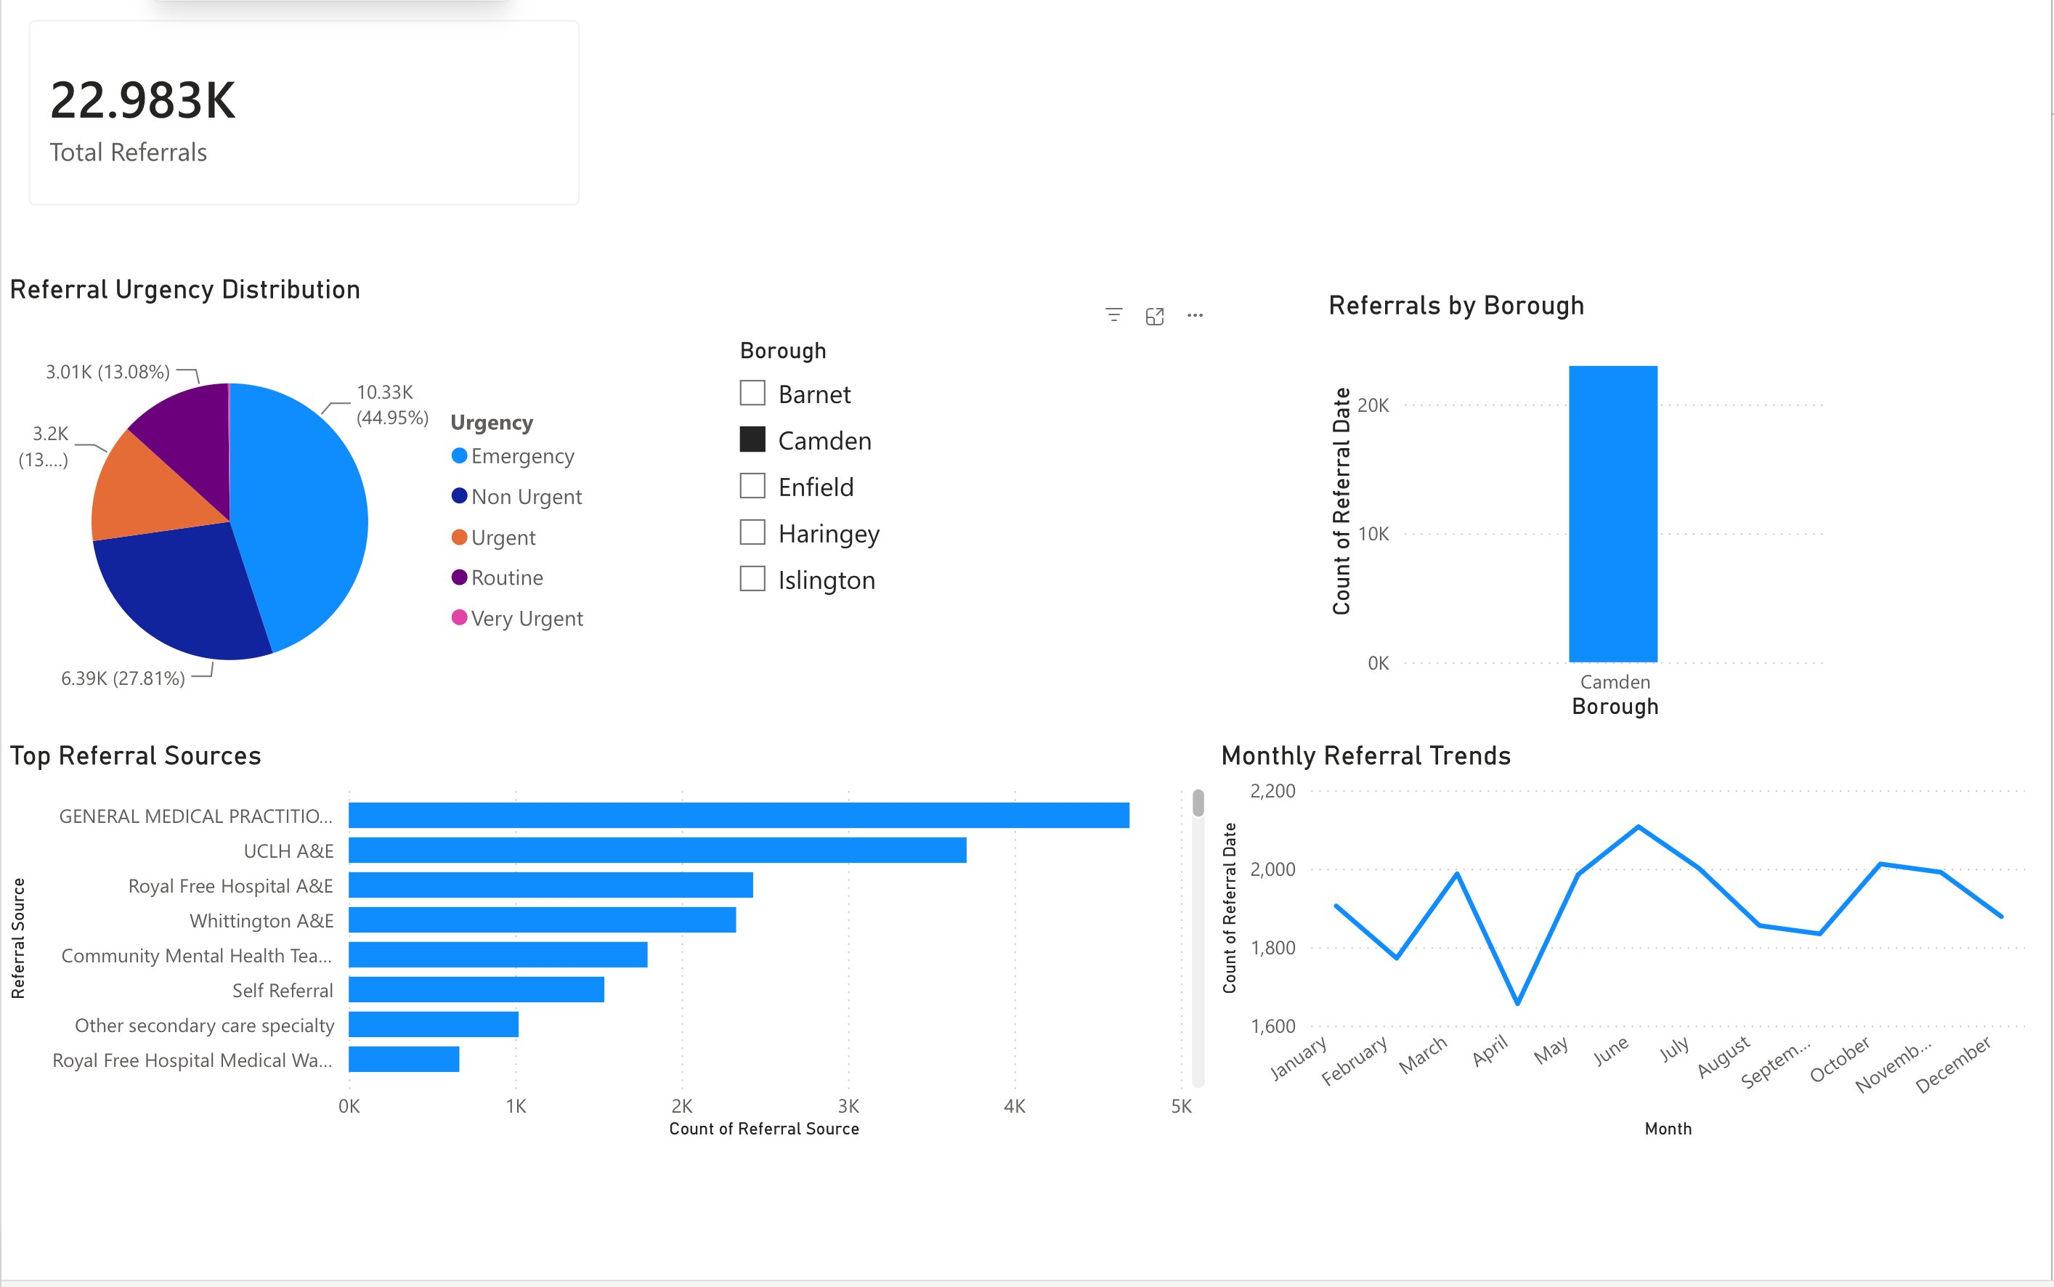
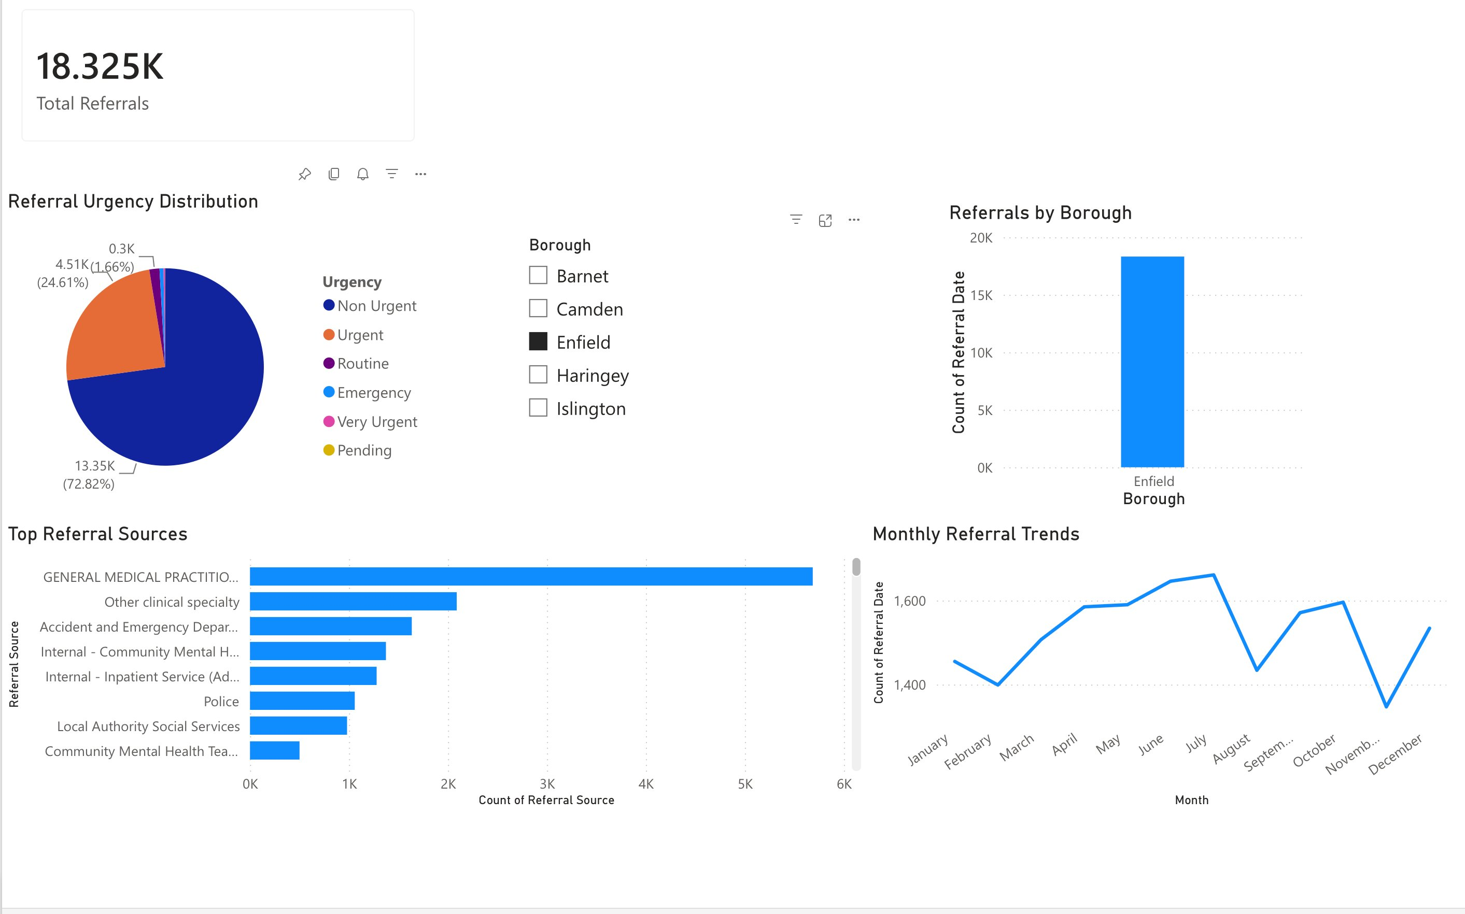
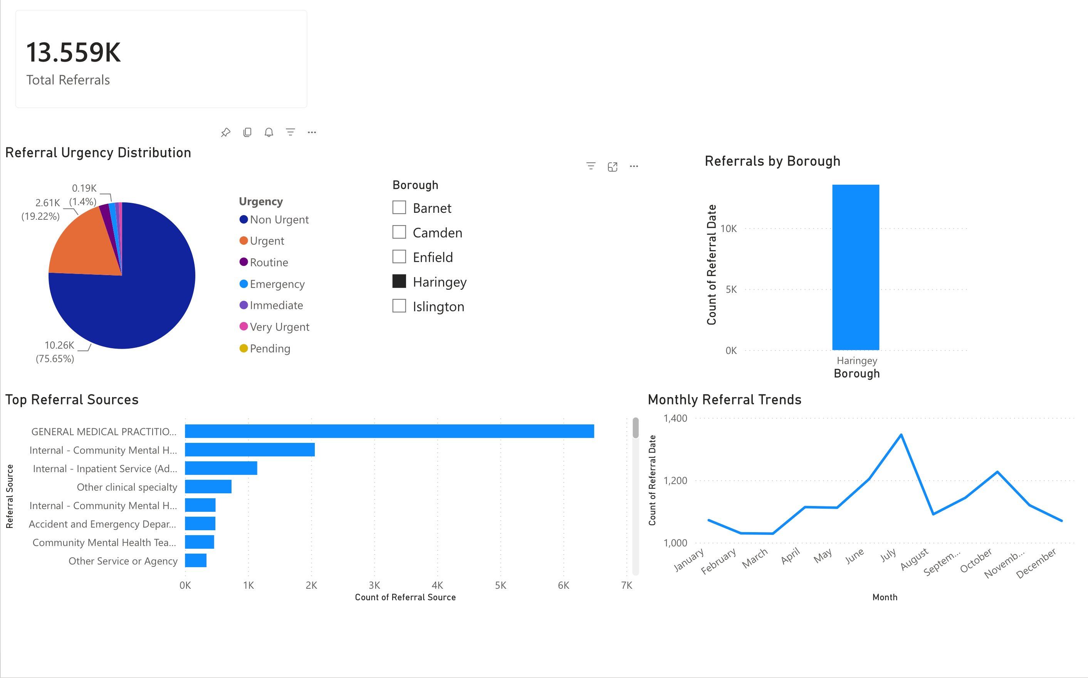
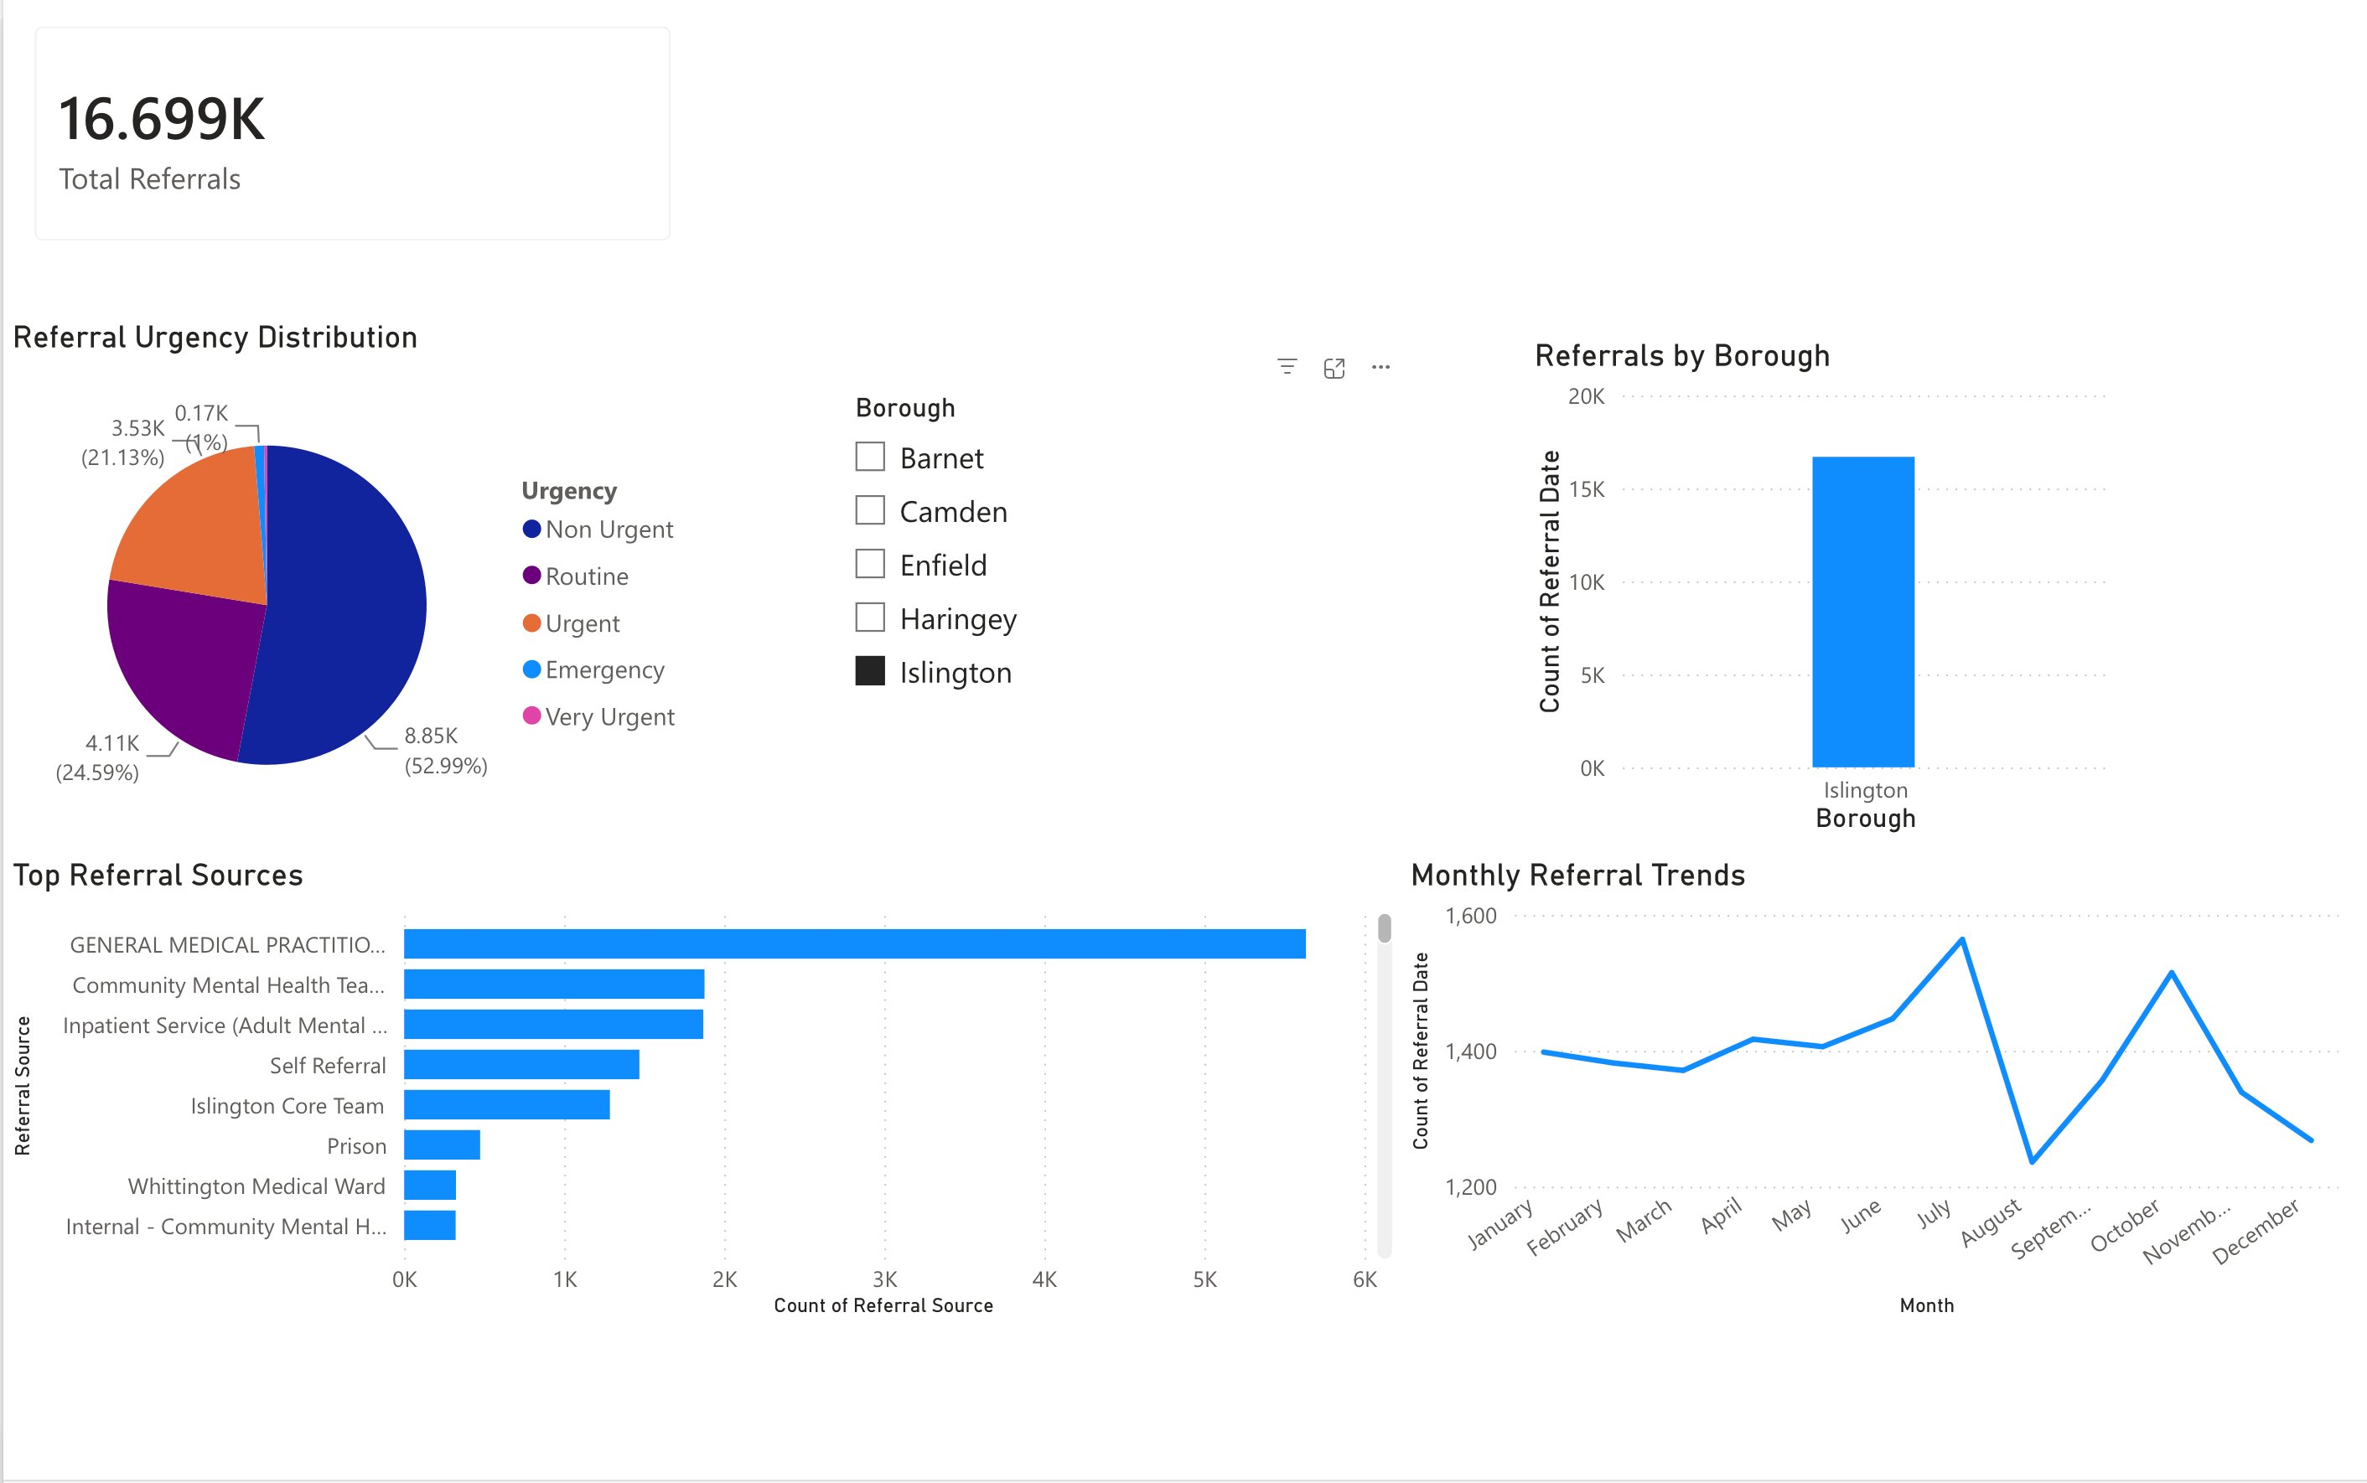
Finding 1 — Referral Volume by Borough
Barnet: 28,992
Camden: 22,983
Enfield: 18,325
Haringey: 13,559
Islington: 16,699
Key Insight:
Barnet has the highest demand at 28,992 referrals — more than double Haringey (13,559). This significant variation suggests differences in population size, service access, or community mental health needs across North London boroughs. Resource allocation should reflect these differences.
Notes:
SLIDE 4 – BOROUGH COMPARISON
Looking at referral volumes by borough, Barnet is clearly the highest with just under 29,000 referrals.
Camden is second with just under 23,000.
Enfield and Islington are in the middle range, while Haringey has the lowest volume at around 13,500.
This is a significant variation —
Barnet receives more than double the referrals of Haringey. This may reflect differences in population size, but it could also suggest differences in how well communities can access mental health services, which is worth investigating further."
Time: ~45 seconds
Tip: Point to each borough as you mention it.

Slide 5
Finding 2 — Urgency Distribution
Urgency Breakdown
62%
Non-Urgent
62,146
Majority — manageable via routine appointments
18%
Urgent
17,818
Needs priority access within days
12%
Emergency
11,811
Requires immediate crisis intervention
8%
Routine
8,197
Planned, lower-priority referrals
Notes:
SLIDE 5 – URGENCY DISTRIBUTION
This pie chart shows how referrals are classified by urgency.
The majority — 62% — are non-urgent, which is positive as it suggests most patients are being referred before reaching crisis point.
However, 12% — that's over 11,800 people — are classified as emergency.
This is significant.
It places considerable pressure on crisis mental health teams. Additionally, nearly 18% are urgent. So combined, almost 30% of all referrals need priority or emergency intervention.
This highlights a real opportunity for the trust to invest in earlier intervention services to reduce the number of people reaching crisis level before getting support."
Time: ~50 seconds
Tip: The emergency figure is your strongest insight — pause on it for effect.

Slide 6
Finding 3 — Where Referrals Come From
Top Sources
GPs
38,695
38% of all referrals — primary care is the main gateway to mental health services
A&E Depts
8,733
9% — patients reaching crisis before getting community support
Internal CMHT
6,372
6% — joined-up working between mental health teams
Community MHT
5,376
5% — referrals from community mental health teams
Notes:
SLIDE 6 – REFERRAL SOURCES
Looking at where referrals come from, GPs are by far the most common source — accounting for 38% of all referrals, that's nearly 39,000 patients.
This shows how critical primary care is as a gateway to mental health support.
The second most common source is Accident and Emergency departments, with over 8,700 referrals.
This is a concern — it means those patients didn't get support earlier and ended up in A&E first.
This suggests that strengthening GP mental health training and increasing community support could help intercept patients before they reach crisis and end up in A&E."
Time: ~45 seconds

Slide 7
Finding 4 — Monthly Referral Trends
Trend Analysis
› Mid-year peaks
Most boroughs see referral increases around July–August, possibly reflecting service pressures after summer.
› August dips
Several boroughs show a sharp drop in August — likely due to staff annual leave reducing capacity.
› Seasonal patterns
Understanding these cycles helps the trust plan staffing and resource levels in advance.
› Borough variation
Each borough has a different trend shape, suggesting locally specific demand drivers.
Notes:
SLIDE 7 – MONTHLY TRENDS
The monthly trend line shows how referrals fluctuate throughout the year.
Most boroughs show peaks around mid-year, particularly July.
Interestingly, there are sharp drops in August across several boroughs — this is likely due to reduced staff capacity during the summer holiday period rather than genuinely fewer patients needing help.
This kind of insight is really useful for workforce planning — if the trust knows demand peaks in July, they can ensure adequate staffing before that peak arrives."
Time: ~40 seconds

Slide 8
Summary & Recommendations
Demand Inequality
Crisis Prevention
Barnet receives 2× more referrals than Haringey. The trust should review whether resource allocation reflects actual borough demand.
11,800+ emergency referrals represent significant pressure. Investing in early intervention services could reduce crisis presentations.
GP as Gateway
Workforce Planning
GPs drive 38% of referrals. Targeted mental health training for GPs could improve referral quality and reduce A&E presentations.
Mid-year demand peaks are consistent. The trust should plan staffing levels in advance of July peaks and address August capacity gaps.
Presented by Lydia Akosah | NHS NLFT Work Experience | May 2026
Notes:
SLIDE 8 – SUMMARY & RECOMMENDATIONS
To summarise, this analysis of over 100,000 NHS mental health referrals across North London has produced four key recommendations.
First, there is a significant inequality in referral demand across boroughs —
Barnet receives twice as many referrals as Haringey, and resource allocation should reflect this.
Second, the high number of emergency referrals — over 11,000 — indicates a need for stronger early intervention services.
Third, GPs are the main referral gateway, and improving their mental health training could improve both referral quality and patient outcomes.
Finally, understanding the seasonal peaks in referral demand can help the trust plan staffing more effectively."
" to conclude, This has been a fantastic learning experience and has shown me how data analytics directly supports NHS service planning and decision-making. Thank you for listening.
Time: ~60 seconds
Tip: End with confidence. You've done a real analysis on real NHS data — that is genuinely impressive for a placement student.

