Slide 1
The Better Backseat Driver:
Increased Safety Through Autonomy
Lyell Read, Phillip Mestas, and Stan Lyakhov

Slide 2
Problems with Motor Vehicles
Deaths and injuries from crashes
Inefficient transportation
Massive pollution

Slide 3
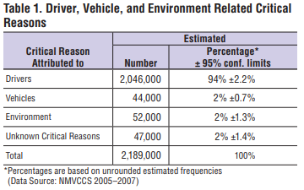
Drivers Cause Most Crashes
Notes:
To support our claim that there are problems with motor vehicles today, I present this data, from the National Highway Traffic Safety Administration. In it, you can see that human error accounts for about 2 million or 94 percent of accidents, where as vehicular failures, environmental factors and cases that were unknown number about 150000 together - only 6 percent. Therefore, humans are one of the problems with the current use of motor vehicles.

Slide 4
The Solution
Everyone is a stakeholder
Use AI to create autonomous vehicles
Much progress has been made already
Notes:
How do we fix this, though? We proposed in our paper that, because every person (and being) is a stakeholder, we should use AI to create vehicles that can drive themselves in a safe, predictable and repeatable way, making the roads safer. In this domain, we have already seen great advances, with startups and developed companies refining AI powered driving every day.

Slide 5
Benefits of Autonomous Vehicles
Less crashes and injuries
Reduce traffic and congestion
Better for the environment
Potential Issues

