Slide 1
More Neural Nets!
Wednesday, Lecture 2
FASE ML Bootcamp
Based on material from:

Slide 2
How do neural networks train?
https://www.3blue1brown.com/neural-networks
2nd, 3rd and 4th videos
For written notes describing the content in the videos, this is a great resource
http://neuralnetworksanddeeplearning.com/index.html

Slide 3
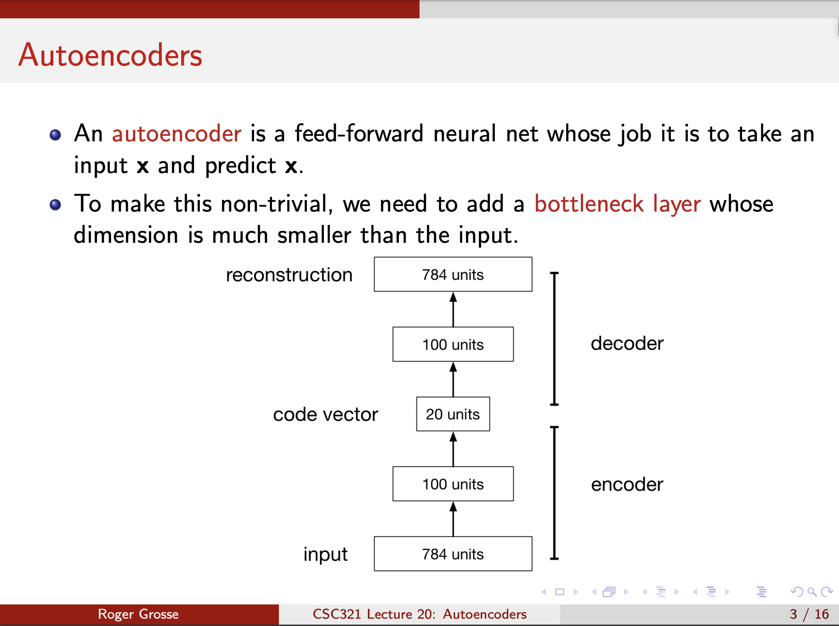

Slide 4
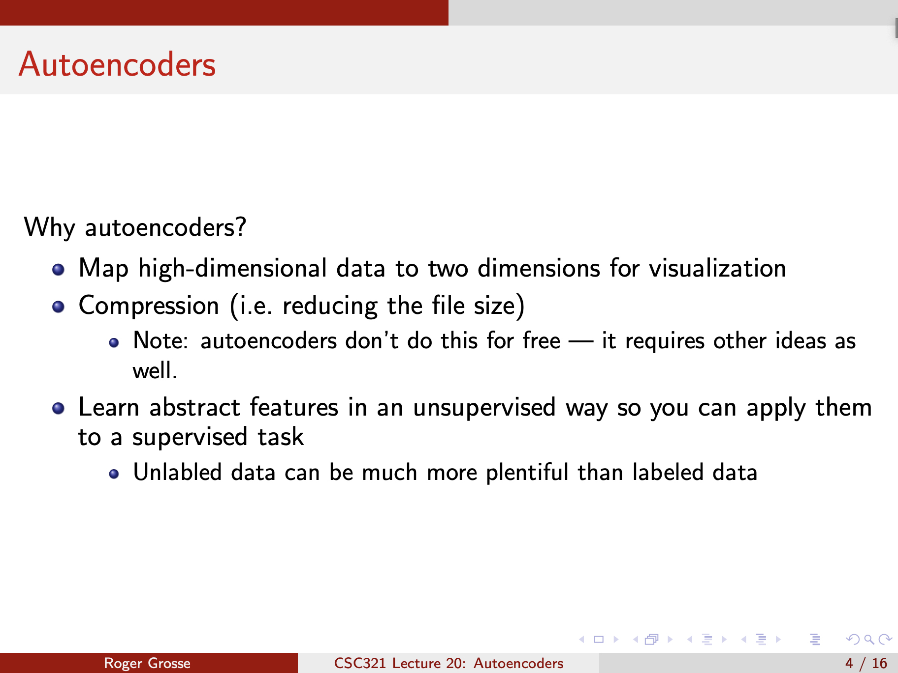

Slide 5
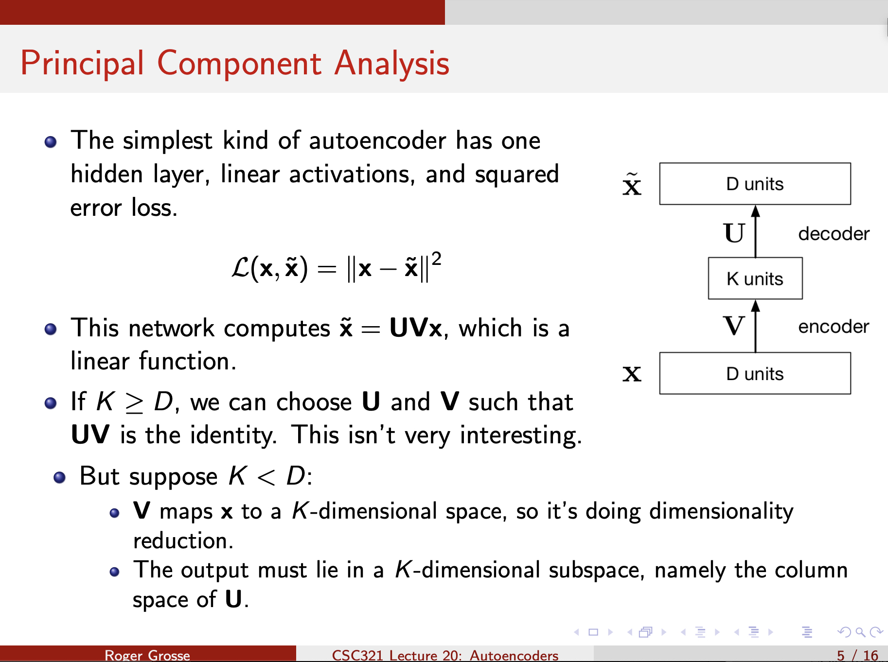

Slide 6
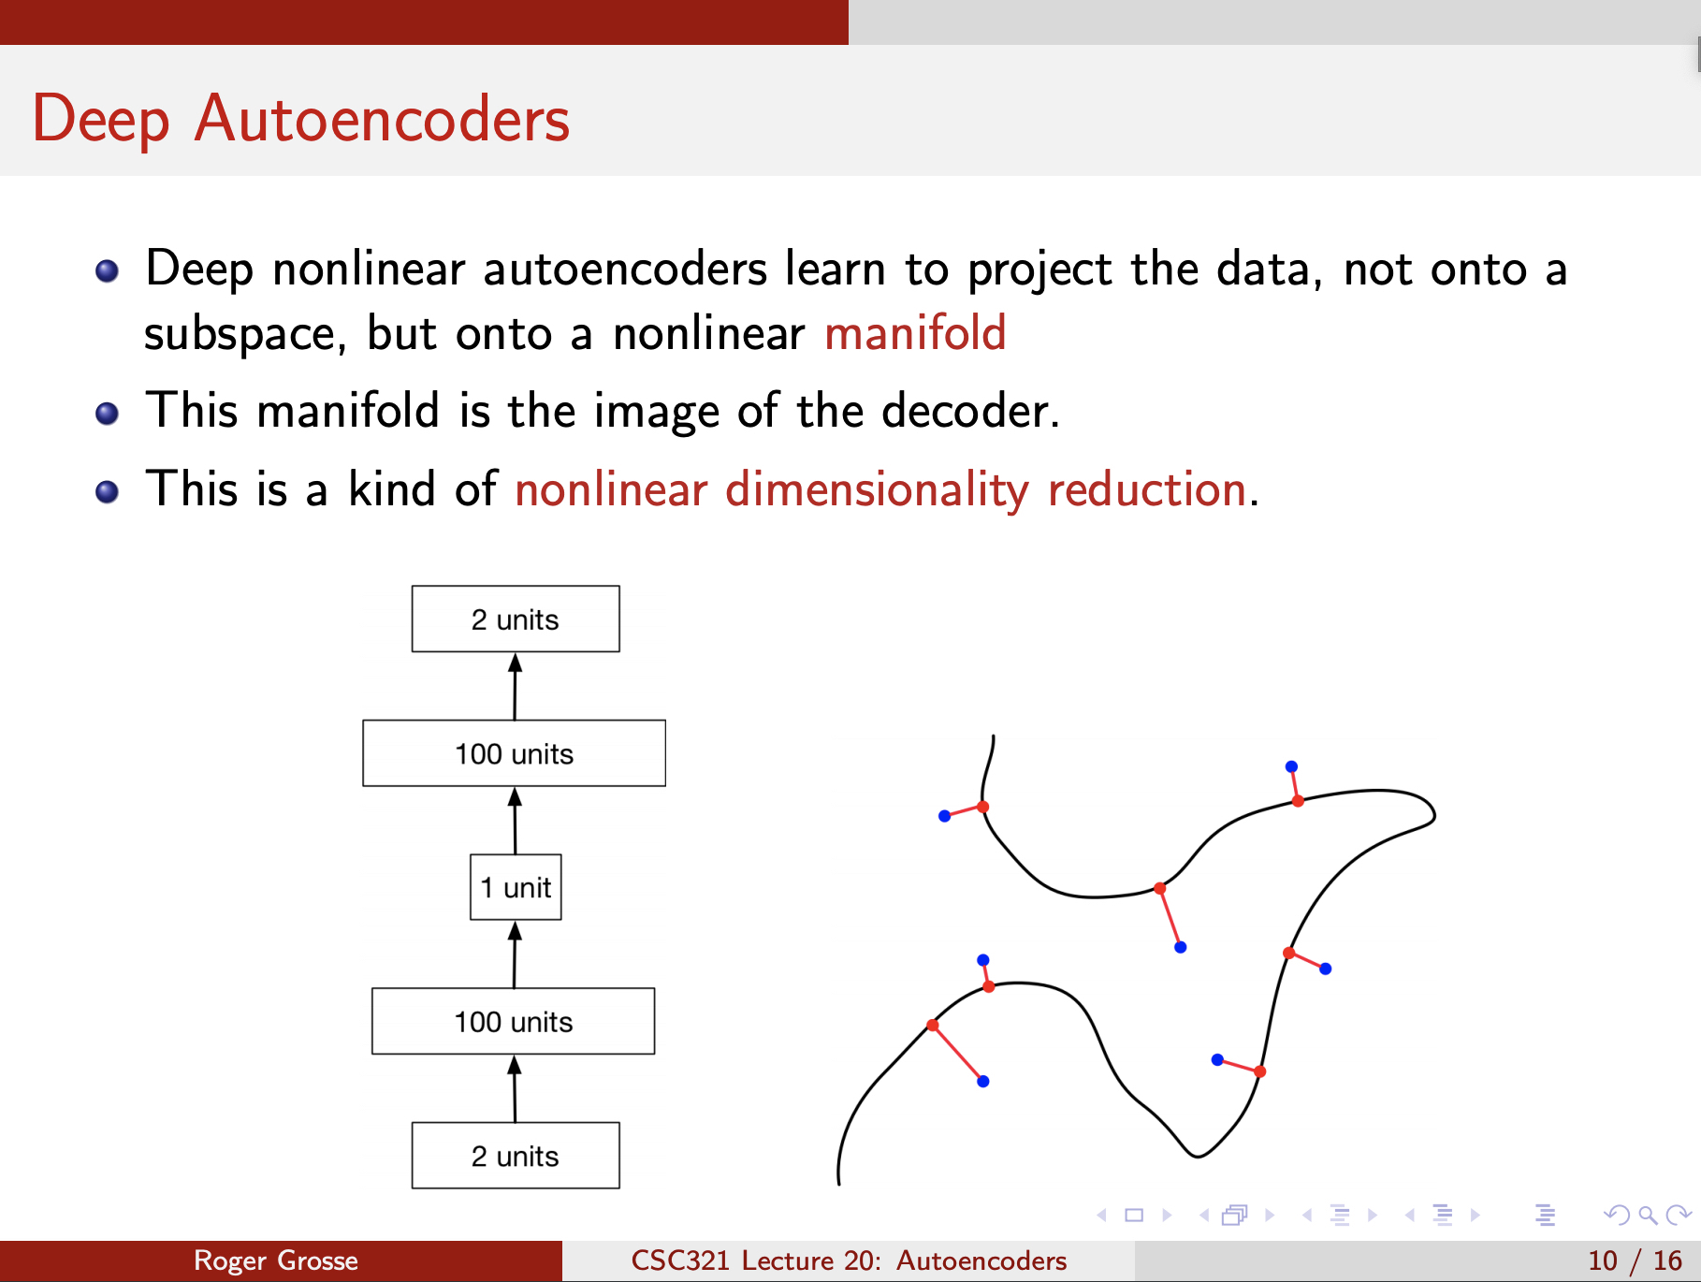

Slide 7
