Slide 1
PA8: what a strong deck looks like
A model deck on a practice story, beat by beat
Beat sheet · Teach · Warn · Show · Advise · Simulation · Q&A · ChatGPT rehearsal
Narration: AI-generated voice
Notes:
NARRATION:
This walkthrough shows what a strong PA8 deck looks like, one beat at a time.
It uses a practice story built from the four practice research questions in the PA7 walkthrough: should Neo sponsor local outdoor clubs?
Your team presents its own findings. The practice story only shows the moves.
SOURCES: PA8 brief · PA7_Excel_Walkthrough (reserved RQs W1–W4).

Slide 2
How to use this model
The practice story
Question: should Neo sponsor local outdoor clubs?
Built from the PA7 practice RQs (Q32, Q31, Q7)
It earns no credit: your deck uses your own findings
Reading the slides
Slides marked "Model deck" are what a team would show
Gold boxes are coach notes: delete them if you copy a layout
Every number comes from the posted data files
Order of work: beat sheet first, slides second, rehearsal third.
Notes:
NARRATION:
The practice story asks whether Neo should sponsor local outdoor clubs. It is built from the PA7 practice questions, so it earns no credit. Your deck uses your own findings.
Slides marked model deck are what a team would put on screen. The gold boxes are coach notes that explain why a slide works. If you copy a layout, delete the coach note.
Work in this order: the beat sheet first, then the slides, then the rehearsal.
SOURCES: PA8 brief, Steps 1–6.

Slide 3
Step 1: fill the beat sheet before any slides
Beat
Time
What's said (the takeaway, aloud)
Evidence
Teach
~3:00
Neo is deciding whether to sponsor outdoor clubs. We asked two samples
aytm n = 600 · class n = 205
Warn
~2:30
The class sample is friends and family. The gender gap holds nationally only
t-tests, both sources
Show
~5:00
Partnerships move few people. The few who respond are likelier to buy
means 3.08 / 3.19 · r 0.43 / 0.25
Advise
~1:30
A small club test, a quality-first message, any discount tested first
Q32, Q31
Simulation
~3:00
Add a screen-out check. Question a round that rewarded club sponsorship
113 of 318 class rows dropped
Coach note Write the takeaway sentence for each beat before you open slideware. If a beat has no evidence, it is not ready.
Notes:
NARRATION:
Step one is the beat sheet, in Appendix A of the submission template. Fill it before you open any slideware.
For each beat, write the sentence you will say aloud and the number that backs it.
Here the Teach beat says what Neo is deciding and which two samples answer it. Warn says what the data cannot claim. Show gives the two or three findings. Advise names what to do. Then the simulation recommendations.
The times add up to fifteen minutes. When a deck runs long, scale every beat down. Never cut a beat: teams that run long usually cut Warn, and that is the beat the client most needs.
SOURCES: PA8 template Appendix A (beat sheet with time budgets).

Slide 4
Should Neo sponsor outdoor clubs? Only as a small test
The decision
Neo is weighing outdoor-club sponsorships as a launch channel
Most homeowners say a partnership would not change their trust (mean 3.08 of 5 nationally)
Our advice: a small, measured test, led by a quality message
Coach note Open with the client's decision and your answer, in the title. Not "Our PA8 project".
Notes:
NARRATION:
Here is the model deck. The first slide opens with the client's decision and the answer, right in the title: should Neo sponsor outdoor clubs? Only as a small test.
Do not open with the course assignment or your team's name. A manager wants the decision and your answer in the first thirty seconds.
SOURCES: Model slide 1 · W1 mean (PA7 walkthrough).

Slide 5
Teach: two samples answered the same questions
aytm panel
Class survey
Coach note Methods in one minute at manager altitude: who, how many, how recruited. Keep the test names for the Q&A.
n (default sample)
600
205
Geography
National US
Mostly Southern California
Screening
Homeowners with outdoor space
Same rules applied at cleaning
Recruitment
Professional online panel
Friends, family and people we met
Notes:
NARRATION:
The Teach beat explains the method in about a minute, at manager altitude: who answered, how many, and how they were recruited.
A samples table does this quickly. Six hundred homeowners from a national panel, and two hundred five from the class survey, mostly Southern California, recruited through friends, family and people the team met.
Keep test names and formulas for the Q&A.
SOURCES: data notes · PA7 brief samples table.

Slide 6
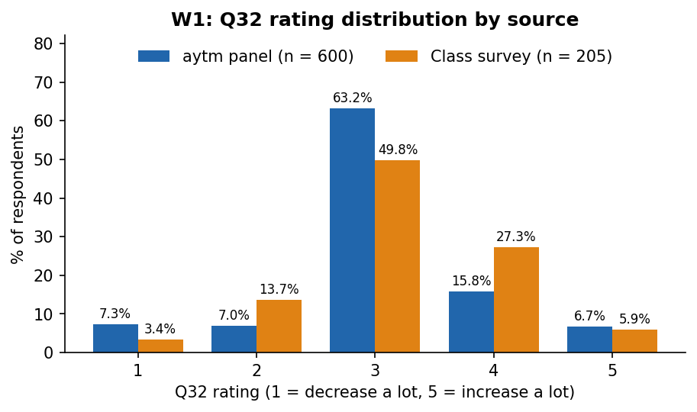
Show: club partnerships would change few homeowners' trust
Say aloud
Most answers sit at 3, no change
22.5% nationally and 33.2% in the class survey say trust would rise
Coach note The title is the takeaway. One chart, percents, both sources in the same colors.
Notes:
NARRATION:
The Show beat gives two or three findings, each as a chart with the takeaway in the title.
Finding one: club partnerships would change few homeowners' trust. Most answers sit at three, no change. Only 22.5% nationally and 33.2% in the class survey say their trust would rise.
Notice the chart: percents, not counts, and the same colors for the two sources on every slide.
SOURCES: PA7 walkthrough W1 (Q32), workbook sheet 3.

Slide 7
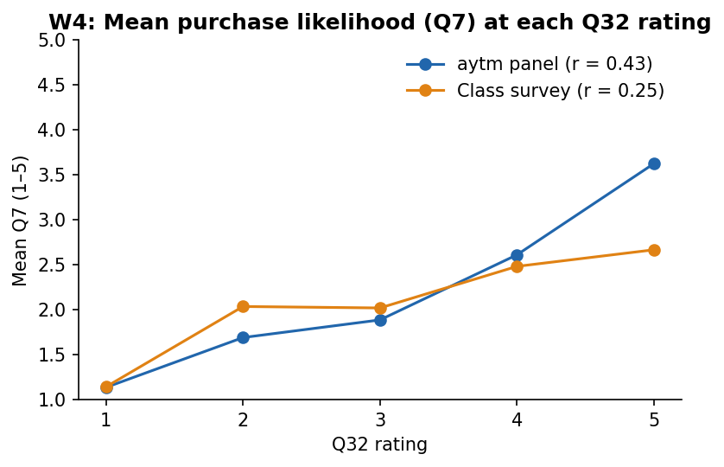
Show: those whose trust rises are likelier to buy
Say aloud
r = 0.43 nationally, 0.25 in the class survey
They move together. That does not show the partnership causes the purchase
Coach note Name the statistic once, then say what it means for the client.
Notes:
NARRATION:
Finding two: the homeowners whose trust would rise are also likelier to buy. The correlation is 0.43 nationally and 0.25 in the class survey.
Say the statistic once, then what it means: partnerships may help reach people who are already leaning toward buying. And be careful with the wording: the two answers move together, which does not show that a partnership causes a purchase.
SOURCES: PA7 walkthrough W4 (Q32 × Q7), workbook sheet 6.

Slide 8
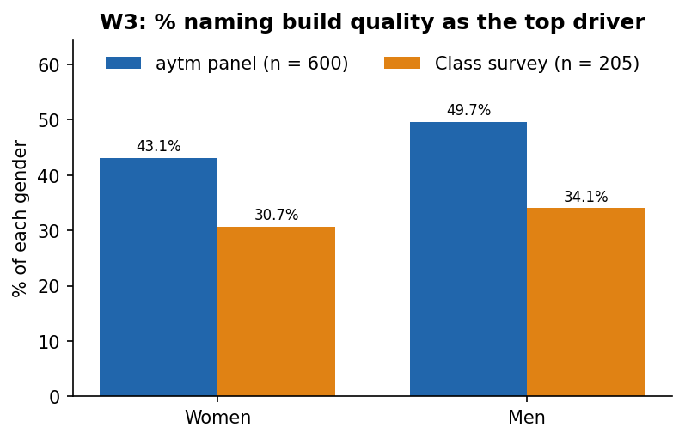
Show: build quality leads for women and men alike
Say aloud
Nationally 43.1% of women and 49.7% of men name build quality first
No significant gender difference in either source
Coach note A null result is still a finding when it changes what the client does: one message for everyone.
Notes:
NARRATION:
Finding three: build quality is the top value driver for women and men alike. Nationally, 43.1% of women and 49.7% of men name it first, and the chi-square shows no significant difference in either source.
A non-significant result is still worth a slide when it changes what the client does. Here it means one quality message can serve the whole market.
SOURCES: PA7 walkthrough W3 (gender × Q31), workbook sheet 5.

Slide 9
Warn: what these data cannot tell Neo
Limits
The class sample reached friends and family of students: it is not a random SoCal sample
Stated trust is not behavior: nobody saw a real sponsorship
A correlation does not show cause
Where the sources disagree
More class respondents say trust would rise (33.2% vs. 22.5%)
Men rate partnerships higher nationally only
Coach note Warn is the beat teams cut when they run long. Keep it: it is why the client can trust the rest.
Notes:
NARRATION:
The Warn beat tells the client what the data cannot claim. The class sample reached friends and family of students, so it is not a random Southern California sample. Stated trust is not behavior, because nobody saw a real sponsorship. And a correlation does not show cause.
Then say where the sources disagree. More class respondents say their trust would rise, and the gender gap appears only in the national panel.
Teams that run long cut this beat first. Keep it: it is the reason the client can trust everything else you say.
SOURCES: PA7 walkthrough Step 5 · W2 t-tests.

Slide 10
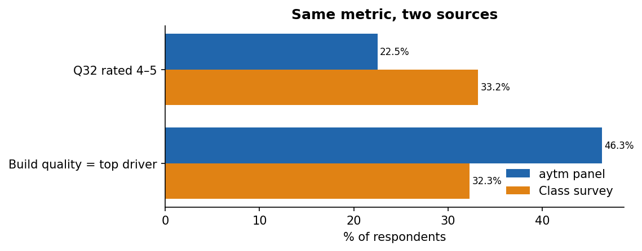
Source comparison: the mean agrees, the share does not
Implication
Act on the shared finding: partnerships move few people
Treat the higher SoCal share as a lead to test, not a fact
Metric
aytm
Class
Same?
Mean Q32 (1–5)
3.08
3.19
Yes
Coach note Call out one convergence and one divergence by number, then say what each means for trust in the finding.
% rating 4–5
22.5%
33.2%
No
Notes:
NARRATION:
Give the source comparison its own slide. Show the same metric from both sources, one convergence and one divergence, each by number.
The mean rating agrees, about three in both. The share rating four or five does not: 22.5% nationally against 33.2% in the class survey.
Then the implication. Neo can act on the shared finding, that partnerships move few people. The higher Southern California share is a lead to test, not a fact, because of who the class sample reached.
SOURCES: PA7 walkthrough 7_Compare · PA8 brief step 3.

Slide 11
Advise: a small club test, led by quality
Decision
Recommendation
Traced to
Segment
Homeowners who say a club partnership would raise their trust (4–5)
They are likelier to buy: r = 0.43 (Q32 × Q7)
Concept
Quality-first message for everyone
Build quality first for 43.1% / 49.7%
Price stance
No sponsor discount until the test shows one pays off
No RQ measured a discount, and partnerships move trust little (mean 3.08)
Channel
Club events as a small test channel, measured by leads
22.5% / 33.2% say trust rises
Coach note Each row names a decision and the number behind it. The budget size of the test is a judgment: say so.
Notes:
NARRATION:
The Advise beat names four things: a segment, a concept, a price stance and a channel. Each one traces to a number you already showed.
Segment: the homeowners who say a club partnership would raise their trust, because they are also likelier to buy.
Concept: a quality-first message for everyone, because build quality leads for women and men.
Price stance: no sponsor discount until the club test shows one pays off. Partnerships move trust very little, and no research question measured a discount, so the honest stance is to test it first.
Channel: club events as a small test, measured by leads.
How big the test should be is a judgment, not a finding. Say so out loud.
SOURCES: PA8 brief Content criterion (segment, concept, price stance, channel).

Slide 12
Improve the simulation: two evidence-backed fixes
Lane A: feedback the real data contradicts
If a round rewarded club sponsorship as the best channel, cite Q32
Only 22.5% nationally say a partnership raises trust
Fix: score that choice against the real share
Lane B: a check the simulation never taught
Screen out respondents who cannot use the product before analysis
In the class survey, 113 of 318 rows failed the outdoor-space or attention check
Fix: add a screen-out step to the analysis round
Coach note One recommendation per lane is enough. Each names the finding behind it.
Notes:
NARRATION:
Part two improves the simulation, with one recommendation in each lane.
Lane A: a round whose feedback the real data contradicts. For example, if a round rewarded club sponsorship as the best channel, cite Q32: only 22.5% nationally say a partnership would raise their trust.
Lane B: a check the simulation never taught. In the class survey, one hundred thirteen of three hundred eighteen rows failed the outdoor-space or attention check, so the analysis round should teach that screen-out step.
One recommendation per lane is enough, as long as each one names the finding behind it.
SOURCES: PA8 brief Part 3 · data notes (Analysis_Sample: 205 of 318 kept).

Slide 13
Q&A backup: the n behind every chart
Chart
Test
aytm n
Class n
Q32 distribution
Descriptive
600
205
Q32 × Q7
Pearson r
600
205
Build quality × gender
Chi-square
600
192
Q32 by gender
t-test
600
192
Coach note A backup slide after the close. Not presented, but it lets every member answer "what was the n?" in seconds.
Notes:
NARRATION:
Last, a backup slide after your closing slide. You do not present it, but it lists the test and the n behind every chart, so anyone on the team can answer "what was the n?" in seconds.
Notice that the gender charts use fewer class respondents, because the two-group tests leave out people who answered non-binary or prefer not to say.
SOURCES: PA7 walkthrough workbook sheets 3–6.

Slide 14
Rehearse with ChatGPT
After your own draft: let it play the client, then check your numbers
Notes:
NARRATION:
Once your team has drafted the beat sheet and the slides yourselves, ChatGPT is useful for two rehearsal jobs: playing the client in the Q&A, and checking that your numbers agree from slide to slide.
Use the Instant setting. Upload your deck as a PDF.
SOURCES: PA8 brief AI reflection block (human first).

Slide 15
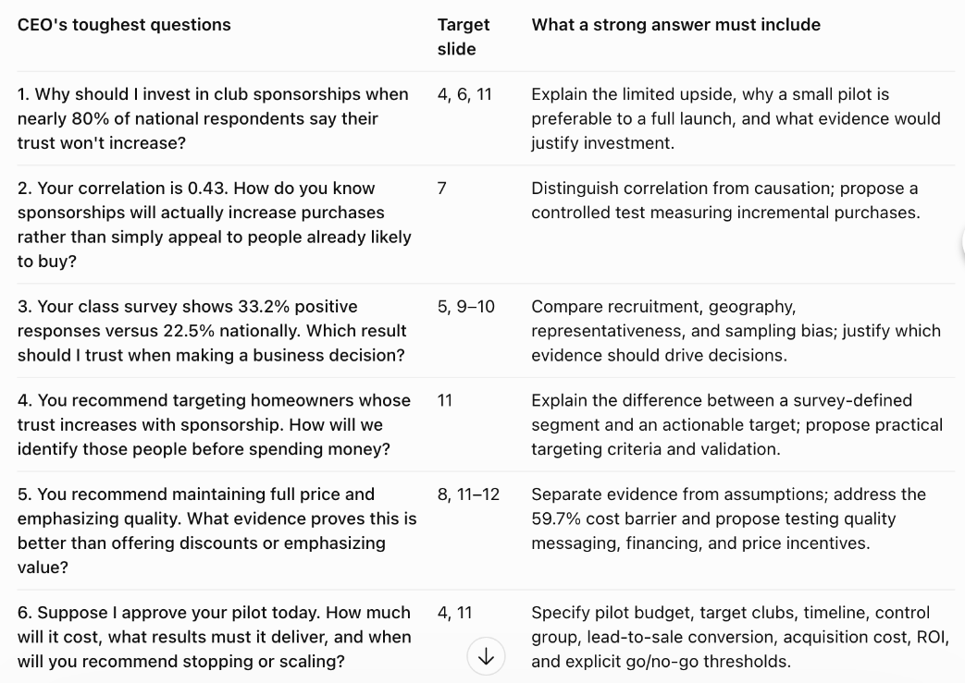
Prompt 1: let it play the CEO in the Q&A
What to ask
You are Neo's CEO. Here is our deck
The six hardest Q&A questions
One table: question, slide, what a strong answer needs
Assign each question to a team member and rehearse the answer out loud.
Notes:
NARRATION:
Prompt one: ask ChatGPT to play Neo's CEO. Upload the deck and ask for the six hardest questions it would ask in the Q&A, in one table, with the slide each one targets and what a strong answer must include.
On this model deck it asked, for example, why invest in sponsorships when nearly eighty percent say their trust would not rise, and how a correlation of point four three shows that sponsorships increase purchases.
Give each question to one team member, and rehearse the answers out loud. That is your Q&A preparation.
SOURCES: ChatGPT screenshot 2026-11-04 (Instant, model deck PDF uploaded).

Slide 16
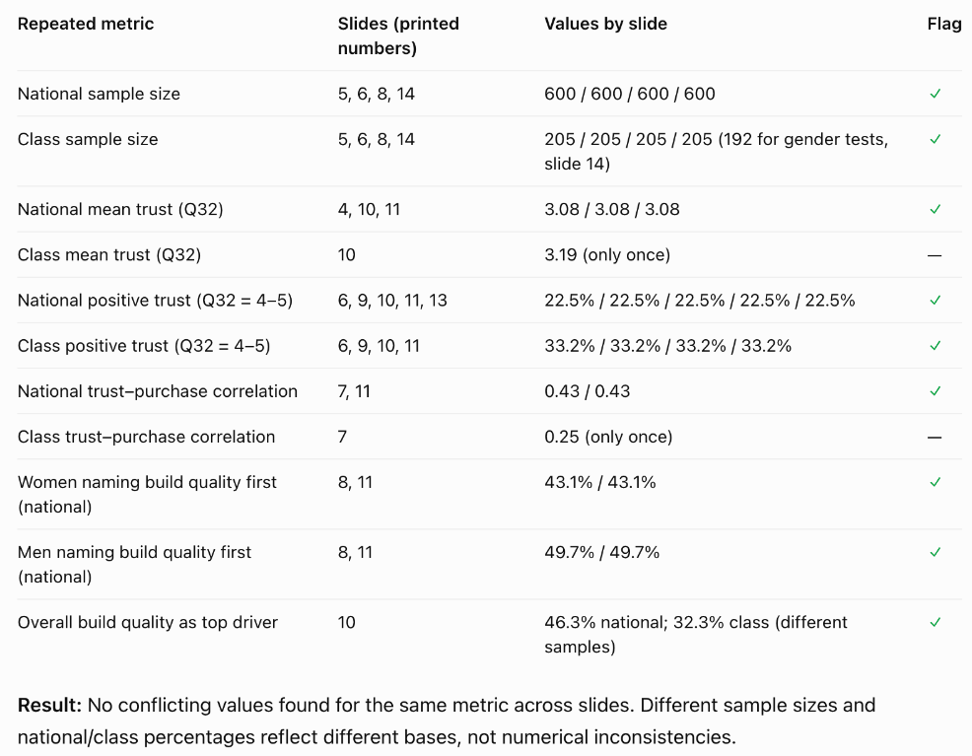
Prompt 2: check that your numbers agree across slides
What to ask
A consistency check, no advice
Every number on more than one slide, with its values
Flag any number with two different values
Then check one flagged or key number yourself against your PA7 results.
Notes:
NARRATION:
Prompt two is a consistency check. Ask for every number that appears on more than one slide, with its value on each slide, and ask it to flag any number that shows two different values.
On the model deck every repeated number matched. In a real team deck, written by several people, this is where mismatched numbers turn up.
ChatGPT can still misread a slide, so check one key number yourself against your PA7 results. And keep the chat: it goes into your AI transcript and your reflection.
SOURCES: ChatGPT screenshot 2026-11-04 (Instant).

Slide 17
Rehearse the talk, then the Q&A
Talk
Time two full run-throughs and aim for 14–16 minutes
Every member presents a beat
Practise the handoffs: name the next speaker and the topic
Say the takeaway, then point at the chart
Q&A
Each member can go one level deeper: the n, why that test, why this recommendation
Keep the backup slide open
If you do not know, say what you would check
Notes:
NARRATION:
Rehearse twice, out loud, with a timer. Aim for fourteen to sixteen minutes. Every member presents a beat, and you practise the handoffs, naming the next speaker and the topic.
For the Q&A, every member should be able to go one level deeper than the slides: the n behind a chart, why that test, why this recommendation over the alternative. If you do not know an answer, say what you would check. That is a strong answer too.
SOURCES: PA8 brief step 6 · rubric criterion 3.

Slide 18
How PA8 is graded: three criteria
Criterion
Weight
Full credit
1. Tell Neo what to do, backed by the data
50%
All beats timed · findings with numbers · source comparison · segment, concept, price, channel
2. Improve the simulation + Process & AI reflection
25%
One fix per lane, traced to evidence · beat sheet before AI · four reflection prompts
3. Slides and delivery
25%
≤ 14 legible slides · 14–16 min, everyone presents · Q&A one level deeper
Each item is scored full, partial or missing. Use the model for the moves and build the deck from your own findings.
Notes:
NARRATION:
PA8 has three criteria. Fifty percent for telling Neo what to do, backed by the data. Twenty-five percent for improving the simulation and your process and AI reflection. And twenty-five percent for slides and delivery.
Each item is scored full, partial or missing. Use this model for the moves, and build your deck from your own findings. Good luck.
SOURCES: PA8 brief, How you'll be graded · _grading/PA8_Instructor_Rubric_FA26.md.

