Slide 1
Pemrograman jaringan
Prodi s1 Teknik informatika
Institut teknologi sepuluh nopember

Slide 2
outline
HTTP
URI
Ilustrasi
GET
POST
HEAD

Slide 3
HTTP 1.1
HyperText Transfer Protocol
RFC (Request For Comments) 2616
https://tools.ietf.org/html/rfc2616
RFC 2068 → RFC 2616
RFC 2616
Updated by: 2817, 5785, 6266, 6585
Obsoleted by: 7230, 7231, 7232, 7233, 7234, 7235

Slide 4
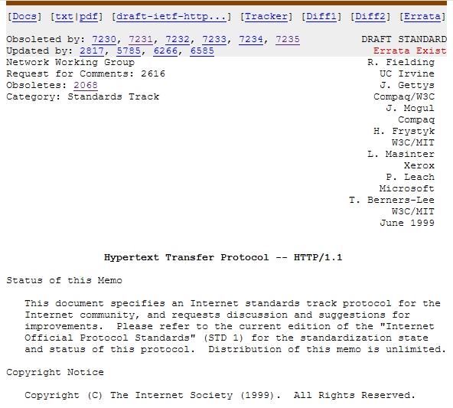
RFC 2616

Slide 5
HTTP 2
This specification is an alternative to, but does not obsolete, the HTTP/1.1 message syntax. HTTP's existing semantics remain unchanged.
https://tools.ietf.org/html/rfc7540
Key goal: decreased delay in multi-object HTTP requests
Divide objects into frames, schedule frames to mitigate HOL blocking

Slide 6
Http 3
HTTP/3 uses QUIC, a multiplexed transport protocol built on UDP.
HTTP/3 uses similar semantics compared to earlier revisions of HTTP
HTTP/3 has lower latency and loads more quickly in real-world usage when compared with previous versions

Slide 7
URI
URI: Uniform Resource Identifier
URL: Uniform Resource Locator
URN: Uniform Resource Name
Analogi
URL: alamat orang
URN: nama orang
Contoh:
URI: http://www.progjar.org/wiki/tugas.txt
URL: http://www.progjar.org
URN: /wiki/tugas.txt

Slide 8
Ilustrasi HTTP
HTTP Klien
ex: Chrome
HTTP Request
HTTP Server
ex: Nginx
HTTP Response

Slide 9
Ilustrasi HTTP
HTTP Request line
HTTP Request header
HTTP Request body (POST)
HTTP Klien
ex: Chrome
HTTP Request
HTTP Server
ex: Nginx
HTTP Response
Status line
HTTP Response header
HTTP Response content
Content: html, css, js

Slide 10
Memeriksa Komunikasi HTTP
Inspect element di browser
Tools pada web browser untuk debugging suatu halaman web
Inspect element → Network

Slide 11
HTTP Header
Request
HTTP Request line
HTTP Request header
Response
Status line
HTTP Response header
HTTP Response content
Header dan content dipisahkan dengan satu baris kosong

Slide 12
HTTP Header
Terdapat dua HTTP header:
HTTP request header
HTTP response header
Berbagai field yang ada di HTTP header
http://en.wikipedia.org/wiki/List_of_HTTP_header_fields

Slide 13
HTTP Request Header
Path
Method
Protocol
HTTP request line
GET / HTTP/1.1
Host: www.its.ac.id
User-Agent: Mozilla/5.0 (Macintosh; Intel Mac OS X 10.15; rv:109.0) Gecko/20100101 Firefox/110.0
Accept: text/html,application/xhtml+xml,application/xml;q=0.9,image/avif,image/webp,*/*;q=0.8
Accept-Language: en-US,en;q=0.5
Accept-Encoding: gzip, deflate, br
Connection: keep-alive
Cookie: _ga=GA1.3.1553611766.1631318143; pll_language=en; _ga_VFMVENFZYE=
Upgrade-Insecure-Requests: 1
HTTP request header as {name: value}

Slide 14
HTTP Request Header
Host
Alamat server tujuan
User-agent
Nama dan versi browser
Nama dan versi sistem operasi
Bahasa yang digunakan
Accept-Language
Bahasa yang digunakan client
Accept-encoding
Kompresi yang digunakan

Slide 15
Content Negotiation
Determine both what file format will be selected to represent a given resource
What encoding will be used to turn text code points into bytes.
The types and languages listed first have the strongest preference value of 1.0, while the ones that are listed later in the header are often demoted to q=0.9 or q=0.8

Slide 16
Content Type
Content types are selected from among the various MIME types that were already established for multimedia that is transmitted as part of e-mail messages
The types text/plain and text/html are both common along with image formats such as image/gif, image/jpg, and image/png.
Documents can be delivered as types including application/pdf.

Slide 17
HTTP Response Header
Status code
Protocol
Status line
HTTP/1.1 200 OK
Server: nginx/1.10.3
Date: Sun, 12 Mar 2023 05:30:09 GMT
Content-Type: text/html; charset=UTF-8
Content-Length: 18085
Connection: keep-alive
Link: <https://www.its.ac.id/wp-json/>; rel="https://api.w.org/"
Link: <https://www.its.ac.id/wp-json/wp/v2/pages/31459>; rel="alternate"; type="application/json"
Link: <https://www.its.ac.id/>; rel=shortlink
Vary: Accept-Encoding
Content-Encoding: gzip
HTTP response header as {name: value}

Slide 18
HTTP Response Header
Content-type
Tipe MIME-type (Multipurpose Internet Mail Extensions)
Content-length
Panjang data yang akan dikirim (dalam bytes)
Last-Modified
Waktu terakhir modifikasi dokumen
Content-encoding
Kompresi yang digunakan

Slide 19
HTTP Request Method
GET: Metode untuk meminta data dari server
POST: Metode untuk mengirim data ke server
HEAD: Metode untuk meminta response header saja

Slide 20
HTTP Status Code
Terdapat 4 kelompok status:
20x: apabila request dapat terpenuhi
30x: untuk redirection
40x: jika ada masalah pada request atau client
50x: jika ada masalah pada response atau server
http://en.wikipedia.org/wiki/List_of_HTTP_status_codes

Slide 21
Contoh Status Code
200 OK
301 Moved Permanently
403 Forbidden
404 Not Found
500 Internal Server Error
503 Service Unavailable

Slide 22
HTTP di Python
Socket biasa
Library
http.client, http.server
requests
urllib3
urllib, urllib.request, urllib.parse

Slide 23
HTML Parser
HTTP Klien
ex: Chrome
HTTP Request
HTTP Server
ex: Nginx
HTTP Response
Status line
HTTP Response header
HTTP Response content
Content: html, css, js → Harus diparser agar menghasilkan tampilan yang baik

Slide 24
HTML Parser
Beautiful Soup
https://www.crummy.com/software/BeautifulSoup/bs4/doc/
HTMLParser
https://docs.python.org/3/library/html.parser.html
request-html
https://github.com/psf/requests-html

Slide 25
data = sock.recv(4096)
print('data:', data)
if data:
data = data.decode('utf-8')
request_header = data.split('\r\n')
print('request header:', request_header)
request_file = request_header[0].split()[1]
response_header = b''
response_data = b''
if request_file == 'index.html' or request_file == '/' or request_file == '/index.html':
f = open('index.html', 'r')
response_data = f.read()
f.close()
content_length = len(response_data)
response_header = 'HTTP/1.1 200 OK\r\nContent-Type: text/html; charset=UTF-8\r\nContent-Length:' \
+ str(content_length) + '\r\n\r\n'
sock.sendall(response_header.encode('utf-8') + response_data.encode('utf-8'))
else:
sock.sendall(b'HTTP/1.1 404 Not found\r\n\r\n')
Memproses header
Memproses konten
yang akan dikirim

Slide 26
Modul requests
>>> import requests
>>> r = requests.get('https://api.github.com/user', auth=('user', 'pass’))
>>> r.status_code
200
>>> r.headers['content-type']
'application/json; charset=utf8’
>>> r.encoding
'utf-8’
>>> r.text
'{"type":"User"...’
>>> r.json()
{'private_gists': 419, 'total_private_repos': 77, ...}
Melakukan request ke server
Tinggal mengambil responnya

Slide 27
Contoh program
https://github.com/studiawan/network-programming/tree/master/bab05
Python requests
https://requests.readthedocs.io/en/latest/
https://github.com/psf/requests
Website untuk mempelajari protokol HTTP: http://httpbin.org

