Slide 1

Network Programming
Department of Informatics
ITS

Slide 2
Outlines
XML Formats
Understanding RPC
XML-RPC
Example implementation of XML-RPC
JSON-RPC

Slide 3
XML Formats
eXtensible Markup Language
Format data with certain tags
Designed for sending data, not displaying data

Slide 4
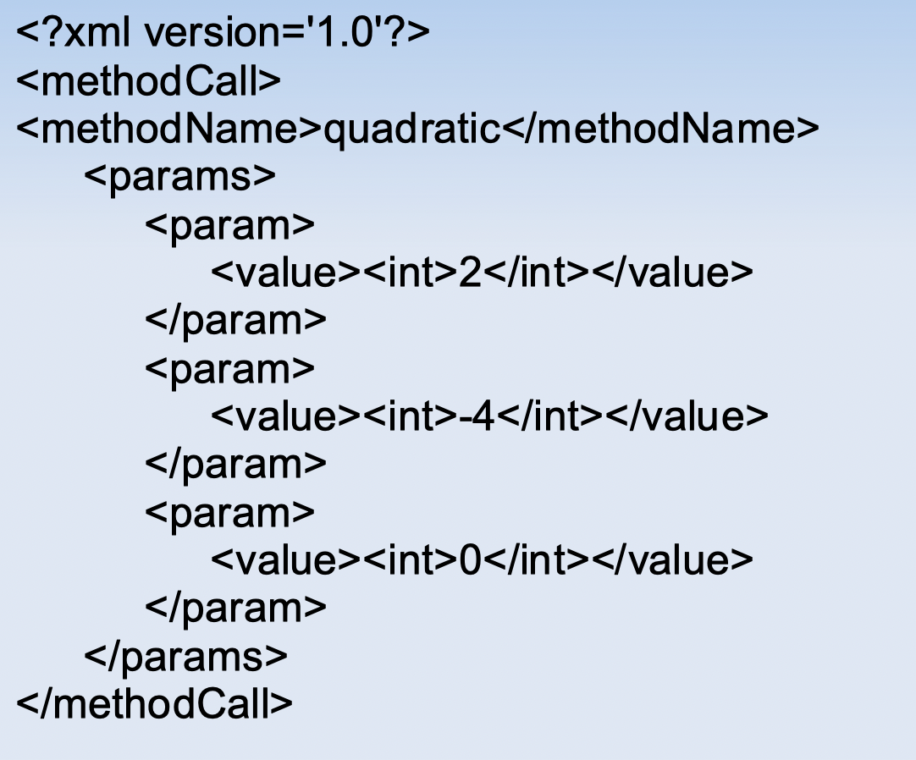
Example of XML format

Slide 5
RPC
Remote Procedure Call
Calling a function or procedure on another computer
Calling a function is similar to calling a function on the local computer

Slide 6
Why RPC?
Reducing the load on a single computer
Requires data from another computer that doesn't belong on the local computer

Slide 7
XML-RPC
eXtensible Markup Language – Remote Procedure Call
A way to:
Calling a procedure or function that resides on another computer
Using XML as data sent via HTTP protocol

Slide 8
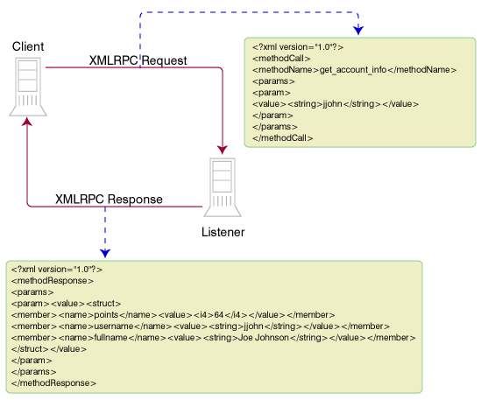
XML-RPC

Slide 9
Supported Data Types
ints;
floats;
strings;
list;
dict;
datetime

Slide 10
Case study
https://grpc.io/showcase/
File system calls
Microservice architecture of an e-commerce
Multiplayer gaming platform

Slide 11
RPC JSONs
JSON: JavaScript Object Notation
JSON-RPC is a remote procedure call (RPC) protocol encoded in JSON.
It is a light-weight protocol that allows for communications between a client and a server.
It's designed to be simple and stateless, with no restrictions on the structure of the data that's sent and received.

Slide 12
RPC JSONs
JSON-RPC is transport agnostic, which means it can be used over different transports like:
HTTP, or
TCP sockets.
This makes it versatile and adaptable to different kinds of networked applications.

Slide 13
Python JSON RPC
jsonrpc
https://json-rpc.readthedocs.io/en/latest/quickstart.html
tinyrpc
https://tinyrpc.readthedocs.io/en/latest/

Slide 14
Example XML-RPC
Libraries used:
https://docs.python.org/3/library/xmlrpc.html,
https://grpc.io/docs/languages/python/quickstart/

Slide 15
Example
https://docs.python.org/3/library/xmlrpc.html
https://github.com/brandon-rhodes/fopnp/tree/m/py3/chapter18
https://github.com/studiawan/network-programming/tree/master/bab09

