Slide 1
Find the Head of Airplane
IPD-final-project
Yufei Liu

Slide 2
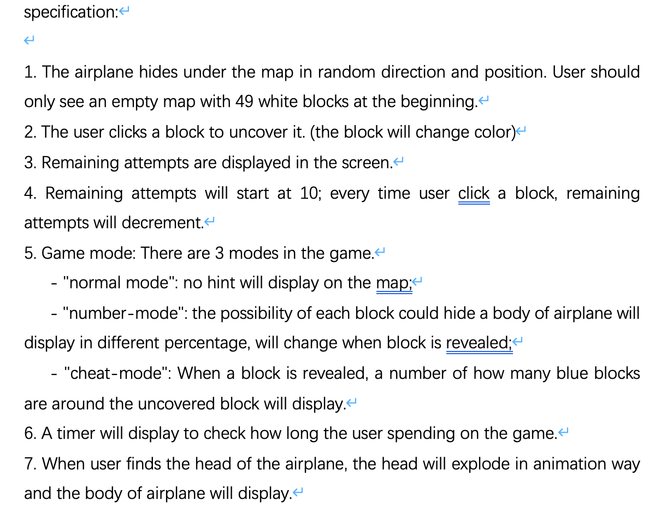

Slide 3

Data definitions

Slide 4
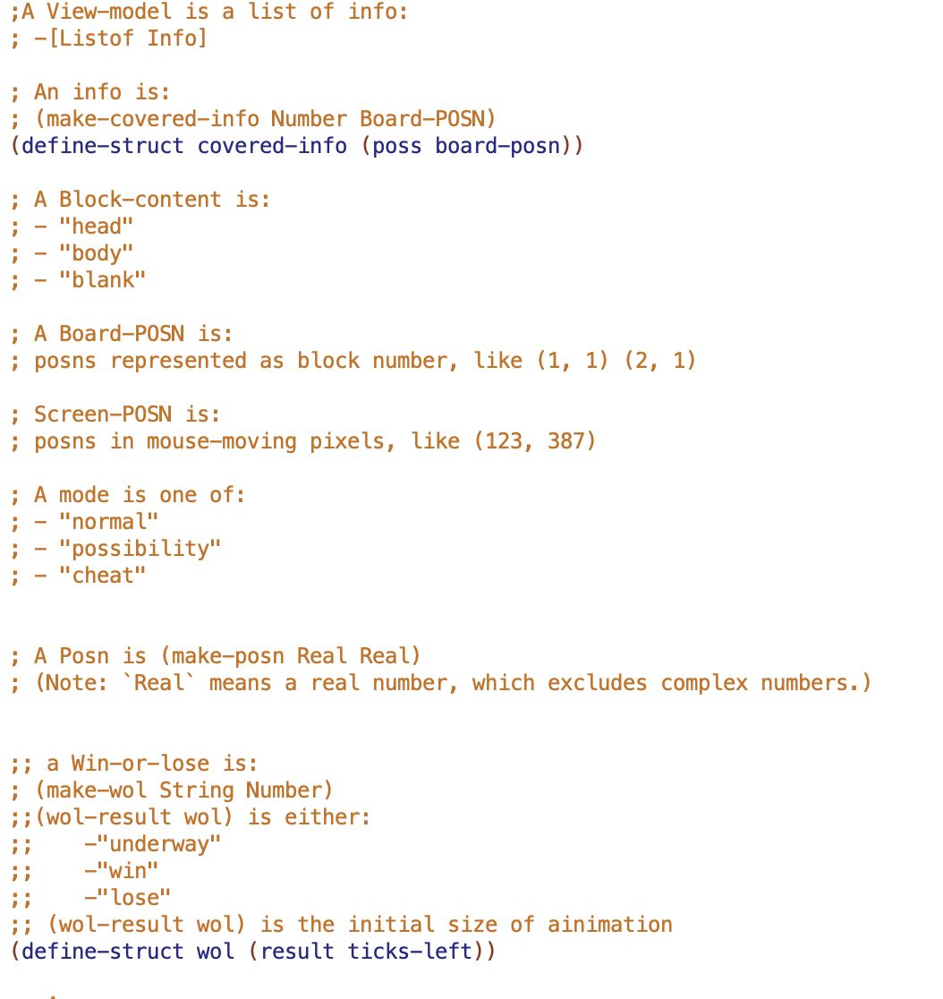

Slide 5
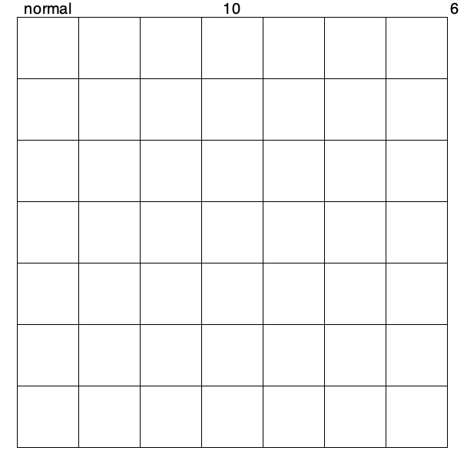
Initial map

Slide 6
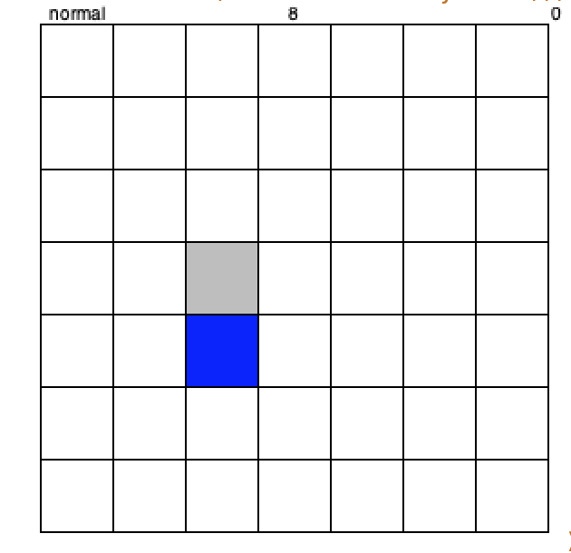
Normal mode

Slide 7
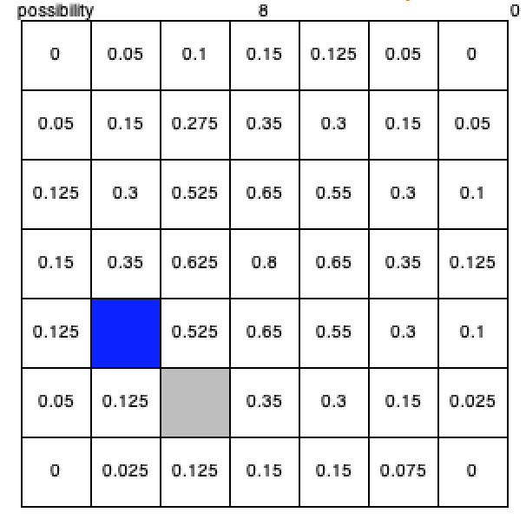
Possibility mode

Slide 8
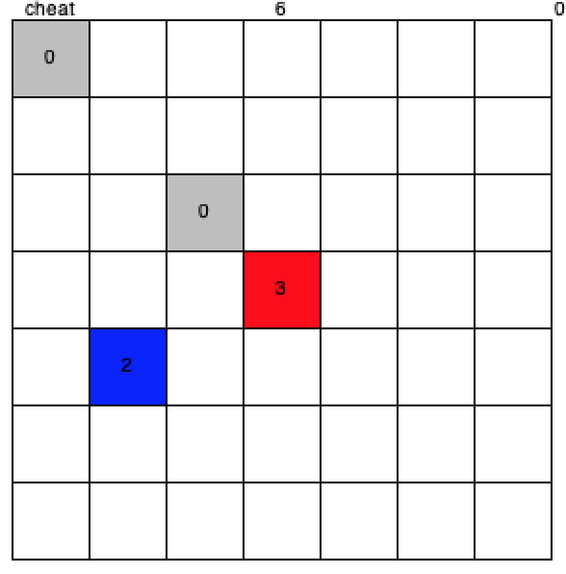
Cheat mode

Slide 9
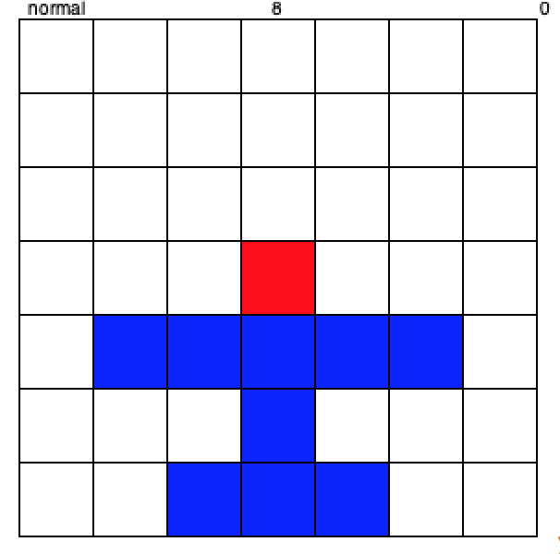
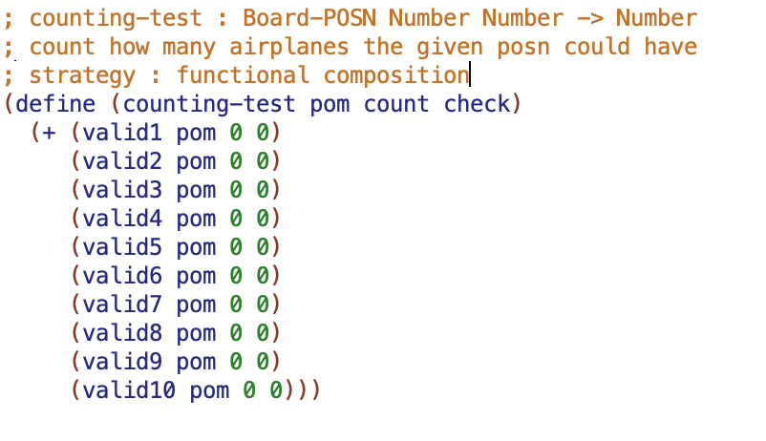
Calculate the possibility
Calculate the total number of the given block that it could hide a part of airplane

Slide 10
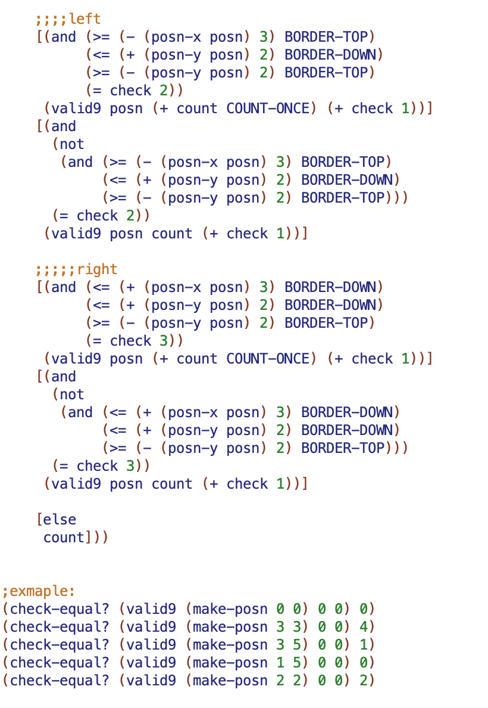
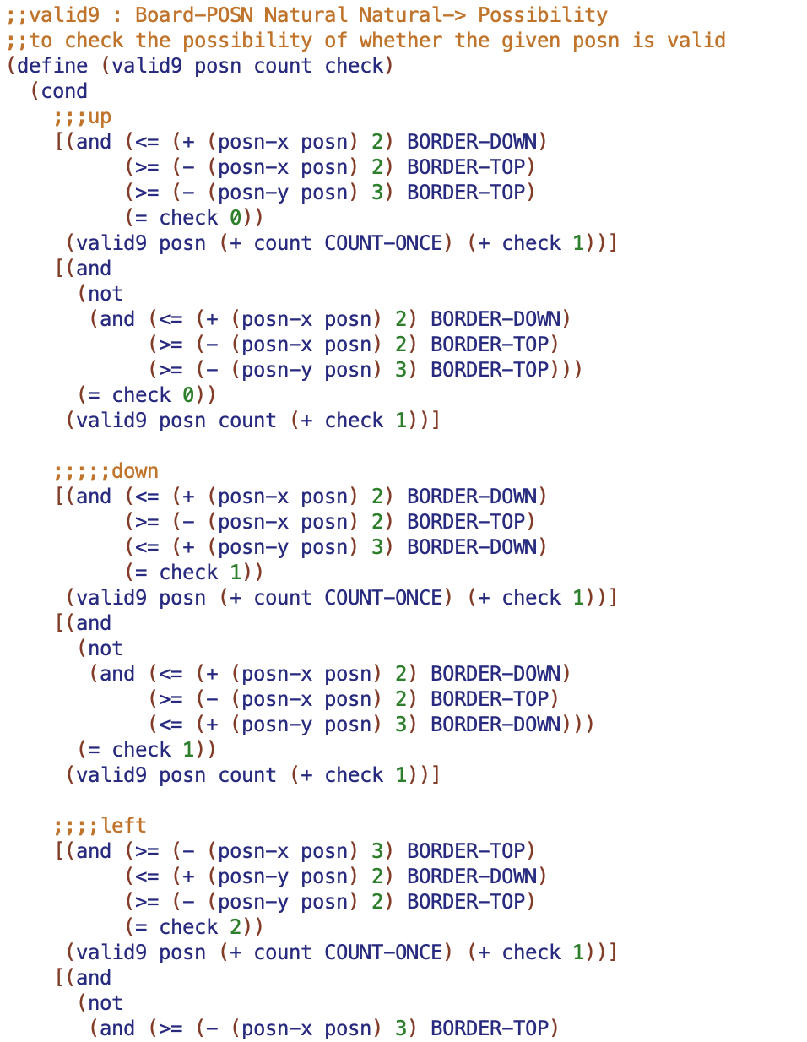

Slide 11


Slide 12
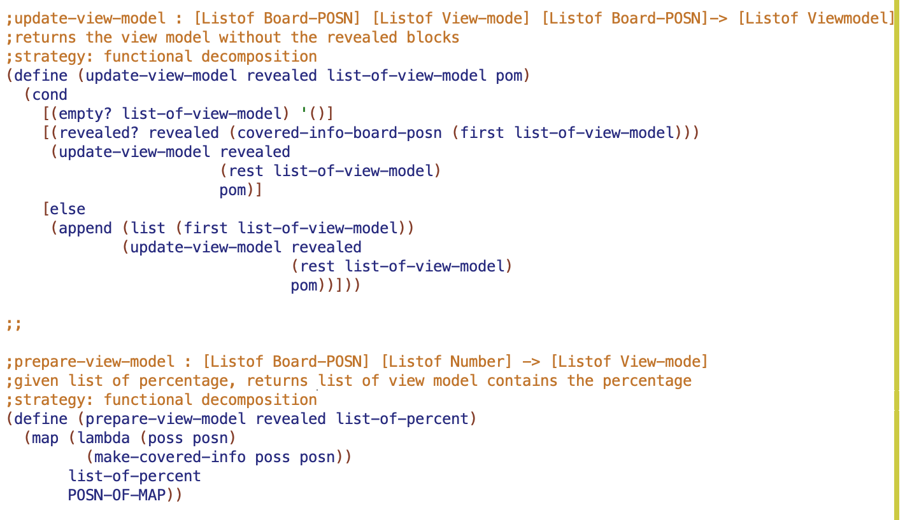
Create view model

Slide 13

Definition of view model

Slide 14
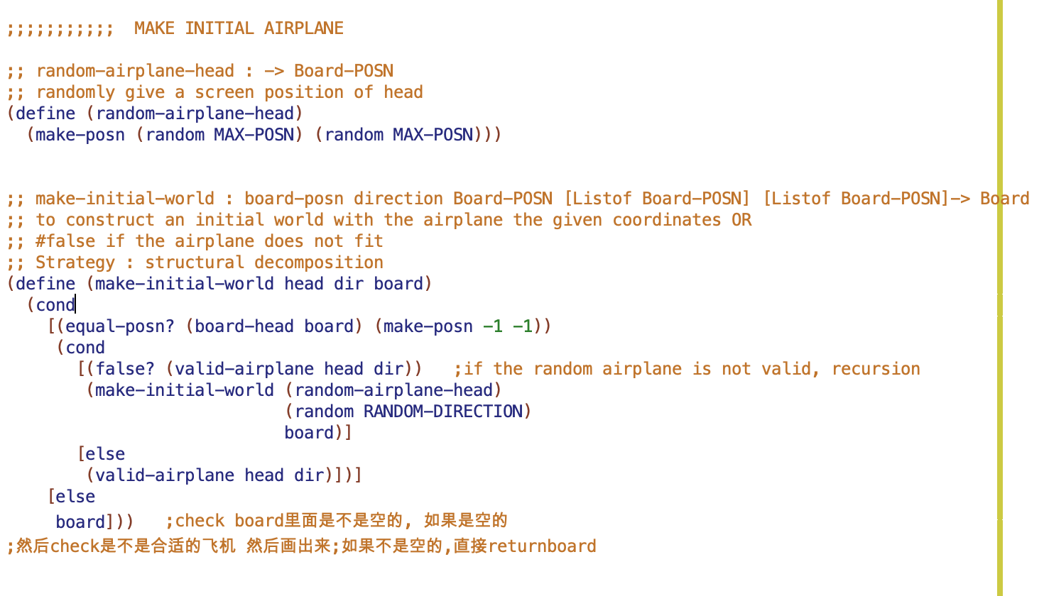
Make initial airplane

Slide 15
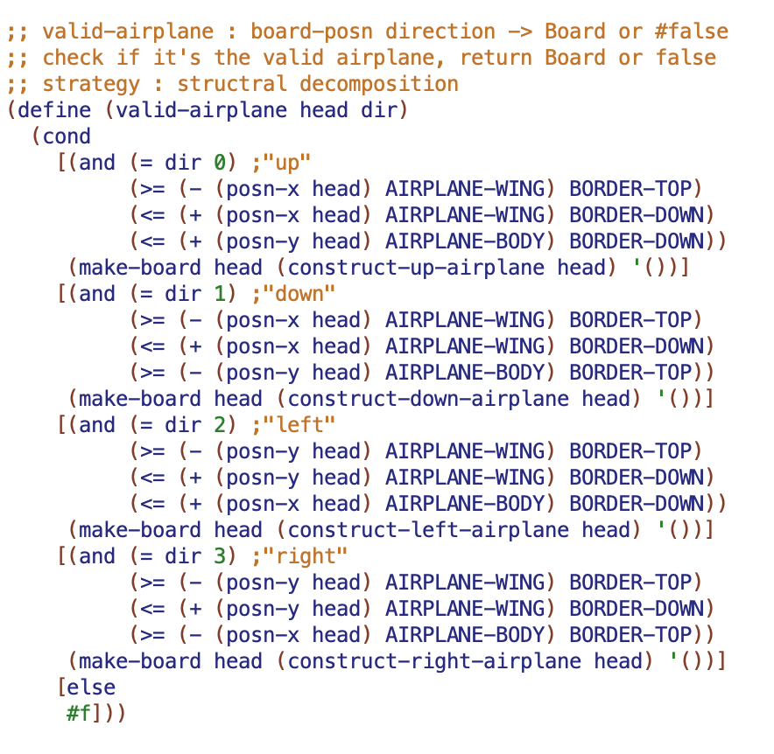
Check if the random airplane is valid

Slide 16
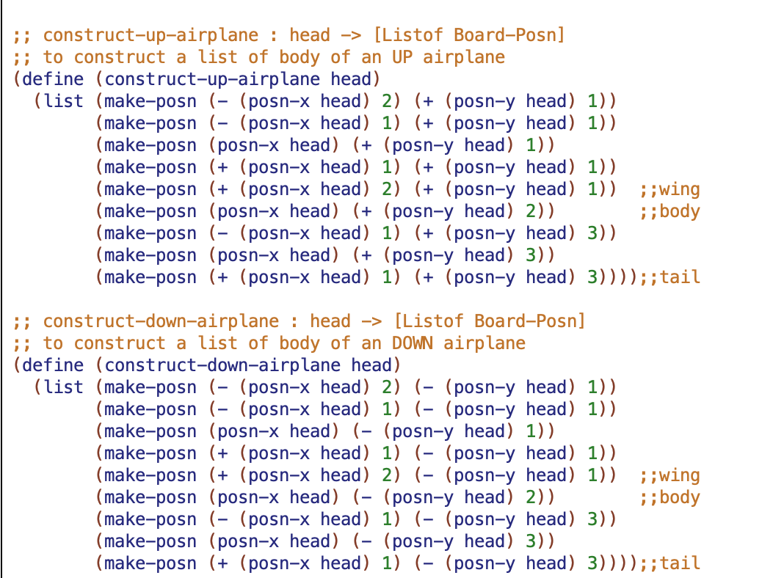
Construct an airplane

Slide 17
Thank you for watching☺️

