Slide 1
ECE 417 Lecture 2: Metric (=Norm) Learning
Mark Hasegawa-Johnson
8/31/2017

Slide 2
Today’s Lecture
Similarity and Dissimilarity of vectors: all you need is a norm
Example: the Minkowski Norm (Lp norm)
Cosine Similarity: you need a dot product
Example: Diagonal Mahalanobis Distance
What is Similarity?
Metric Learning

Slide 3
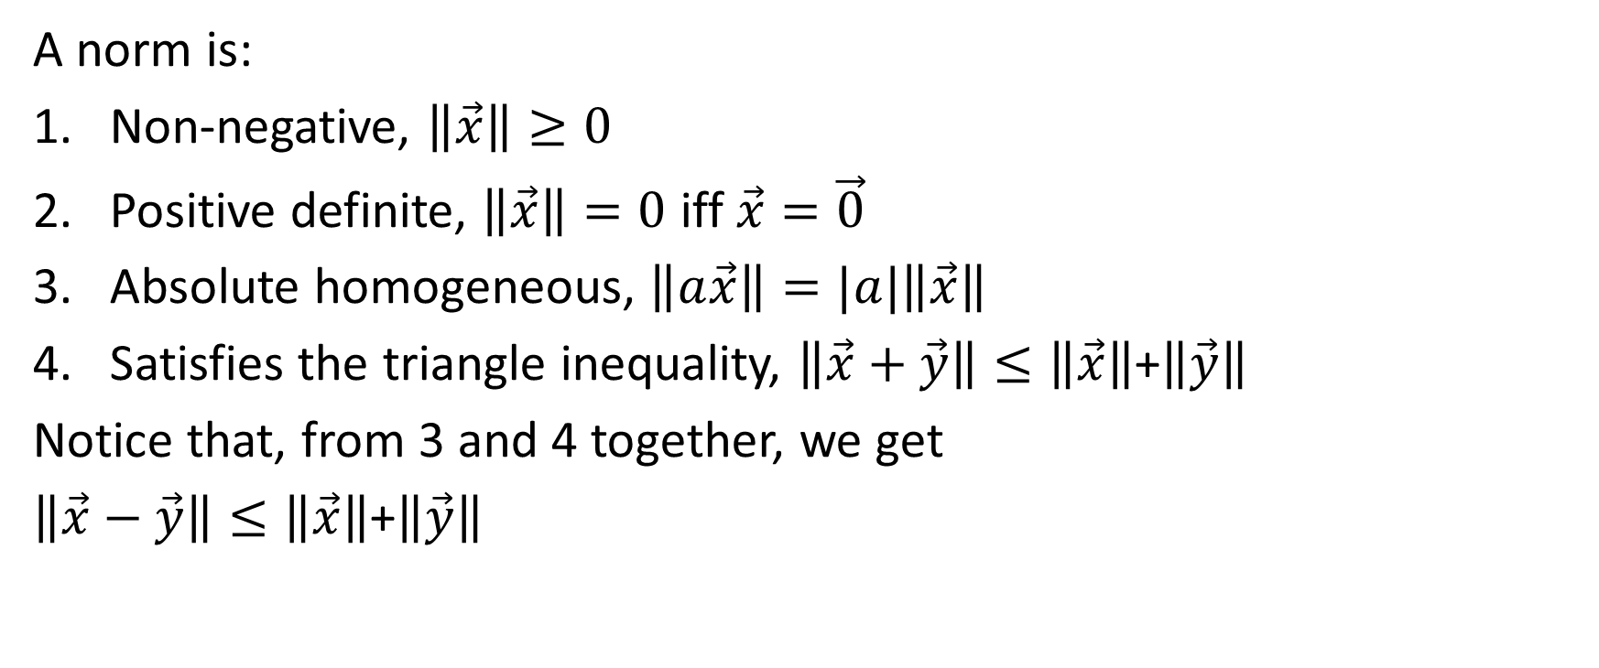
Norm (or Metric, or Length) of a vector
A norm is:
Non-negative, $\left\|\vec{x}\right\|≥0$
Positive definite, $\left\|\vec{x}\right\|=0$ iff $\vec{x}=\vec{0}$
Absolute homogeneous, $\left\|a\vec{x}\right\|=|a|\left\|\vec{x}\right\|$
Satisfies the triangle inequality, $\left\|\vec{x}+\vec{y}\right\|≤\left\|\vec{x}\right\|$+$\left\|\vec{y}\right\|$
Notice that, from 3 and 4 together, we get
$\left\|\vec{x}−\vec{y}\right\|≤\left\|\vec{x}\right\|$+$\left\|\vec{y}\right\|$

Slide 4
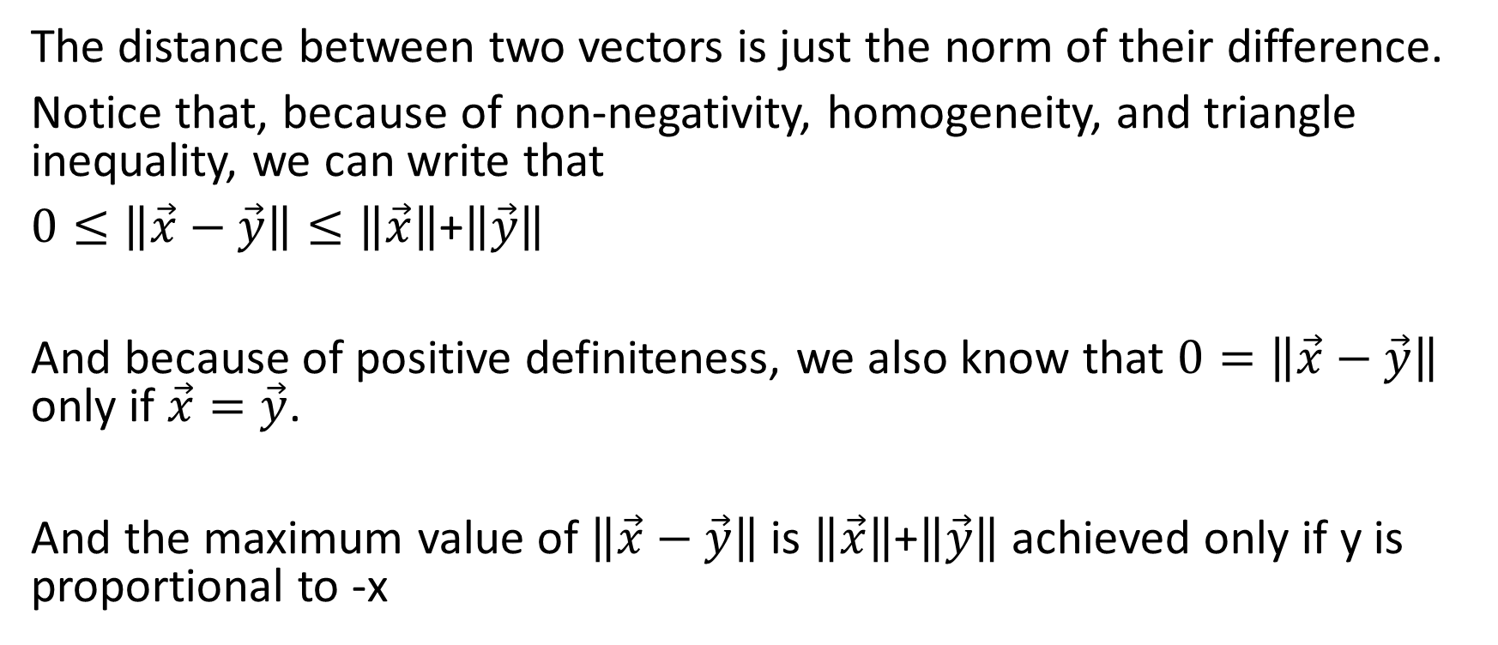
Distance between two vectors
The distance between two vectors is just the norm of their difference.
Notice that, because of non-negativity, homogeneity, and triangle inequality, we can write that
$0≤\left\|\vec{x}−\vec{y}\right\|≤\left\|\vec{x}\right\|$+$\left\|\vec{y}\right\|$
And because of positive definiteness, we also know that $0=\left\|\vec{x}−\vec{y}\right\|$ only if $\vec{x}=\vec{y}$.
And the maximum value of $\left\|\vec{x}−\vec{y}\right\|$ is $\left\|\vec{x}\right\|$+$\left\|\vec{y}\right\|$ achieved only if y is proportional to -x

Slide 5
Today’s Lecture
Similarity and Dissimilarity of vectors: all you need is a norm
Example: the Minkowski Norm (Lp norm)
Cosine Similarity: you need a dot product
Example: Diagonal Mahalanobis Distance
What is Similarity?
Metric Learning

Slide 6
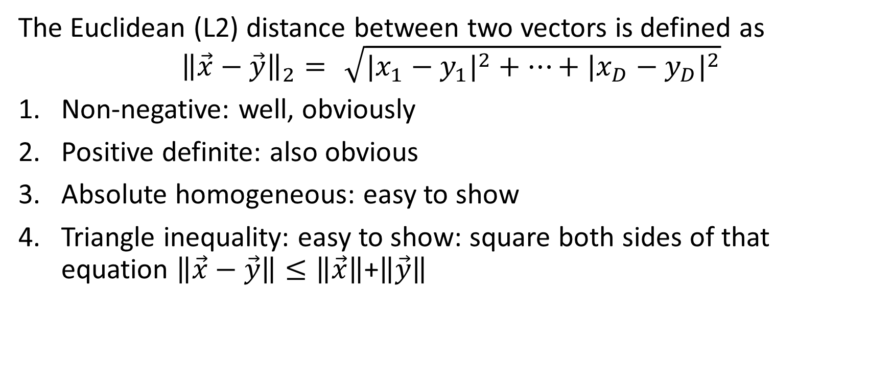
Example: Euclidean (L2) Distance
The Euclidean (L2) distance between two vectors is defined as
$${\left\|\vec{x}−\vec{y}\right\|}_{2}=\sqrt{{|x_{1}−y_{1}|}^{2}+…+{|x_{D}−y_{D}|}^{2}}$$
Non-negative: well, obviously
Positive definite: also obvious
Absolute homogeneous: easy to show
Triangle inequality: easy to show: square both sides of that equation $\left\|\vec{x}−\vec{y}\right\|≤\left\|\vec{x}\right\|$+$\left\|\vec{y}\right\|$

Slide 7
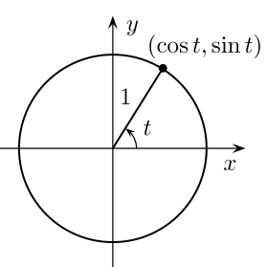

Example: Euclidean (L2) Distance
Here are the vectors $\vec{x}$, in 2-dimensional space, that have ${\left\|\vec{x}\right\|}_{2}=1$
Attribution: Gustavb, https://commons.wikimedia.org/wiki/File:Unit_circle.svg

Slide 8
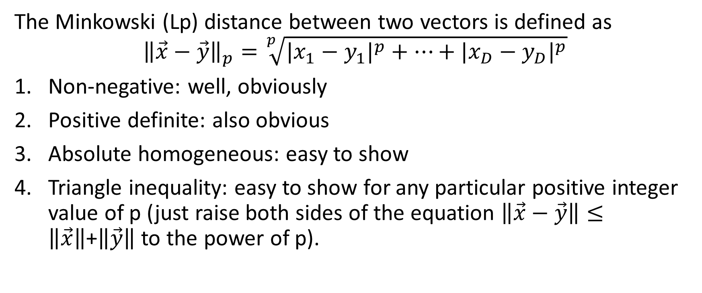
Example: Minkowski (Lp) Norm
The Minkowski (Lp) distance between two vectors is defined as
$${\left\|\vec{x}−\vec{y}\right\|}_{p}=\sqrt[p]{{|x_{1}−y_{1}|}^{p}+…+{|x_{D}−y_{D}|}^{p}}$$
Non-negative: well, obviously
Positive definite: also obvious
Absolute homogeneous: easy to show
Triangle inequality: easy to show for any particular positive integer value of p (just raise both sides of the equation $\left\|\vec{x}−\vec{y}\right\|≤\left\|\vec{x}\right\|$+$\left\|\vec{y}\right\|$ to the power of p).

Slide 9
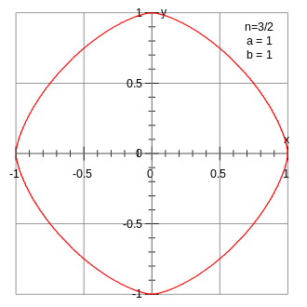

Example: Minkowski (Lp) Distance
Here are the vectors $\vec{x}$, in 2-dimensional space, that have ${\left\|\vec{x}\right\|}_{3/2}=1$
Attribution: Krishnavedala, https://en.wikipedia.org/wiki/Lp_space#/media/File:Superellipse_rounded_diamond.svg

Slide 10
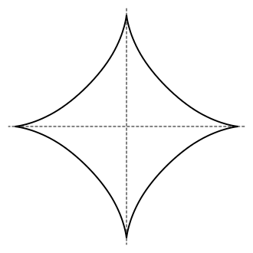

Example: Minkowski (Lp) Distance
Here are the vectors $\vec{x}$, in 2-dimensional space, that have ${\left\|\vec{x}\right\|}_{2/3}=1$
Attribution: Joelholdsworth, https://commons.wikimedia.org/wiki/File:Astroid.svg

Slide 11
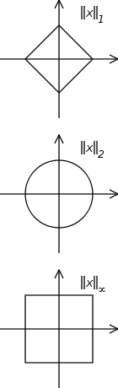
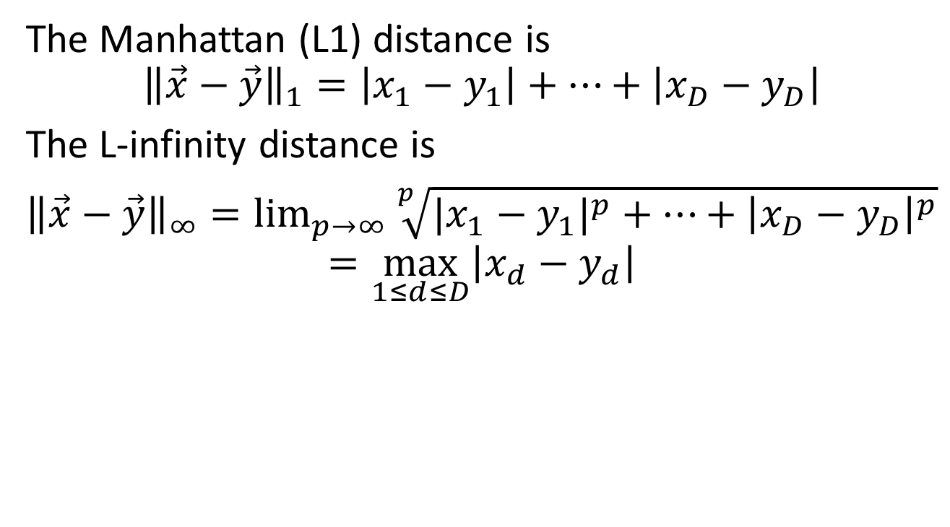
Manhattan Distance and L-infinity Distance
The Manhattan (L1) distance is
$${\left\|\vec{x}−\vec{y}\right\|}_{1}=\left|x_{1}−y_{1}\right|+…+\left|x_{D}−y_{D}\right|$$
The L-infinity distance is
${\left\|\vec{x}−\vec{y}\right\|}_{∞}=\lim_{p→∞}{\sqrt[p]{{|x_{1}−y_{1}|}^{p}+…+{\left|x_{D}−y_{D}\right|}^{p}}}$
$$=\max_{1≤d≤D}\left|x_{d}−y_{d}\right|$$
Attribution: Esmil, https://commons.wikimedia.org/wiki/File:Vector_norms.svg

Slide 12
Today’s Lecture
Similarity and Dissimilarity of vectors: all you need is a norm
Example: the Minkowski Norm (Lp norm)
Cosine Similarity: you need a dot product
Example: Diagonal Mahalanobis Distance
What is Similarity?
Metric Learning

Slide 13
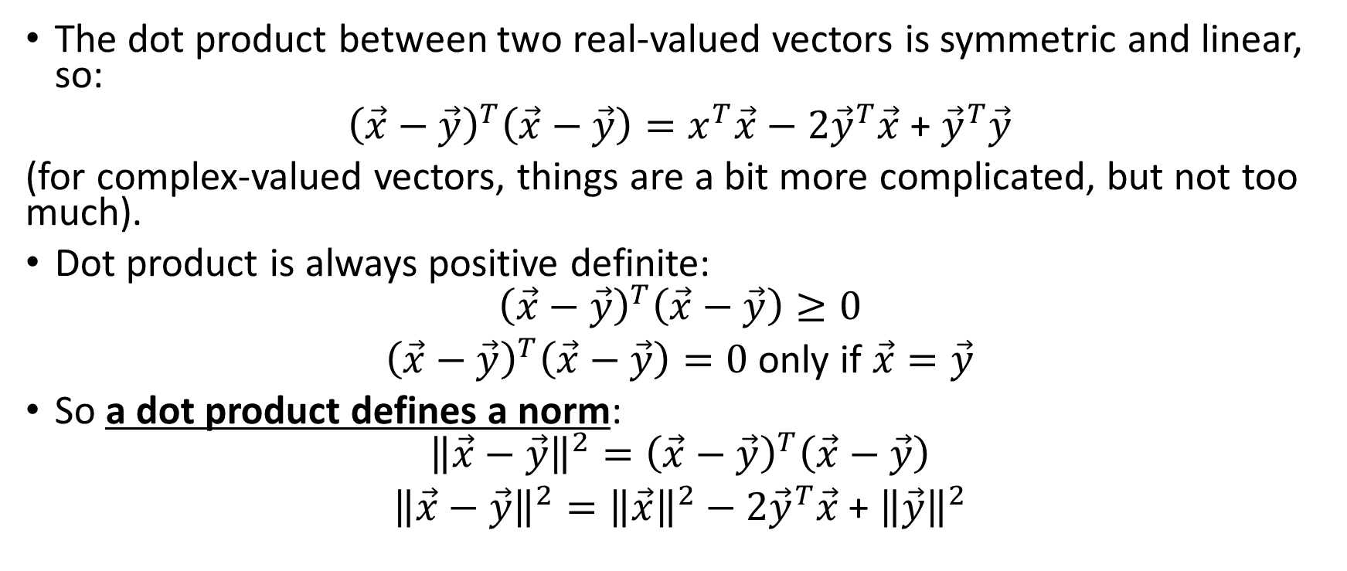
Dot product defines a norm
The dot product between two real-valued vectors is symmetric and linear, so:
${\left(\vec{x}−\vec{y}\right)}^{T}\left(\vec{x}−\vec{y}\right)=x^{T}\vec{x}−2{\vec{y}}^{T}\vec{x}$ + ${\vec{y}}^{T}\vec{y}$
(for complex-valued vectors, things are a bit more complicated, but not too much).
Dot product is always positive definite:
$${\left(\vec{x}−\vec{y}\right)}^{T}\left(\vec{x}−\vec{y}\right)≥0$$
${\left(\vec{x}−\vec{y}\right)}^{T}\left(\vec{x}−\vec{y}\right)=0$ only if $\vec{x}=\vec{y}$
So a dot product defines a norm:
$${{\left\|\vec{x}−\vec{y}\right\|}^{2}=\left(\vec{x}−\vec{y}\right)}^{T}\left(\vec{x}−\vec{y}\right)$$
${\left\|\vec{x}−\vec{y}\right\|}^{2}={\left\|\vec{x}\right\|}^{2}−2{\vec{y}}^{T}\vec{x}$ + ${\left\|\vec{y}\right\|}^{2}$

Slide 14
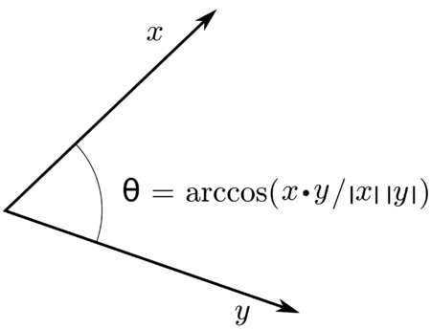

Cosine
The cosine of the angle between two vectors is
$$\cos{(\vec{x},\vec{y})}=\frac{{\vec{y}}^{T}\vec{x}}{{\left\|\vec{x}\right\|}_{2}{\left\|\vec{y}\right\|}_{2}}$$
Attribution: CSTAR, https://commons.wikimedia.org/wiki/File:Inner-product-angle.png

Slide 15
Today’s Lecture
Similarity and Dissimilarity of vectors: all you need is a norm
Example: the Minkowski Norm (Lp norm)
Cosine Similarity: you need a dot product
Example: Diagonal Mahalanobis Distance
What is Similarity?
Metric Learning

Slide 16
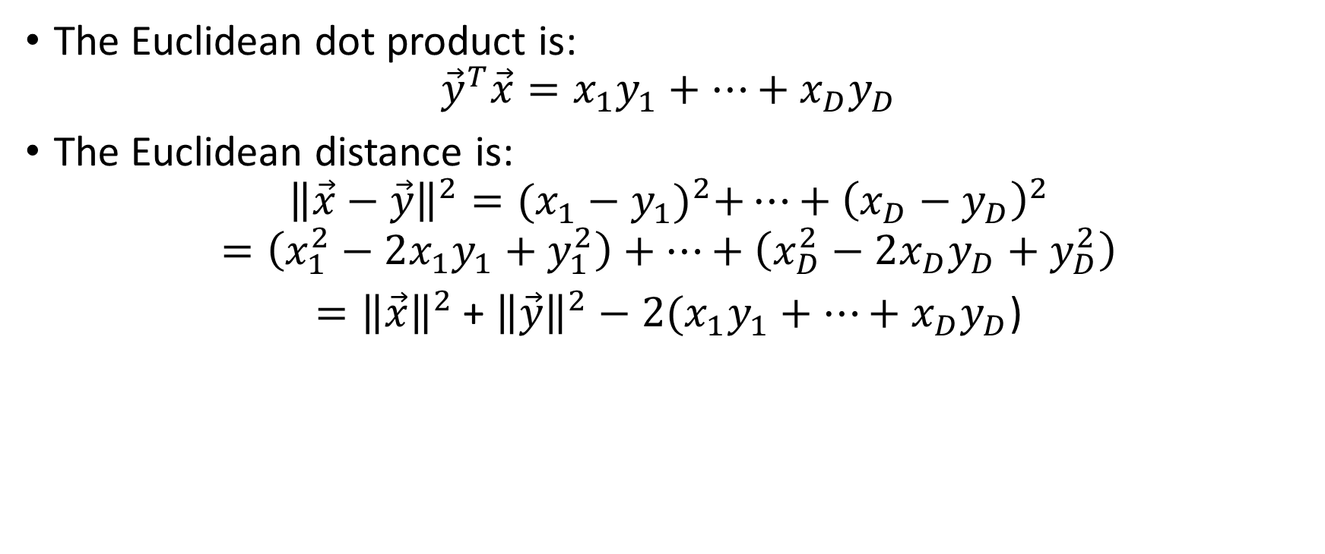
Example: Euclidean distance
The Euclidean dot product is:
$${\vec{y}}^{T}\vec{x}={x_{1}y}_{1}+…+{x_{D}y}_{D}$$
The Euclidean distance is:
$${{\left\|\vec{x}−\vec{y}\right\|}^{2}={({x_{1}−y}_{1})}^{2}+…+\left(x_{D}−y_{D}\right)}^{2}$$
$$=\left({x_{1}^{2}−2x_{1}y}_{1}+y_{1}^{2}\right)+…+\left({x_{D}^{2}−2x_{D}y}_{D}+y_{D}^{2}\right)$$
$={\left\|\vec{x}\right\|}^{2}$ + ${\left\|\vec{y}\right\|}^{2}−2({x_{1}y}_{1}+…+{x_{D}y}_{D}$)

Slide 17
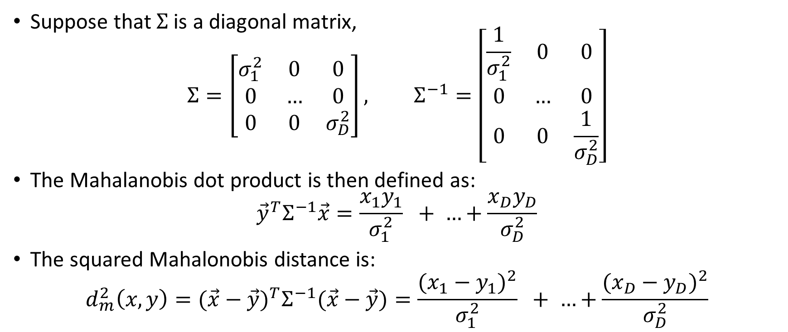
Example: Mahalanobis Distance
Suppose that $Σ$ is a diagonal matrix,
$$Σ=\left[\begin{matrix}σ_{1}^{2} & 0 & 0 \\ 0 & … & 0 \\ 0 & 0 & σ_{D}^{2}\end{matrix}\right], Σ^{−1}=\left[\begin{matrix}\frac{1}{σ_{1}^{2}} & 0 & 0 \\ 0 & … & 0 \\ 0 & 0 & \frac{1}{σ_{D}^{2}}\end{matrix}\right]$$
The Mahalanobis dot product is then defined as:
$${\vec{y}}^{T}Σ^{−1}\vec{x}=\frac{x_{1}y_{1}}{σ_{1}^{2}} + …+\frac{x_{D}y_{D}}{σ_{D}^{2}}$$
The squared Mahalonobis distance is:
$${d_{m}^{2}\left(x,y\right)=(\vec{x}−\vec{y})}^{T}Σ^{−1}(\vec{x}−\vec{y})=\frac{{(x_{1}−y_{1})}^{2}}{σ_{1}^{2}} + …+\frac{{(x_{D}−y_{D})}^{2}}{σ_{D}^{2}}$$

Slide 18
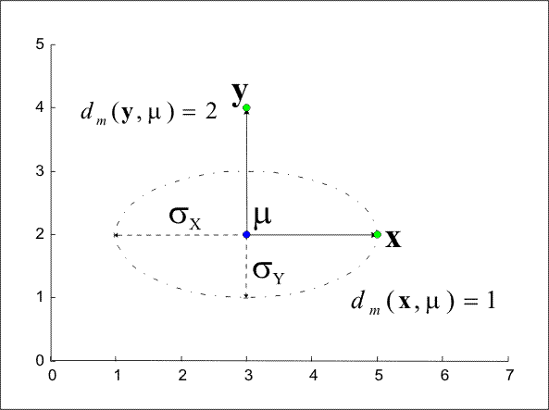
Example: Mahalanobis Distance
Attribution: Piotrg, https://commons.wikimedia.org/wiki/File:MahalanobisDist1.png

Slide 19
Today’s Lecture
Similarity and Dissimilarity of vectors: all you need is a norm
Example: the Minkowski Norm (Lp norm)
Cosine Similarity: you need a dot product
Example: Diagonal Mahalanobis Distance
What is Similarity?
Metric Learning

Slide 20



What is similarity?

Slide 21
What is similarity?
Typical Ocean
Roundness
Peach
Ocean at Sunset
Redness

Slide 22
Today’s Lecture
Similarity and Dissimilarity of vectors: all you need is a norm
Example: the Minkowski Norm (Lp norm)
Cosine Similarity: you need a dot product
Example: Diagonal Mahalanobis Distance
What is Similarity?
Metric Learning

Slide 23
Metric Learning
The goal: learn a function f(x,y) such that, if the user says y1 is more like x and y2 is less like x, then
f(x,y1) < f(x,y2)

Slide 24
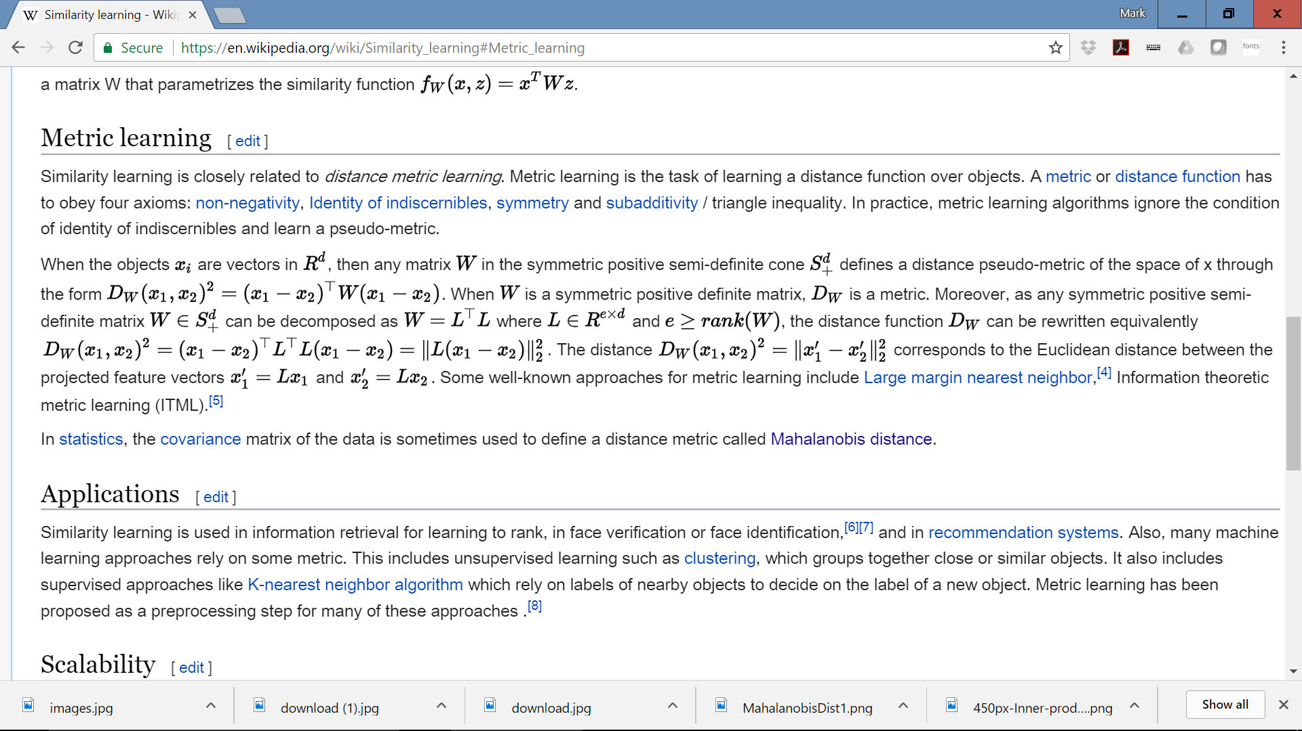

Slide 25
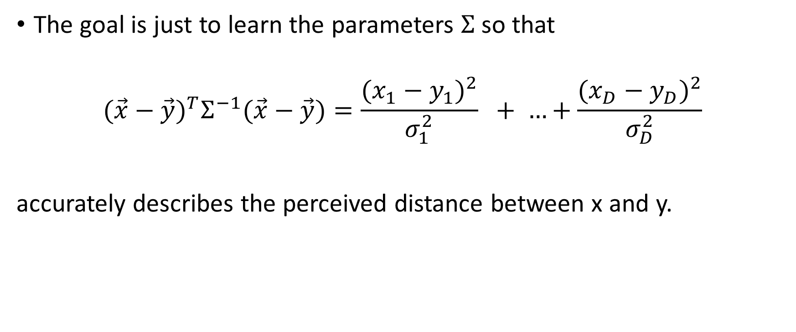
Mahalanobis Distance Learning
The goal is just to learn the parameters $Σ$ so that
$${(\vec{x}−\vec{y})}^{T}Σ^{−1}(\vec{x}−\vec{y})=\frac{{(x_{1}−y_{1})}^{2}}{σ_{1}^{2}} + …+\frac{{(x_{D}−y_{D})}^{2}}{σ_{D}^{2}}$$
accurately describes the perceived distance between x and y.

Slide 26
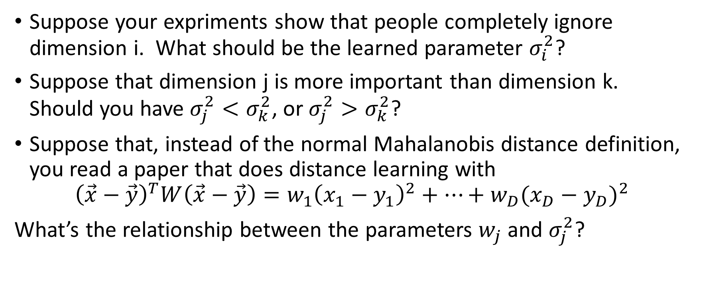
Sample problem
Suppose your expriments show that people completely ignore dimension i. What should be the learned parameter $σ_{i}^{2}$?
Suppose that dimension j is more important than dimension k. Should you have $σ_{j}^{2}<σ_{k}^{2}$, or $σ_{j}^{2}>σ_{k}^{2}$?
Suppose that, instead of the normal Mahalanobis distance definition, you read a paper that does distance learning with
$${\left(\vec{x}−\vec{y}\right)}^{T}W\left(\vec{x}−\vec{y}\right)={w_{1}\left(x_{1}−y_{1}\right)}^{2}+…+{w_{D}(x_{D}−y_{D})}^{2}$$
What’s the relationship between the parameters $w_{j}$ and $σ_{j}^{2}$?

