Slide 1
Learning Models From Data
Yangge Li

Slide 2
Motivation
Models are essential to verification. However, we do not have access to models.
Creating models based on physics laws can be time consuming and the models may also not accurate be enough.
Use deep learning to efficiently learn model dynamics from example executions.

Slide 3
Related Work
Use deep artificial neural network that, over a bounded time interval, provides accurate solutions for the chaotic three-body problem at low computational cost. [1]
Use Rectified Linear Unit Network Model to represent the dynamics of helicopter. [2]
Employ a neural network based dynamics model to synthesize control for trajectories. [3]

Slide 4

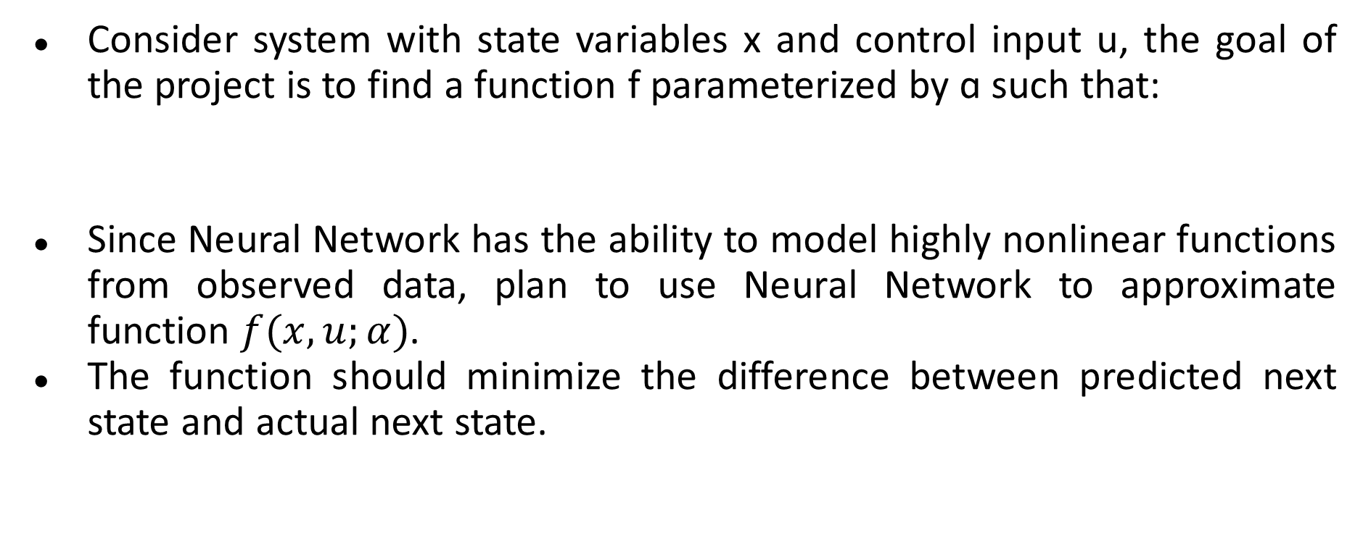
Problem Description
Consider system with state variables x and control input u, the goal of the project is to find a function f parameterized by ɑ such that:
Since Neural Network has the ability to model highly nonlinear functions from observed data, plan to use Neural Network to approximate function $f(x,u;α)$.
The function should minimize the difference between predicted next state and actual next state.

Slide 5
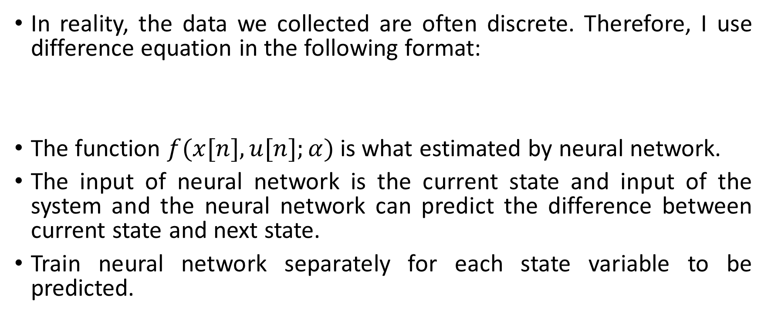
Problem Solution
In reality, the data we collected are often discrete. Therefore, I use difference equation in the following format:
The function $f(x[n],u[n];α)$is what estimated by neural network.
The input of neural network is the current state and input of the system and the neural network can predict the difference between current state and next state.
Train neural network separately for each state variable to be predicted.

Slide 6
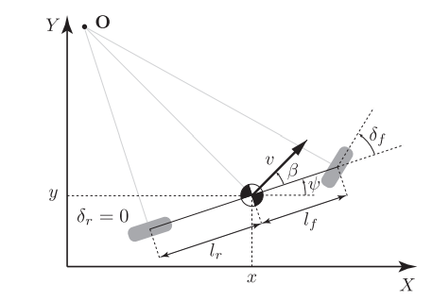
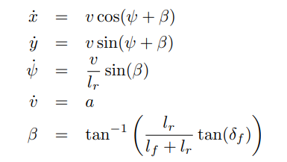
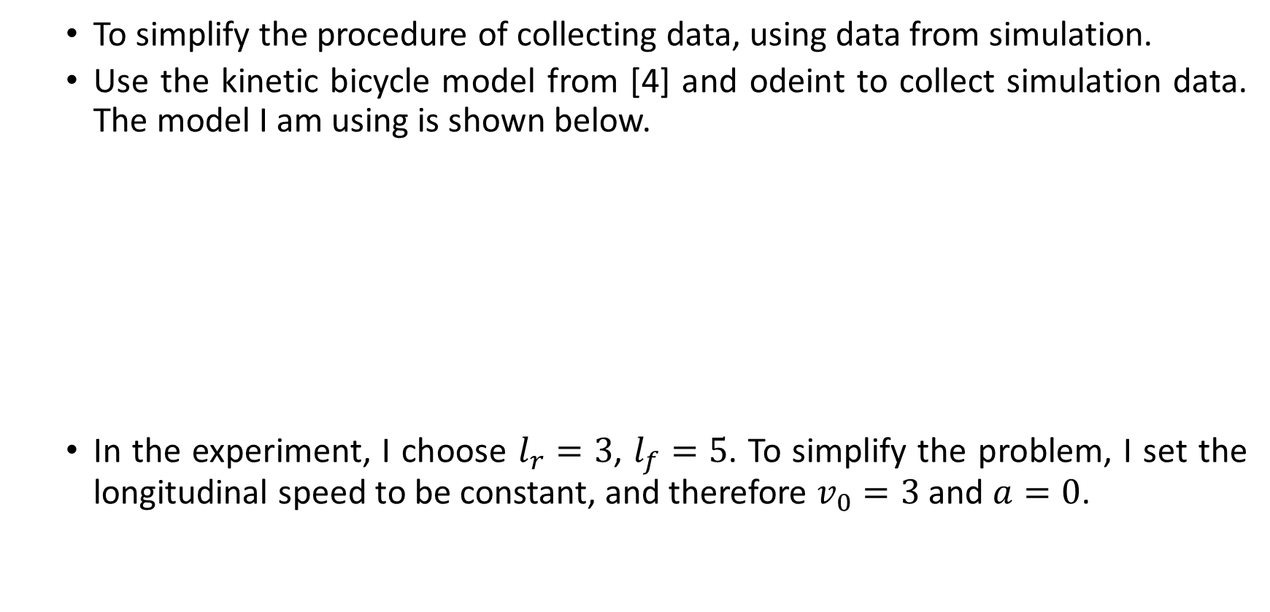
Experiment Setup
To simplify the procedure of collecting data, using data from simulation.
Use the kinetic bicycle model from [4] and odeint to collect simulation data. The model I am using is shown below.
In the experiment, I choose $l_{r}=3$, $l_{f}=5$. To simplify the problem, I set the longitudinal speed to be constant, and therefore $v_{0}=3$ and $a=0$.

Slide 7
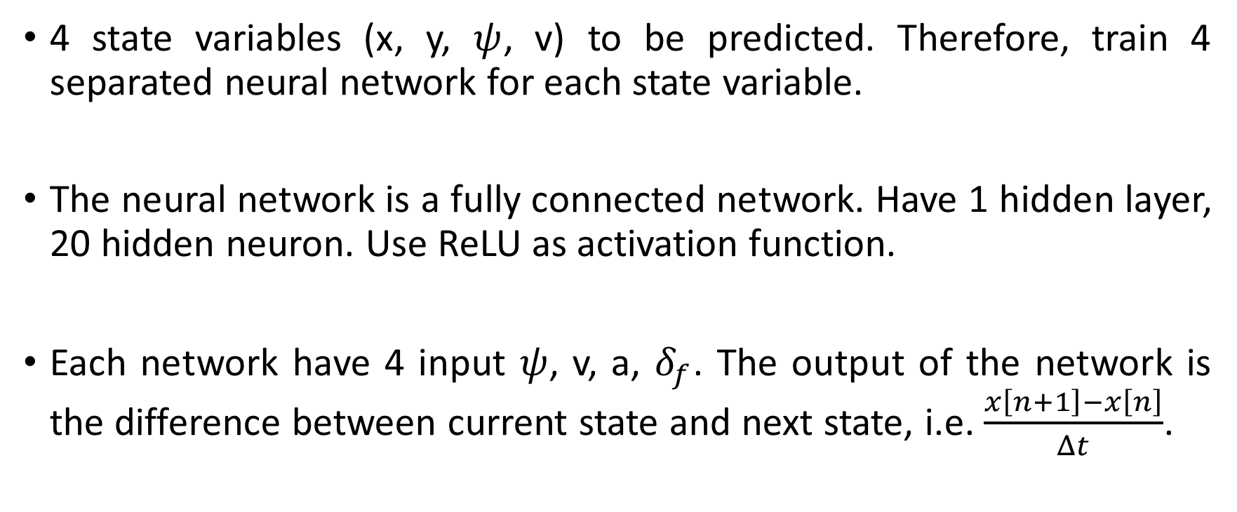
Experiment Setup
4 state variables (x, y, $ψ$, v) to be predicted. Therefore, train 4 separated neural network for each state variable.
The neural network is a fully connected network. Have 1 hidden layer, 20 hidden neuron. Use ReLU as activation function.
Each network have 4 input $ψ$, v, a, $δ_{f}$. The output of the network is the difference between current state and next state, i.e. $\frac{x\left[n+1\right]−x\left[n\right]}{Δt}$.

Slide 8
Experiment Setup
The training data are obtained by running the model with fixed turning angle at 30, 20, 10, 0, -10, -20, -30 degree for 120 seconds with the time step of 0.01s. Some example training trajectories is shown below:
Pictures
The training labels are obtained by calculating the difference between current state variable and next state variable divided by time step.

Slide 9
Experiment Result
To test the performance of the model I obtained. I run the model I obtained with random initial state and time varying turning angle between -30 to 30 degree.
Simulation is performed with same initial state and same input sequence and the simulation results are compared with results from the calculated trajectory from my model.
Some experiment results are shown in the following slides.

Slide 10
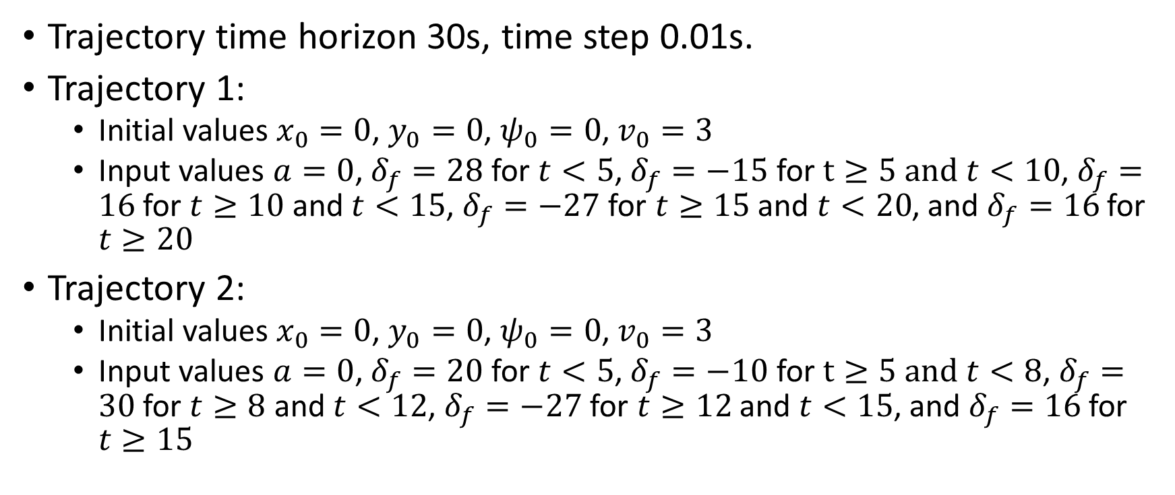
Experiment Result
Trajectory time horizon 30s, time step 0.01s.
Trajectory 1:
Initial values $x_{0}=0$, $y_{0}=0$, $ψ_{0}=0$, $v_{0}=3$
Input values $a=0$, $δ_{f}=28$ for $t<5$, $δ_{f}=−15$ for $t≥5 and t<10$, $δ_{f}=16$ for $t≥10$ and $t<15$, $δ_{f}=−27$ for $t≥15$ and $t<20$, and $δ_{f}=16$ for $t≥20$
Trajectory 2:
Initial values $x_{0}=0$, $y_{0}=0$, $ψ_{0}=0$, $v_{0}=3$
Input values $a=0$, $δ_{f}=20$ for $t<5$, $δ_{f}=−10$ for $t≥5 and t<8$, $δ_{f}=30$ for $t≥8$ and $t<12$, $δ_{f}=−27$ for $t≥12$ and $t<15$, and $δ_{f}=16$ for $t≥15$

Slide 11
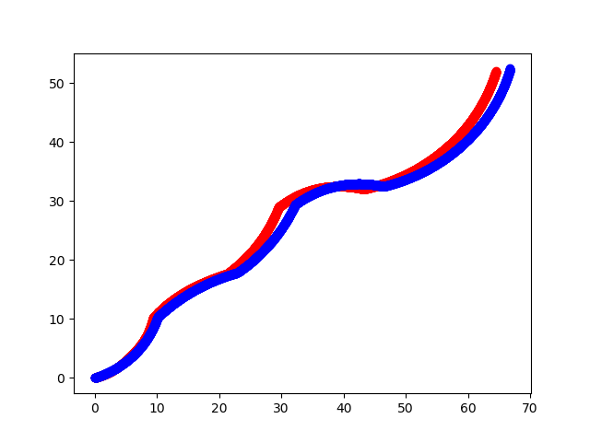
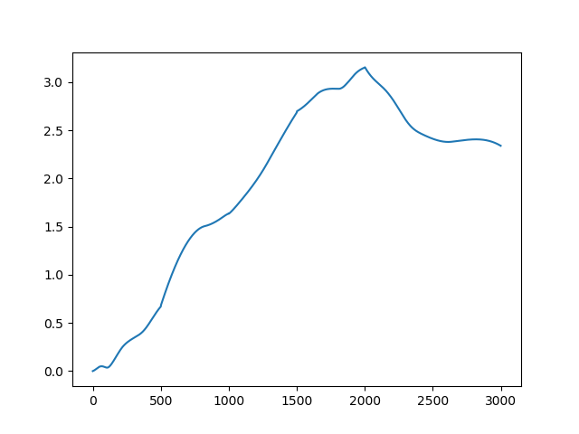
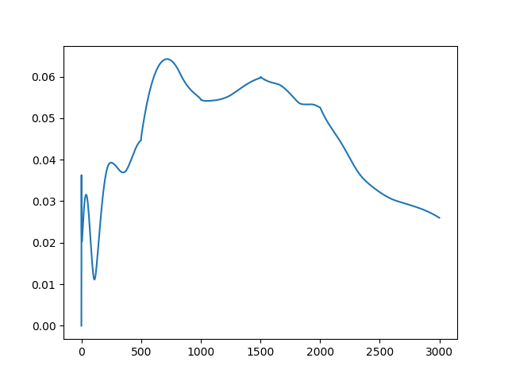
Experiment Result

Slide 12
Observation and Conclusion
Neural network is able to approximate the dynamics of systems
Even a network with really simple structure is able to model system with complexity
The neural network have some ability to handle situation that is not presented in the training set

Slide 13
Future Work

Slide 14
Reference

