Slide 1
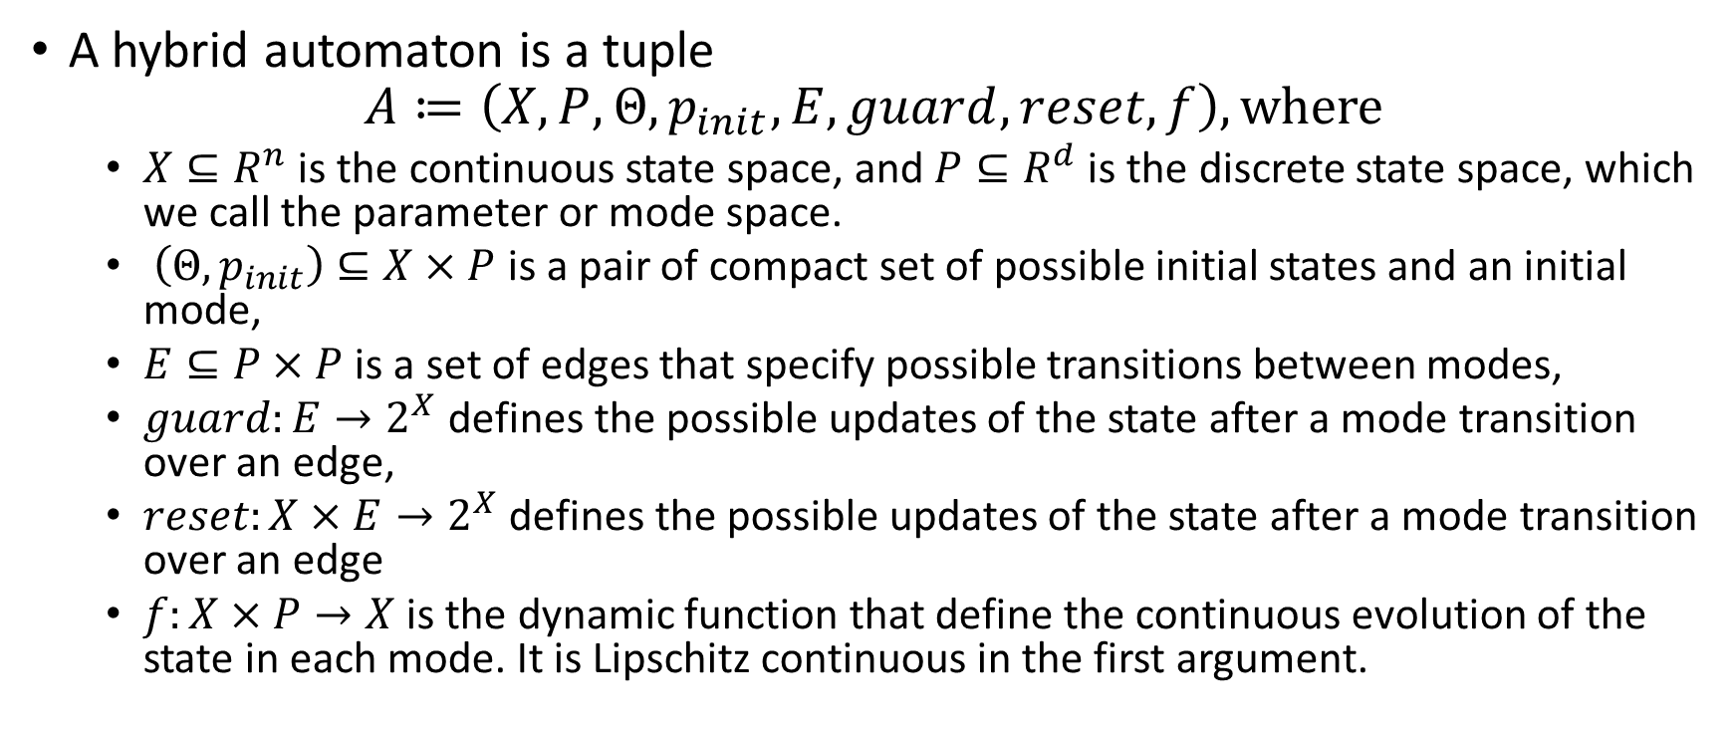
Hybrid automaton
A hybrid automaton is a tuple
$$A≔\left(X,P,Θ,p_{init},E, guard, reset, f\right), where$$
$X⊆R^{n}$ is the continuous state space, and $P⊆R^{d}$ is the discrete state space, which we call the parameter or mode space.
$\left(Θ,p_{init}\right)⊆X×P$ is a pair of compact set of possible initial states and an initial mode,
$E⊆P×P$ is a set of edges that specify possible transitions between modes,
$guard:E→2^{X}$ defines the possible updates of the state after a mode transition over an edge,
$reset:X×E→2^{X}$ defines the possible updates of the state after a mode transition over an edge
$f:X×P→X$ is the dynamic function that define the continuous evolution of the state in each mode. It is Lipschitz continuous in the first argument.

Slide 2
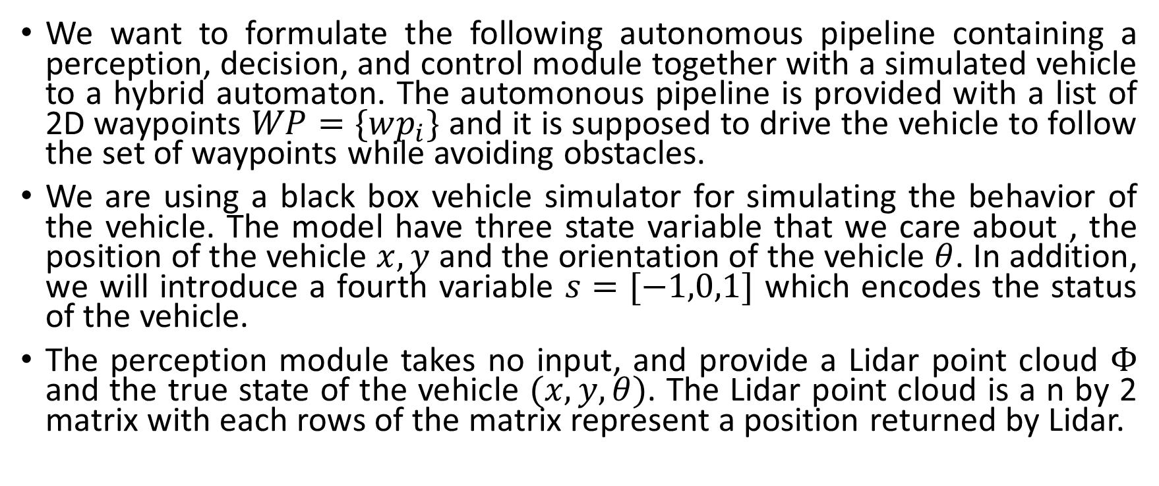
Autonomous agent case study
We want to formulate the following autonomous pipeline containing a perception, decision, and control module together with a simulated vehicle to a hybrid automaton. The automonous pipeline is provided with a list of 2D waypoints $WP=\{wp_{i}\}$ and it is supposed to drive the vehicle to follow the set of waypoints while avoiding obstacles.
We are using a black box vehicle simulator for simulating the behavior of the vehicle. The model have three state variable that we care about , the position of the vehicle $x,y$ and the orientation of the vehicle $θ$. In addition, we will introduce a fourth variable $s=[−1,0,1]$ which encodes the status of the vehicle.
The perception module takes no input, and provide a Lidar point cloud $Φ$ and the true state of the vehicle $(x,y,θ)$. The Lidar point cloud is a n by 2 matrix with each rows of the matrix represent a position returned by Lidar.

Slide 3
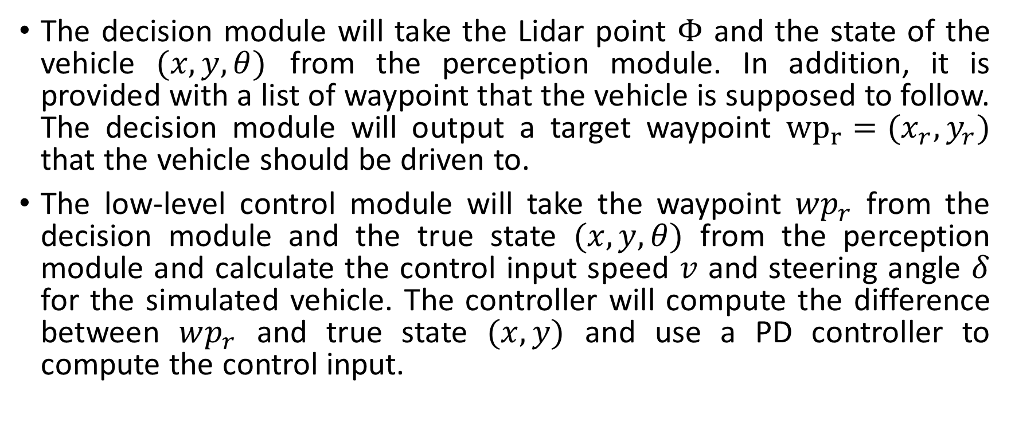
Autonomous agent case study
The decision module will take the Lidar point $Φ$ and the state of the vehicle $(x,y,θ)$ from the perception module. In addition, it is provided with a list of waypoint that the vehicle is supposed to follow. The decision module will output a target waypoint ${wp}_{r}={(x}_{r},y_{r})$ that the vehicle should be driven to.
The low-level control module will take the waypoint $wp_{r}$ from the decision module and the true state $(x,y,θ)$ from the perception module and calculate the control input speed $v$ and steering angle $δ$ for the simulated vehicle. The controller will compute the difference between $wp_{r}$ and true state $(x,y)$ and use a PD controller to compute the control input.

Slide 4
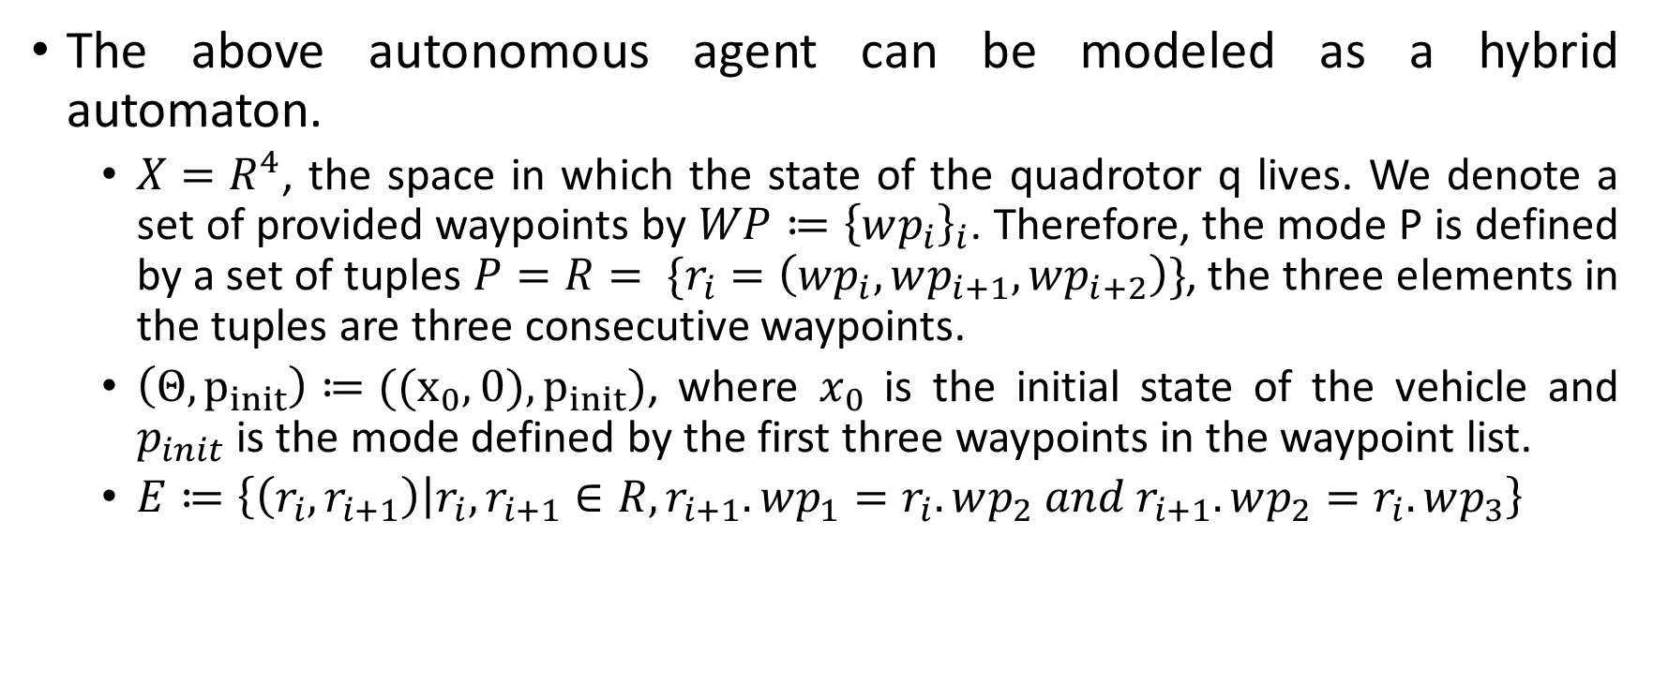
Model as Hybrid Automaton
The above autonomous agent can be modeled as a hybrid automaton.
$X=R^{4}$, the space in which the state of the quadrotor q lives. We denote a set of provided waypoints by $WP≔{\left\{wp_{i}\right\}}_{i}$. Therefore, the mode P is defined by a set of tuples $P=R= \{r_{i}=\left(wp_{i},wp_{i+1},wp_{i+2}\right)\}$, the three elements in the tuples are three consecutive waypoints.
$\left(Θ,p_{init}\right)≔((x_{0},0),p_{init})$, where $x_{0}$ is the initial state of the vehicle and $p_{init}$ is the mode defined by the first three waypoints in the waypoint list.
$E≔\left\{\left(r_{i},r_{i+1}\right) | r_{i},r_{i+1}∈R, r_{i+1}.wp_{1}=r_{i}.wp_{2} and r_{i+1}.wp_{2}=r_{i}.wp_{3}\right\}$

Slide 5
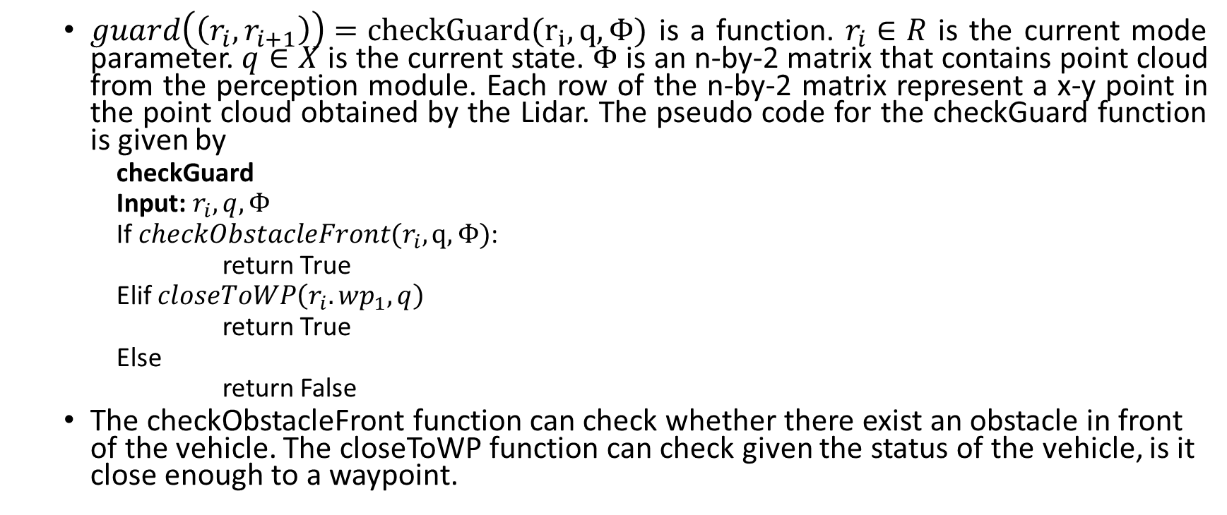
Model as Hybrid Automaton - Guard
$guard\left(\left(r_{i},r_{i+1}\right)\right)=checkGuard(r_{i}, q,Φ)$ is a function. $r_{i}∈R$ is the current mode parameter. $q∈X$ is the current state. $Φ$ is an n-by-2 matrix that contains point cloud from the perception module. Each row of the n-by-2 matrix represent a x-y point in the point cloud obtained by the Lidar. The pseudo code for the checkGuard function is given by
checkGuard
Input: $r_{i}, q, Φ$
If $checkObstacleFront(r_{i},q,Φ)$:
return True
Elif $closeToWP\left(r_{i}.wp_{1},q\right)$
return True
Else
return False
The checkObstacleFront function can check whether there exist an obstacle in front of the vehicle. The closeToWP function can check given the status of the vehicle, is it close enough to a waypoint.

Slide 6

Model as Hybrid Automaton – Reset
$reset\left(q,\left(r_{i},r_{i+1}\right)\right)=computeReset(r_{i}, q,Φ)$ is the function that determines the reset value during mode transition. The pseudo code for the computeReset function is given by
computeReset
Input: $r_{i}, q, Φ$
If $checkObstacleFront(r_{i},q,Φ)$:
if $q.s<0$:
if $checkObstacleFrontRight\left(r_{i},q,Φ\right):$
$q.s=1$
else:
$q.s=0$
elif $q.s>0$:
if $checkObstacleFrontLeft(r_{i},q,Φ)$:
$q.s=−1$
else:
$q.s=0$
else:
if $checkObstacleFrontLeft(r_{i},q,Φ)$:
$q.s=1$
else:
$q.s=−1$
Return $r_{i}$
The checkObstacleFrontLeft and checkObstacleFrontRight functions can be used to check if there exist an obstacle at front left/front right side of the vehicle.

Slide 7

$f\left(q,r\right)=g\left(q,h\left(q,r_{i}\right)\right)$, where $g:X×U→X$ is the right hand side of the differential equation of q and $h:X×P→U$ is the controller.

Slide 8
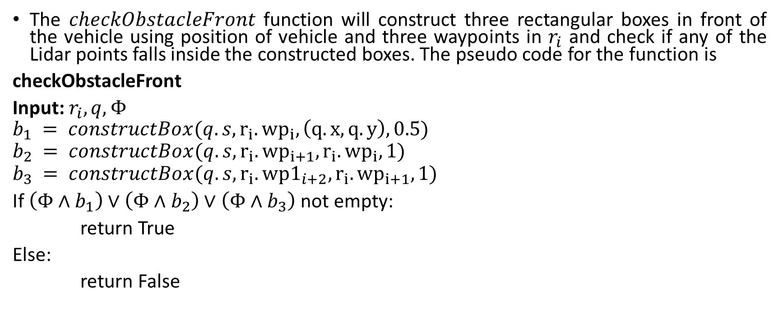
Model as Hybrid Automaton - checkObstacleFront
The $checkObstacleFront$ function will construct three rectangular boxes in front of the vehicle using position of vehicle and three waypoints in $r_{i}$ and check if any of the Lidar points falls inside the constructed boxes. The pseudo code for the function is
checkObstacleFront
Input: $r_{i}, q, Φ$
$$b_{1} = constructBox({q.s,r}_{i}.{wp}_{i}, \left(q.x, q.y\right),0.5)$$
$$b_{2} = constructBox(q.s,r_{i}.{wp}_{i+1},r_{i}.{wp}_{i},1)$$
$$b_{3} = constructBox(q.s,r_{i}.wp1_{i+2},r_{i}.{wp}_{i+1},1)$$
If $\left(Φ∧b_{1}\right)∨\left(Φ∧b_{2}\right)∨\left(Φ∧b_{3}\right)$ not empty:
return True
Else:
return False

Slide 9

Model as Hybrid Automaton - constructBox
The constructBox function will construct a rectangular box given the current vehicle status $s$, a set of two waypoints, and a radius $r$. The function will first shift the two waypoints according to the status of the vehicle.

