Slide 1
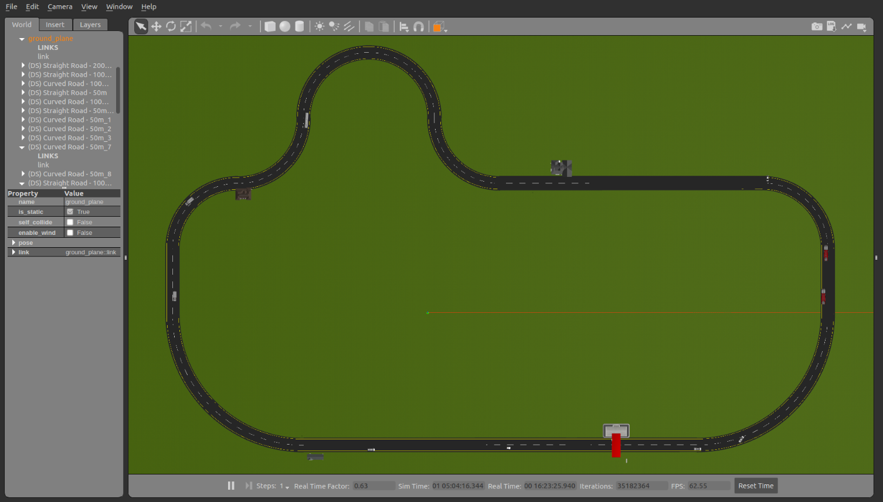
Environment
The environment contains track (which also define a series of waypoints), static obstacles and dynamic obstacles (pedestrian). Below shows an example of an environment.

Slide 2

Problem formulation
Given a environment $E$, the initial state of the vehicle defined by the position and orientation of the vehicle $(x_{0},y_{0},θ_{0})$, we want to show that the vehicle will never bump into any obstacles while keeping on the track.

Slide 3
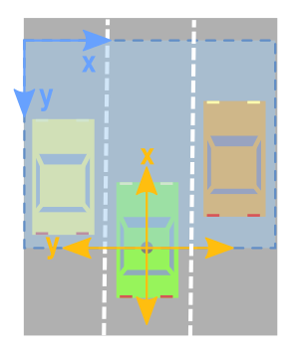
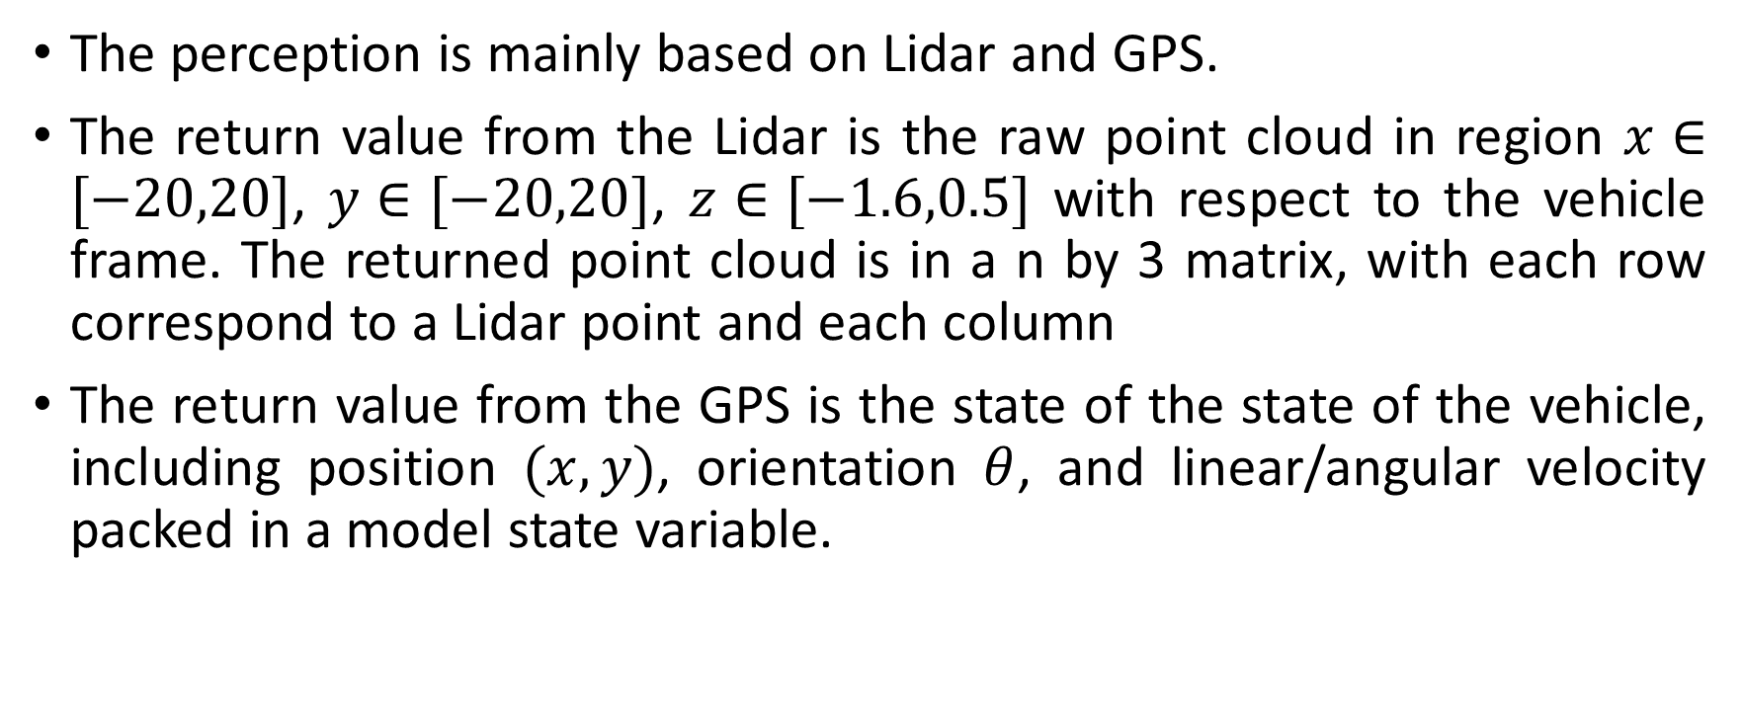
Perception Module
The perception is mainly based on Lidar and GPS.
The return value from the Lidar is the raw point cloud in region $x∈[−20,20]$, $y∈[−20,20]$, $z∈[−1.6,0.5]$ with respect to the vehicle frame. The returned point cloud is in a n by 3 matrix, with each row correspond to a Lidar point and each column
The return value from the GPS is the state of the state of the vehicle, including position $(x,y)$, orientation $θ$, and linear/angular velocity packed in a model state variable.

Slide 4
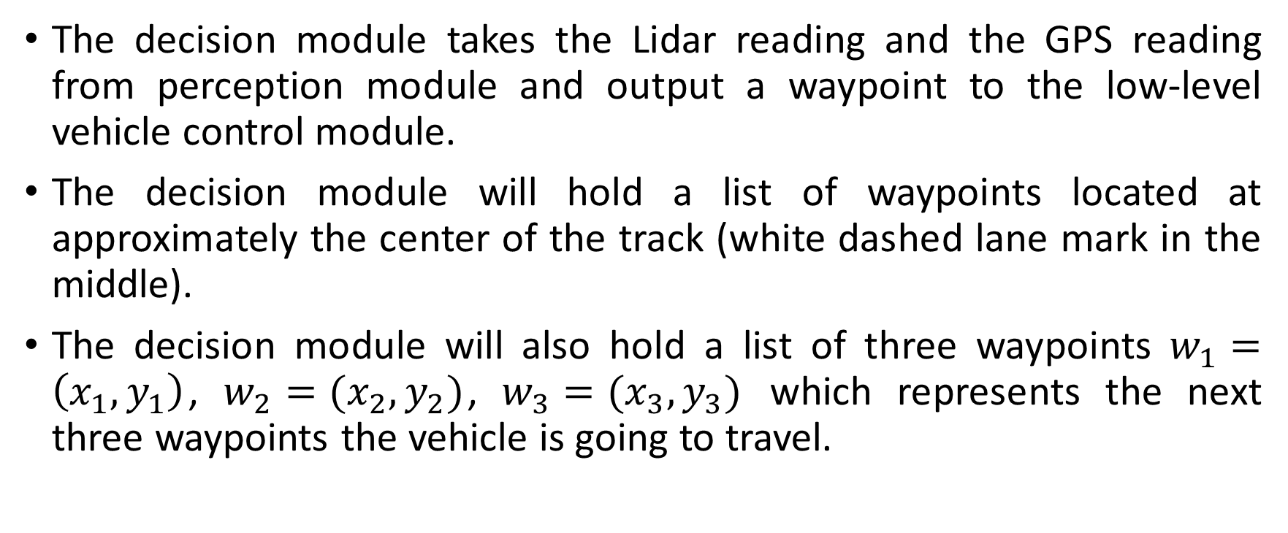
Decision Module
The decision module takes the Lidar reading and the GPS reading from perception module and output a waypoint to the low-level vehicle control module.
The decision module will hold a list of waypoints located at approximately the center of the track (white dashed lane mark in the middle).
The decision module will also hold a list of three waypoints $w_{1}=\left(x_{1},y_{1}\right)$, $w_{2}=(x_{2},y_{2})$, $w_{3}=(x_{3},y_{3})$ which represents the next three waypoints the vehicle is going to travel.

Slide 5
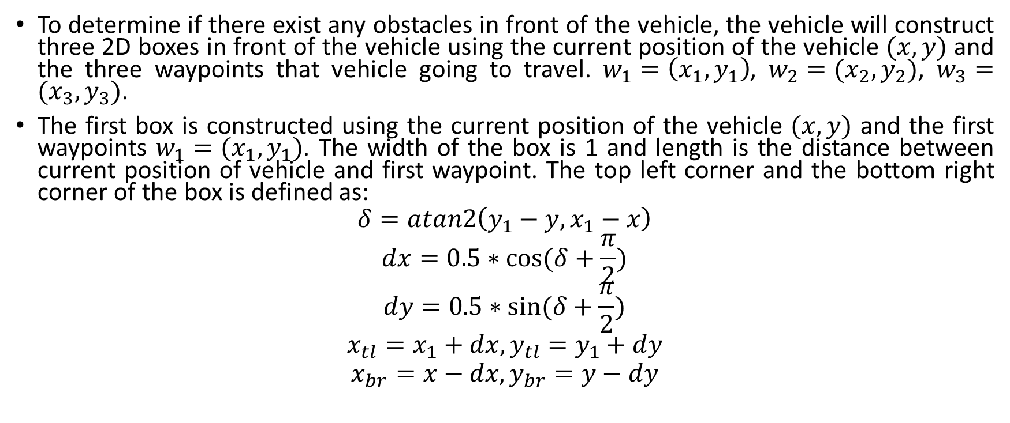
Decision Module
To determine if there exist any obstacles in front of the vehicle, the vehicle will construct three 2D boxes in front of the vehicle using the current position of the vehicle $(x,y)$ and the three waypoints that vehicle going to travel. $w_{1}=\left(x_{1},y_{1}\right)$, $w_{2}=(x_{2},y_{2})$, $w_{3}=(x_{3},y_{3})$.
The first box is constructed using the current position of the vehicle $(x,y)$ and the first waypoints $w_{1}=(x_{1},y_{1})$. The width of the box is 1 and length is the distance between current position of vehicle and first waypoint. The top left corner and the bottom right corner of the box is defined as:
$$δ=atan2\left(y_{1}−y,x_{1}−x\right)$$
$$dx=0.5∗cos⁡(δ+\frac{π}{2})$$
$$dy=0.5∗sin⁡(δ+\frac{π}{2})$$
$$x_{tl}=x_{1}+dx, y_{tl}=y_{1}+dy$$
$$x_{br}=x−dx, y_{br}=y−dy$$

Slide 6
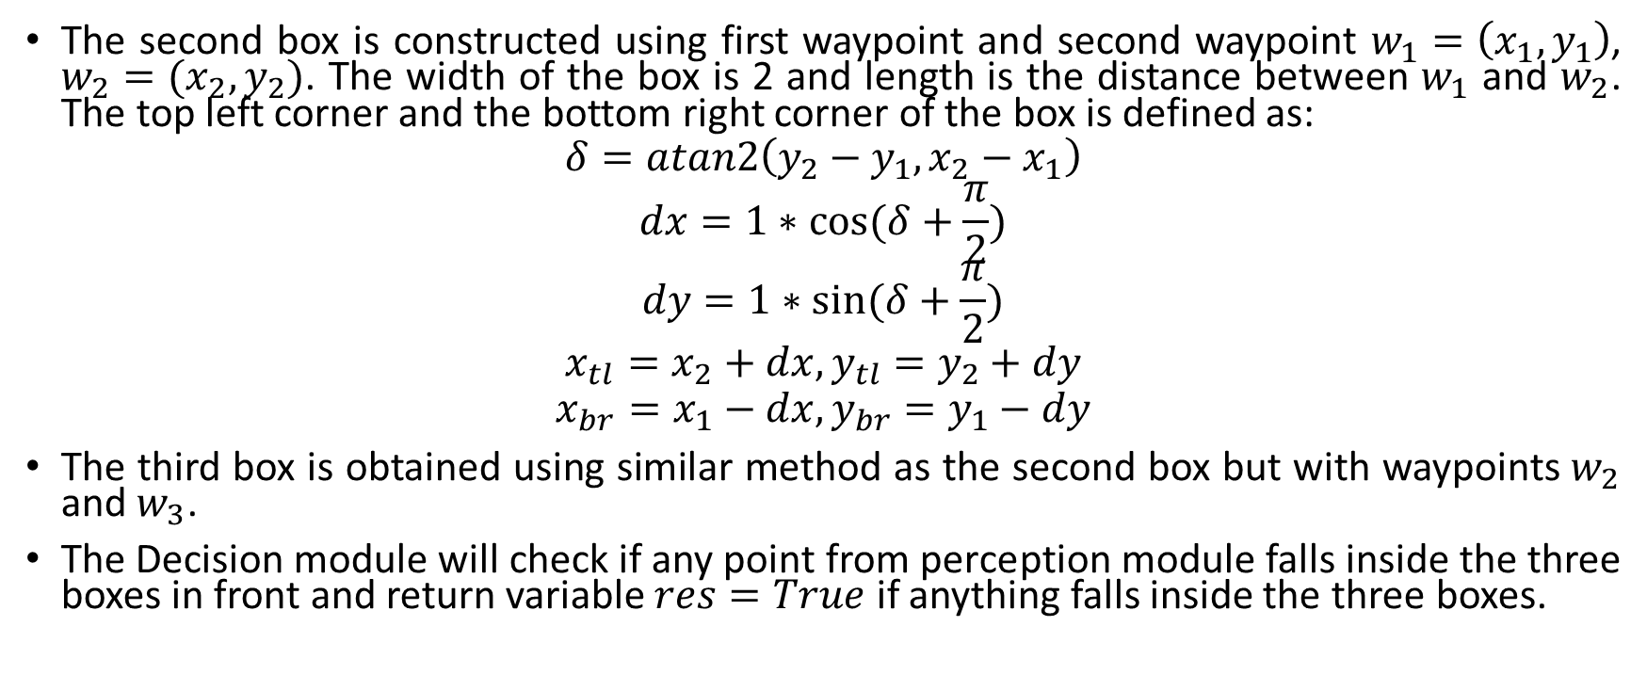
Decision Module
The second box is constructed using first waypoint and second waypoint $w_{1}=\left(x_{1},y_{1}\right)$, $w_{2}=(x_{2},y_{2})$. The width of the box is 2 and length is the distance between $w_{1}$ and $w_{2}$. The top left corner and the bottom right corner of the box is defined as:
$$δ=atan2\left(y_{2}−y_{1},x_{2}−x_{1}\right)$$
$$dx=1∗cos⁡(δ+\frac{π}{2})$$
$$dy=1∗sin⁡(δ+\frac{π}{2})$$
$$x_{tl}=x_{2}+dx, y_{tl}=y_{2}+dy$$
$$x_{br}=x_{1}−dx, y_{br}=y_{1}−dy$$
The third box is obtained using similar method as the second box but with waypoints $w_{2}$ and $w_{3}$.
The Decision module will check if any point from perception module falls inside the three boxes in front and return variable $res=True$ if anything falls inside the three boxes.

Slide 7
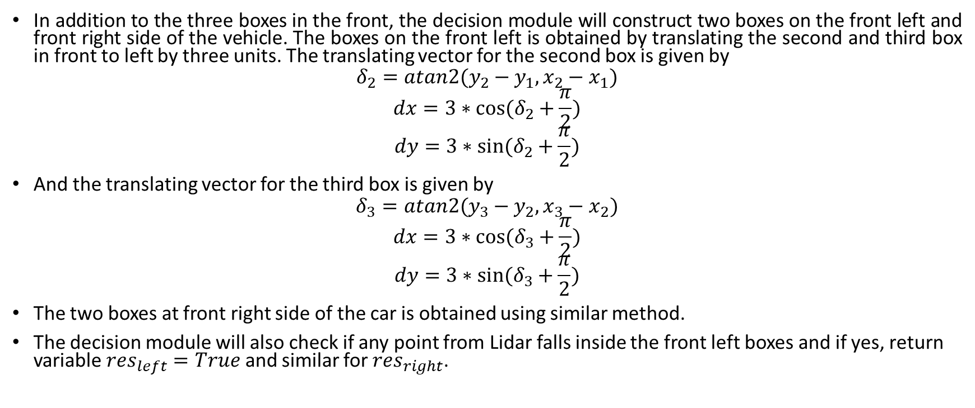
Decision Module
In addition to the three boxes in the front, the decision module will construct two boxes on the front left and front right side of the vehicle. The boxes on the front left is obtained by translating the second and third box in front to left by three units. The translating vector for the second box is given by
$$δ_{2}=atan2(y_{2}−y_{1},x_{2}−x_{1})$$
$$dx=3∗cos⁡(δ_{2}+\frac{π}{2})$$
$$dy=3∗sin⁡(δ_{2}+\frac{π}{2})$$
And the translating vector for the third box is given by
$$δ_{3}=atan2(y_{3}−y_{2},x_{3}−x_{2})$$
$$dx=3∗cos⁡(δ_{3}+\frac{π}{2})$$
$$dy=3∗sin⁡(δ_{3}+\frac{π}{2})$$
The two boxes at front right side of the car is obtained using similar method.
The decision module will also check if any point from Lidar falls inside the front left boxes and if yes, return variable $res_{left}=True$ and similar for $res_{right}$.

Slide 8
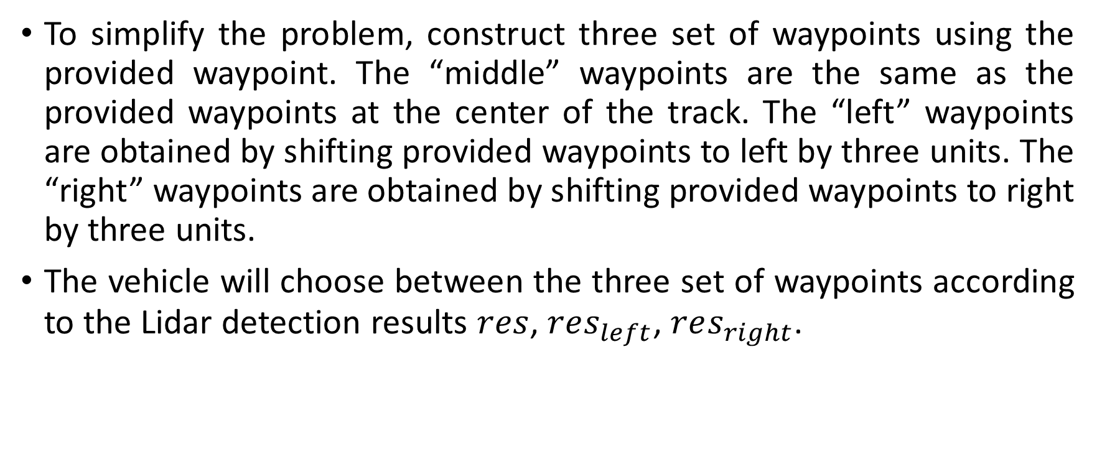
Decision Module
To simplify the problem, construct three set of waypoints using the provided waypoint. The “middle” waypoints are the same as the provided waypoints at the center of the track. The “left” waypoints are obtained by shifting provided waypoints to left by three units. The “right” waypoints are obtained by shifting provided waypoints to right by three units.
The vehicle will choose between the three set of waypoints according to the Lidar detection results $res$, $res_{left}$, $res_{right}$.

Slide 9
Decision Module
The high level movement of the vehicle is determined using the following logic:
If the vehicle is on left set of waypoints:
If an object is detected in front and front right is clear:
Shift to follow middle set of waypoints
If an object is detected in front and front right is not clear:
Shift to follow right set of waypoints
If the vehicle is on right set of waypoints:
If an object is detected in front and front left is clear:
Shift to follow middle set of waypoints
If an object is detected in front and front left is not clear:
Shift to follow left set of waypoints
If the vehicle is following middle set of waypoints:
If an object is detected in front and front left is clear:
Shift to follow left
If an object is detected in front and front right is clear:
Shift to follow right

Slide 10
Decision Module
As mentioned above, the decision module will hold a list of three waypoints that the vehicle will travel next. If the vehicle state is changed (which indicates that the vehicle need to change lane to avoid obstacles), the coordinates for the three waypoints will be updated correspondingly to the. In addition, the closest waypoint will be moved from the list and a new waypoint will be append to the list to ensure smooth lane changing.
When the vehicle reaches a waypoint, the first waypoint in the list will be popped out and a new waypoint on the same lane will be append into the list.
The first waypoint in the list will be returned to the low-level control module.

Slide 11
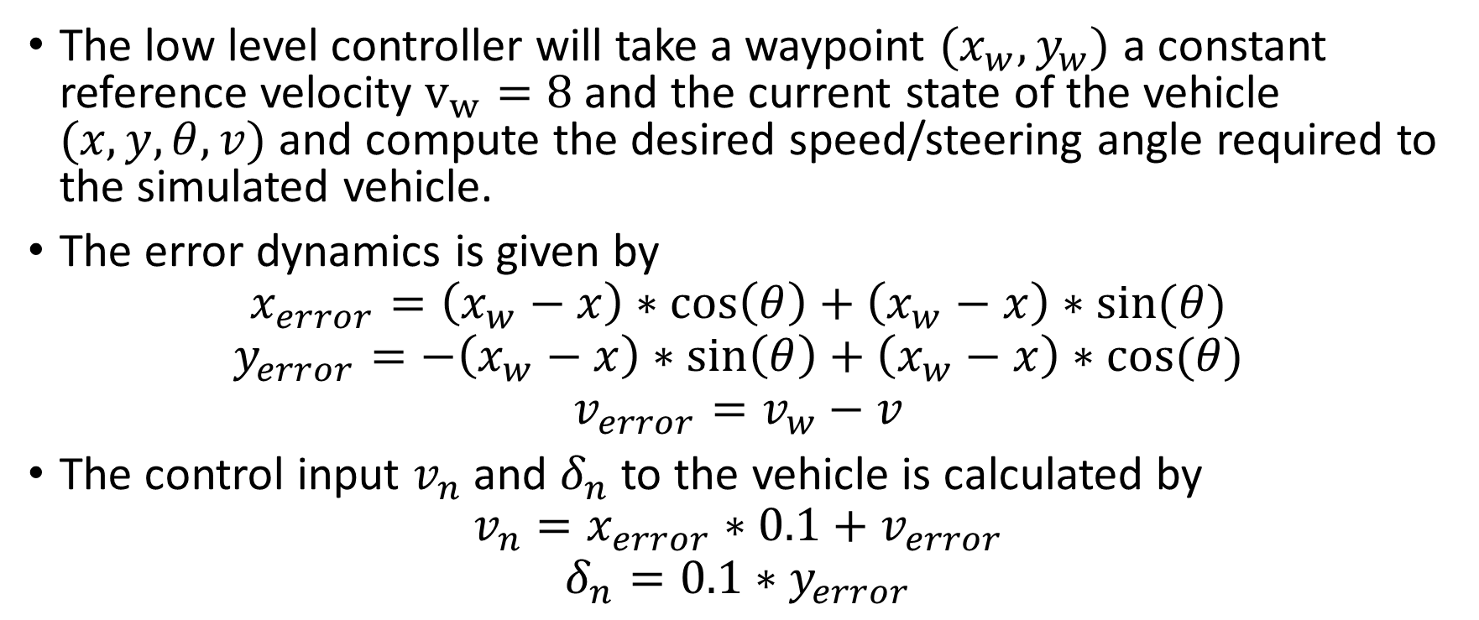
Low Level Control module
The low level controller will take a waypoint $(x_{w},y_{w})$ a constant reference velocity $v_{w}=8$ and the current state of the vehicle $(x,y,θ,v)$ and compute the desired speed/steering angle required to the simulated vehicle.
The error dynamics is given by
$$x_{error}=\left(x_{w}−x\right)∗\cos\left(θ\right)+\left(x_{w}−x\right)∗sin⁡(θ)$$
$$y_{error}=−\left(x_{w}−x\right)∗\sin\left(θ\right)+\left(x_{w}−x\right)∗cos⁡(θ)$$
$$v_{error}=v_{w}−v$$
The control input $v_{n}$ and $δ_{n}$ to the vehicle is calculated by
$$v_{n}=x_{error}∗0.1+v_{error}$$
$$δ_{n}=0.1∗y_{error}$$

Slide 12
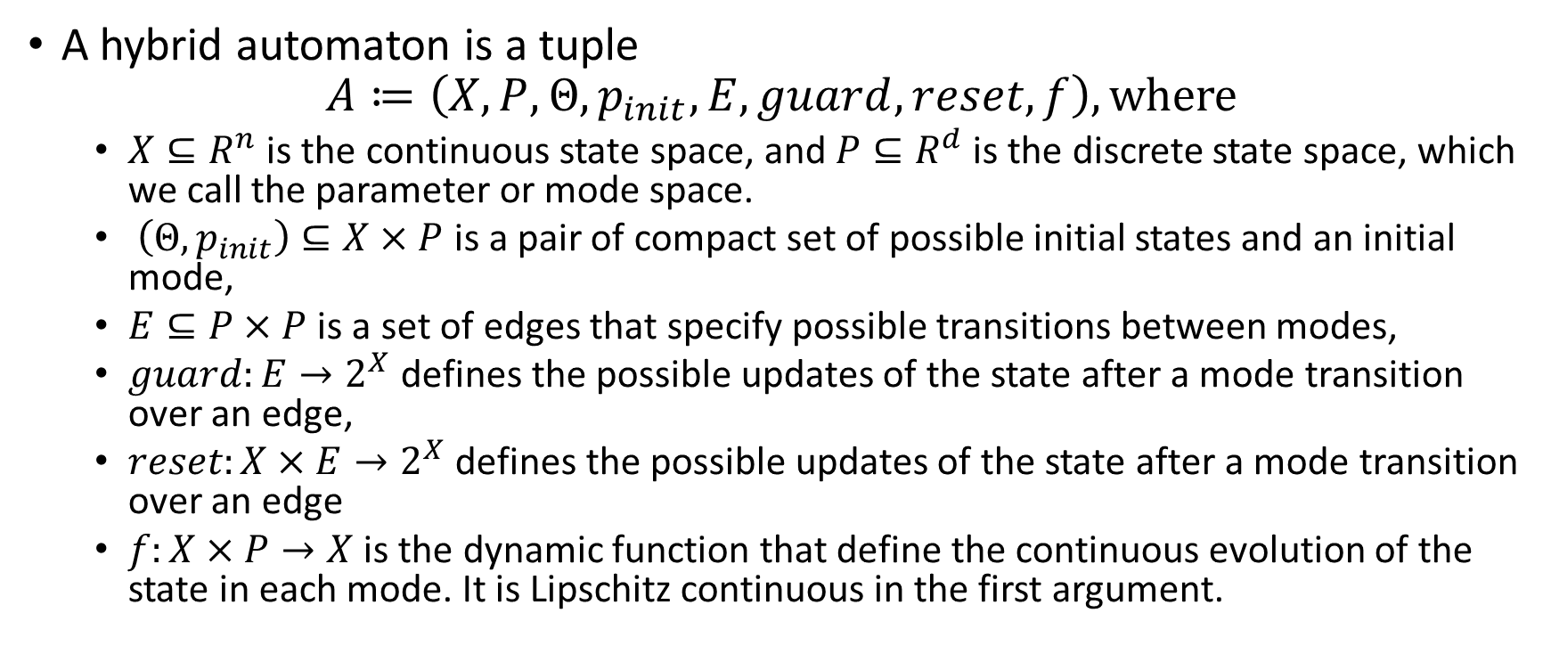
Hybrid automaton
A hybrid automaton is a tuple
$$A≔\left(X,P,Θ,p_{init},E, guard, reset, f\right), where$$
$X⊆R^{n}$ is the continuous state space, and $P⊆R^{d}$ is the discrete state space, which we call the parameter or mode space.
$\left(Θ,p_{init}\right)⊆X×P$ is a pair of compact set of possible initial states and an initial mode,
$E⊆P×P$ is a set of edges that specify possible transitions between modes,
$guard:E→2^{X}$ defines the possible updates of the state after a mode transition over an edge,
$reset:X×E→2^{X}$ defines the possible updates of the state after a mode transition over an edge
$f:X×P→X$ is the dynamic function that define the continuous evolution of the state in each mode. It is Lipschitz continuous in the first argument.

Slide 13
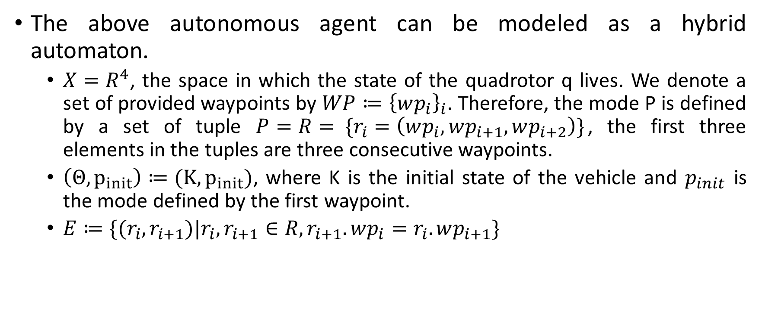
Model as Hybrid Automaton
The above autonomous agent can be modeled as a hybrid automaton.
$X=R^{4}$, the space in which the state of the quadrotor q lives. We denote a set of provided waypoints by $WP≔{\left\{wp_{i}\right\}}_{i}$. Therefore, the mode P is defined by a set of tuple $P=R= \{r_{i}=\left(wp_{i},wp_{i+1},wp_{i+2}\right)\}$, the first three elements in the tuples are three consecutive waypoints.
$\left(Θ,p_{init}\right)≔(K,p_{init})$, where K is the initial state of the vehicle and $p_{init}$ is the mode defined by the first waypoint.
$E≔\{(r_{i},r_{i+1})|r_{i},r_{i+1}∈R, r_{i+1}.wp_{i}=r_{i}.wp_{i+1}\}$

Slide 14
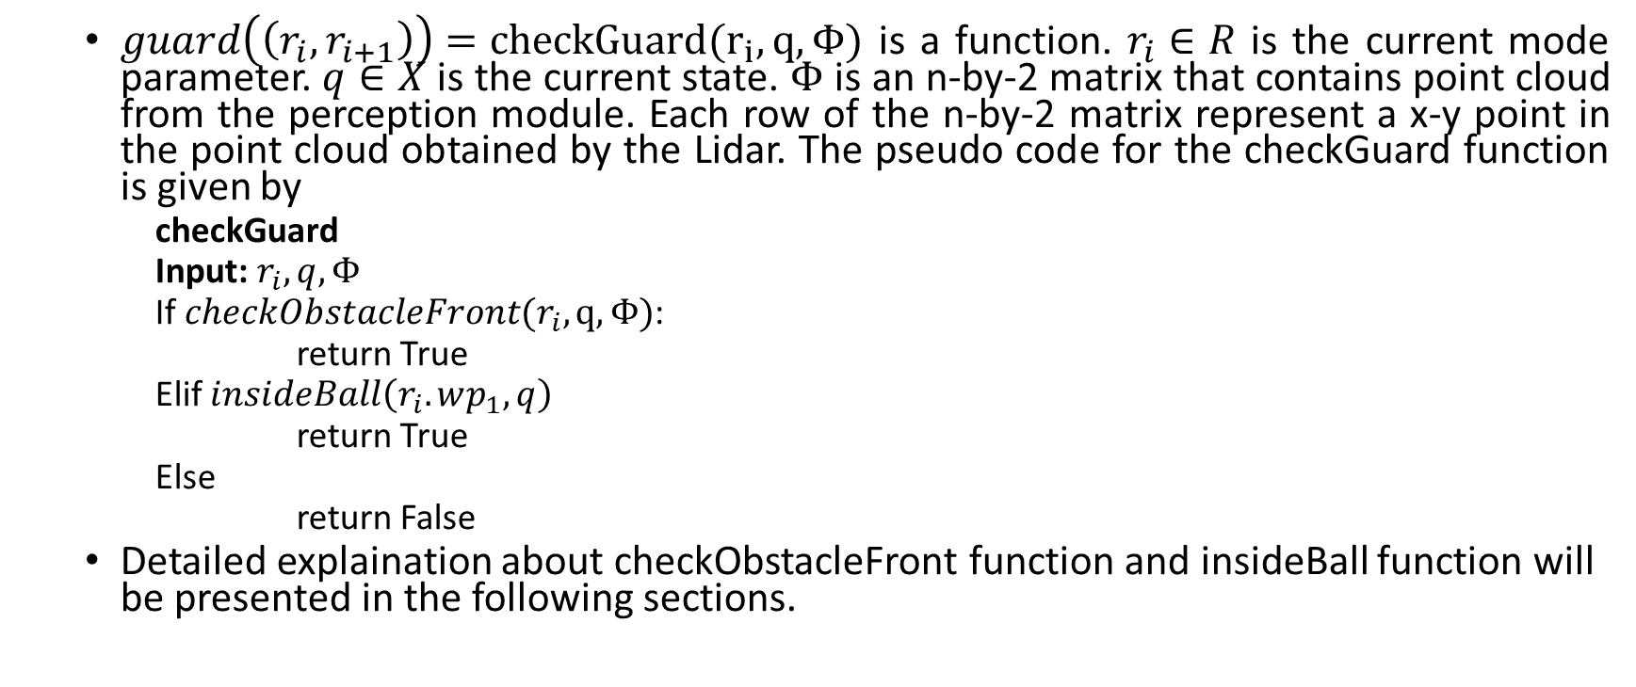
Model as Hybrid Automaton
$guard\left(\left(r_{i},r_{i+1}\right)\right)=checkGuard(r_{i}, q,Φ)$ is a function. $r_{i}∈R$ is the current mode parameter. $q∈X$ is the current state. $Φ$ is an n-by-2 matrix that contains point cloud from the perception module. Each row of the n-by-2 matrix represent a x-y point in the point cloud obtained by the Lidar. The pseudo code for the checkGuard function is given by
checkGuard
Input: $r_{i}, q, Φ$
If $checkObstacleFront(r_{i},q,Φ)$:
return True
Elif $insideBall\left(r_{i}.wp_{1},q\right)$
return True
Else
return False
Detailed explaination about checkObstacleFront function and insideBall function will be presented in the following sections.

Slide 15

$reset\left(q,\left(r_{i},r_{i+1}\right)\right)=computeReset(r_{i}, q,Φ)$ is the function that determines the reset value during mode transition. The pseudo code for the computeReset function is given by

Slide 16
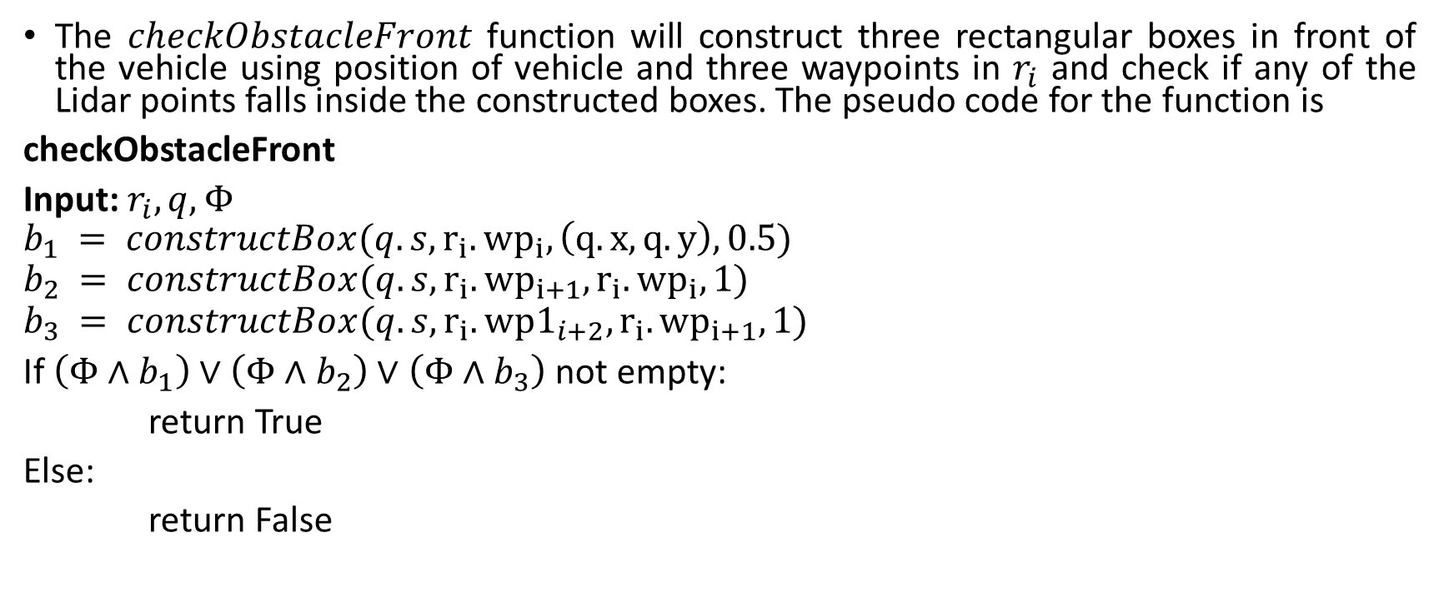
Model as Hybrid Automaton - checkObstacleFront
The $checkObstacleFront$ function will construct three rectangular boxes in front of the vehicle using position of vehicle and three waypoints in $r_{i}$ and check if any of the Lidar points falls inside the constructed boxes. The pseudo code for the function is
checkObstacleFront
Input: $r_{i}, q, Φ$
$$b_{1} = constructBox({q.s,r}_{i}.{wp}_{i}, \left(q.x, q.y\right),0.5)$$
$$b_{2} = constructBox(q.s,r_{i}.{wp}_{i+1},r_{i}.{wp}_{i},1)$$
$$b_{3} = constructBox(q.s,r_{i}.wp1_{i+2},r_{i}.{wp}_{i+1},1)$$
If $\left(Φ∧b_{1}\right)∨\left(Φ∧b_{2}\right)∨\left(Φ∧b_{3}\right)$ not empty:
return True
Else:
return False

Slide 17

Model as Hybrid Automaton - constructBox
The constructBox function will construct a rectangular box given the current vehicle status $s$, a set of two waypoints, and a radius $r$. The function will first shift the two waypoints according to the status of the vehicle.

