Slide 1
Neural Network based controller synthesis
Yangge Li

Slide 2
Introduction
The goal of this project is to synthesize controllers for nonlinear systems and reach-avoid requirements.
The synthesize controllers consist of a reference trajectory and tracking controller which drives the system’s state towards the reference
The tracking controller will be a neural networks controller learded from example running data
Using reachability analysis tool to calculate the error bound of the tracking controller.

Slide 3
Reference Trajectory
The controller we have is trying to track a given reference trajectory.
The reference trajectory is a straight line connecting the initial position of the vehicle and a point 15 unit away from the initial position of the vehicle.
The reference trajectory is constructed by assuming the vehicle is running at constant velocity 5.

Slide 4
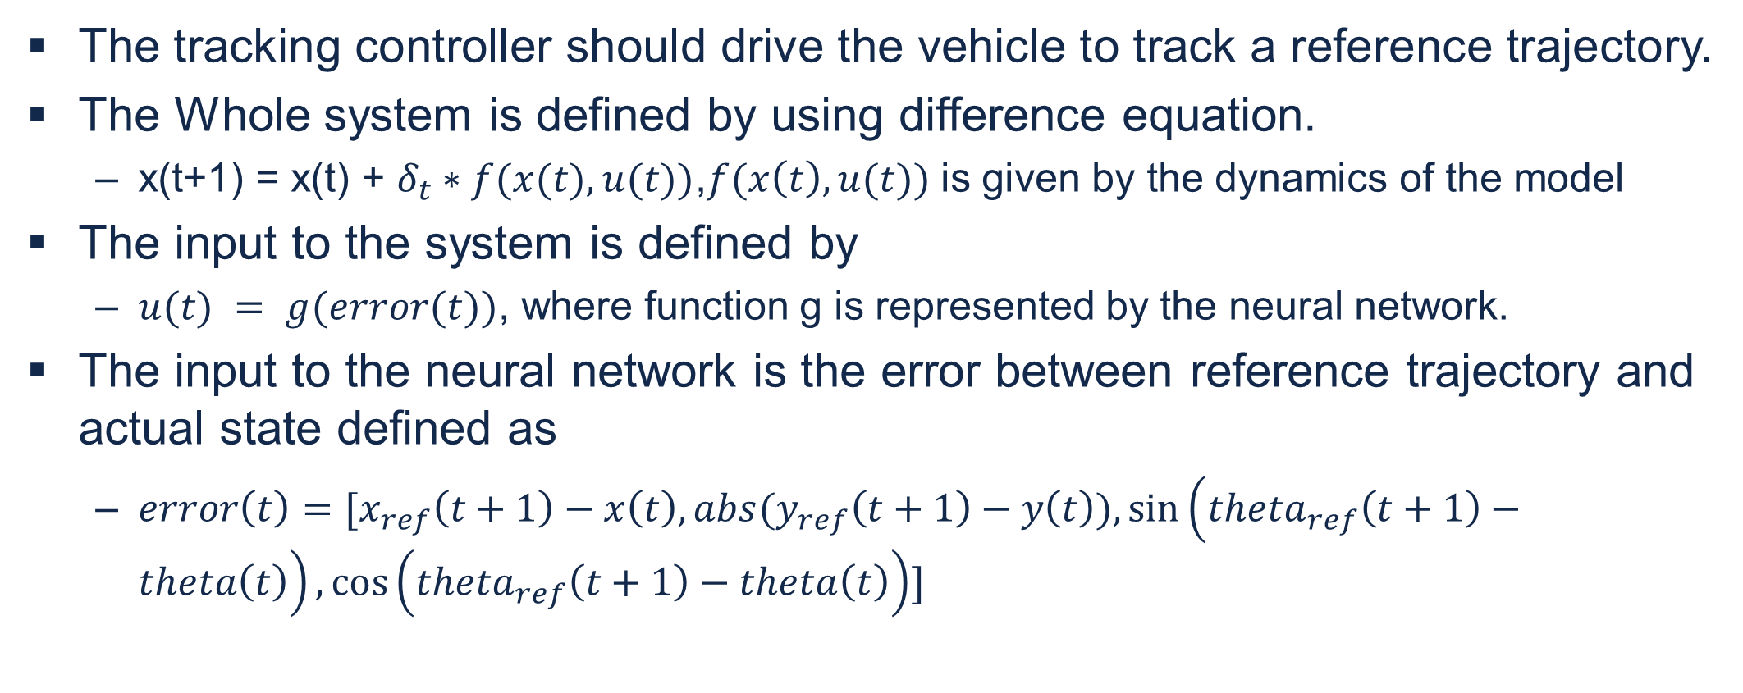
Tracking Controller
The tracking controller should drive the vehicle to track a reference trajectory.
The Whole system is defined by using difference equation.
x(t+1) = x(t) + $δ_{t}∗f(x(t),u(t))$,$f(x\left(t\right),u(t))$ is given by the dynamics of the model
The input to the system is defined by
$u(t) = g(error(t))$, where function g is represented by the neural network.
The input to the neural network is the error between reference trajectory and actual state defined as
$error\left(t\right)=[x_{ref}\left(t+1\right)−x\left(t\right), abs(y_{ref}\left(t+1\right)−y\left(t\right)),sin\left(theta_{ref}\left(t+1\right)−theta\left(t\right)\right),\cos\left(theta_{ref}\left(t+1\right)−theta\left(t\right)\right)]$

Slide 5
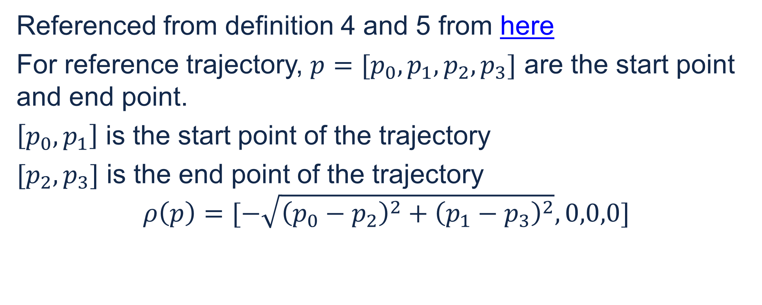
Translation and rotation symmetry of the system
Referenced from definition 4 and 5 from here
For reference trajectory, $p=[p_{0},p_{1},p_{2},p_{3}]$ are the start point and end point.
$\left[p_{0},p_{1}\right]$ is the start point of the trajectory
$[p_{2},p_{3}]$ is the end point of the trajectory
$$ρ\left(p\right)=[−\sqrt{{\left(p_{0}−p_{2}\right)}^{2}+{\left(p_{1}−p_{3}\right)}^{2}},0,0,0]$$

Slide 6
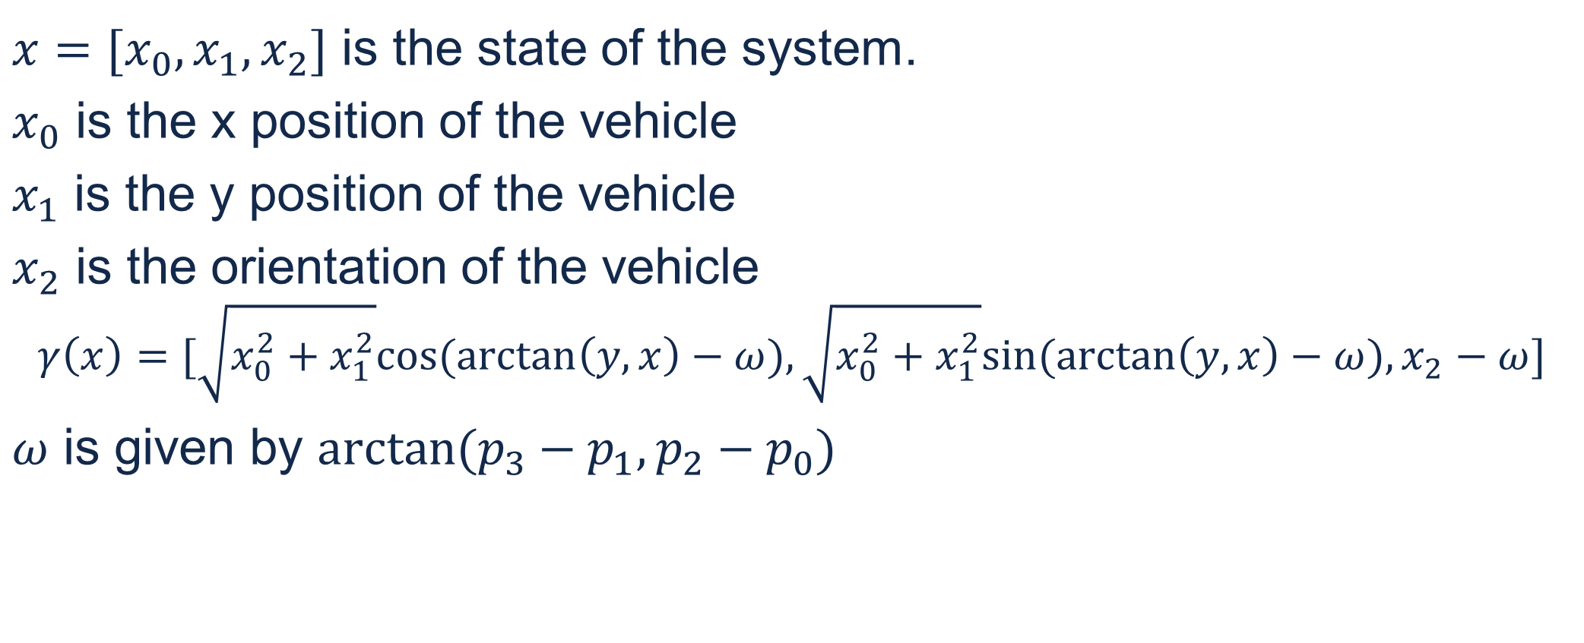
Symmetry of system
$x=[x_{0},x_{1},x_{2}]$ is the state of the system.
$x_{0}$ is the x position of the vehicle
$x_{1}$ is the y position of the vehicle
$x_{2}$ is the orientation of the vehicle
$$γ\left(x\right)=[\sqrt{x_{0}^{2}+x_{1}^{2}}cos⁡(\arctan\left(y,x\right)−ω),\sqrt{x_{0}^{2}+x_{1}^{2}}sin⁡(\arctan\left(y,x\right)−ω),x_{2}−ω]$$
$ω$ is given by $arctan⁡(p_{3}−p_{1},p_{2}−p_{0})$

Slide 7
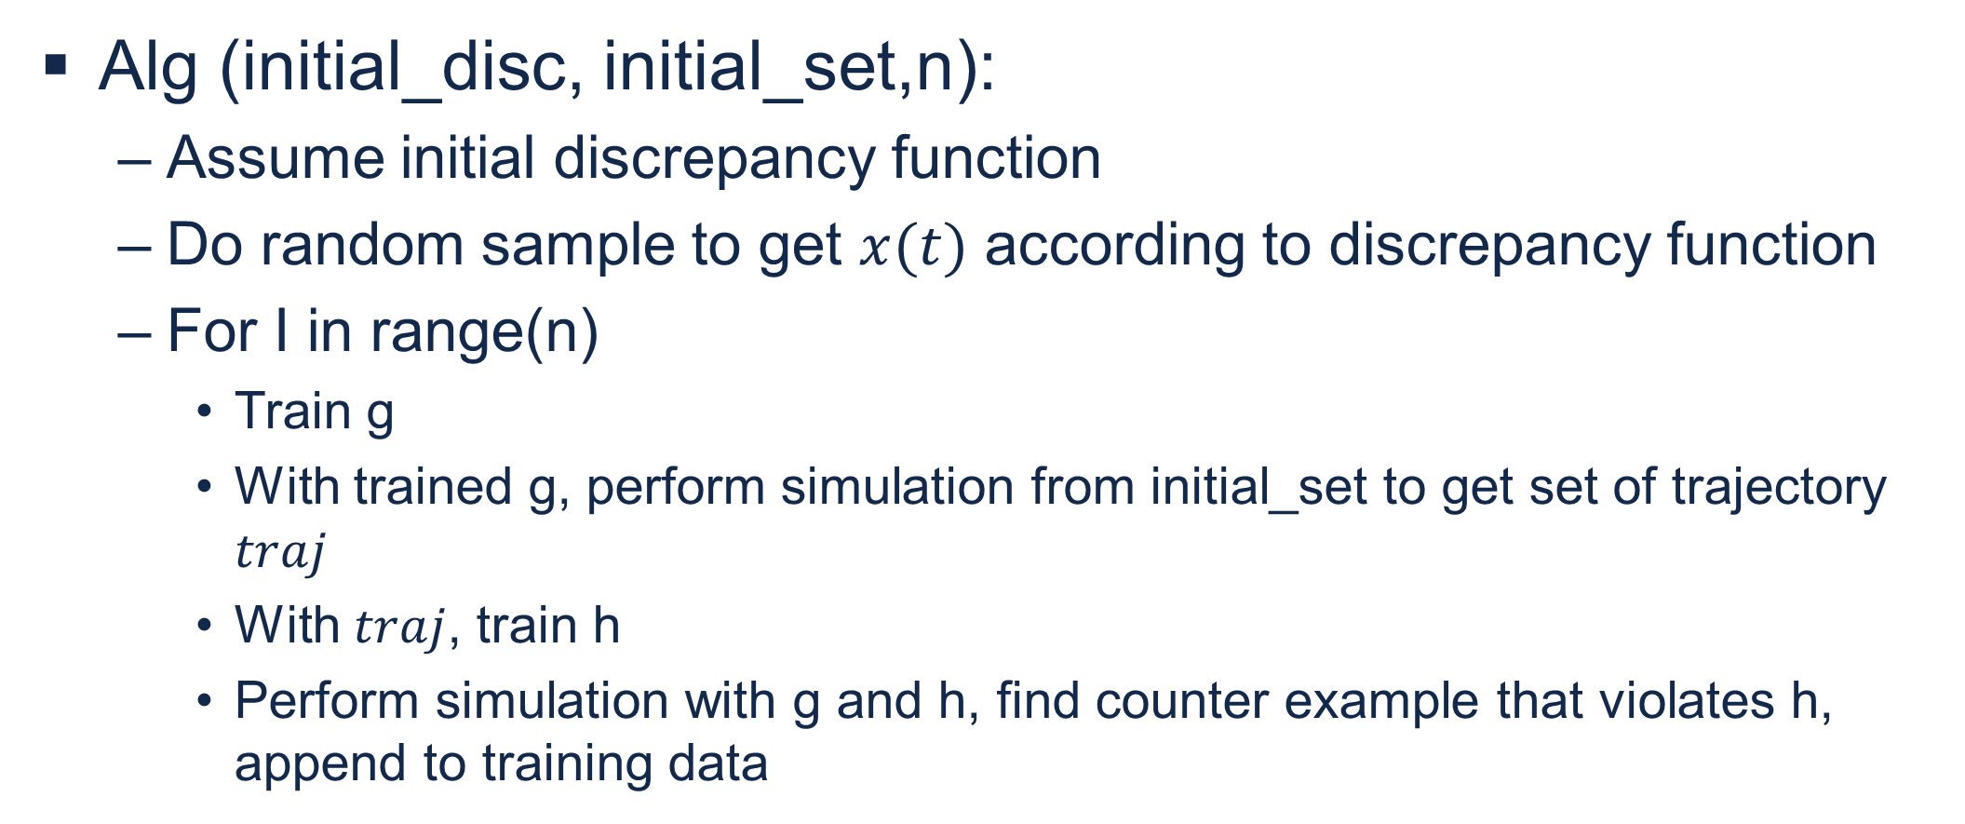
Alg (initial_disc, initial_set,n):
Assume initial discrepancy function
Do random sample to get $x(t)$ according to discrepancy function
For I in range(n)
Train g
With trained g, perform simulation from initial_set to get set of trajectory $traj$
With $traj$, train h
Perform simulation with g and h, find counter example that violates h, append to training data

Slide 8
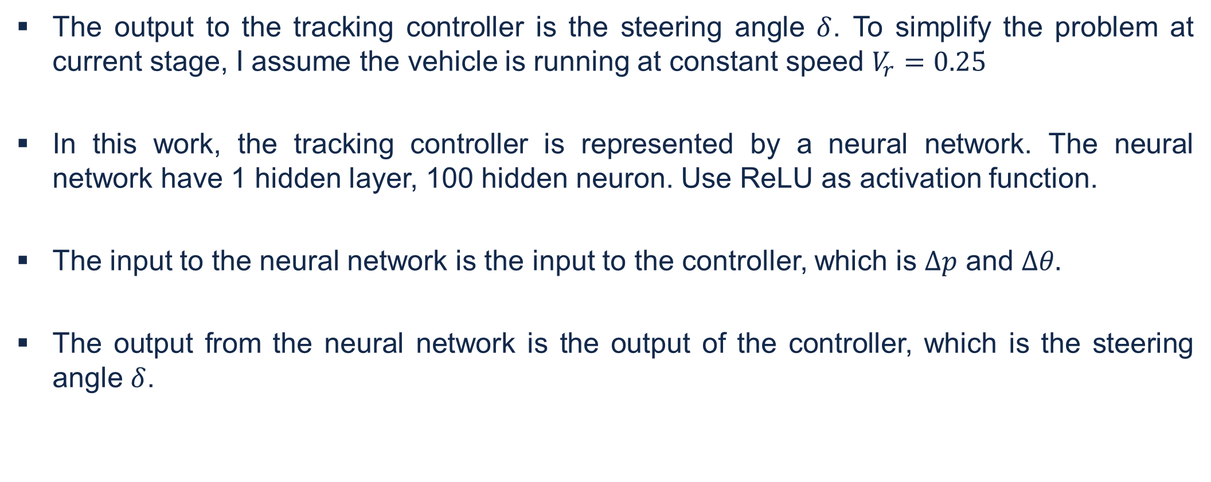
Tracking Controller
The output to the tracking controller is the steering angle $δ$. To simplify the problem at current stage, I assume the vehicle is running at constant speed $V_{r}=0.25$
In this work, the tracking controller is represented by a neural network. The neural network have 1 hidden layer, 100 hidden neuron. Use ReLU as activation function.
The input to the neural network is the input to the controller, which is $Δp$ and $Δθ.$
The output from the neural network is the output of the controller, which is the steering angle $δ$.

Slide 9
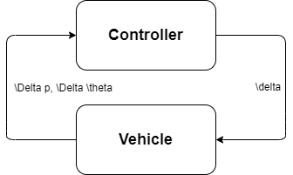
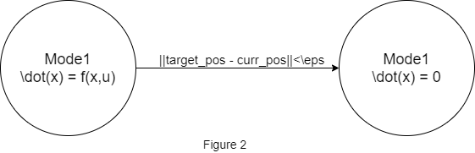
Computing the reachabe set
With the tracking controller and a vehicle model, it is able to close the loop to form a non linear autonomous system (figure 1) to be analyzed by reachability computation algorithm.
The transition graph of the system is shown in figure 2.
Use DryVR to compute the reachtube of the system. Since DryVR can handle black box model.

Slide 10
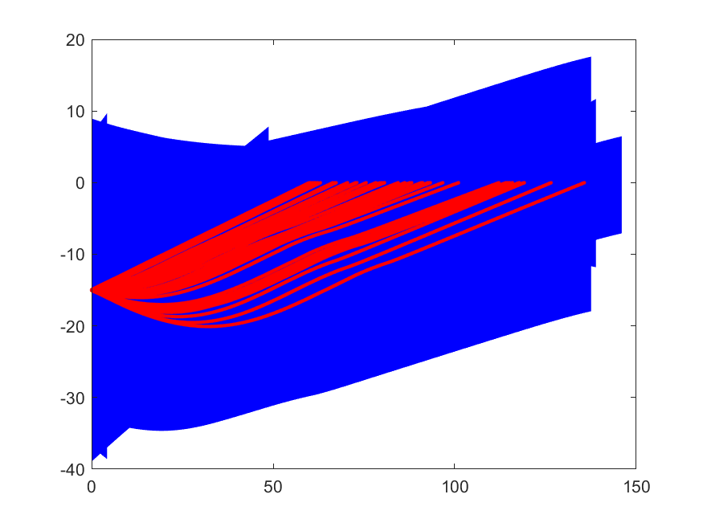
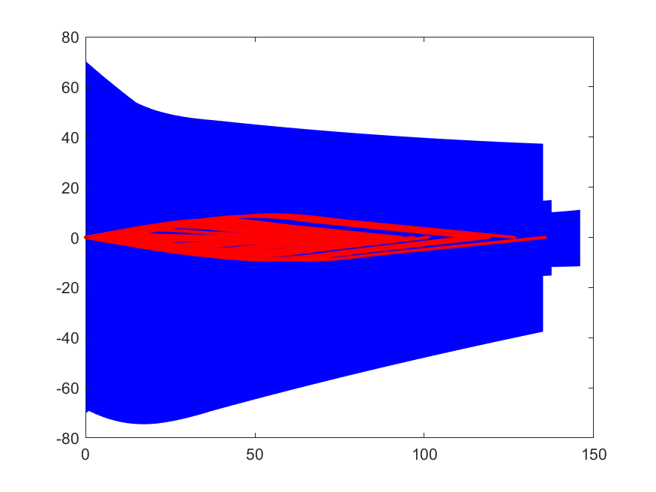
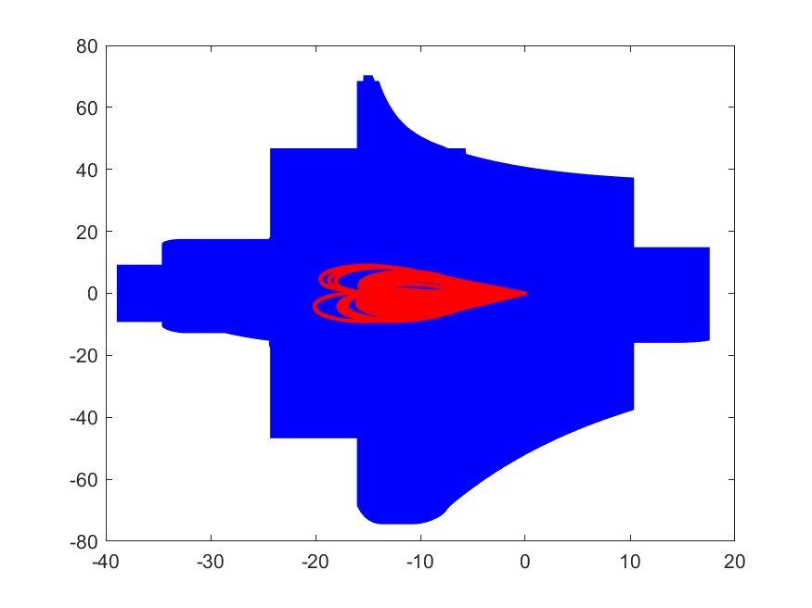

Computed Reachtube
The below figures shows the reach tube computed by DryVR for the vehicle with initial condition $−15.05≤x≤−14.05, −0.05≤y≤0.05, −π≤θ≤π$, where x, y are the position of the vehicle and $θ$ is the orientation of the vehicle.
In the pictures, the reach tube for mode 1 is not plotted since the vehicle will remain stationary in that mode. The red traces in the plot shows random simulation trajectories with the neural network tracking controller.
The first plot plots time vs x. The second plot plots time vs y. The third plot plots x vs y.

Slide 11
Next Step
With the reachtube computed, it is possible to obtain a bound for the error of tracking the reference trajectory.
The next step is to generate a reference trajectory that the vehicle can follow and can reach the goal.

