Slide 1
Neural Network based controller synthesis
Yangge Li

Slide 2
Introduction
The goal of this project is to synthesize controllers for nonlinear systems and reach-avoid requirements.
The synthesize controllers consist of a reference trajectory and tracking controller which drives the system’s state towards the reference
The tracking controller will be a neural networks controller learned from example running data
Using reachability analysis tool to calculate the error bound of the tracking controller.

Slide 3
Reference Trajectory
The controller we have is trying to track a given reference trajectory.
The reference trajectory is a straight line connecting the initial position of the vehicle and a point 15 unit away from the initial position of the vehicle.
The reference trajectory is constructed by assuming the vehicle is running at constant velocity 5.

Slide 4
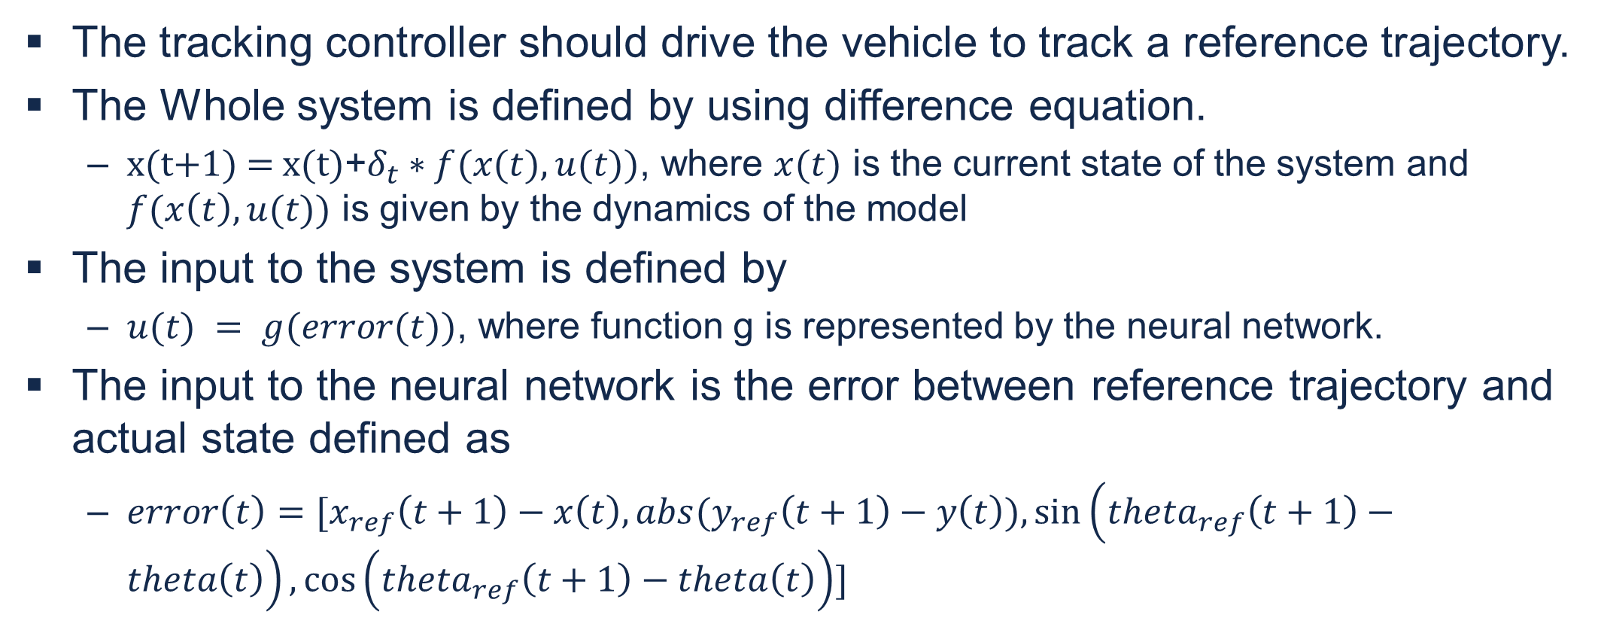
Tracking Controller
The tracking controller should drive the vehicle to track a reference trajectory.
The Whole system is defined by using difference equation.
$\text{x}\text{(}\text{t}\text{+1) = }\text{x}\text{(}\text{t}\text{)}\text{+}δ_{t}∗f(x(t),u(t))$, where $x(t)$ is the current state of the system and $f(x\left(t\right),u(t))$ is given by the dynamics of the model
The input to the system is defined by
$u(t) = g(error(t))$, where function g is represented by the neural network.
The input to the neural network is the error between reference trajectory and actual state defined as
$error\left(t\right)=[x_{ref}\left(t+1\right)−x\left(t\right), abs(y_{ref}\left(t+1\right)−y\left(t\right)),sin\left(theta_{ref}\left(t+1\right)−theta\left(t\right)\right),\cos\left(theta_{ref}\left(t+1\right)−theta\left(t\right)\right)]$

Slide 5
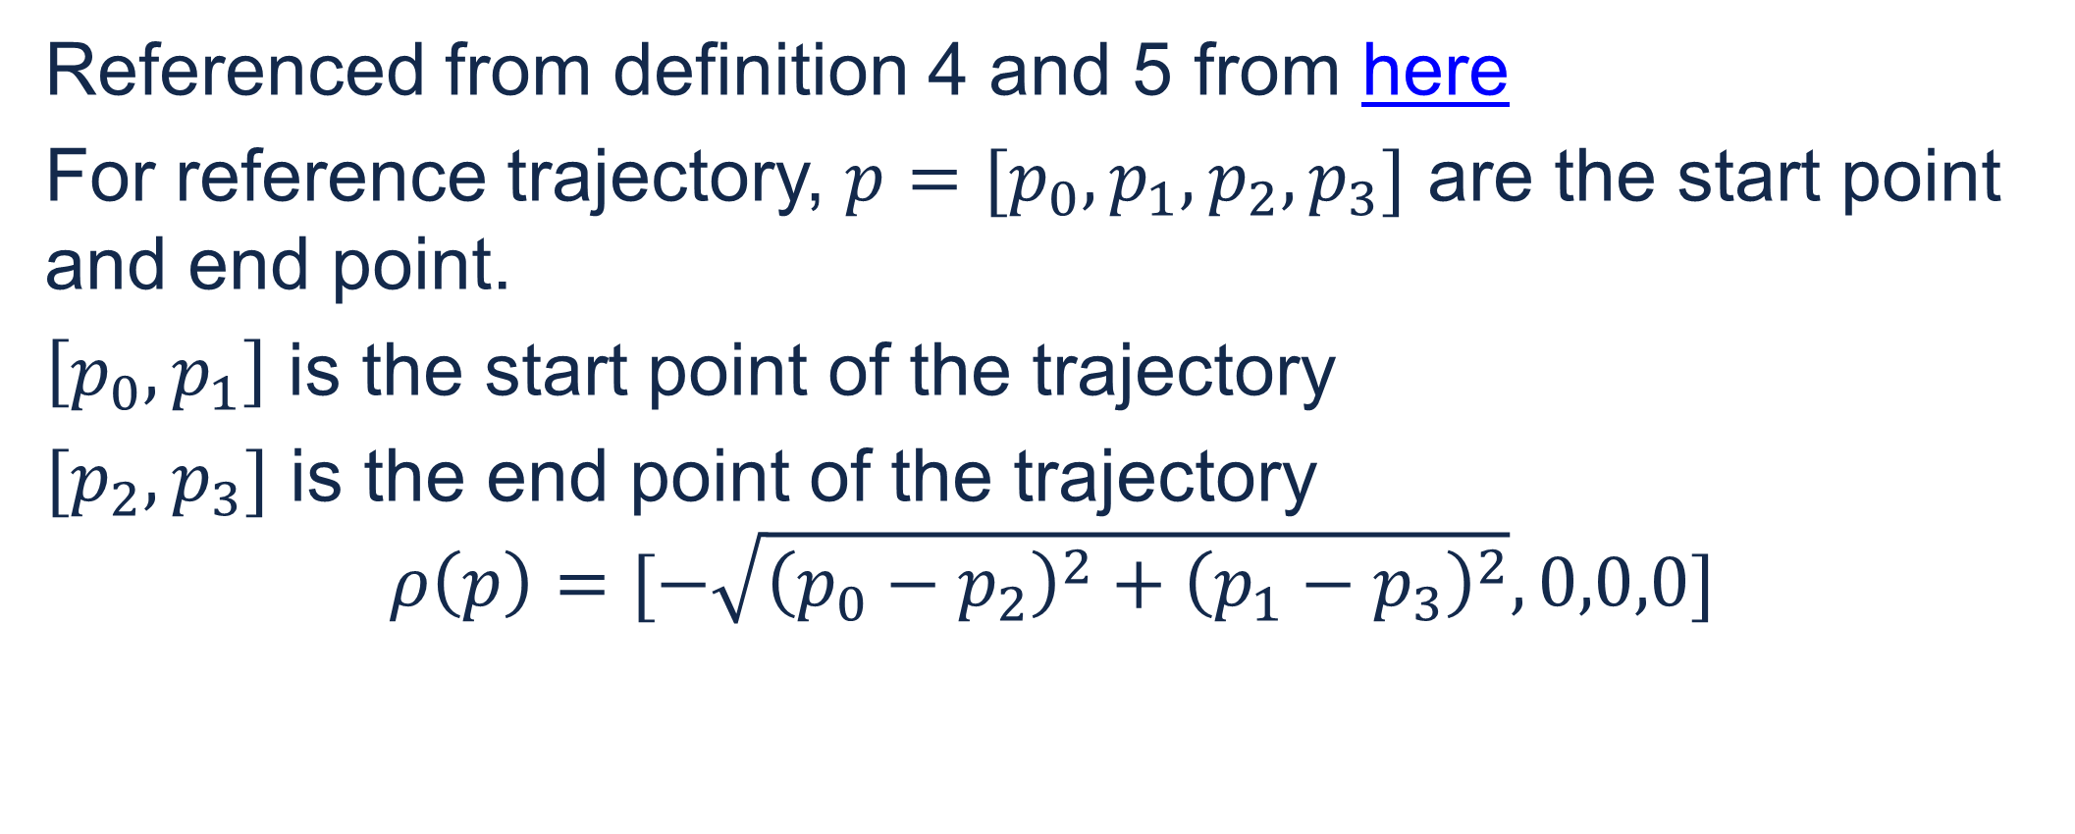
Translation and rotation symmetry of the system
Referenced from definition 4 and 5 from here
For reference trajectory, $p=[p_{0},p_{1},p_{2},p_{3}]$ are the start point and end point.
$\left[p_{0},p_{1}\right]$ is the start point of the trajectory
$[p_{2},p_{3}]$ is the end point of the trajectory
$$ρ\left(p\right)=[−\sqrt{{\left(p_{0}−p_{2}\right)}^{2}+{\left(p_{1}−p_{3}\right)}^{2}},0,0,0]$$

Slide 6
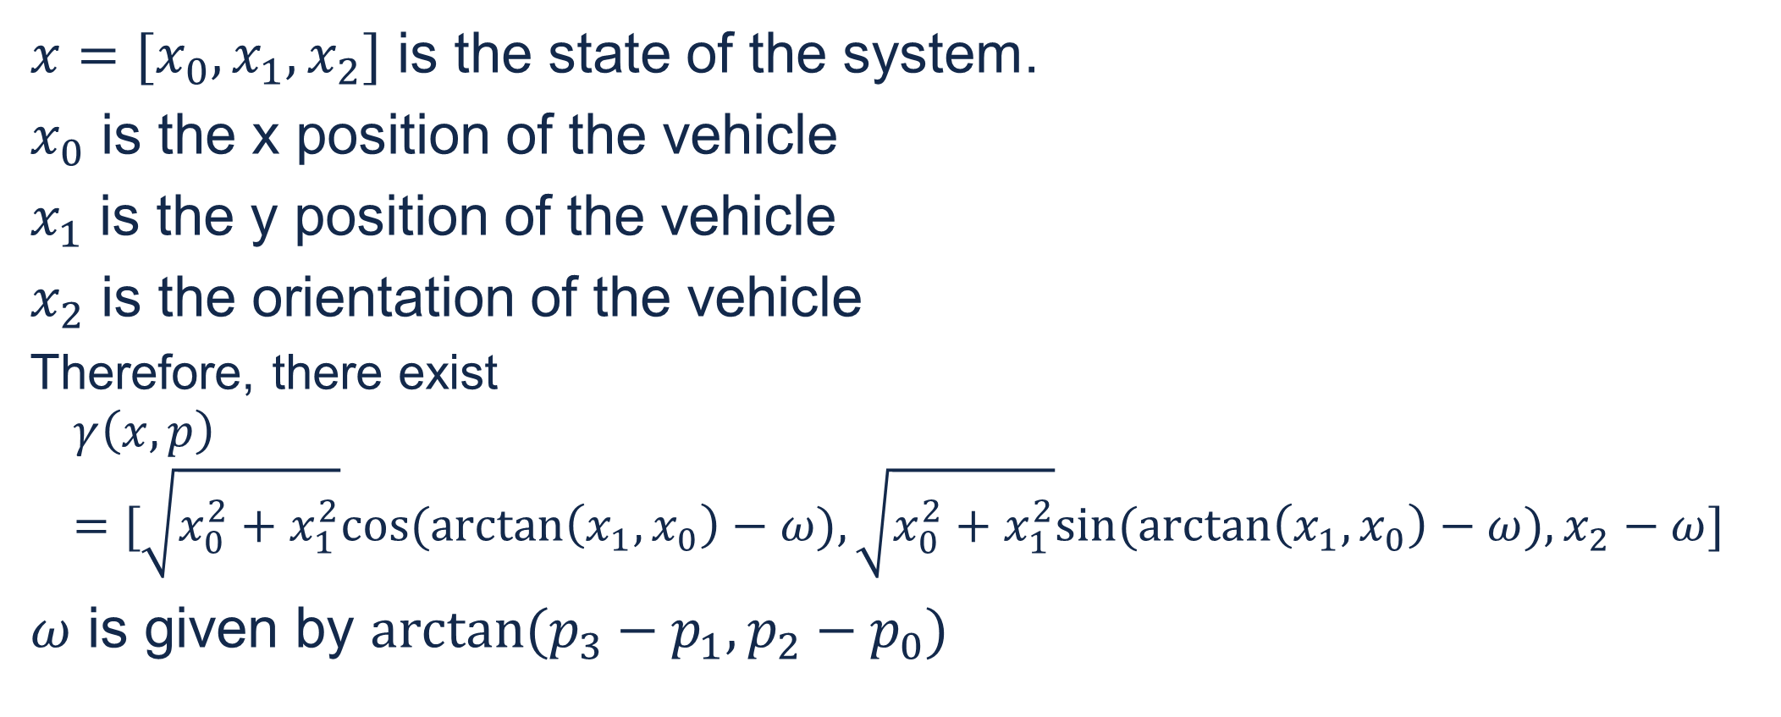
Translation and rotation symmetry of the system
$x=[x_{0},x_{1},x_{2}]$ is the state of the system.
$x_{0}$ is the x position of the vehicle
$x_{1}$ is the y position of the vehicle
$x_{2}$ is the orientation of the vehicle
Therefore, there exist
$$γ\left(x,p\right)=[\sqrt{x_{0}^{2}+x_{1}^{2}}cos⁡(\arctan\left(x_{1},x_{0}\right)−ω),\sqrt{x_{0}^{2}+x_{1}^{2}}sin⁡(\arctan\left(x_{1},x_{0}\right)−ω),x_{2}−ω]$$
$ω$ is given by $arctan⁡(p_{3}−p_{1},p_{2}−p_{0})$

