Slide 1
Gender recognition based on speech recognition
校交1802 李俊

Slide 2
Content
Data analysis
Data pre-processing
Initial realization
Optimum
Model evaluation
Abstract: The main use of hand-written SVM models to solve nonlinear classification problems, focusing on further optimizing the SVM model through various methods to achieve the expected accuracy, and finally giving a model evaluation of SVM

Slide 3
Data analysis
The features of voice
The relationship between features

Slide 4
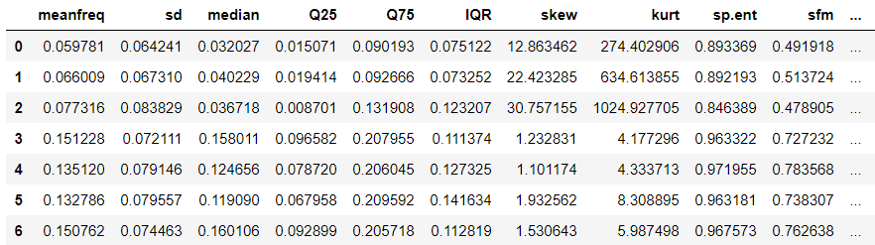
The features of voice
Each sample in voice.csv contains 20 eigenvalues that include the length of the speech signal, the fundamental frequency, the Data such as standard deviation, band median point/division frequency/third frequency, and so on.

Slide 5
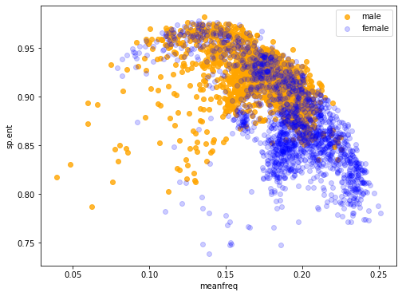
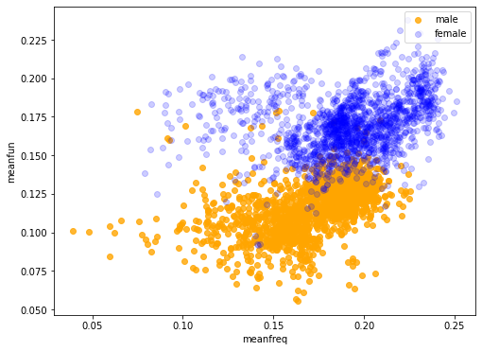
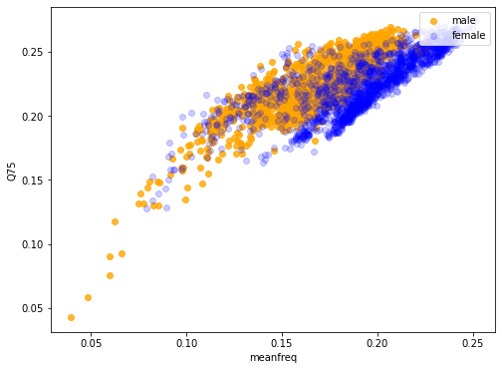
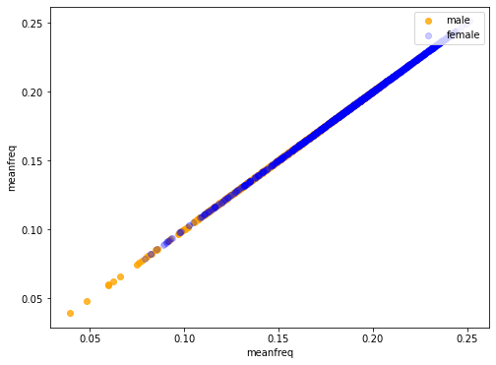
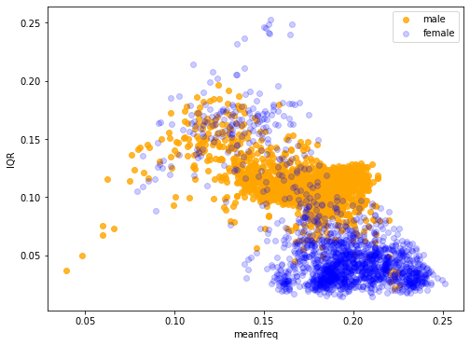
The relationship between features

Slide 6
Data pre-processing
string mapping
Division of training set and test set
cross-validation
In the dataset, the data under the label column is in the form of strings, which need to be mapped to numbers for ease of processing.
Before dividing the training and test sets, the data needed to be randomly scrambled because in the original data file, the data were broken down by gender Sorted, not randomized.
Divide the data into 5 mutually exclusive subsets, each group accounting for 20% of the total data, use one set of data as a test set at a time, the remaining 4 groups as a training set, repeated 5 times

Slide 7
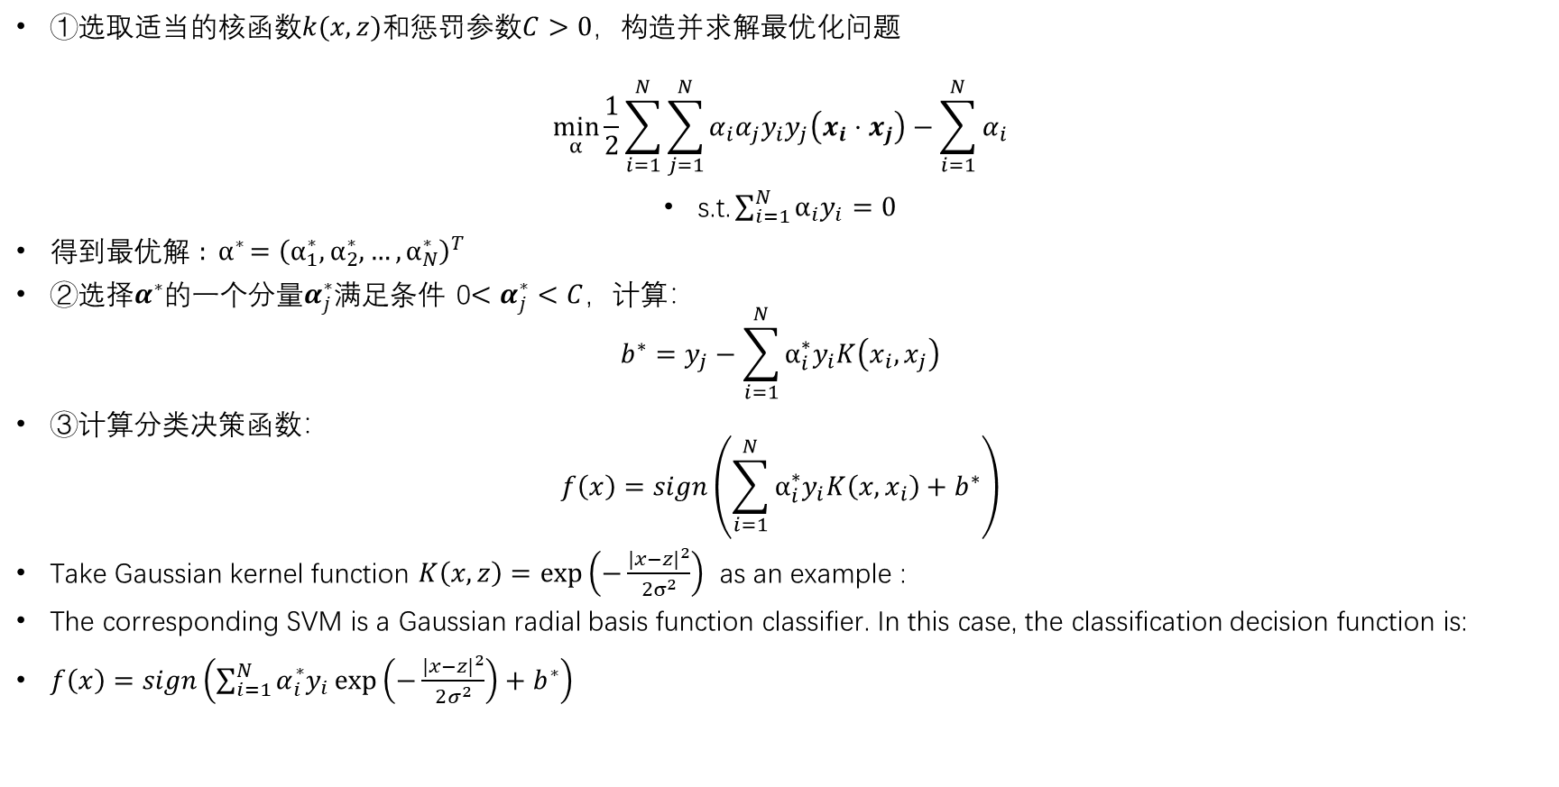
Steps of SVM Initial realization
①选取适当的核函数$k(x,z)$和惩罚参数$C>0$，构造并求解最优化问题
$$\min_{α}{\frac{1}{2}\sum_{i=1}^{N}{\sum_{j=1}^{N}{α_{i}α_{j}y_{i}y_{j}\left(x_{i}⋅x_{j}\right)}}−\sum_{i=1}^{N}{α_{i}}}$$
$\text{s}\text{.}\text{t}\text{.}\sum_{i=1}^{N}{α_{i}y_{i}}=0$
得到最优解 ${: α}^{∗}={\left(α_{1}^{∗},α_{2}^{∗},…,α_{N}^{∗}\right)}^{T}$
②选择$α^{∗}$的一个分量$α_{j}^{∗}$满足条件 0$<α_{j}^{∗}<C$，计算：
$$b^{∗}=y_{j}−\sum_{i=1}^{N}{α_{i}^{∗}y_{i}K\left(x_{i},x_{j}\right)}$$
③计算分类决策函数：
$$f\left(x\right)=sign\left(\sum_{i=1}^{N}{α_{i}^{∗}y_{i}K\left(x,x_{i}\right)}+b^{∗}\right)$$
Take Gaussian kernel function $K\left(x,z\right)=\exp\left(−\frac{|x−z|^{2}}{2σ^{2}}\right)$ as an example :
The corresponding SVM is a Gaussian radial basis function classifier. In this case, the classification decision function is:
$f\left(x\right)=sign\left(\sum_{i=1}^{N}{α_{i}^{∗}y_{i}}\exp\left(−\frac{|x−z|^{2}}{2σ^{2}}\right)+b^{∗}\right)$
[1] 李航．统计学习方法．北京：清华大学出版社，2019：第七章，pp.142-143.

Slide 8
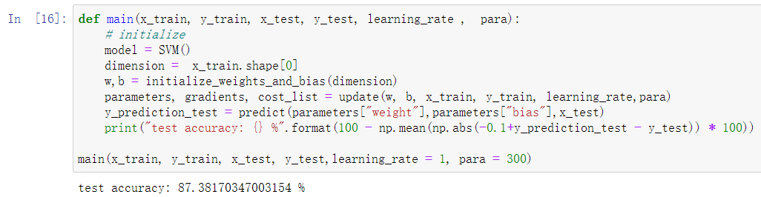
Result of SVM Initial realization
class SVM(object):
"""
SVM model
"""
def __init__(self, max_iter=10000, kernel_type='linear', C=1.0, epsilon=0.00001):
self.max_iter = max_iter
self.kernel_type = kernel_type
self.kernel_func_list = {
'linear': self._kernel_linear,
'quadratic': self._kernel_quadratic,
}
self.kernel_func = self.kernel_func_list[kernel_type]
self.C = C
self.epsilon = epsilon
self.alpha = None
………
Algorithm | Training set accuracy | Test set accuracy
BaseLine | 50% | 50%
Logistic Regression | 97% | 98%
CART | 96% | 97%
Random Forest | 100% | 98%
SVM | 100% | 99%
XGBoost | 100% | 99%

Slide 9
Optimum
Data standardization
Kernel tricks
Penalty variables
Others

Slide 10
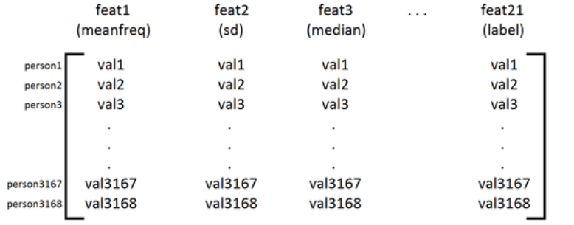
Data standardization
INTRODUCTION:
The normalization of data is to scale the data so that it falls into a small specific interval. It is often used in the processing of certain comparison and evaluation indicators to remove the unit limitation of the data and convert it into a dimensionless pure value, so that indicators of different units or magnitudes can be compared and weighted.
Realization:
By normalizing the data, i.e., by shifting the distribution of each attribute to have a mean with zero and a standard deviation set to one, support was found for SVM has a prediction accuracy of 96%. The prediction accuracy using cross-validation view was 94%.
Result: After data standardization, the prediction accuracy using cross-validation viewing was 94%.
proposal | Training set accuracy | Test Set Accuracy | Cross-validation accuracy
post-standardization | 96.31% | 96.42% | 94.55%
pre-standardization | 87.45% | 87.96% | 87.38%

Slide 11
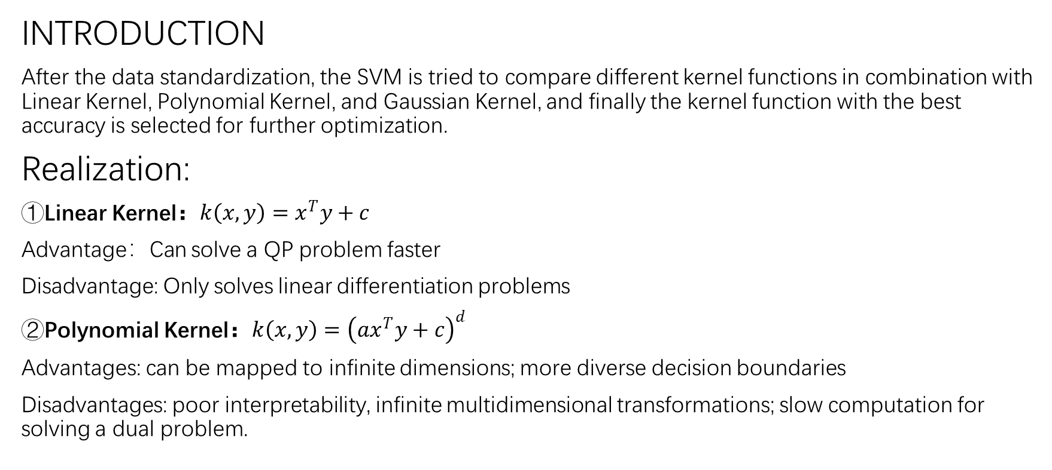
Kernel tricks
INTRODUCTION
After the data standardization, the SVM is tried to compare different kernel functions in combination with Linear Kernel, Polynomial Kernel, and Gaussian Kernel, and finally the kernel function with the best accuracy is selected for further optimization.
Realization:
①Linear Kernel：$k\left(x,y\right)=x^{T}y+c$
Advantage：Can solve a QP problem faster
Disadvantage: Only solves linear differentiation problems
②Polynomial Kernel：$k\left(x,y\right)={\left(ax^{T}y+c\right)}^{d}$
Advantages: can be mapped to infinite dimensions; more diverse decision boundaries
Disadvantages: poor interpretability, infinite multidimensional transformations; slow computation for solving a dual problem.

Slide 12
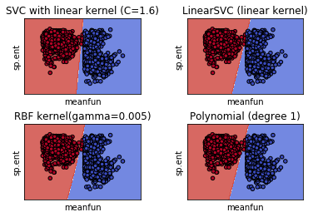
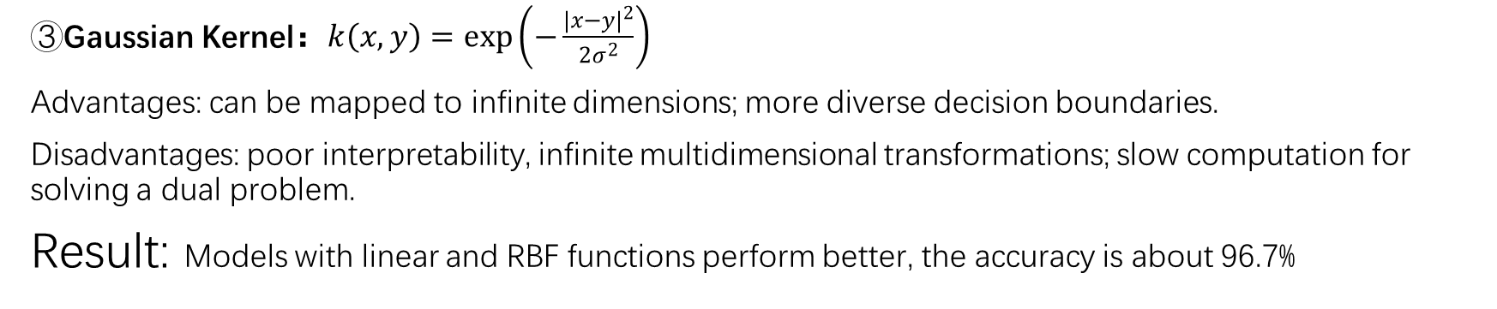
Kernel tricks
③Gaussian Kernel：$k\left(x,y\right)=\exp\left(−\frac{|x−y|^{2}}{2σ^{2}}\right)$
Advantages: can be mapped to infinite dimensions; more diverse decision boundaries.
Disadvantages: poor interpretability, infinite multidimensional transformations; slow computation for solving a dual problem.
Result: Models with linear and RBF functions perform better, the accuracy is about 96.7%
proposal | cross-validation
kernel=linear | 96.71%
kernel=RBF | 96.79%
kernel=poly | 93.39%

Slide 13
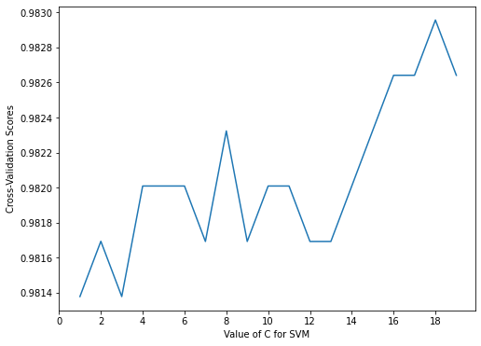
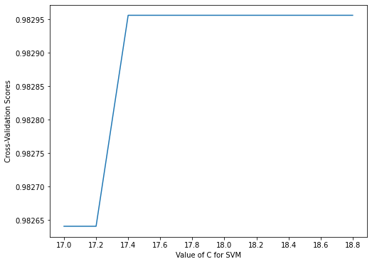
Penalty variables
INTRODUCTION:
The parameter C is the penalty variable. The larger the value of C, the more severe the penalty for misclassification. The case of classification pairs. the smaller the value of C, the smaller the penalty for misclassification, allowing errors to be made, treating some points of misclassification as noise Ignore.
Result: The model has the highest accuracy of about 98% when C is 17.4.
Accuracy of parameter C for values 1.0-20.0
Accuracy of parameter C for values 17.0-19.0

Slide 14
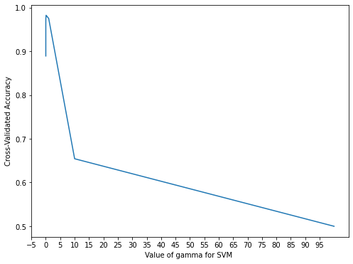
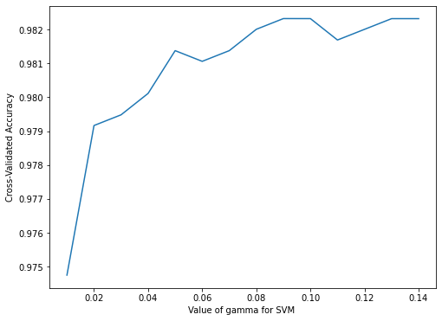
Other parameters
INTRODUCTION:
If the final RBF kernel function is adopted, then the gamma parameter is one of the more important parameters in addition to the C parameter in the support vector machine.
Result: When gamma is equal to 0.090, the accuracy of the model reaches its highest value at around 98.2%.
Accuracy of gamma for values 0-100.0
Accuracy of gamma for values 0-0.15

Slide 15
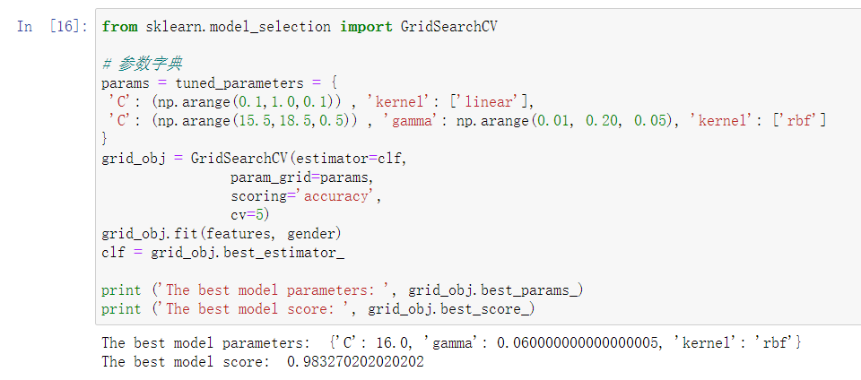
Optimization summary
We can use a grid search to pick an optimal combination of parameters.
proposal | The best solution
pre-processing | Data standardization
SVM kernel | RBF
Penalty variables C | 16.0
RBF Gamma | 0.06
Result:
The RBF kernel function is selected, when the parameter C is 16.0 and the gamma is 0.06, the model accuracy is the highest, and the cross-validation accuracy is about 98.32%

Slide 16
Model evaluation
Acc curve and Loss curve
Random testing of samples
Error classification check

Slide 17
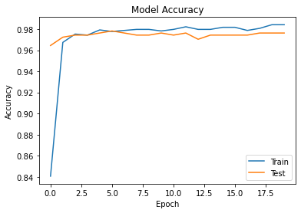
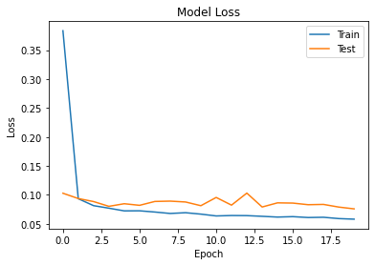
Acc curve and Loss curve
Overall, the training set accuracy and the test set accuracy are approaching each other. The images do not show that the training set accuracy ultimately far exceeds the test set accuracy, so overfitting and trends are not considered.
[1] 李航．统计学习方法．北京：清华大学出版社，2019：第七章，p.131.

Slide 18
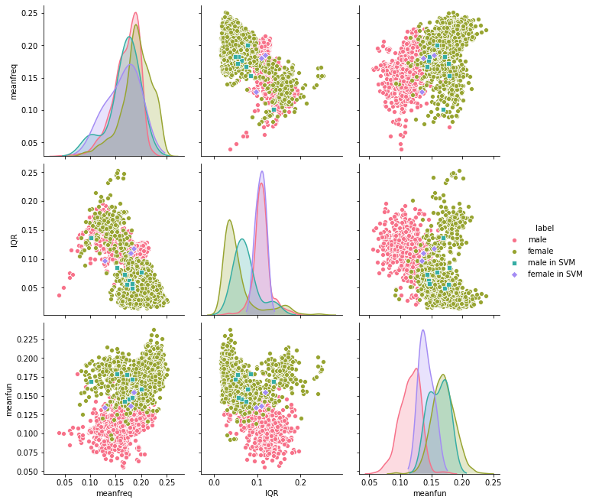
Error classification check
We can see that the distribution of misclassified samples is mainly located at the junction of the two clusters, that is, the sound features tend to be neutral. Therefore, it is difficult for the model to distinguish the category of these people. A small number of samples fall into the middle of the heterosexual cluster, which makes the model wrongly classified.

Slide 19
Application
Speech signal processing
Format conversion
Feature extraction
Combined SVM model prediction
Use any device to record a human voice, save it in MP3 format, convert it into a WAV waveform by using the correlation principle, then extract the features and combine them with the SVM model prediction

Slide 20
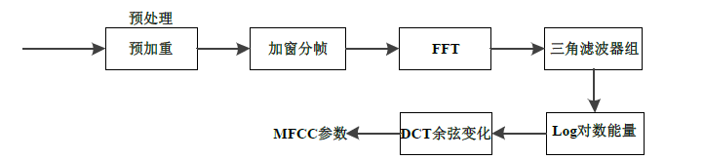
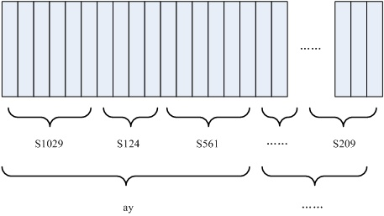
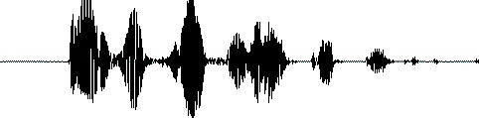
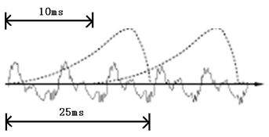
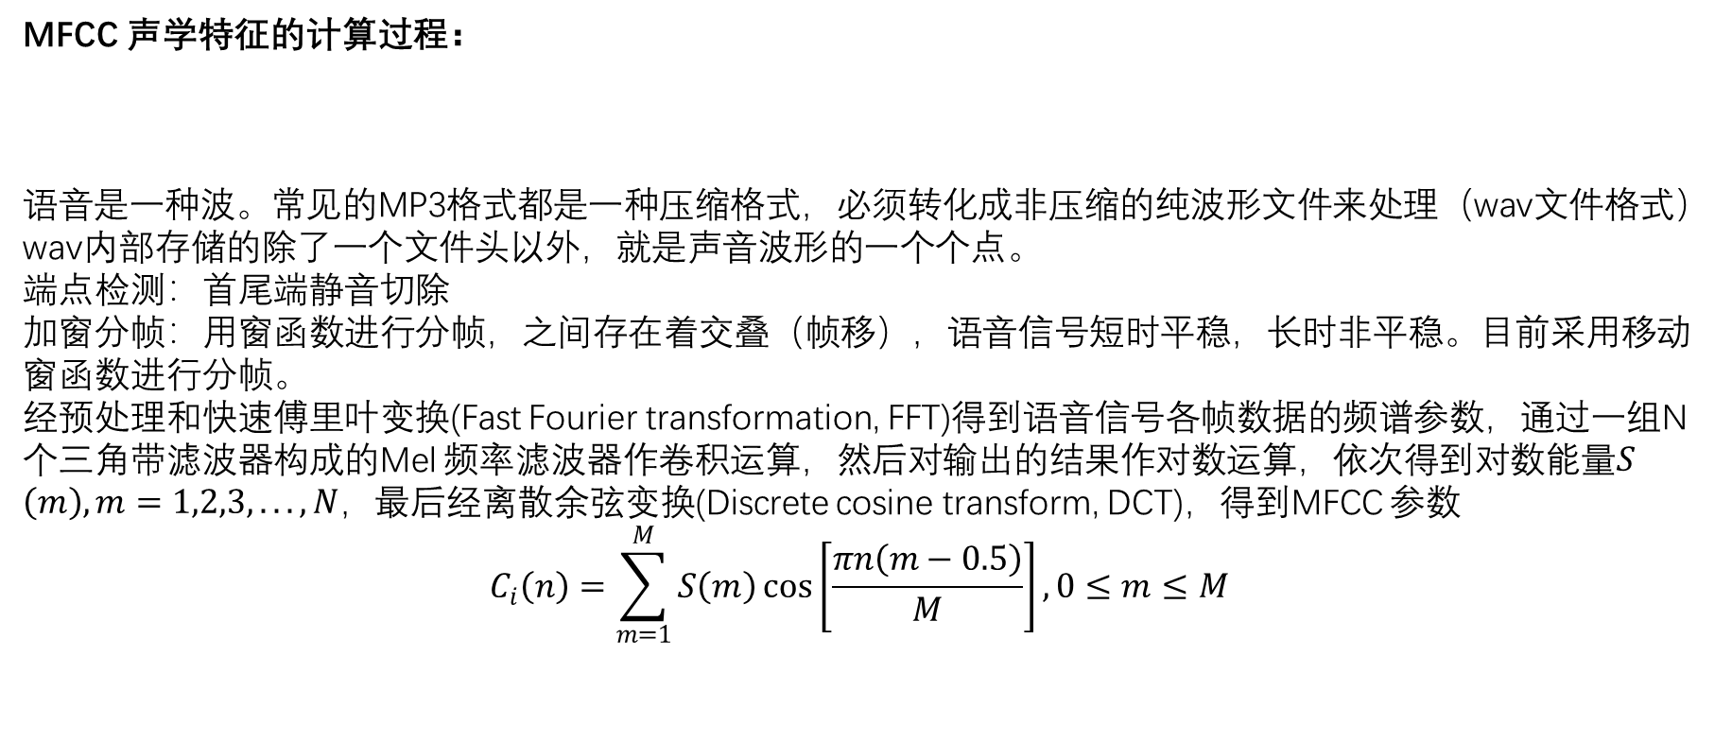
基于MFCC的声学特征提取
MFCC 声学特征的计算过程：
语音是一种波。常见的MP3格式都是一种压缩格式，必须转化成非压缩的纯波形文件来处理（wav文件格式）wav内部存储的除了一个文件头以外，就是声音波形的一个个点。
端点检测：首尾端静音切除
加窗分帧：用窗函数进行分帧，之间存在着交叠（帧移），语音信号短时平稳，长时非平稳。目前采用移动窗函数进行分帧。
经预处理和快速傅里叶变换(Fast Fourier transformation, FFT)得到语音信号各帧数据的频谱参数，通过一组N 个三角带滤波器构成的Mel 频率滤波器作卷积运算，然后对输出的结果作对数运算，依次得到对数能量$S\left(m\right),m=1,2,3,...,N，$最后经离散余弦变换(Discrete cosine transform, DCT)，得到MFCC 参数
$$C_{i}\left(n\right)=\sum_{m=1}^{M}{S\left(m\right)}\cos\left[\frac{πn\left(m−0.5\right)}{M}\right],0≤m≤M$$
[1] Hu Zhengquan, Zeng Yuming, Zong Yuan, et al. Improvement of MFCC parameters extraction in speaker recognition（http://kns.cnki.net/kcms/detail/11.2121.O4.20190228.1539.002.html）

Slide 21
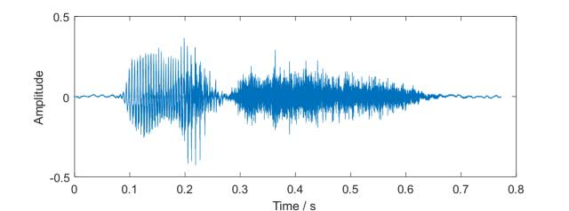

Result
②Feature extraction
③Combined SVM model prediction
①Speech signal processing and Format conversion
Converting WAV waveforms to the 20 eigenvalues required for cost experiments
The set of eigenvalues generated by the recorded sound source is used as a sample vector to make predictions using the SVM model
Record a line from the movie Flipped and save it as 20200622_090350.mp3
feature | meanfreq | sd | median | Q25 | Q75
val | 0.169353 | 0.068168 | 0.142837 | 0.115805 | 0.239285
feature | mode | centroid | meanfun | minfun | maxfun
val | 0.120477 | 0.169353 | 0.11109 | 0.023256 | 0.181818
feature | IQR | skew | kurt | sp.ent | sfm
val | 0.12348 | 2.038745 | 7.546507 | 0.921624 | 0.48264
feature | meandom | mindom | maxdom | dfrange | modindx
val | 0.917969 | 0.007813 | 5.59375 | 5.585938 | 0.239254
20200622_090350.mp3
forecast result ：male
WAVE from 0s to 0.8s.
MFCC开源框架(based on python) URL: https://github.com/jameslyons/python_speech_features

Slide 22
Thanks!

