Slide 1
Likelihood Ratios and Generative Classifiers for
Unsupervised Out-of-Domain Detection in Task Oriented Dialog

Slide 2
Contents
Introduction
Contribution summary
Methodology
  Maximum Softmax Probability
  Softmax Entropy
  Local Outlier Factor
  Likelihood
  Likelihood Ratio
  Generative classifier
Evaluation
Datasets
Experiment
Conclusion and insights

Slide 3
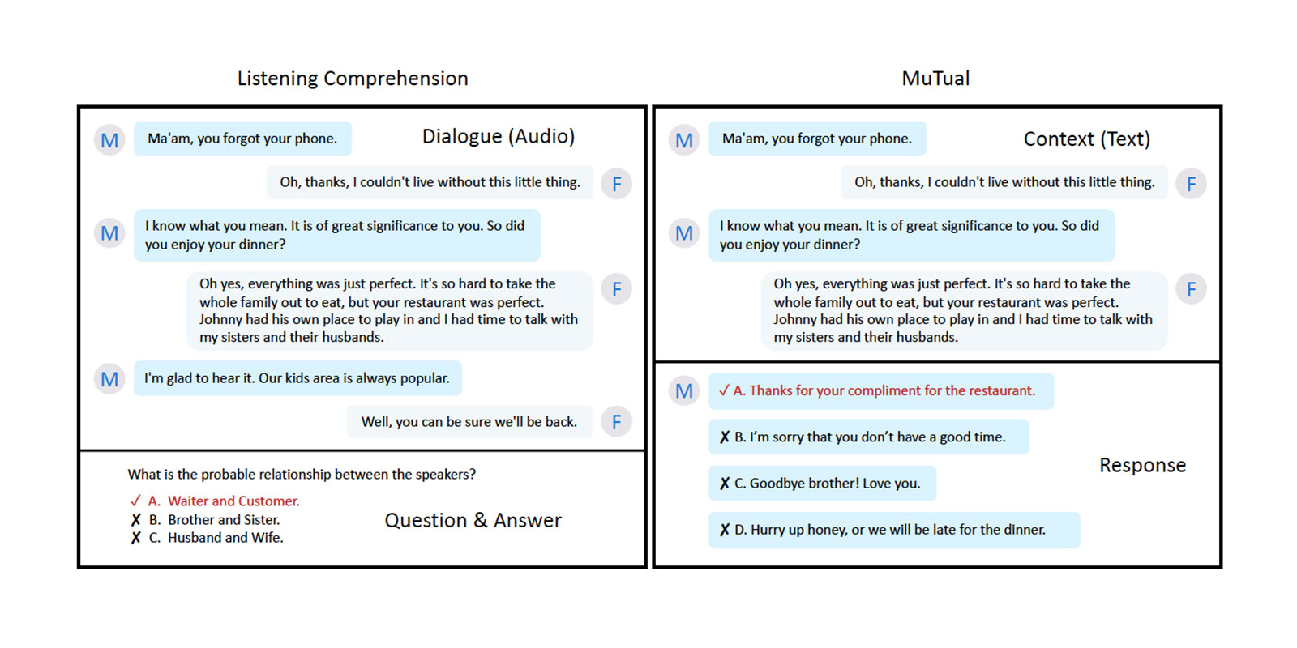
Introduction
Problem
  Many previous OOD detection method is aimed at the image dataset
Scene： OOD detection for Task Oriented Dialog

Slide 4
Contribution summary
We release ROSTD, a novel dataset1 of 4500 OOD sentences for intent classification
They test many OOD detection method in this task and propose a novel method, which achieve the SOTA performance. This new method include:
  A generative classifier
  A correction from a “background” model

Slide 5
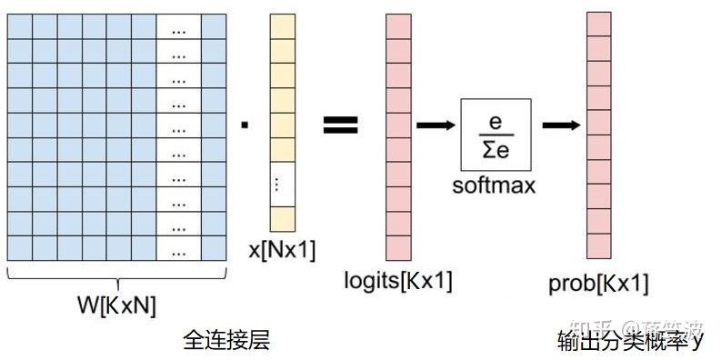
Methodology
All our methods attempt to estimate a score which is indicative of the data point being OOD. For an input x, we refer to this function as η(x).

Slide 6




1.Maximum Softmax Probability
MSP uses the maximum probability as
The lesser “confident” the classifier is about its predicted outcome, i.e. the argmax label, the greater is
Likelihood:
τ is the softmax temperature. Increasing τ smoothens the distribution while decreasing τ makes it peakier.

Slide 7

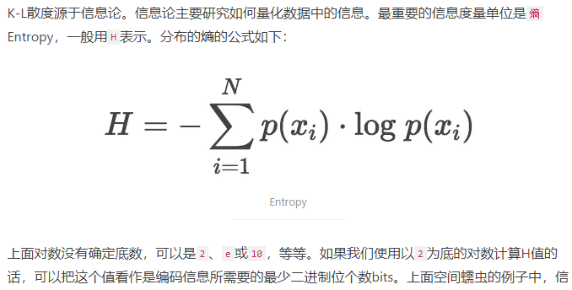
2.Softmax Entropy

Slide 8
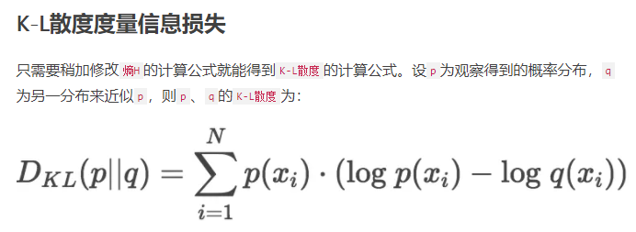
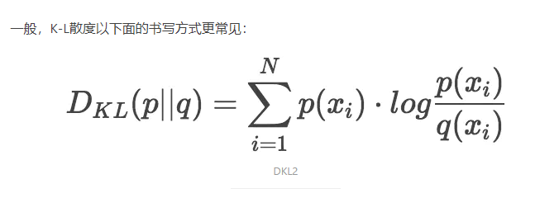
2.Softmax Entropy

Slide 9
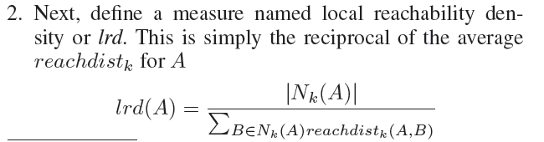
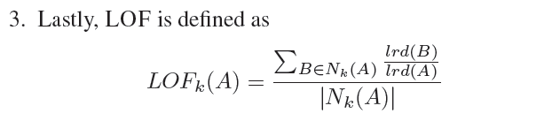
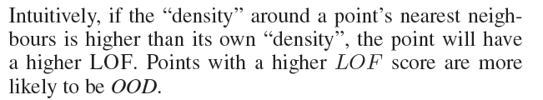
3. Local Outlier Factor

Slide 10
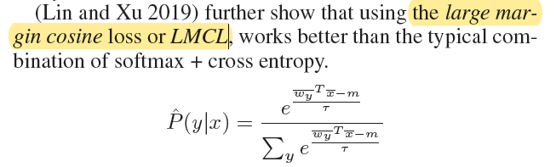
3. Local Outlier Factor
https://github.com/thuiar/DeepUnkID

Slide 11
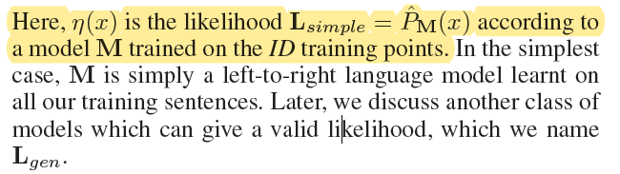
4.Likelihood (simple)

Slide 12
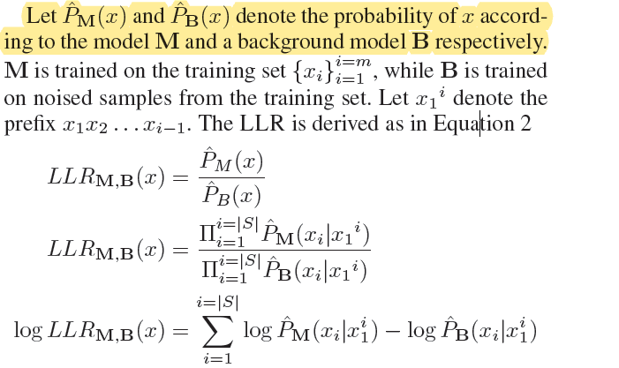
5.Likelihood Ratio

Slide 13
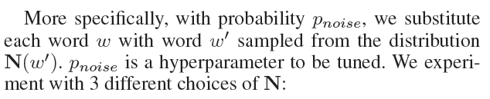




5.How to introduce noise?
Random word substitution

Slide 14
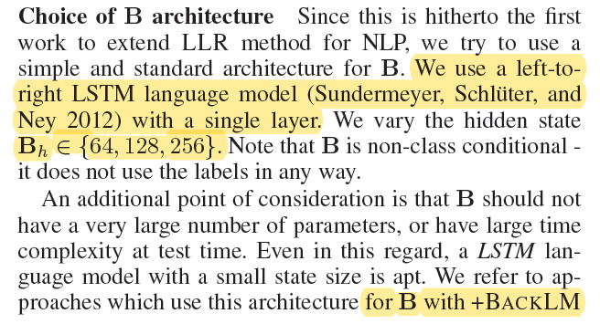
5.Choice of B architecture

Slide 15
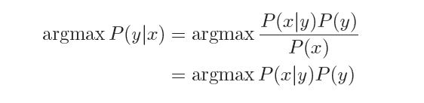


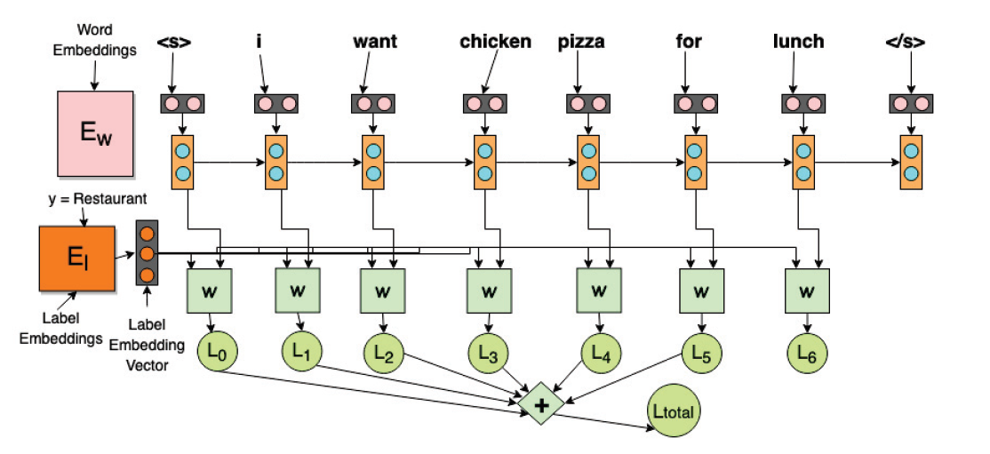
6.Generative Classifier

Slide 16
Evaluation
FPR@k%TPR
AUROC
AUPROOD

Slide 17
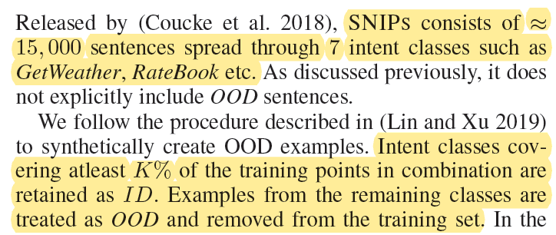
Datasets
SNIPS

Slide 18
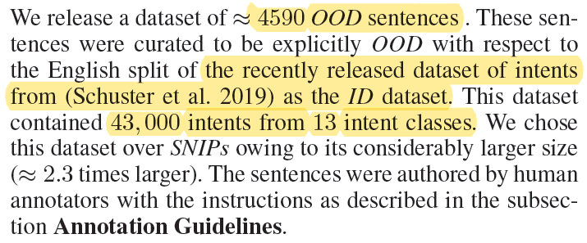
ROSTD

Slide 19
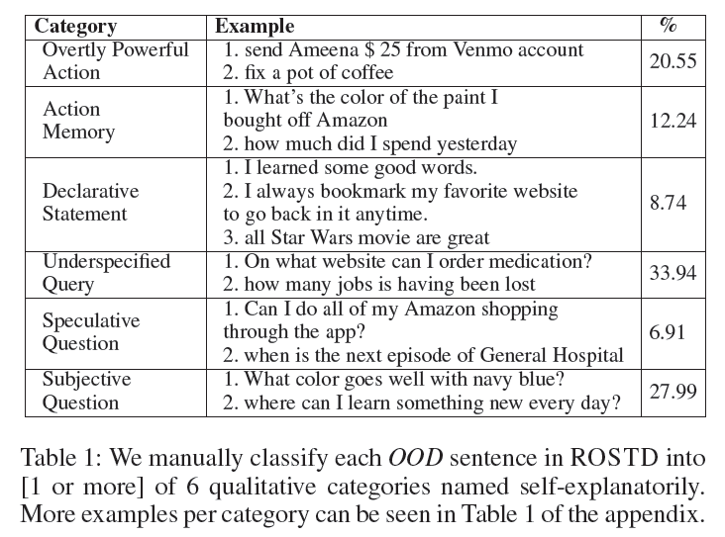
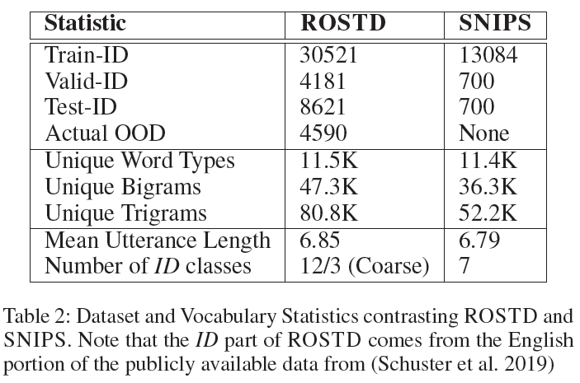
数据集
ROSTD

Slide 20
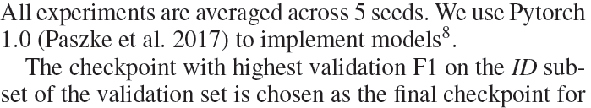
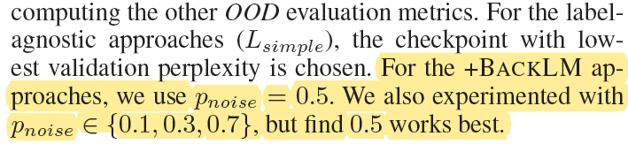
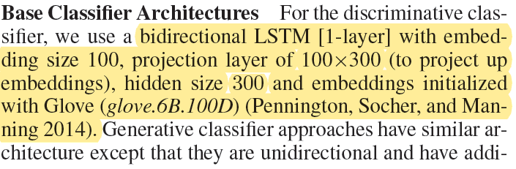
Experiment setting

Slide 21
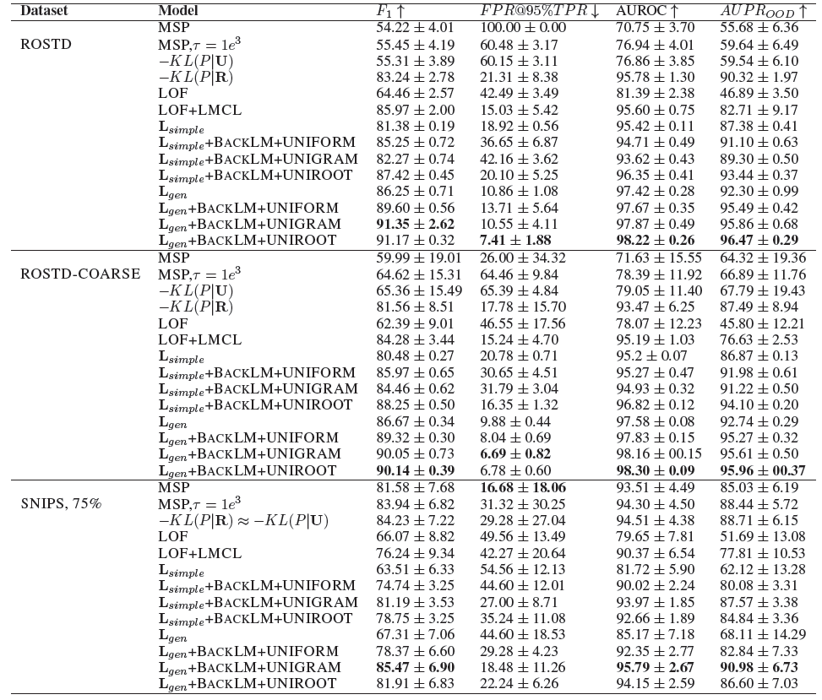
experiment

Slide 22
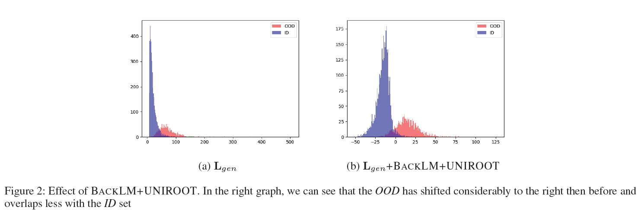
experiment

Slide 23
Contribution and insight
1.作者提供了一个专门做OOD检测的NLP数据集，看实验结果上性能可以提高，而且作者使用的方法比较简单，是否可以加入能量模型或者其他改进使得性能提高。
2.作者的新方法generative classifier，模型也比较简单，作为一个track在其他场景使用。
3.一般的OOD检测都是基于CV的，NLP上的OOD检测刚起步，定义和方法还没有很多，感觉有机会深入下。

