Slide 1


Entropic Out-of-Distribution Detection
Wenyu Jiang
NJU
NJU-CS

Slide 2
Outline
Background
Methodology
Experiment
Summary

Slide 3
Background

Slide 4

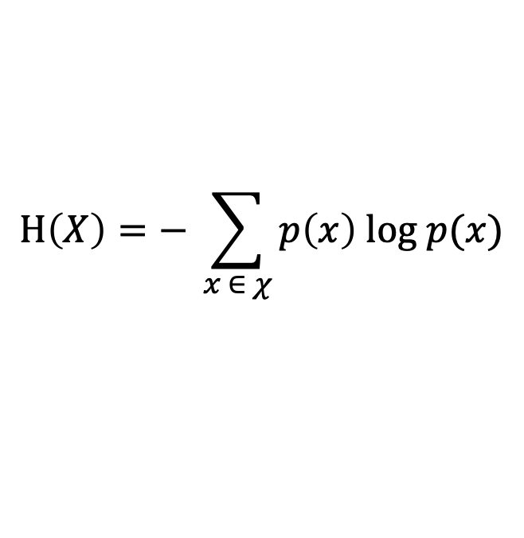
The principle of maximum entropy
Entropy (information theory):
在信息论中，熵是对随机变量不确定性的度量
$$Η\left(X\right)=− \sum_{x ∈ χ}{p\left(x\right) log p(x)}$$
满足已知信息(约束条件)
不做任何未知假设
(将未知事件当作等概率事件处理)
系统的信息熵最大
《数学之美 (第三版)》
对测试集(未知)不作任何主观假设！
Notes:
最大熵原理指出，当我们需要对一个随机事件的概率分布进行预测时，我们的预测应当满足全部已知的条件，而对未知的情况不要做任何主观假设。在这种情况下，概率分布最均匀，预测的风险最小。

Slide 5
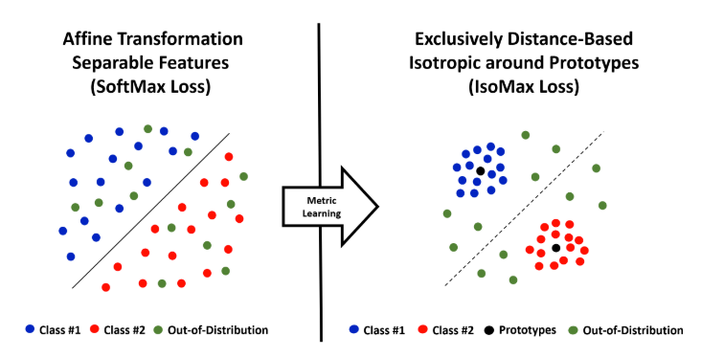
Motivation
The Drawbacks of Softmax loss :
Anisotropy
Low mean entropy posterior probability distributions
Notes:
好好理解这两个缺点

Slide 6
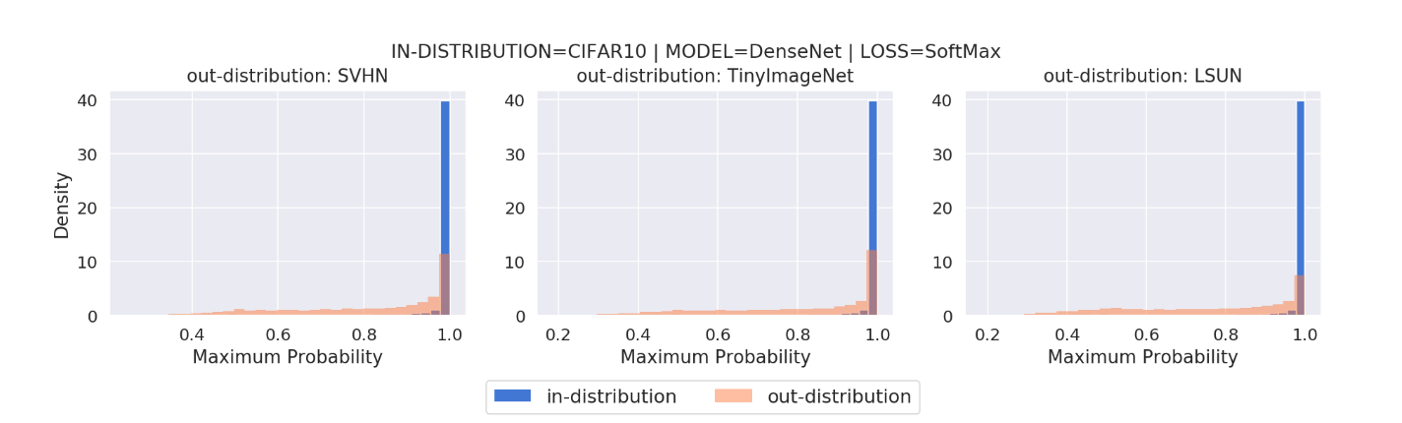
Motivation
The Drawbacks of Softmax loss :
Anisotropy
Low mean entropy posterior probability distributions
Notes:
好好理解这两个缺点

Slide 7
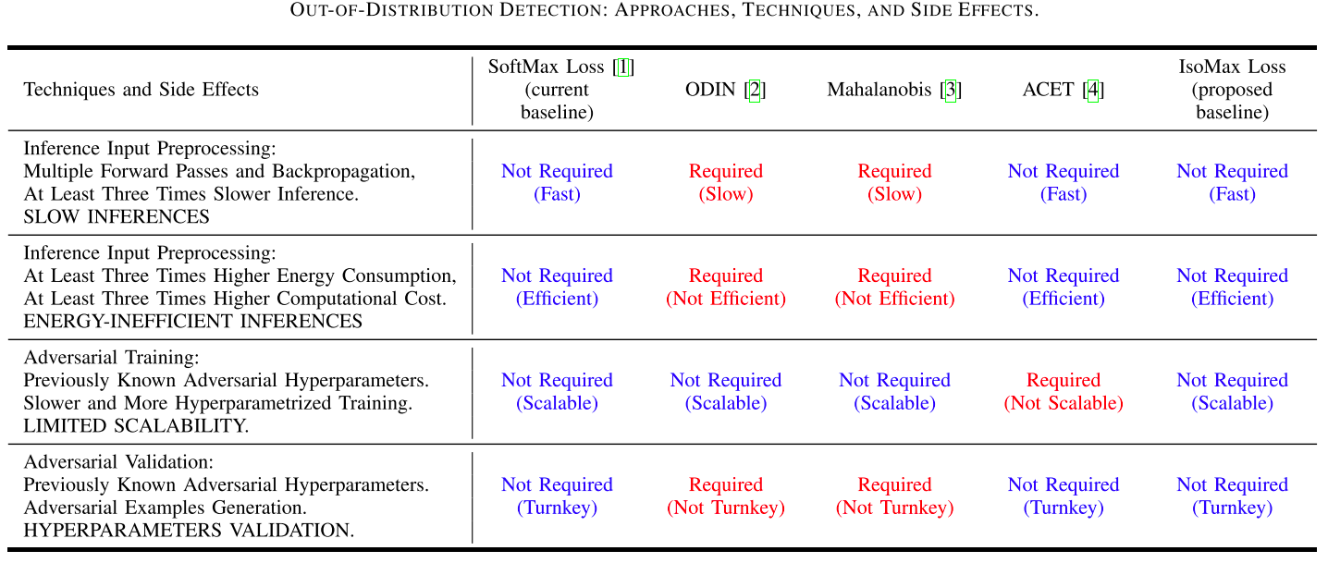
Current OOD detection approaches
Notes:
当前的OOD检测算法绕过了SoftMax的问题，同时采用的技巧带来了一些负面效应。

Slide 8
Methodology
Notes:
各向同性
后验概率分布熵最大 ：产生尽可能不自信的后验概率分布，只要它们与正确的预测匹配。

Slide 9

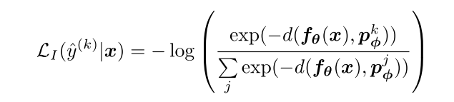
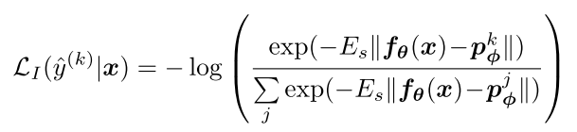
Overview - Isotropy Maximization Loss
$f_{θ}$(x): x’s high-level feature (embedding) $p_{∅}^{j}$: the prototype associated with the class j
the isotropic layer
SoftMax function
cross-entropy
Entropy Maximization
entropy scale trick
Notes:
各向同性
后验概率分布熵最大化

Slide 10
Explanation - Isotropy Maximization Loss
Isotropy
learn a feature space which is consistent with the chosen metric from the start.
The loss minimization is achieved by reducing the distances between the high-level features (embeddings) and the associated class prototypes, while simultaneously keeping high distances among class prototypes.
The main aim of metric learning, which is to reduce intraclass distances while increasing interclass distances.
This is performed naturally during the neural network training, avoiding the need for feature extraction and metric learning postprocessing phases.
Notes:
解决SoftMax的各向异性（这是什么）
不同于基于metric learning 的OOD检测算法
本篇文章是怎么做到的

Slide 11
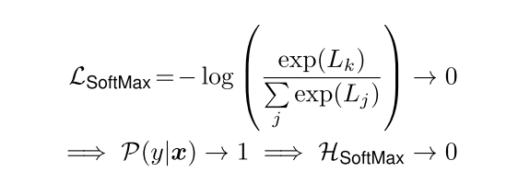
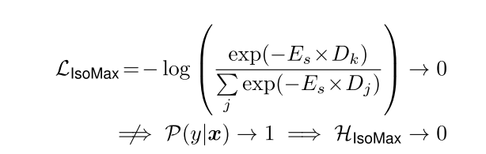
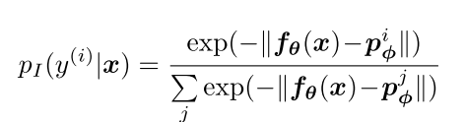
Explanation - Isotropy Maximization Loss
Contradiction between cross-entropy minimization
and maximum entropy posterior probability distribution!
Just use the principle of maximum entropy as theoretical motivation for constructing high entropy (low confident) posterior probability distribution, still relying on computationally efficient cross-entropy minimization.
Notes:
SoftMax产生过度自信的预测（为什么？）
如何满足最大熵原理以避免产生过度自信的预测？

Slide 12
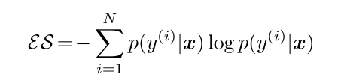
Entropic Score
Notes:
各向同性
后验概率分布熵最大化

Slide 13
Experiment

Slide 14
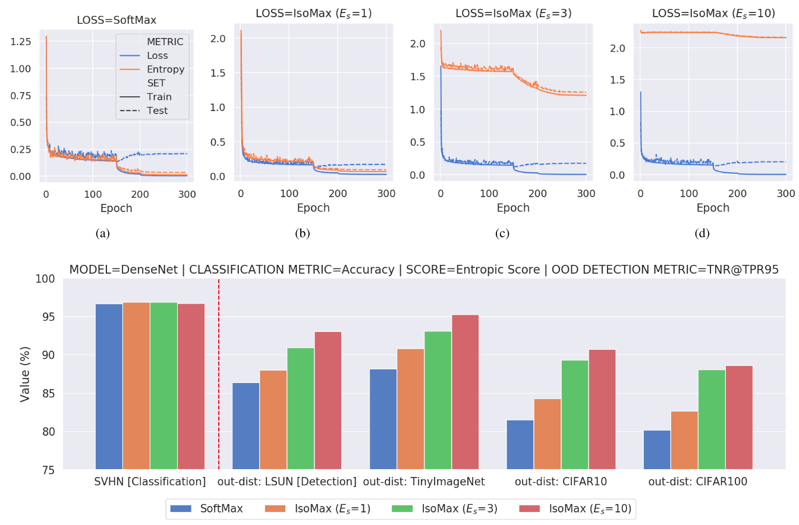
IsoMax loss effects
Notes:
各向同性
后验概率分布熵最大化

Slide 15
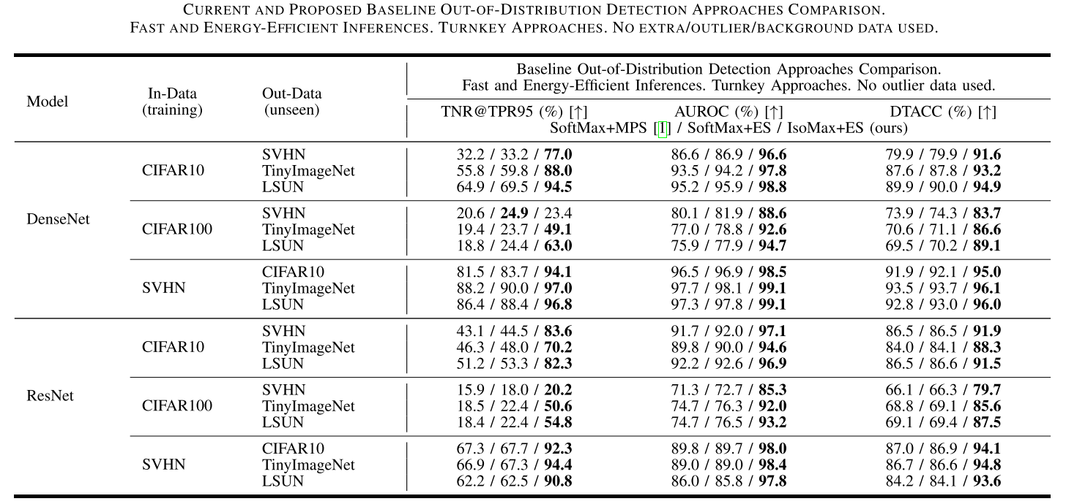
SoftMax v.s. IsoMax
Notes:
各向同性
后验概率分布熵最大化

Slide 16
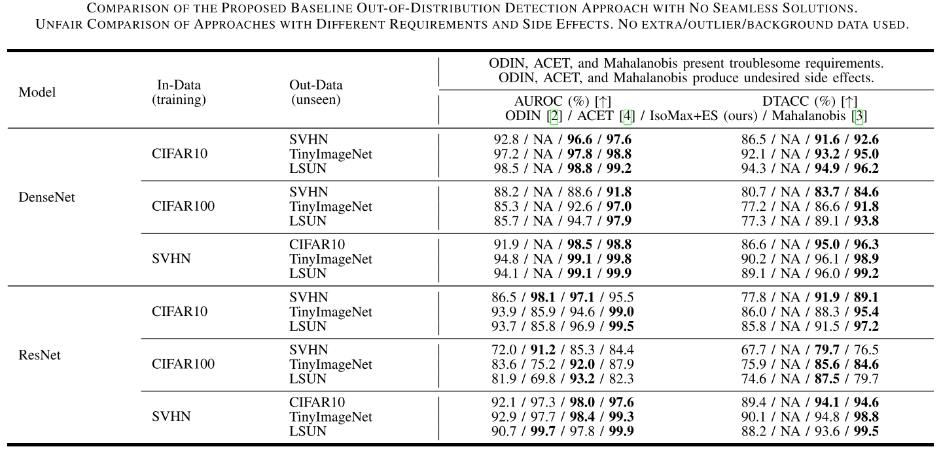
Others v.s. IsoMax
Notes:
各向同性
后验概率分布熵最大化

Slide 17
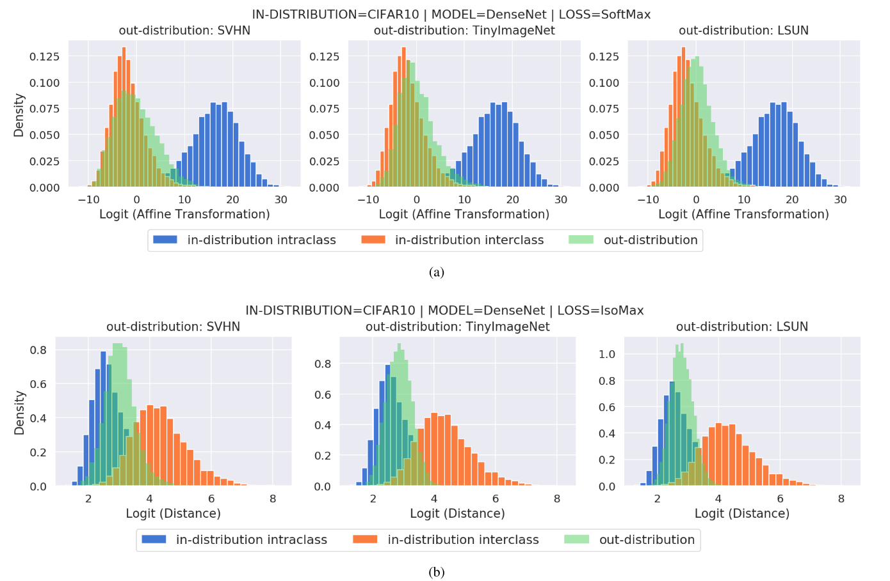
Logits
Notes:
各向同性
后验概率分布熵最大化

Slide 18
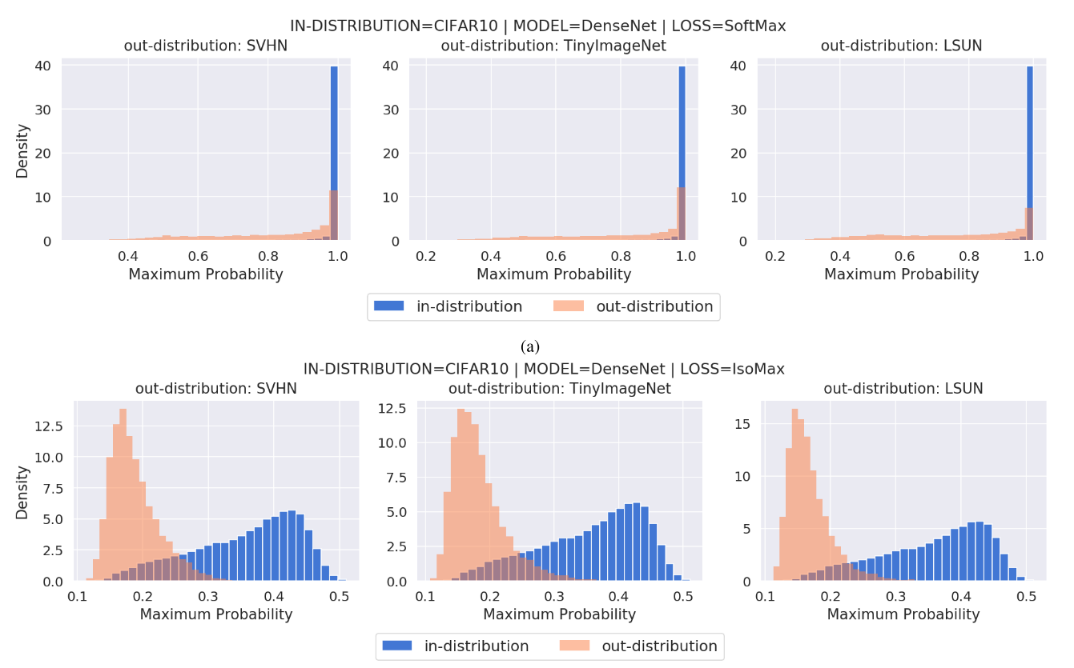
Maximum Probability
Notes:
各向同性
后验概率分布熵最大化

Slide 19
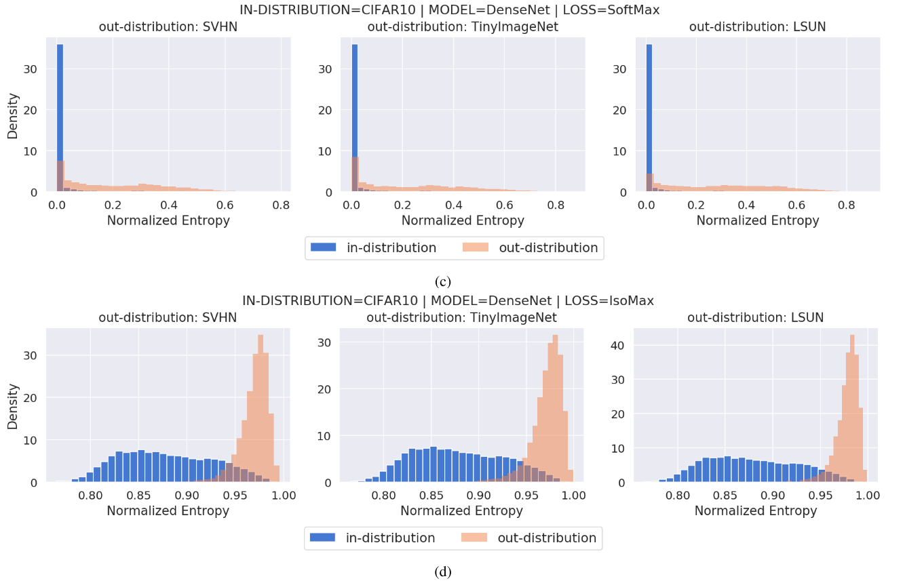
Normalized Entropy
Notes:
各向同性
后验概率分布熵最大化

Slide 20
Summary

Slide 21
Major contributions
The theoretical intuitions that associates the unsatisfactory OOD detection performance of current neural networks with the SoftMax loss anisotropy and disagreement with maximum entropy principle.
The IsoMax loss, which is isotropic, in agreement with the maximum entropy principle, and works as a seamless SoftMax loss drop-in replacement.
The experimental demonstration that the entropy, which is a fast and energy-efficient computation, provides high OOD detection performance when the posterior probability distribution follows the maximum entropy principle, i.e., it presents high mean entropy.
The proposed approach improves neural networks baseline OOD detection performance.

Slide 22
Some think
什么原因导致了当前神经网络令人不满意的OOD检测性能？
为什么SoftMax学到的是低熵的后验概率分布？
不对测试集作任何假设，随机变量不确定性（熵）最大，等概率分布

Slide 23
Thank you!
Q&A

