Slide 1


Generalized ODIN: Detecting Out-of-distribution Image without Learning from Out-of-distribution Data
Cheng Hao
2021.2.1
NJU
NJU-CS

Slide 2
Contents
Contribution Summary
Background
Related method
Methodology
Experiment
Performance
Ablation Study
Robustness Study
Semantic Shift versus Non-semantic Shift
Some think

Slide 3
Contribution Summary
Motivation
ODIN needs tuning with Ood data for its two strategies— temperature scaling and input preprocessing, which is not realistic.
Contribution
A new perspective of decomposed confidence for motivating a set of classifier designs that consider the closed-world assumption.
A modified input preprocessing method without tuning.

Slide 4
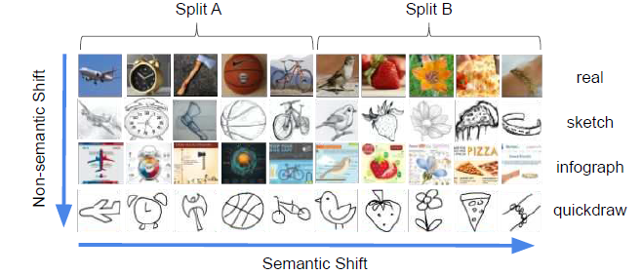


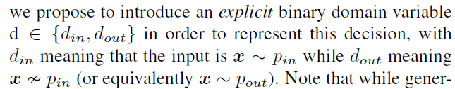
Background
Problem
How can the model avoid making a prediction when encountering an input , or reject a low confidence prediction when ?
Answer: Setting a score s(x)

Slide 5
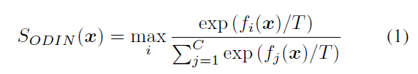

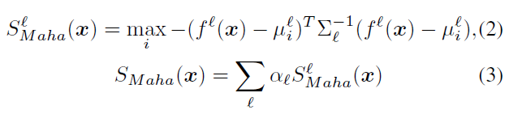

Related Methods
ODIN
Mahalanobis

Slide 6




methodology
Reconsider the output , doesn’t consider the domain at all
The author uses the explicit variable in the classifier as:
Futher, they use a dividend/divisor structure as the prior knowledge to design the structure of classifiers.

Slide 7
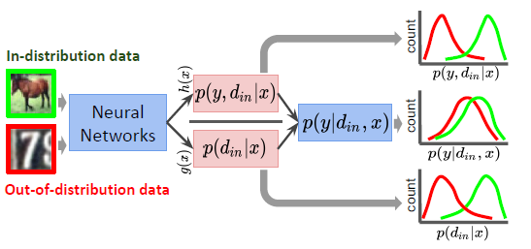


Structure summary

Slide 8
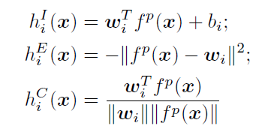
g(x)和h(x)函数形式
g(x):
hi(x)三种形式：inner-product (I), negative Euclidean distance (E), and cosine similarity (C)
其中x是倒数第二层网络的输出。

Slide 9




A Modified Input Preprocessing Strategy
In ODIN, the perturbation of input is given by
In our method, we search for the ǫ which maximizes the score S(x) with only the in-distribution validation dataset :
is from a coarser grid

Slide 10
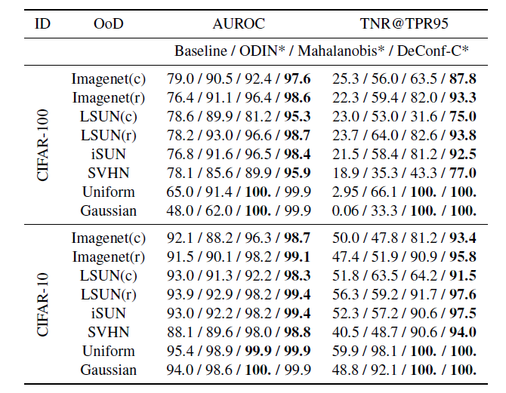
Expriment
four OoD detection methods have no access to OoD data during training and validation

Slide 11
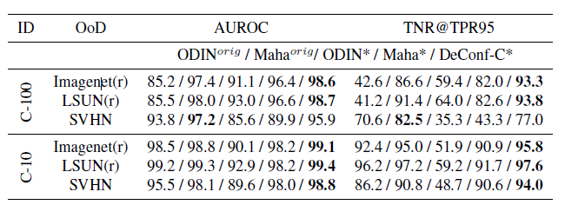
Experiment

Slide 12
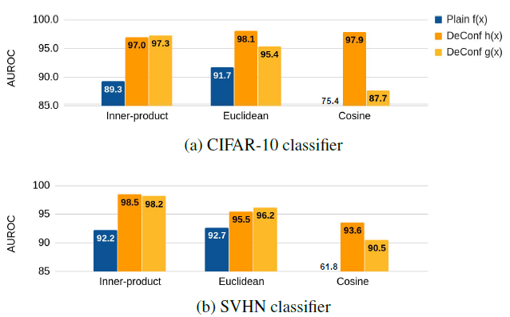
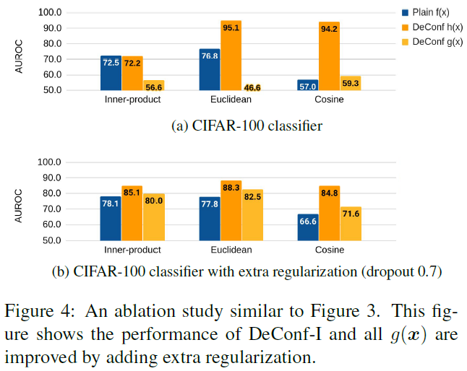
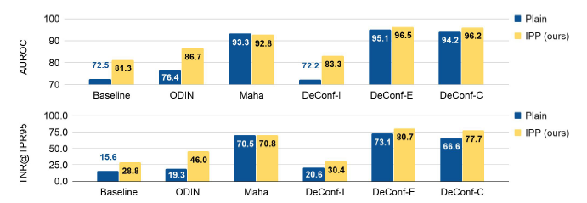
Ablation Study
1. The dividend/divisor structure
2. Extra regularization
3.IPP strategy

Slide 13
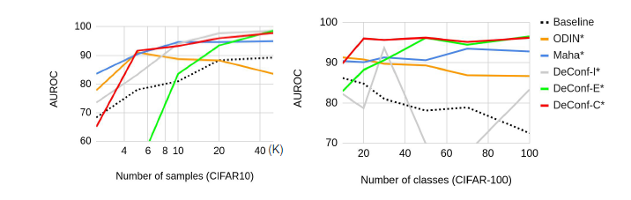
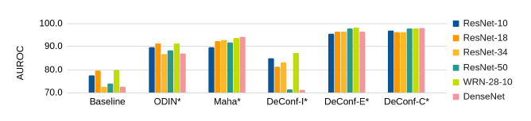
Robustness Study
1. Number of samples or classes
2.Different model

Slide 14
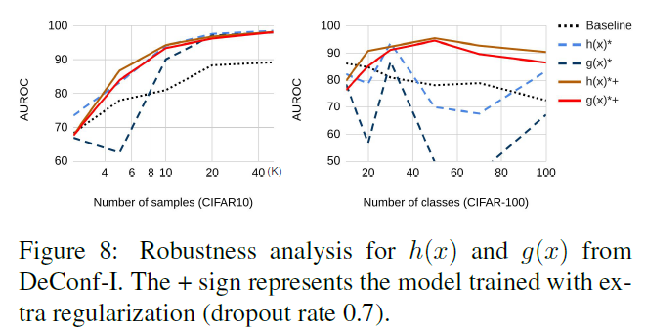
Robustness Study

Slide 15
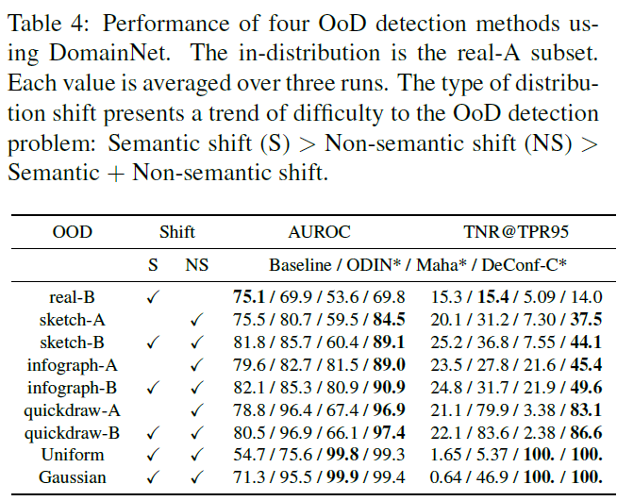
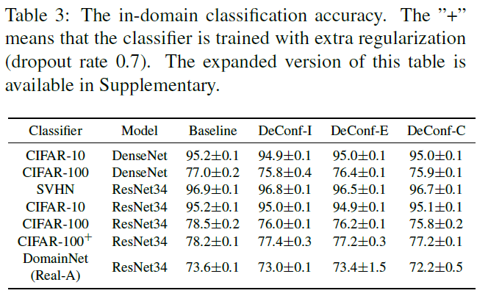
Semantic Shift versus Non-semantic Shift
两个点：
1.Difficulty: Semantic shift (S) > Non-semantic shift (NS) > Semantic + Non-semantic shift.
2.Mahalanobis方法的失效

Slide 16
Some think
本文的设置是不使用OOD样本来做OOD detection，还有其他方法吗？这种设置的Baseline是什么？
本文基于域来做OOD的，这种概率的分解较为简单，基于域的假设是否合理，概率分解的假设是否合理，如果合理，那可以用到其他方法上。
凭什么说学习到的h(x)和g(x)就可以作为那两个概率，是否可以加一些约束，学到更好的h(x)和g(x)
本文提出的Semantic Shift和Non-semantic Shift的OOD场景， Semantic Shift是比较难分辨的，是否可以进行深入研究一下，作者也说了there is still large room for improvement。

Slide 17
Thank you!
Q&A

