Slide 1


Self-Supervised Learning for Generalizable Out-of-Distribution Detection
Cheng Hao
2021.1.18
NJU
NJU-CS

Slide 2
Contribution Summary
Our high level idea is to simultaneously train in-distribution classifiers and out-of-distribution detectors in one network. Specifically, we use additional nodes as reject functions in the last layer of our neural network.
Contribution
Our method learns to generalize nicely on unseen OOD distributions. In particular, learning such generalizable OOD features is important for the detection robustness when a mixed of unseen distributions are present.
Different from existing methods (Liang, Li, and Srikant 2017; Lee et al. 2018), our method does not need tuning with a sub-sample of the targeted OOD set, and therefore can use any “free” unlabeled OOD set for training.
Our method can also benefit in-distribution classification accuracy, via rejecting ambiguous samples near the boundaries of the training set distribution.

Slide 3
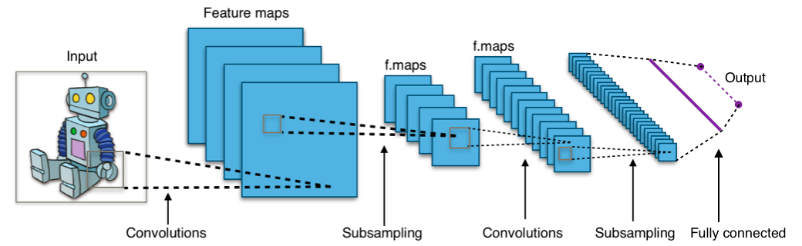
Typical CNN Architecture
Notes:
在cnn的每个卷积层，数据都是以三维形式存在的，可以将其看作许多个二维图片叠在一起，其中每一个称为一个feature map，
例如，在输入层，如果是灰度图片，那就只有一个feature map;如果是彩色图片，一般就是3个feature map(rgb)
其他层：层与层之间会有若干个卷积核，上一层的每一个feature map跟每个卷积核做卷积，都会产生下一层的feature map，有N个卷积核，下层就会产生N个feature map（每个卷积核有长宽高三个维度，卷积核的深度与当前图像的深度(feature map的张数)相同，长宽人为指定）
Feature map的作用：在同一层中，我们希望得到对于一张图片多种角度的描述，具体来讲就是用多种不同的卷积核对图像做卷积操作，得到不同核上的响应，作为图像的特征

Slide 4
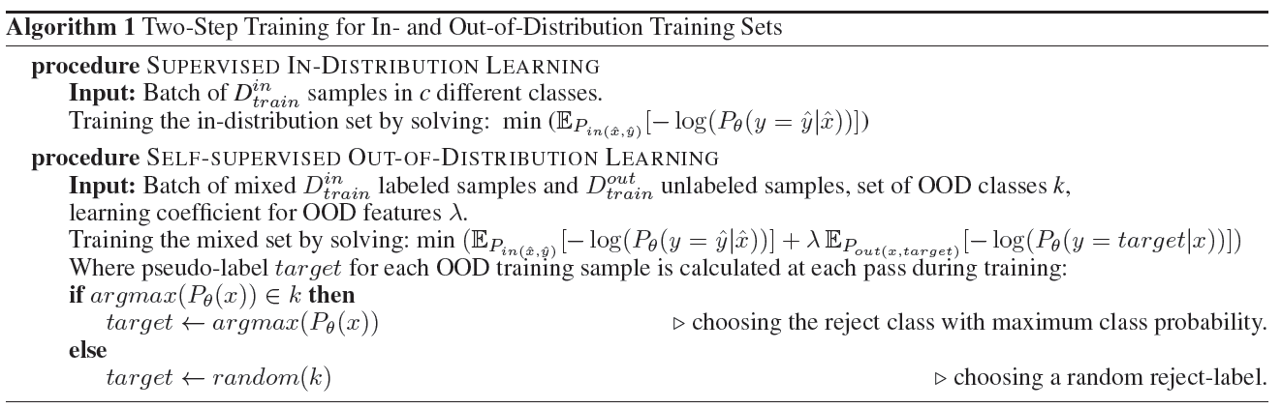
Algorithm

Slide 5
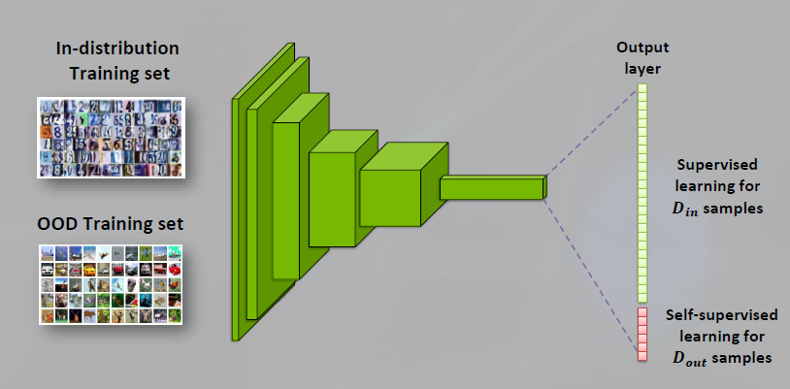
Network Structure

Slide 6
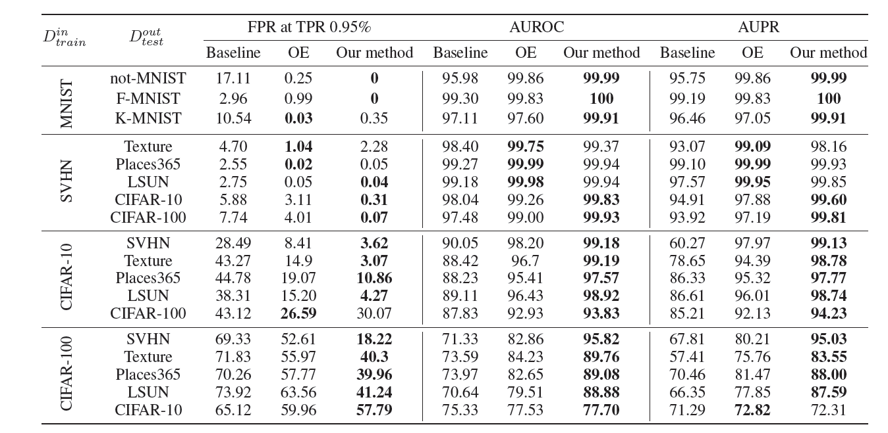
Experiment results
Notes:
大数据集ID 小数据集OOD效果不好

Slide 7
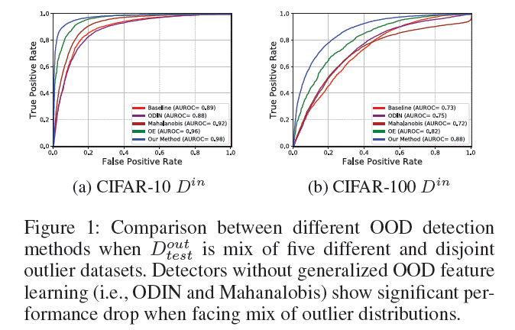
Experiment results

Slide 8
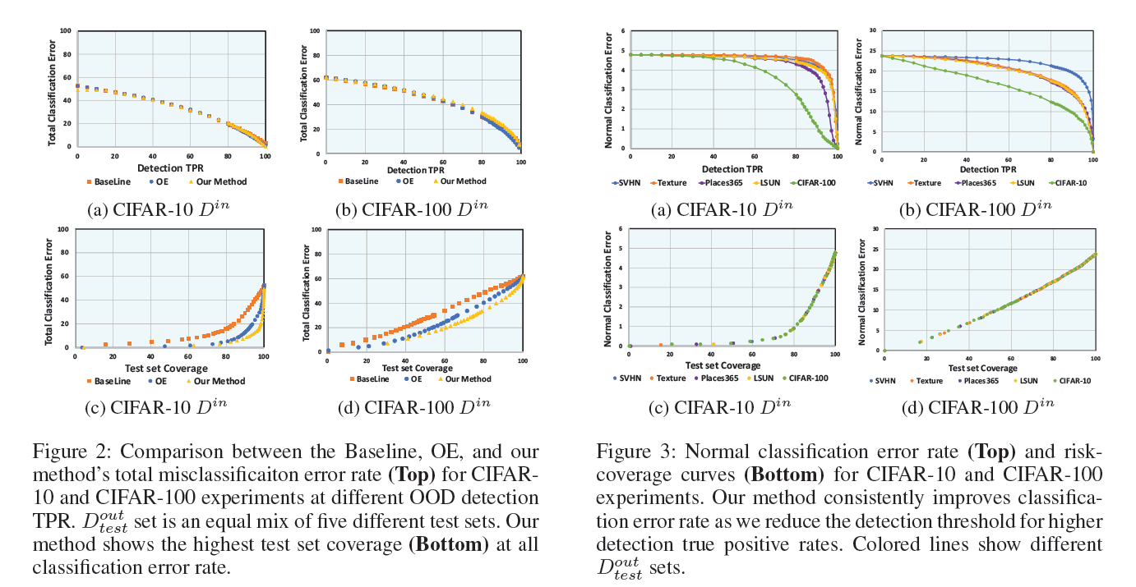
Experiment results

Slide 9
Discussion
Generalizable OOD Feature Learning
Synthesized OOD Training Set
Multiple Reject Classes
OOD Detection Scores
Comparison to One Class Classification

Slide 10
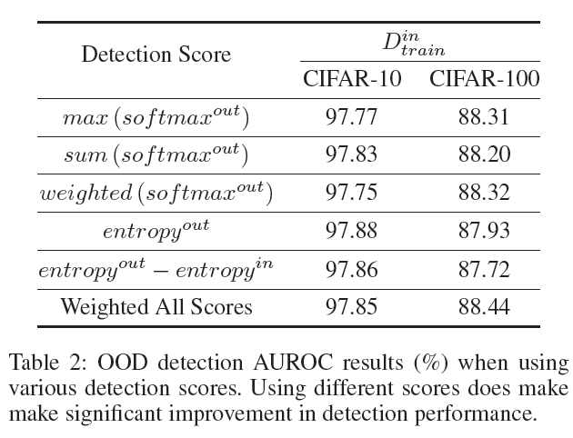
OOD Detection Scores

Slide 11
Some think
OOD检测的泛化性 = 针对不同的OOD数据的混合分布的检测能力好？能否改进其他经典方法比如ODIN，MD来解决经典方法的这一问题
Self-supervised的方法可以适用于OOD这个场景，调研使用其他Self-supervised的方法来改进。
对于这样的，有一个OOD dataset作为auxiliary OOD dataset用来训练，要选取什么样的OOD数据集？自己生成的好还是直接用现实中存在的好？
Notes:
细化，足够有迷惑性

Slide 12
Thank you!
Q&A

