Slide 1
L-Shapley and C-Shapley:
Efficient Model Interpretation for Structured Data

Slide 2
目录
Background and preliminaries
  Importance of a feature subset
  Shapley value for measuring interaction between features
  The challenge with computing Shapley values
Methods
  Local shapley
  Connected shapley
Properties
Experiments

Slide 3
目录
Background and preliminaries
  Importance of a feature subset
  Shapley value for measuring interaction between features
  The challenge with computing Shapley values
Methods
  Local shapley
  Connected shapley
Properties
Experiments

Slide 4


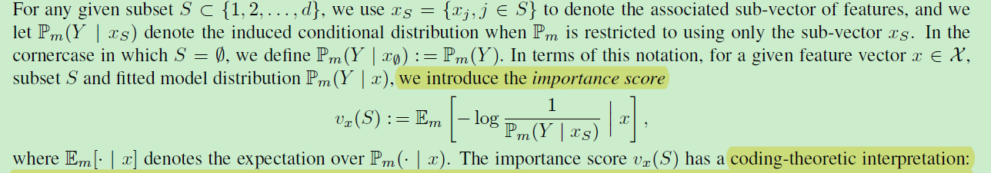
Importance of a feature subset-setting

Slide 5
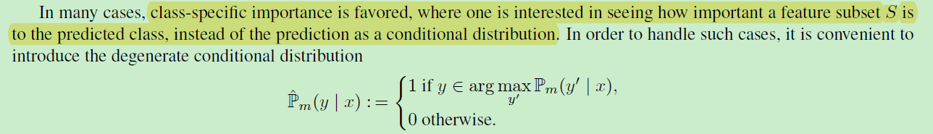
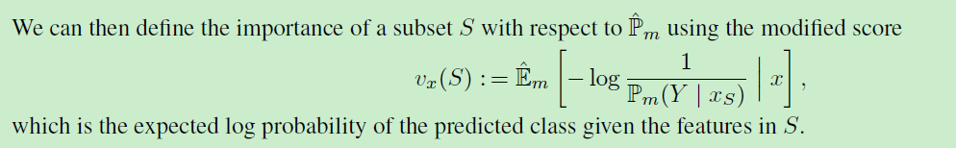
Importance of a feature subset-setting simplify

Slide 6
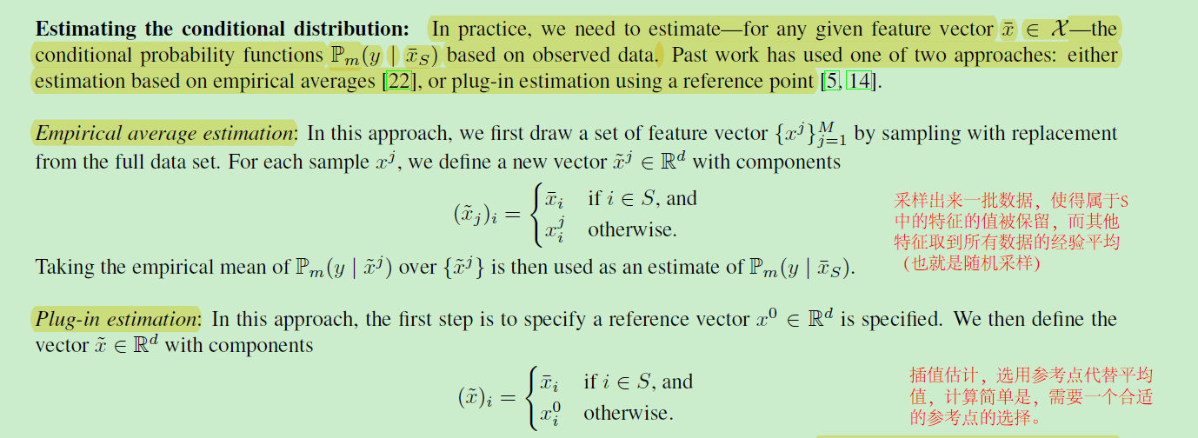
Importance of a feature subset
估计条件分布方法-经验平均估计和插值估计

Slide 7
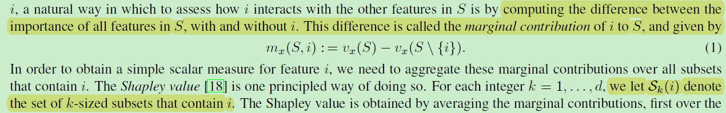
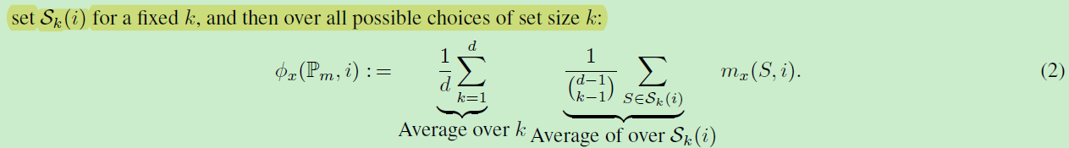
Shapley value for measuring interaction between features
上面这句话中是一条负面的电影评价，not这个词对于分类位负面具有很大的重要性，但是如果把not单独拿出来他的重要性就为0，所以，需要考虑特征之间的相互作用

Slide 8
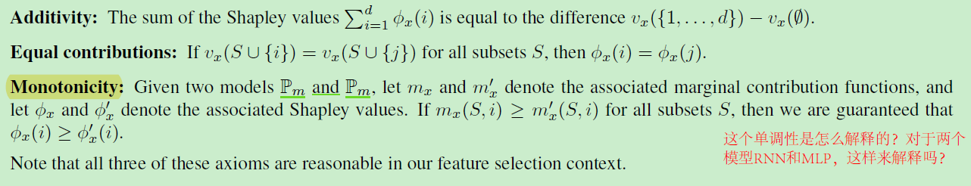
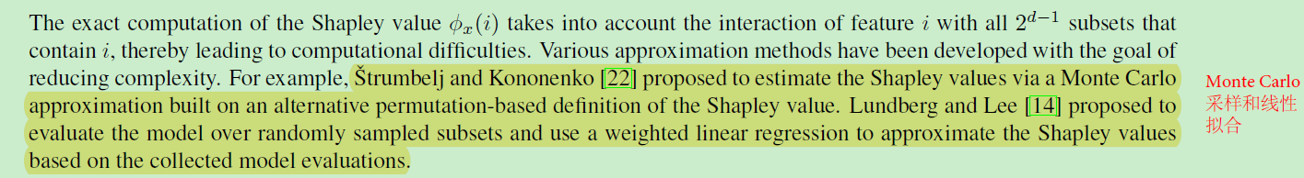
The properties and challenges of shapley value

Slide 9
目录
Background and preliminaries
  Importance of a feature subset
  Shapley value for measuring interaction between features
  The challenge with computing Shapley values
Methods
  Local shapley
  Connected shapley
Properties
Experiments

Slide 10
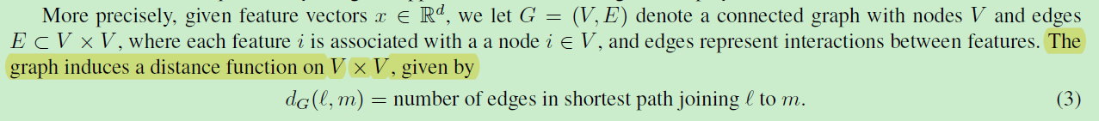
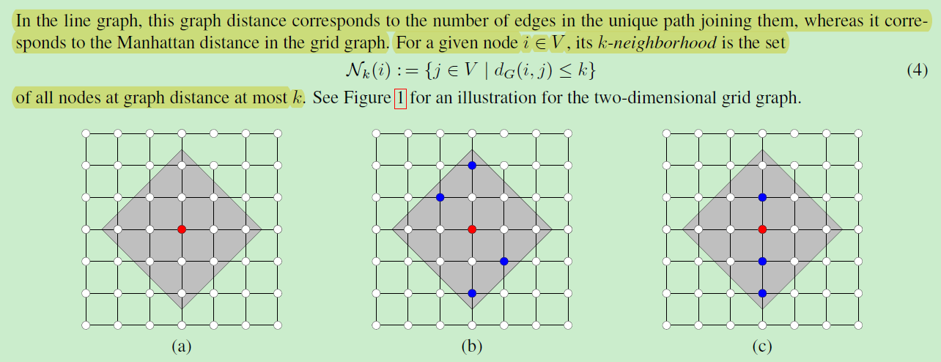
Methods

Slide 11
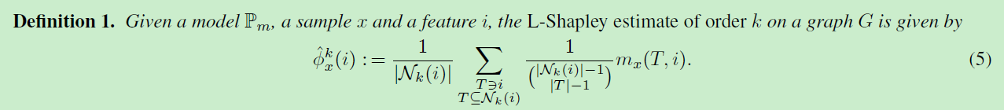
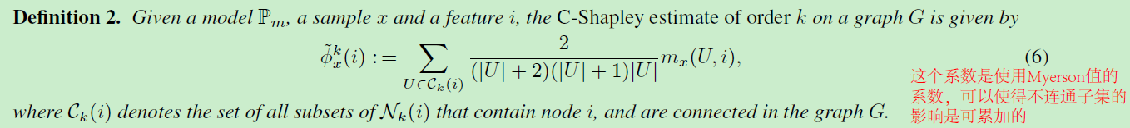
L-shapley and C-shapley
Local shapley
Connected shapley

Slide 12




L-shapley and C-shapley
 | shapley | L-shapley | C-shapley
line graph
grid graph

Slide 13
目录
Background and preliminaries
  Importance of a feature subset
  Shapley value for measuring interaction between features
  The challenge with computing Shapley values
Methods
  Local shapley
  Connected shapley
Properties
Experiments

Slide 14
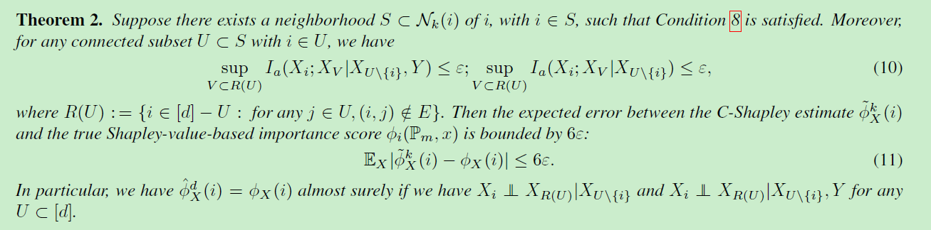
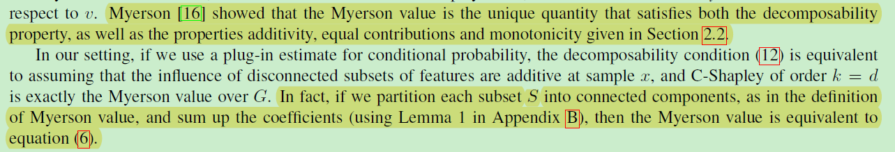
properties
和原始shapley值近似
与Myerson值有关

Slide 15
目录
Background and preliminaries
  Importance of a feature subset
  Shapley value for measuring interaction between features
  The challenge with computing Shapley values
Methods
  Local shapley
  Connected shapley
Properties
Experiments

Slide 16
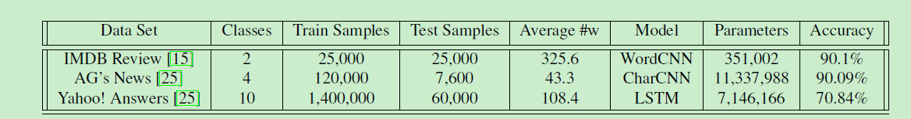
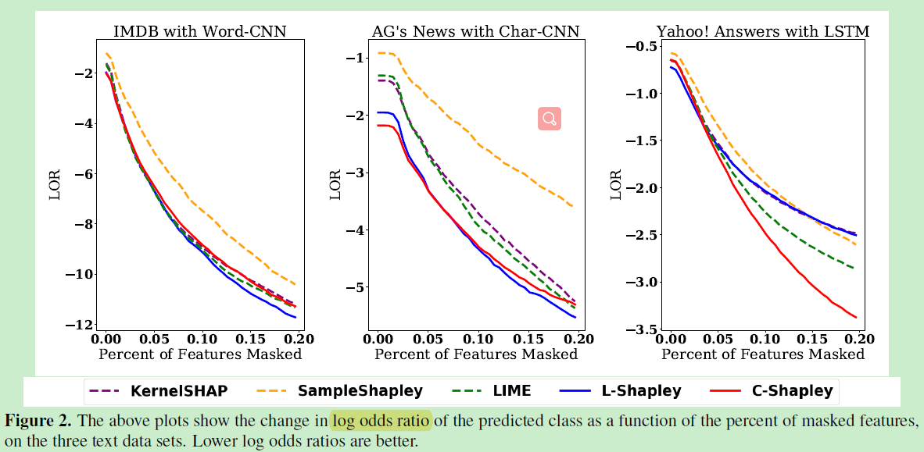
Experiments-text

Slide 17
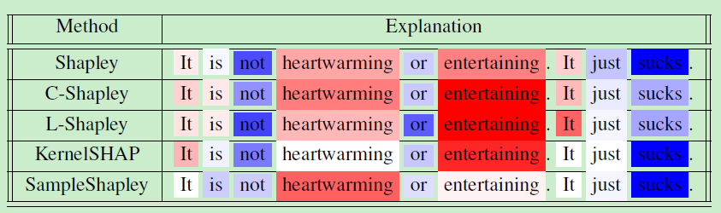
text

Slide 18
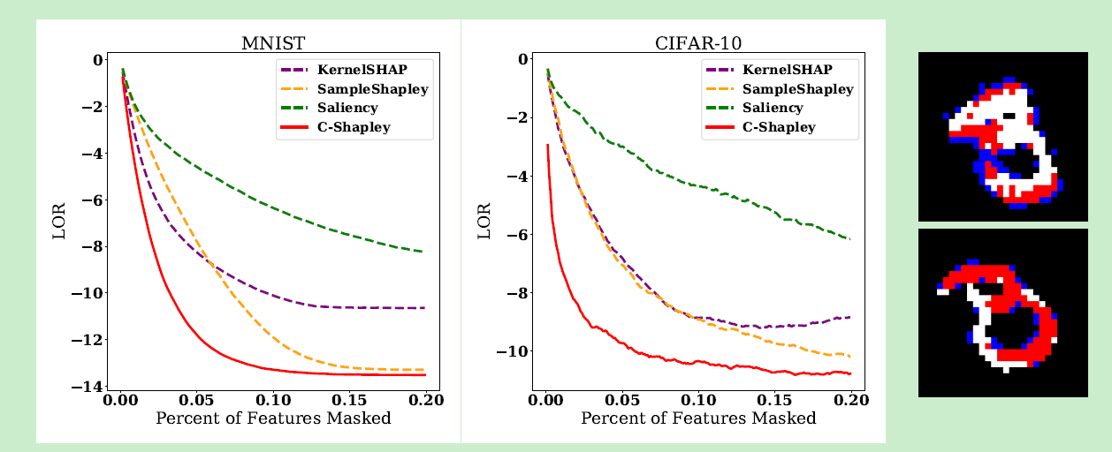
image

Slide 19

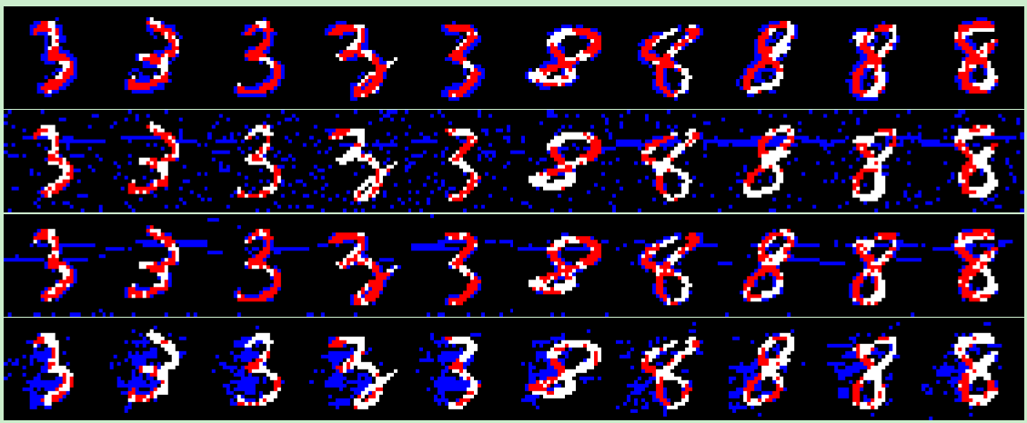
image

Slide 20
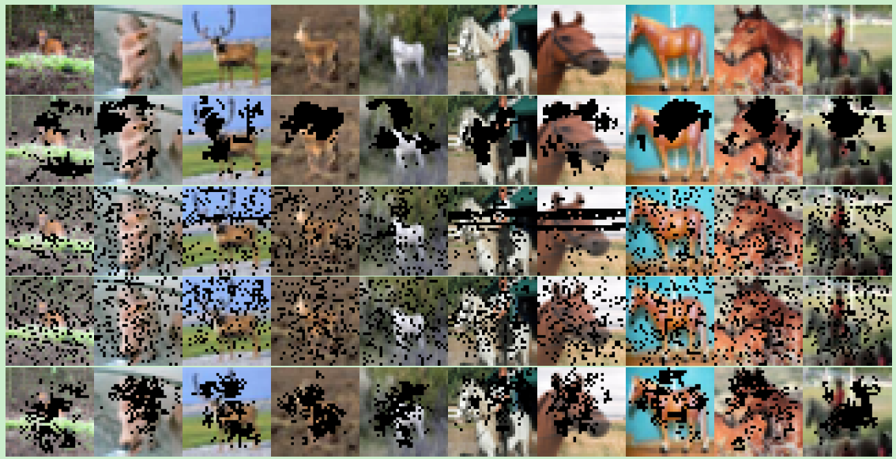
image

