Slide 1


“Why Should I Trust You?” Explaining the Predictions of Any Classifier
Wenyu Jiang
NJU
NJU-CS
Notes:
复杂的模型难以解释，用简单的可解释性比较好的模型在局部近似复杂模型

Slide 2
Outline
Background
Methodology
Experiment
Summary

Slide 3
Background

Slide 4

Motivation
“If the users do not trust a model or a prediction they will not use it.”
Trust an individual prediction
Take some action based on prediction
Trust a model
After evaluation, human believes the model will behave in reasonable ways if deployed “in the wild”.
We won’t trust a black-box model
Notes:
人是机器学习领域中不可忽视的一环，即使训练出来的分类器准确度再高，如果是黑箱，人类不理解就不愿意信任，也就不会使用。
A need: 让用户信任非常重要，信任分为两种，用户足够信任单独预测，基于此采取一些行为；信任整体模型，相信模型在部署后会以一种合理的方式运行。用户必须自信，模型在真实世界的感兴趣的指标上运行的很好。

Slide 5

Model evaluation’s challenge
Data leakage
Unintentional leakage of signal into training data
Dataset shift
Training data is different than test data
…
The model’s accuracy is excellent! We can deploy it!?
However, I don’t understand the model’s behavior.
Notes:
数据泄露：病人的id作为训练数据的一个特征，被发现和训练集和验证集中的数据目标类别强相关。仅仅通过观察预测和原始数据，很难发现这个问题。
数据偏移：20个新闻组数据集
如何让用户信任单次预测，同时解决这些挑战以信任模型，我们需要为提供解释。由解释提供的洞察力可以帮助我们把不值得信任的模型变为值得信任的模型，例如移除泄漏的数据或者修改训练集以避免数据偏移
举一个推荐系统的例子，与引人注目的文章标题相关的特征，放置高的重要性，虽然对模型准确度有益，但是对用户粘性和留存率带来坏处，为模型预测提供解释可以避免这一点。

Slide 6
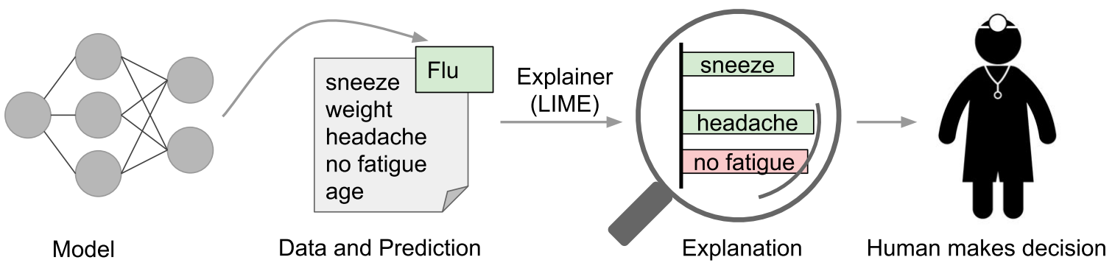
Medical Diagnosis Case
A model predicts that a patient has the flu, and the explanation highlights the symptoms in the patient’s history that led to the prediction. With these, a doctor can make an informed decision about whether to trust the models prediction.
Notes:
In this case, an explanation is a small list of symptoms with relative weights
绿色症状对贡献预测，红色症状反对预测
给定解释，人类利用应用领域的先验知识来判断是否相信预测，同时可以避免数据泄漏

Slide 7
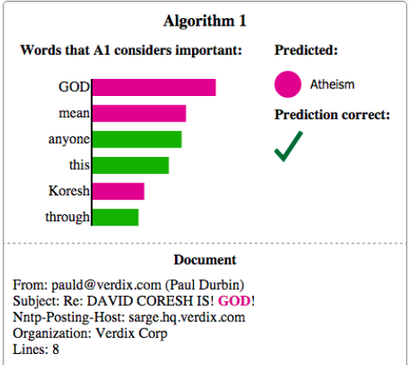
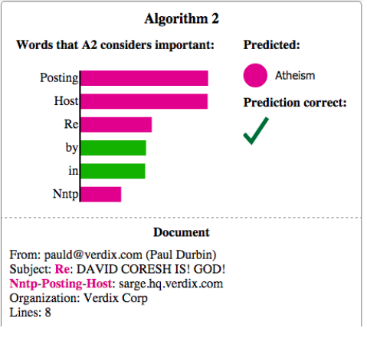
Document Classifiers Case

Slide 8
Problems
How to explain an individual explanation?
How to explain and evaluate a model as a whole?
Desired Characteristics for Explainers
Characteristics | Meaning
Interpretable | the explanations should be easy to understand, the “input variables” in the explanations may need to be different than the features
Local fidelity | the explanations must respond to how the model behaves in the vicinity of the instance being predicted
Model -agnostic | an explainer should be able to explain any model
Global perspective | explain the model
Notes:
数据泄露：病人的id作为训练数据的一个特征，被发现和训练集和验证集中的数据目标类别强相关。仅仅通过观察预测和原始数据，很难发现这个问题。
数据偏移：20个新闻组数据集

Slide 9
Methodology

Slide 10
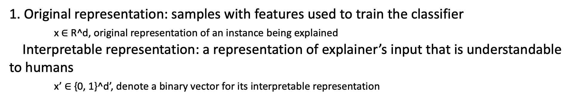
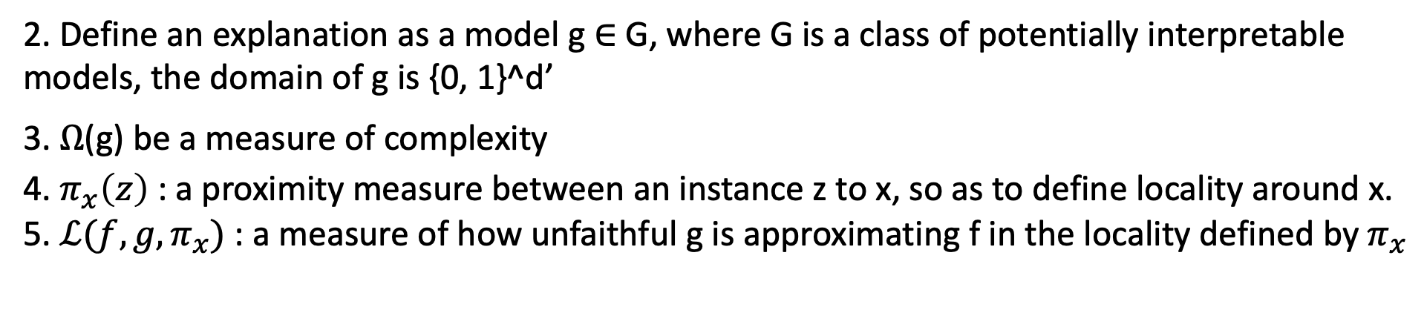
LIME(Local Interpretable Model-agnostic Explanations)
“LIME: explain the predictions of agnostic model in a faithful way by approximating it locally with an interpretable model”
1. Original representation: samples with features used to train the classifier
x $∈$ R^d, original representation of an instance being explained
Interpretable representation: a representation of explainer’s input that is understandable to humans
x’ $∈$ {0, 1}^d’, denote a binary vector for its interpretable representation
2. Define an explanation as a model g $∈$ G, where G is a class of potentially interpretable models, the domain of g is {0, 1}^d’
3. $Ω$(g) be a measure of complexity
4. $π_{x}\left(z\right)$ : a proximity measure between an instance z to x, so as to define locality around x.
5. $ℒ(f, g,π_{x})$ : a measure of how unfaithful g is approximating f in the locality defined by $π_{x}$
Notes:
LIME 学习一个可解释模型，在预测附近近似原始模型

Slide 11

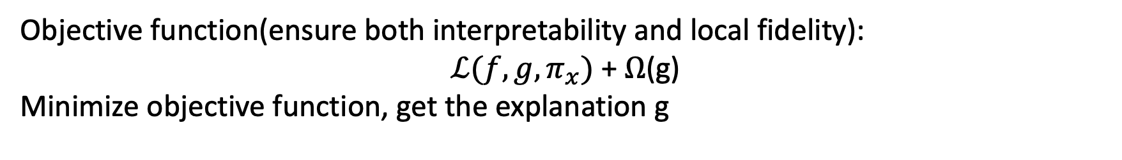
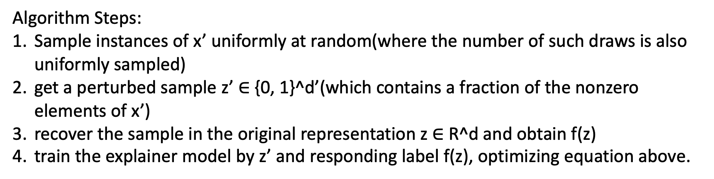
LIME Procedure
Objective function(ensure both interpretability and local fidelity):
$ℒ(f, g,π_{x})$ + $Ω$(g)
Minimize objective function, get the explanation g
Algorithm Steps:
Sample instances of x’ uniformly at random(where the number of such draws is also uniformly sampled)
get a perturbed sample z’ $∈$ {0, 1}^d’(which contains a fraction of the nonzero elements of x’)
recover the sample in the original representation z $∈$ R^d and obtain f(z)
train the explainer model by z’ and responding label f(z), optimizing equation above.

Slide 12
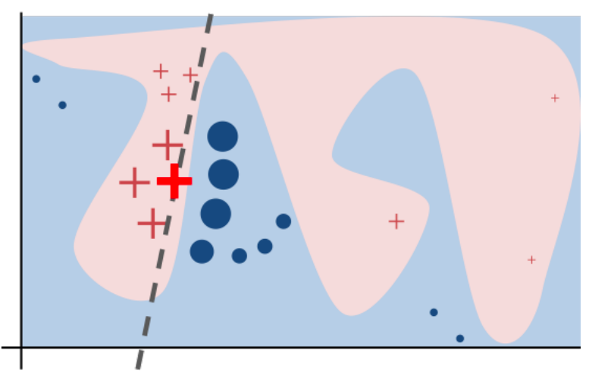
LIME toy example

Slide 13
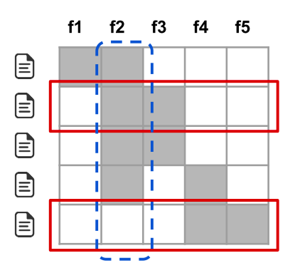
SP-LIME
SP-LIME: a method that selects a set of representative instances with explanations to address the “trusting the model” problem, via submodular optimizaton.
Notes:
用户没有时间检查大量的解释，所以需要明智审慎的选择需要解释的样本

Slide 14
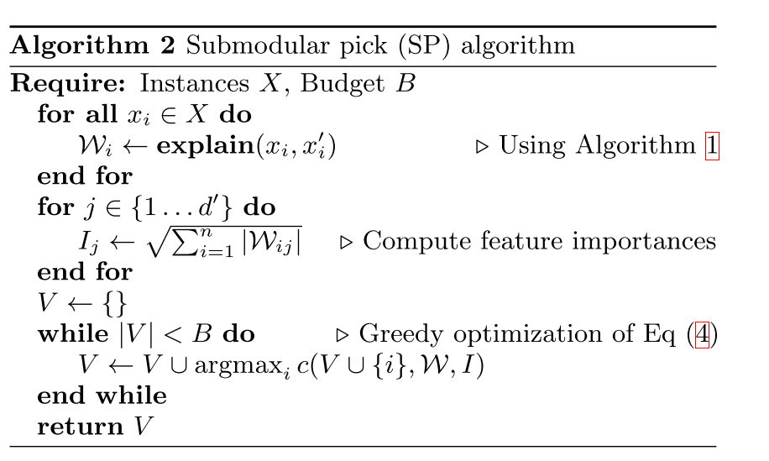
SP-LIME
Notes:
挑选对解释重要的特征，同时避免选择有着相似解释的样本（尽可能覆盖新的特征）
原问题是一个NP-hard问题，将它转换成贪婪算法求解，得到近似最优解

Slide 15
Experiment
Notes:
实验有两部分，一部分是没有人参与，一部分是有人参与，可解释性必不可少的一环就是人
仿真用户实验，人类主体评估

Slide 16
Simulated User Experiments

Slide 17
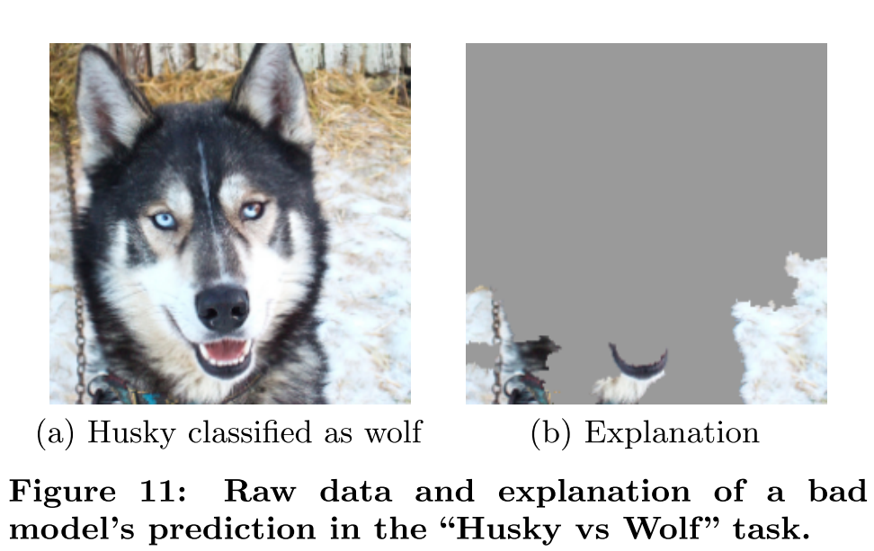
Evaluation with Human Subjects
Notes:
背景是雪的狼图片，与普通的哈士奇图片，差的分类器

Slide 18
Summary

Slide 19
What we can do with explanation
Trust an individual prediction or not
Trust a model or not
Choose between models
Improve an untrustworthy classifier by feature engineering

Slide 20
Reference

Slide 21
Thank you!
Q&A

