Slide 1
Post-disaster rescue system
Group 1
IBM Call For Code 2019

Slide 2

Introduction
WHO WE ARE?
OUR TEAM
Jixiang Luo(Team leader)
From Shanghai Jiao Tong University
Yaoming Wang(Team member)
Support by IBM Cloud
Jin Li(Team member)
ENTER YOUR MIND
Bowen Shi(Team member)

Slide 3
Begin with tragedies !

Slide 4
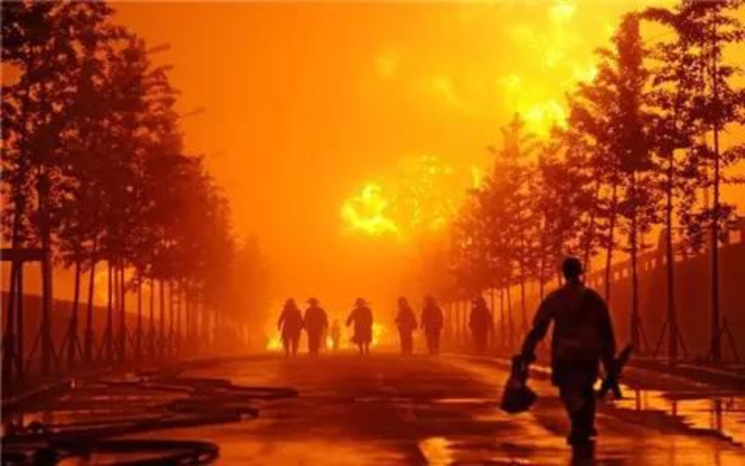

Slide 5
What can we do for them?
Should we do something for them?

Slide 6

WeChat
Video link
Anniversary
Forward

Slide 7
Technology reduces sacrifice
Safe and efficient rescue!
Risk assessment is hard to rescuers
Potential risks are hard covered by rescuers

Slide 8
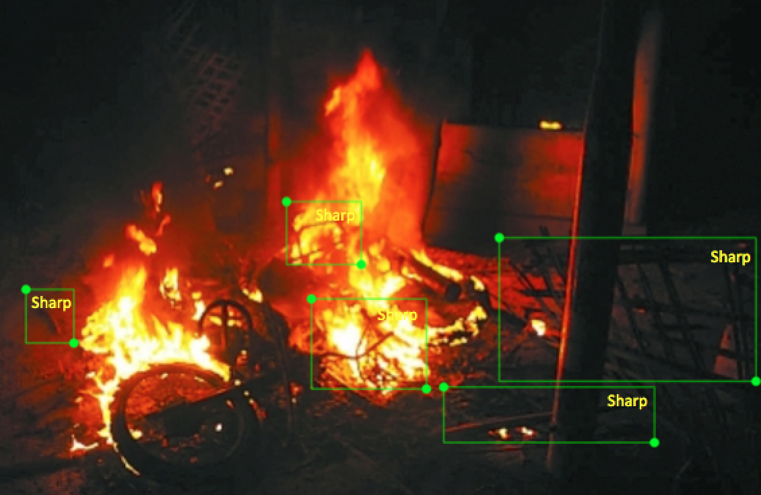
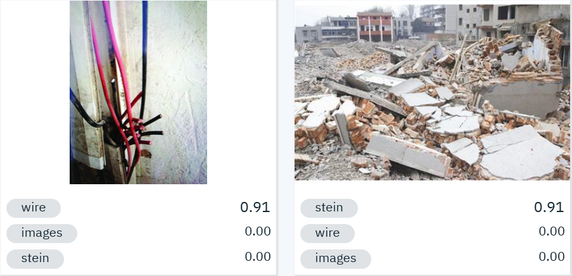
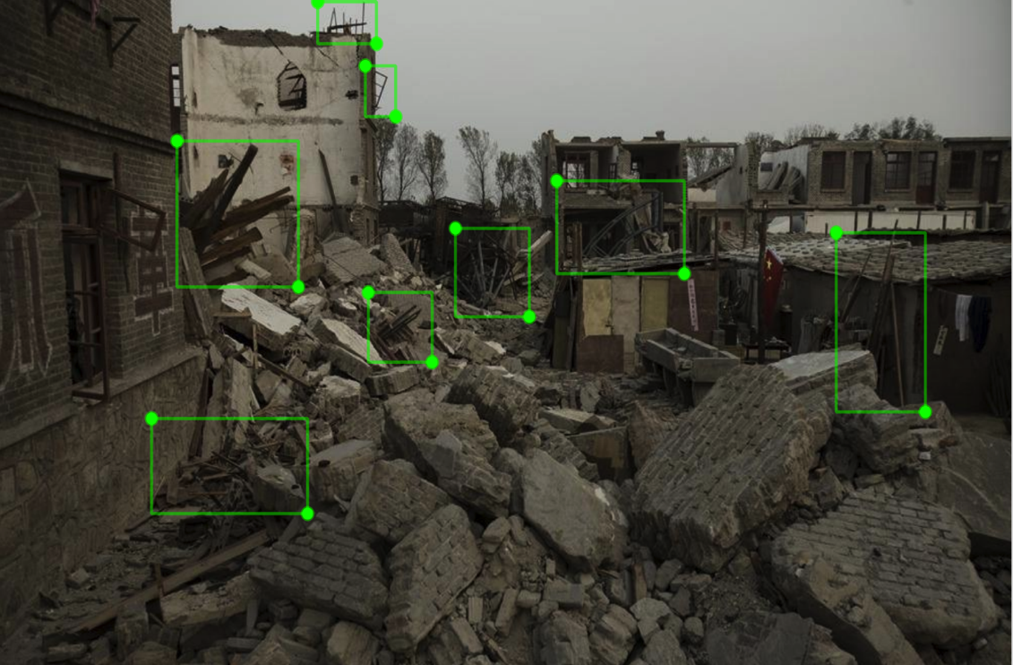
Solution
Risk Assessment:
Classification:
Demonstration via IBM Visual Recognition-kq
Object Localization:
Object Detection:

Slide 9
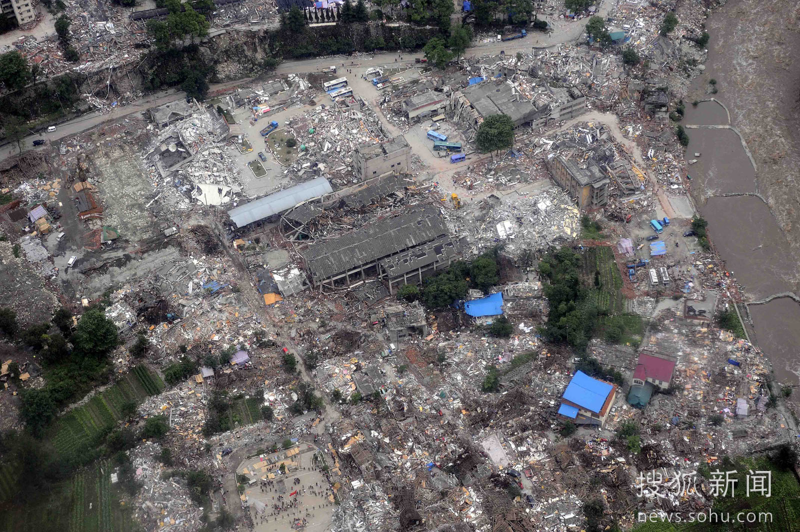
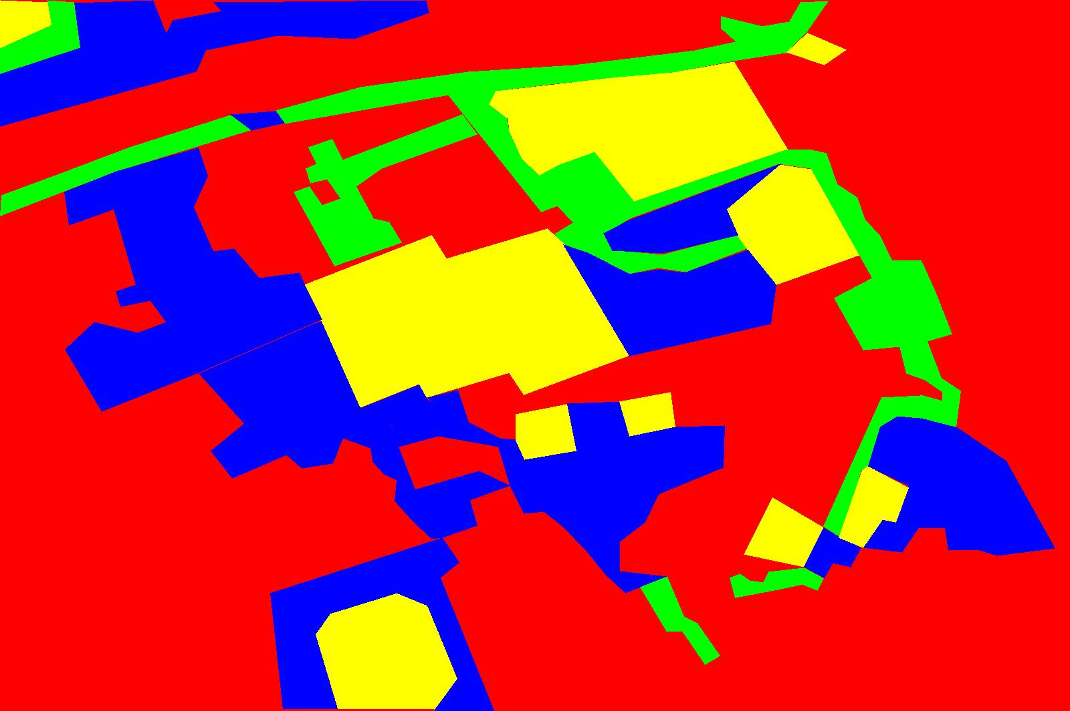
Solution
Path programming via UAV in disaster district

Slide 10
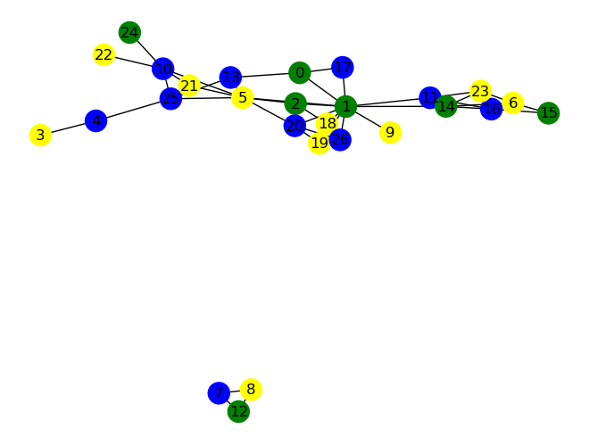
Solution
Path programming via UAV in disaster district

Slide 11
Solution
Path Programming Algorithm

Slide 12
Outlook
1. Collect the data to optimize model to handle the more sophisticated scenes.
2. Optimize the algorithm for path programming, to dynamic estimate the dangerous coefficients faster and more accurately.
3. Share the information among the victims to save themselves, not only for rescuers.

Slide 13
thanks
WE ARE THE BEST TEAM&VENTURE ENTREPRENEUR

