Slide 1
Words Validation
Intel Corporation
Data Center Platform Application Engineering
Henry Li
May 2nd , 2019
Reference Number: xxxxxx
Revision Number: 0.1
Intel Confidential

Slide 2
Legal Disclaimer
Notice: This document contains information on products in the design phase of development. The information here is subject to change without notice. Do not finalize a design with this information.
Intel technologies’ features and benefits depend on system configuration and may require enabled hardware, software or service activation. Learn more at Intel.com, or from the OEM or retailer..
No computer system can be absolutely secure. Intel does not assume any liability for lost or stolen data or systems or any damages resulting from such losses.
You may not use or facilitate the use of this document in connection with any infringement or other legal analysis concerning Intel products described herein. You agree to grant Intel a non-exclusive, royalty-free license to any patent claim thereafter drafted which includes subject matter disclosed herein.
No license (express or implied, by estoppel or otherwise) to any intellectual property rights is granted by this document.
The products described may contain design defects or errors known as errata which may cause the product to deviate from published specifications. Current characterized errata are available on request.
This document contains information on products, services and/or processes in development. All information provided here is subject to change without notice. Contact your Intel representative to obtain the latest Intel product specifications and roadmaps.
Intel disclaims all express and implied warranties, including without limitation, the implied warranties of merchantability, fitness for a particular purpose, and non-infringement, as well as any warranty arising from course of performance, course of dealing, or usage in trade.
(Optional-Turbo Boost Disclaimer) Intel® Turbo Boost Technology requires a PC with a processor with Intel Turbo Boost Technology capability. Intel Turbo Boost Technology performance varies depending on hardware, software and overall system configuration. Check with your PC manufacturer on whether your system delivers Intel Turbo Boost Technology. For more information, see http://www.intel.com/technology/turboboost
<Use only if applicable> Warning: Altering PC clock or memory frequency and/or voltage may (i) reduce system stability and use life of the system, memory and processor; (ii) cause the processor and other system components to fail; (iii) cause reductions in system performance; (iv) cause additional heat or other damage; and (v) affect system data integrity. Intel assumes no responsibility that the memory, included if used with altered clock frequencies and/or voltages, will be fit for any particular purpose. Check with memory manufacturer for warranty and additional details.
<Use only if applicable> Tests document performance of components on a particular test, in specific systems. Differences in hardware, software, or configuration will affect actual performance. Consult other sources of information to evaluate performance as you consider your purchase. For more complete information about performance and benchmark results, visit http://www.intel.com/performance.
<Use only if applicable> Cost reduction scenarios described are intended as examples of how a given Intel- based product, in the specified circumstances and configurations, may affect future costs and provide cost savings. Circumstances will vary. Intel does not guarantee any costs or cost reduction.
<Use only if applicable> Results have been estimated or simulated using internal Intel analysis or architecture simulation or modeling, and provided to you for informational purposes. Any differences in your system hardware, software or configuration may affect your actual performance.
<Use only if applicable> Intel does not control or audit third-party benchmark data or the web sites referenced in this document. You should visit the referenced web site and confirm whether referenced data are accurate.
<Use only if applicable> Intel® AMT should be used by a knowledgeable IT administrator and requires enabled systems, software, activation, and connection to a corporate network. Intel AMT functionality on mobile systems may be limited in some situations. Your results will depend on your specific implementation. Learn more by visiting Intel® Active Management Technology.
<Use only if applicable> Intel is a sponsor and member of the Benchmark XPRT Development Community, and was the major developer of the XPRT family of benchmarks. Principled Technologies is the publisher of the XPRT family of benchmarks. You should consult other information and performance tests to assist you in fully evaluating your contemplated purchases.
Copies of documents which have an order number and are referenced in this document may be obtained by calling 1-800-548-4725 or by visiting www.intel.com/design/literature.htm.
Intel and the Intel logo <Add terms trademarked by Intel and used in this document> are trademarks of Intel Corporation in the U. S. and/or other countries.
*Other names and brands may be claimed as the property of others.
Copyright © 201, Intel Corporation. All Rights Reserved.

Slide 3
Rquirement specification

Slide 4
To validate words in a language that uses broad and slender
Broad Vowels are A, O, and U.
Slender Vowels are E and I.
A valid word in this language can never have a broad vowel on one side of a consonant group, and a slender on the other.

Slide 5
Data Driven

Slide 6
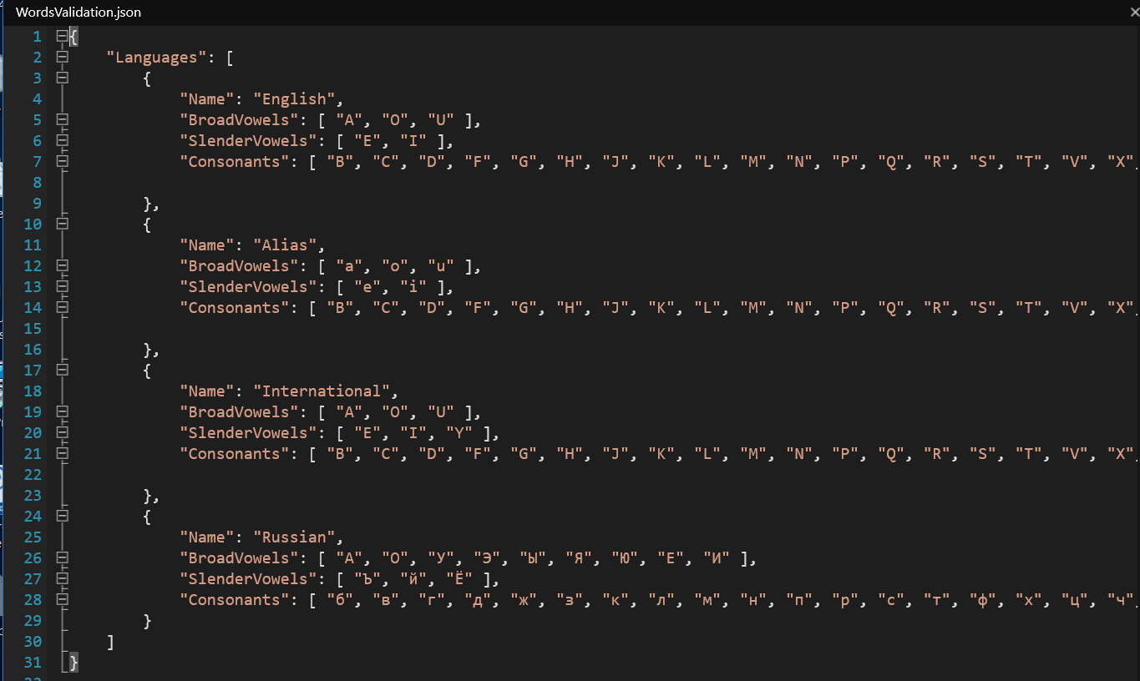
A Json schema has been designed and used to hold the information data of of multiple languages. A new type of language can be easily added.

Slide 7
Objects layout/Class diagram

Slide 8
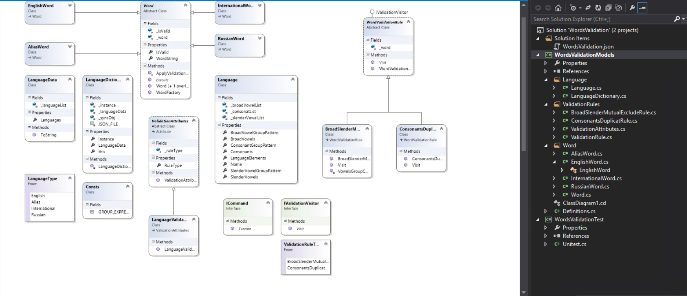

Slide 9
Design patterns been used
URL for design patterns https://www.geeksforgeeks.org/software-design-patterns/
UR

Slide 10
Compose Design Pattern
Class Name : Language. This class is used as a container to hold the basic language data, Broad Vowels, Slender Vowels and Consonants. The composed attributes include: BroadVowlGroupPattern, SlenderVowegroupPattern, ConsonantGroupPattern, LanguageElements and ValidationPattern
File Name : Language.cs.
Ref : https://www.geeksforgeeks.org/composite-design-pattern/

Slide 11
Singleton Design Pattern
Class Name : LanguageDictionary. This class is implemented as thread safe and served as an fast interfaces/Proxy(ref: https://www.geeksforgeeks.org/proxy-design-pattern/) to access the configured languages data (Indexer)
File Name : LanguageDictionary.cs.
Ref: https://www.geeksforgeeks.org/singleton-design-pattern/

Slide 12
Bridge/Command Design Pattern
Interface Name: ICommand. The implementer is the class Word (abstract class)
class Class Name : Word
File Name Word.cs.
Ref: https://www.geeksforgeeks.org/bridge-design-pattern/,

Slide 13
Abstract Factory Design Pattern
The implementation leverages the reflection class provided by .NET (Python can also supports). A instance of a concrete type of Word class is dynamically created driven by the contents data of a language. This makes this design in a graceful way to be extended and resilient .
File Name : Word.cs.
Ref: https://www.geeksforgeeks.org/abstract-factory-pattern/

Slide 14
Unit Test Results

Slide 15
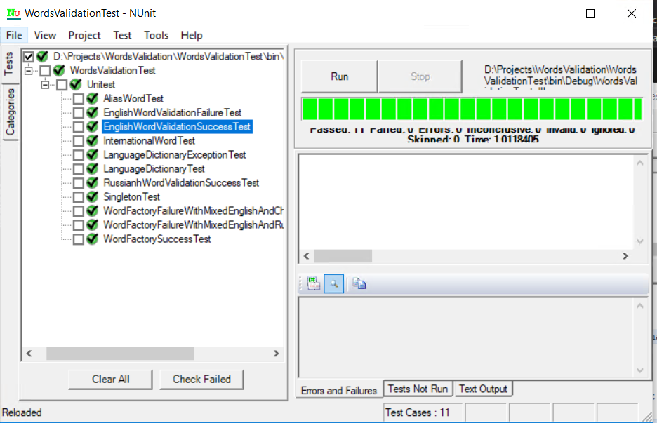
File Name : Unitest.cs

Slide 16
Code analyze Results

Slide 17
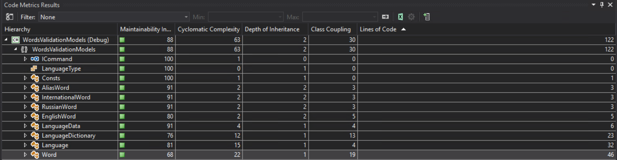
Model Name : WordsValidationModels

Slide 18
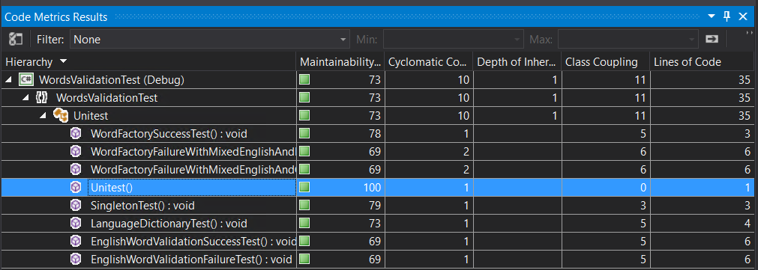
Model Name : WordsValidationTest

Slide 19
Code Coverage Results

Slide 20
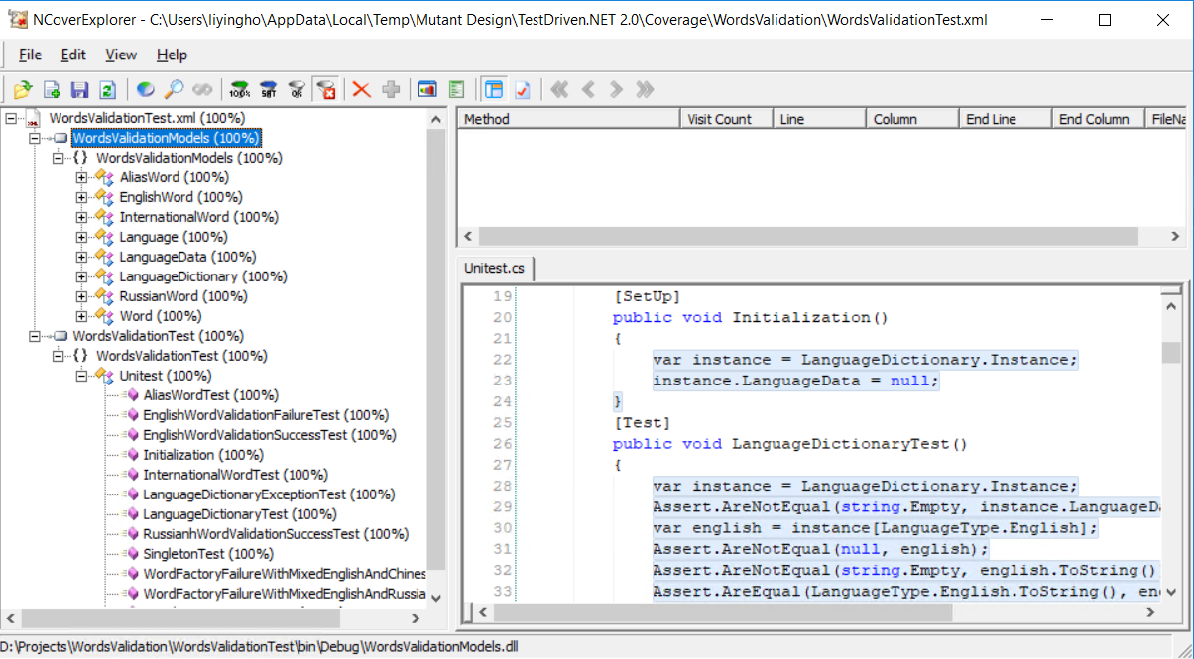

Slide 21
Miscellanies

Slide 22
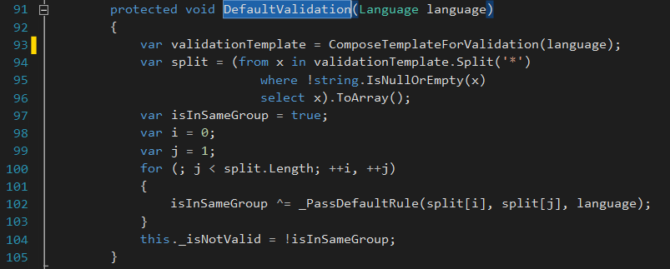
At this moment, there are two words validation functions have been implemented for demo/unites perpose, the one is called DefaultValidation, a member function from the base class Word, that is invoked by the Execute() method for all derived classless that inherit the base Word. The second implementation is from the EnglishWord class, the regular expression is used for the implementation and has be fully tested.

Slide 23
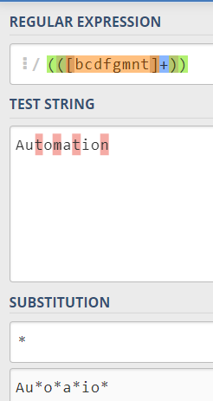
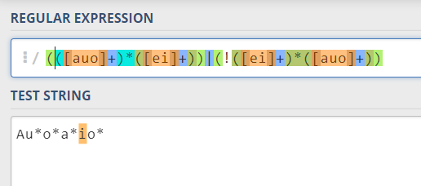
The following diagram illustrated two Regular expression have been used to achieve a English word validation : 1. Replace all consonants group with “*”, 2. Use the regular expression to find the violation, in this example, the Slender vowel “I” has been caught at the right hand side, and the left hand side is a Broad Vowel “a”

