Slide 1
uncertain
corners
certain corners
uncertain
corners

Slide 2
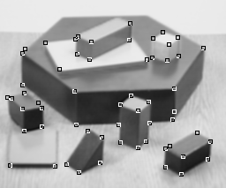

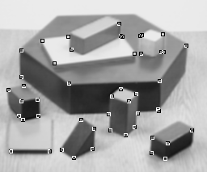


Slide 3
