Slide 1
Technology Architecture
Azure Cloud Virtual Machine
Azure Cloud Virtual Machine
Azure Cloud Virtual Machine
Azure Cloud Virtual Machine
Nginx/Django+Opencv/Pillow
Region of
Interest
Feature
extract
Generate
report
Sqlite3
Database
Neural Network
wechat
wechat
Palm
Report

Slide 2
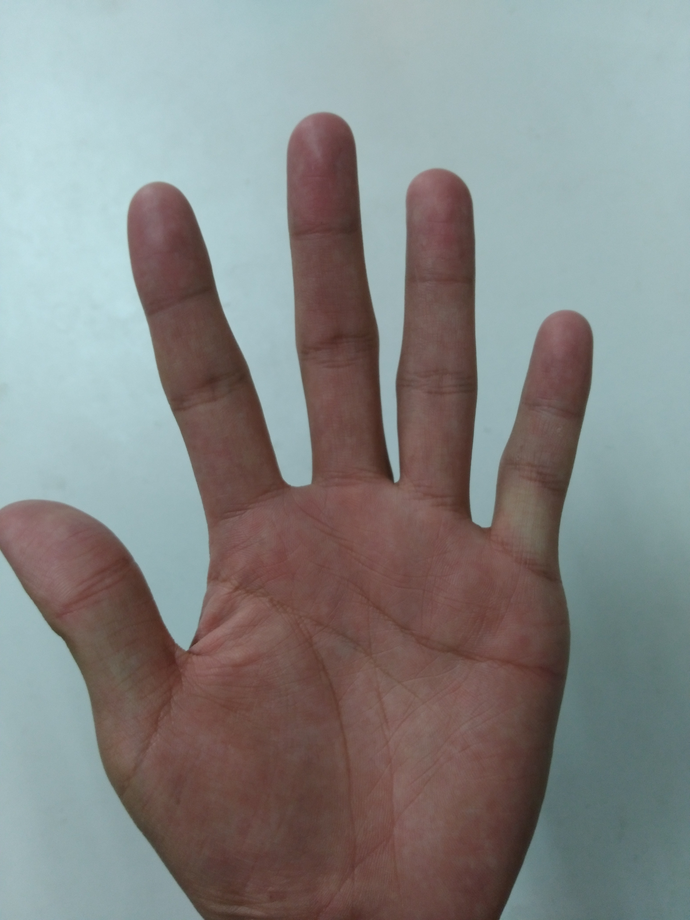
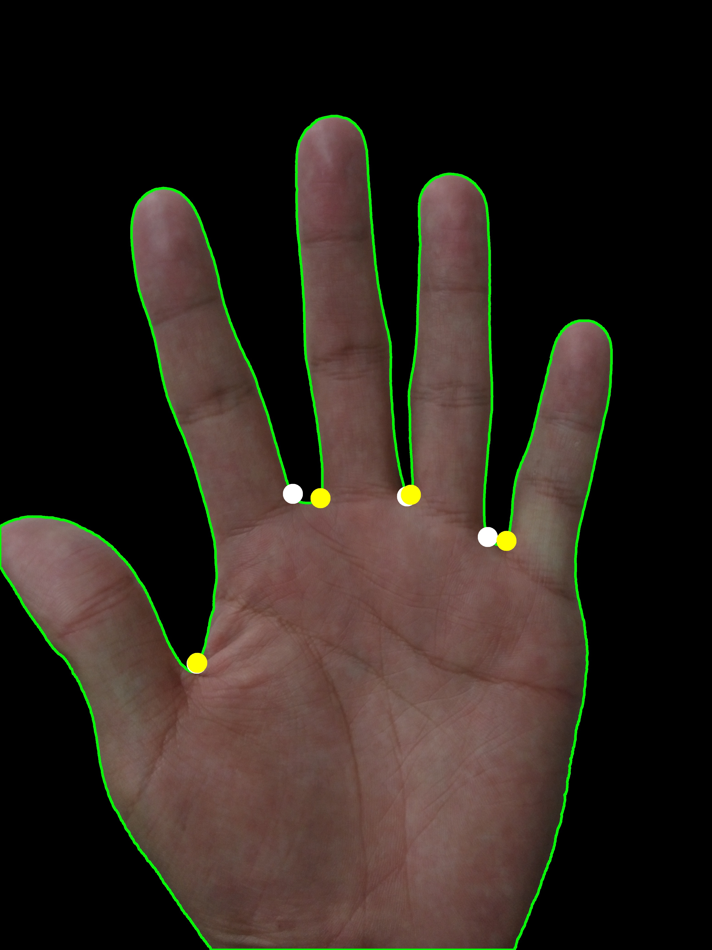

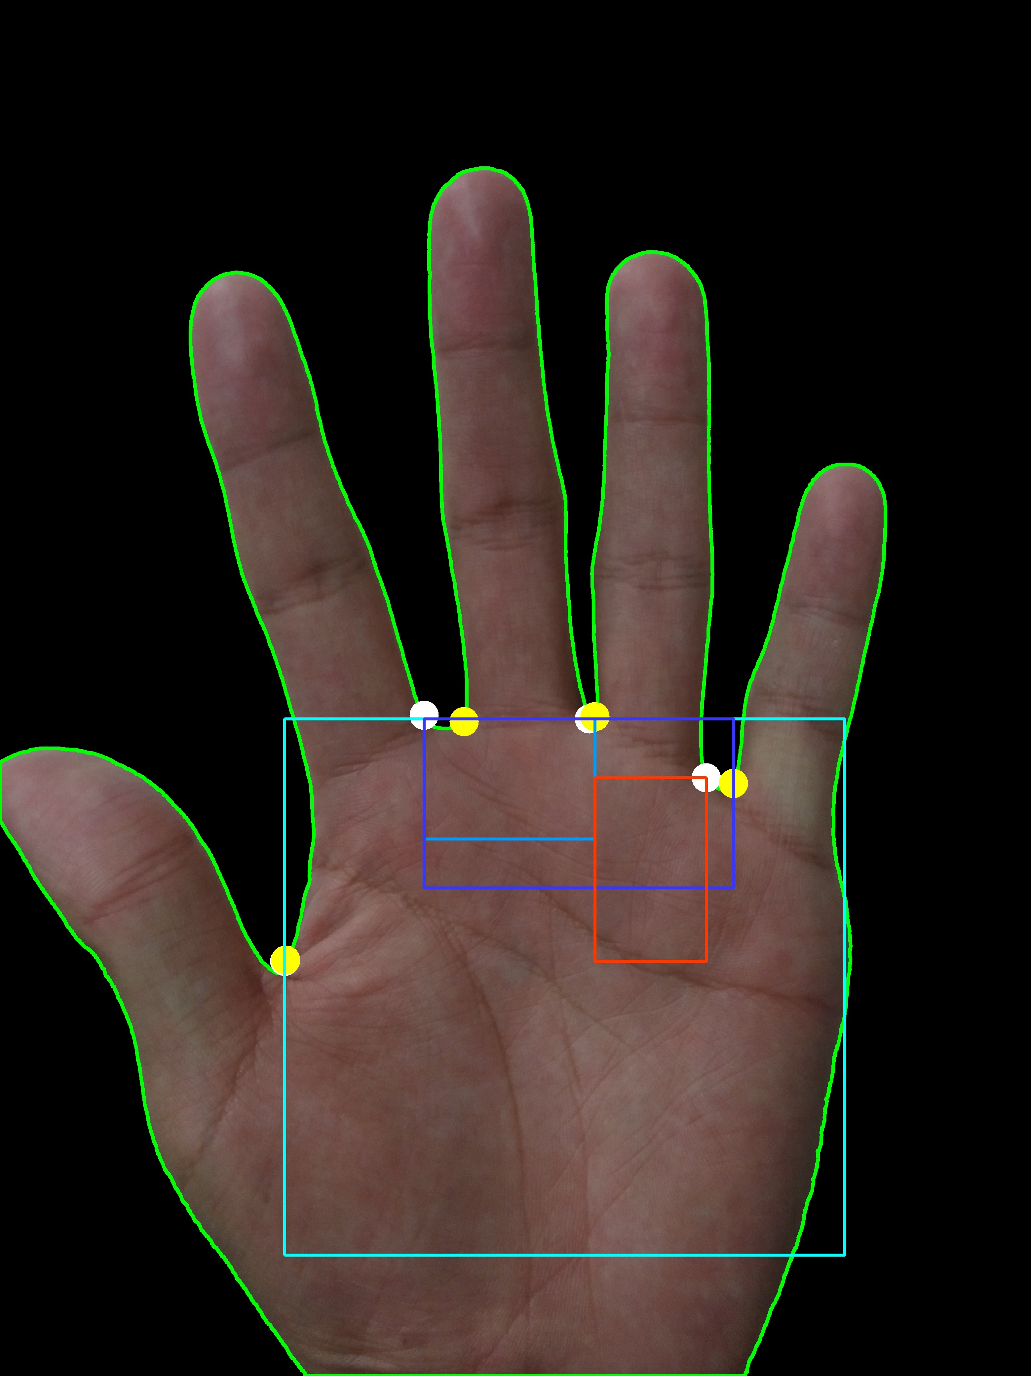
Region of Interest
FindContour
DivideRegion
INPUT
FindAnchors
OUTPUT

Slide 3

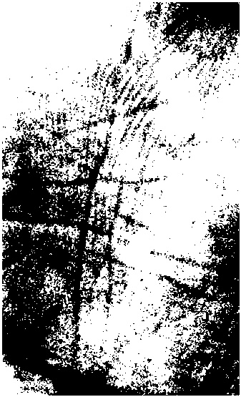
Feature Extract
Blur
Threshold
Feature
Extract
Feature_7:True
Feature_8:False
INPUT
OUTPUT

