Slide 1

Classification
Classification
- 2005 -

Slide 2
What’s Classification?
Classify data
- Mark the data “Class label” by some Knowledge.
How to Classify data
- Rules : Extract important information from dataset to be rules, and use rules to predict the class label.
ex : If 扁桃腺 xxx… and 脈搏 xxx… and 呼吸 xxx… …. Then 流行性感冒A
- So far, data features is the key point of the classification method.
Class 1
Classification
Model
Unknown
Data
Class 2
Class 3

Slide 3
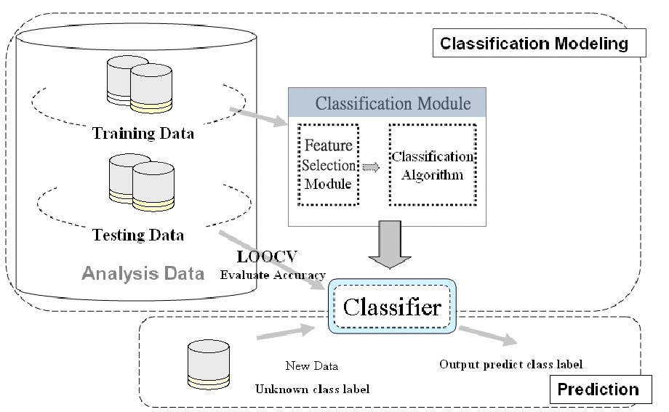
Classification
Supervised learning (classification)

Slide 4
Classification vs. Prediction
Classification : A Two Step Process
Model construction: describing a set of predetermined classes
  Each tuple/sample is assumed to belong to a predefined class, as determined by the class label attribute
  The set of tuples used for model construction is training set
  The model is represented as classification rules, decision trees, or mathematical formulae
Model usage: for classifying future or unknown objects
  Estimate accuracy of the model
    The known label of test sample is compared with the classified result from the model
    Accuracy rate is the percentage of test set samples that are correctly classified by the model
    Test set is independent of training set, otherwise over-fitting will occur
Prediction:
  If the accuracy is acceptable, use the model to classify data tuples whose class labels are not known

Slide 5
Data Mining
- Basic Classification Tech -
ID3, C4.5, C5 – Decision Tree
CBA
KNN
Neural Network
SVM

Slide 6
Classification
- Decision Tree -
A Classification Model
ID3
  Just can process categorical attribute
C4.5, C5
  Can process continuous attribute
The algorithms are introduced by Quinlan
Reference website
  http://www.cis.temple.edu/~ingargio/cis587/readings/id3-c45.html

Slide 7
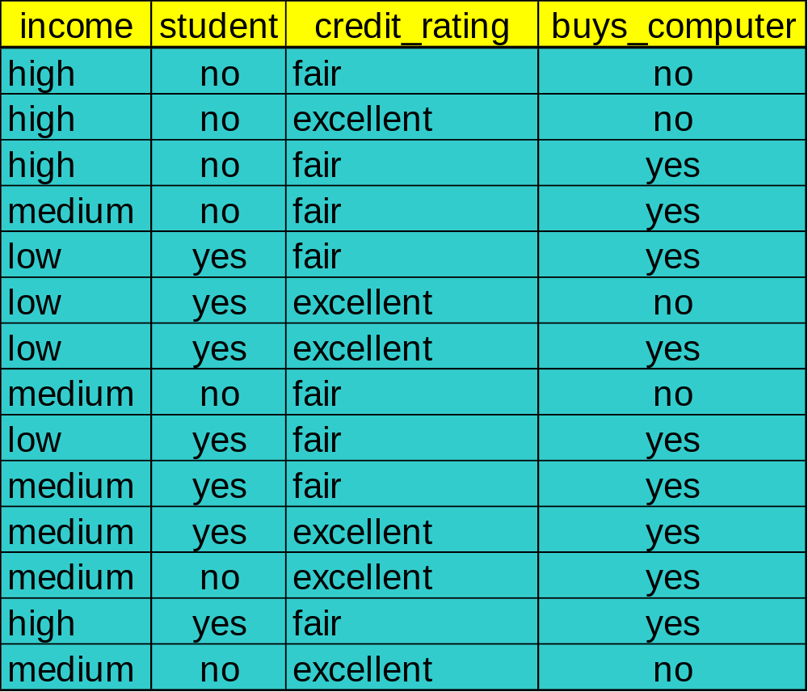
Training Dataset
This follows an example from Quinlan’s ID3

Slide 8
Output: A Decision Tree for “buys_computer”
age?
<=30
overcast
>40
30..40
student?
yes
credit rating?
no
yes
excellent
fair
no
yes
no
yes
If age <=30 and not a student Then buys_computer = NO

Slide 9
Classification by Decision Tree Induction
Decision tree
  Tree was built by attributes (features).
  Keep the rules with tree structure.
    Internal node denotes a test on an attribute
    Branch represents an outcome of the test
    Leaf nodes represent class labels or class distribution
Use of decision tree: Classifying an unknown sample by tracing tree path
  Test the attribute value of the sample against the decision tree

Slide 10
Decision Tree Generation
Decision tree generation consists of two phases
  Tree construction
    At start, all the training examples are at the root (Top-down)
    Partition examples recursively based on selected attributes
  Tree pruning (ID3 doesn’t have)
    Identify and remove branches that reflect noise or outliers

Slide 11
Basic Decision Tree
- Basic Procedure of ID3 -
First. Transform all attributes to adaptive form.
ID3 Algorithm :
Step1. Select the attribute with the strongest ability to classify
the data set.
Step2. Separate the data into sub-dataset [D₁,D₂,D₃,D₄…] with
this attribute values.
Step3. For each sub-dataset, recursively applied the
algorithm. Until all data of the sub-dataset are belong
one class, or no attribute can be used.

Slide 12
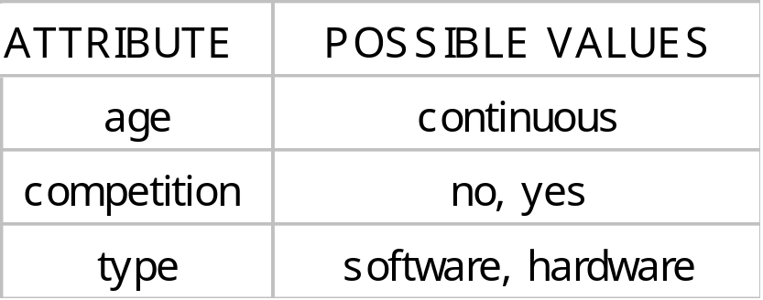
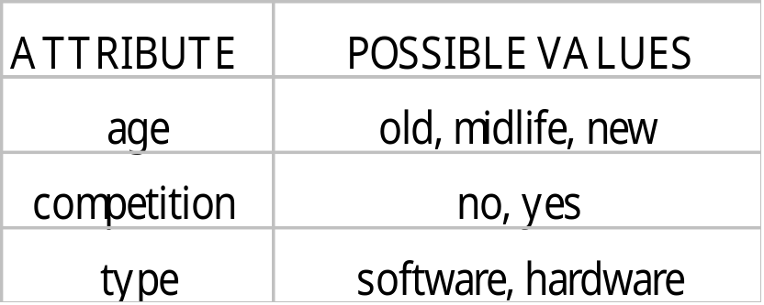
Attribute Transformation
Transform the continuous attribute into category attribute

Slide 13
Attribute Selection Measure
Information gain (ID3/C4.5)
  All attributes are assumed to be categorical
  Can be modified for continuous-valued attributes
Gini index (IBM IntelligentMiner)
  All attributes are assumed continuous-valued
  Assume there exist several possible split values for each attribute
  May need other tools, such as clustering, to get the possible split values
  Can be modified for categorical attributes

Slide 14
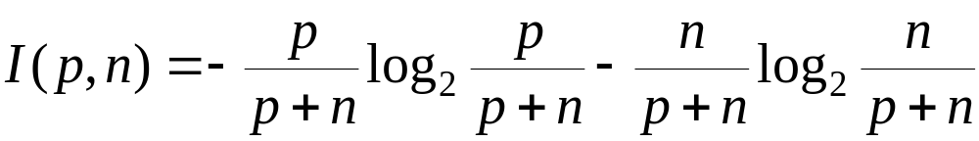
Information Gain (ID3/C4.5)
Select the attribute with the highest information gain
Assume there are two classes, P and N
  Let the set of examples S contain p elements of class P and n elements of class N
  The amount of information, needed to decide if an arbitrary example in S belongs to P or N is defined as

Slide 15
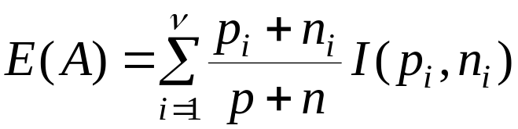

Information Gain in Decision Tree Induction
Assume that using attribute A a set S will be partitioned into sets {S₁, S₂ , …, S_{v}}
  If S_{i} contains p_{i} examples of P and n_{i} examples of N, the entropy, or the expected information needed to classify objects in all subtrees S_{i} is
The encoding information that would be gained by branching on A

Slide 16
Basic Decision Tree
- How to validate the classify ability of an attribute
We must choose a attribute with the largest Entropy (亂度) –*這還不能拿來選取類別
  Larger entropy presents the value distribution of this attribute is more even
亂度大
亂度小
1 2 3
1 2 3

Slide 17
Basic Decision Tree
- How to validate the classify ability of an attribute
Attribute P (p₁,p₂, ….,p_{n}) [p_{x}: The probability of the transaction with the x_{th} value of P]
Entropy(P) = I(P) = - (p1*lg(p1) + p2*lg(p2) + .. + pn*lg(pn))
Information converyed by this distribution
For a data set T
Info(T) = I(P)
P = (|C₁|/|T| , |C₂|/|T| ,…, |C_{n}|/|T|)

Slide 18
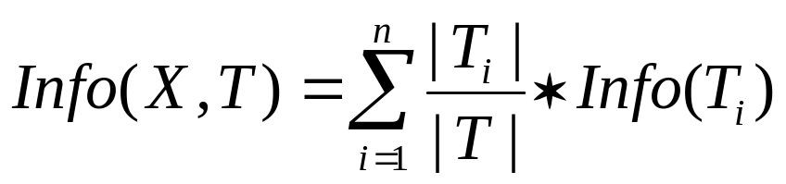
Basic Decision Tree
- How to validate the classify ability of an attribute
What is the entropy of an attribute X in data set T ?
Definition : Gain (X,T) = Info(T) – Info(X,T)
Gain 表示考不考慮 attribute X對分類亂度的差異 , 顯然我們需要取能使Gain的值最大的attribute….理由 表示他們的每一個值對於分類亂度最小…(也就是對該attribute的每一種值都很偏其中一個類別 ex: value1的資料大多都是第X類)…最有分類能力

Slide 19
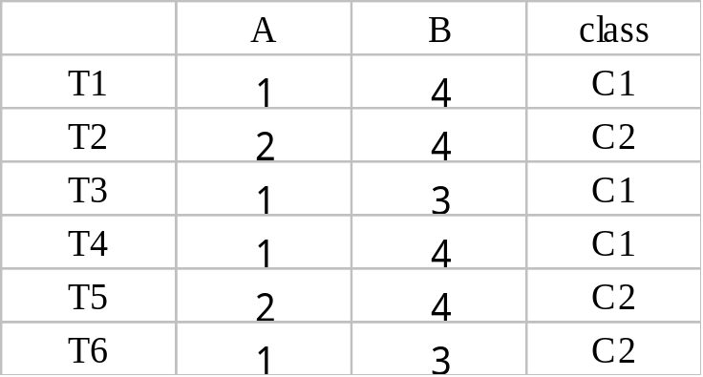
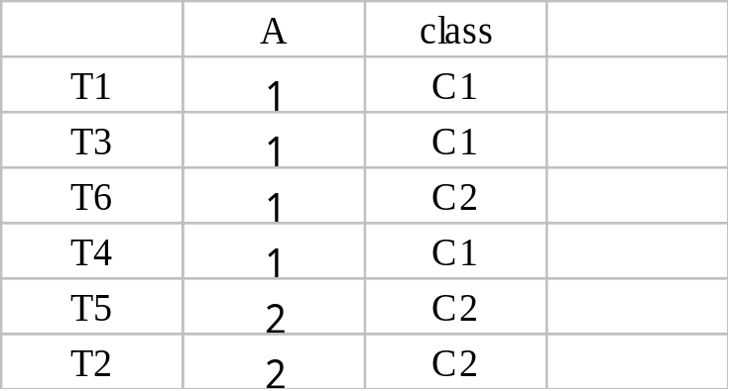
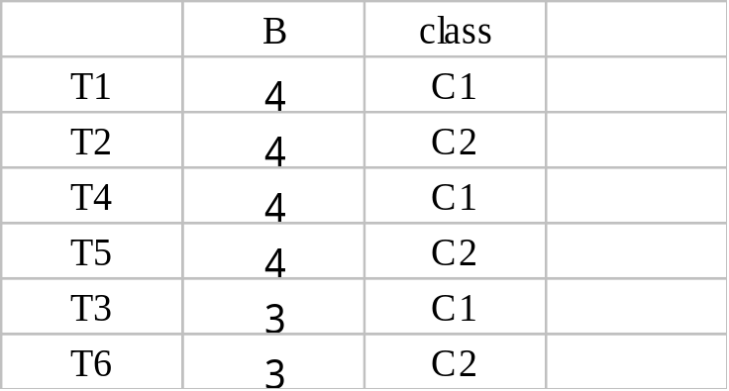
Basic Decision Tree
- How to validate the classify ability of an attribute
Info(T) = I(3/6, 3/6) = I (0.5, 0.5)
= - (0.5*lg(0.5) + 0.5*lg(0.5)) = 1
Info (A,T) = 4/6*( -(1/4*lg(1/4) + 3/4*lg(3/4))) + 2/6 *( -(2/2*lg(2/2)) = 0.541
Gain (A,T) = 1- 0.541 =0.459
Gain (B,T) = 1-1=0
Info (B,T) = 4/6*(-(1/2*lg(1/2)+1/2*lg(1/2))) + 2/4*(-(1/2*lg(1/2)+1/2*lg(1/2))) = 1
由資料和Gain數值都可看出 Attribute A顯然有比較好的分類能力

Slide 20
Basic Decision Tree
- How to validate the classify ability of an attribute
6
6
6
3
3
3
3
3
3
4
2
4
2
1
3
2
2
2
1
1
Info(T) = I(3/6, 3/6) = I (0.5, 0.5)
= - (0.5*lg(0.5) + 0.5*lg(0.5)) = 1
Info (A,T) =
4/6*( -(1/4*lg(1/4) + 3/4*lg(3/4))) +
2/6 *( -(2/2*lg(2/2)) = 0.541
Info (B,T) =
4/6*(-(1/2*lg(1/2)+1/2*lg(1/2))) +
2/4*(-(1/2*lg(1/2)+1/2*lg(1/2))) = 1

Slide 21
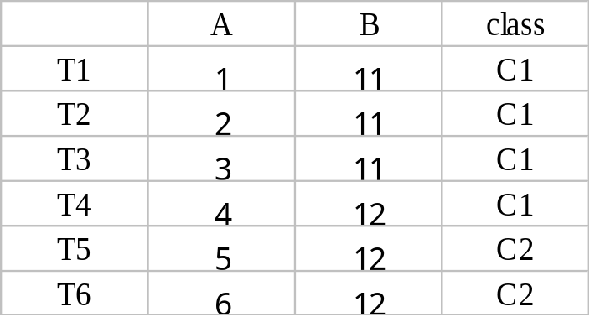
New validation method
- Gain Ratios -
There is one drawback of Gain method.
For example :
Gain (A,T) = Info(T) – 0 = 0.9183
Gain (B,T) = Info(T) – Info(B,T)
= 0.9183 - 0.459 = 0.4593
Obviously, A is not a good attribute for classification. A is more like a key of this dataset. But the method of Gain, we will choose the attribute A be with the best classify ability.

Slide 22
Basic Decision Tree
outlook
overcast
sunny
rain
Humidity
Windy
<=75
>75
True
False
play
play
don’t play
don’t play
play

Slide 23
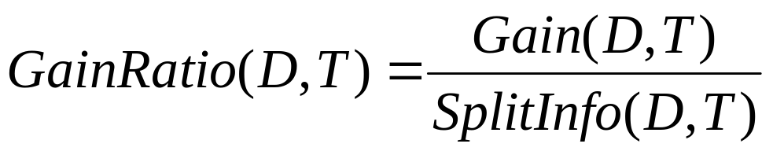
New validation method
- Gain Ratios -
簡單的說就是再除以該Attribute本身的的亂度 (不是對分類的)
SplitInfo(D,T) = I (|T₁|/|T| , |T₂|/|T| ,…, |T_{n}|/|T|)
GainRatio(D,A) = 0.9183 / I (1/6 , 1/6 , 1/6 , 1/6 , 1/6 , 1/6 , 1/6)
=0.9183 / 2.80 = 0.328
GainRatio(D,B) = 0.4593 / I (1/2,1/2) = 0.4593 / 1 =0.4593
GainRatio correctly guide us to choose the attribute B.

Slide 24
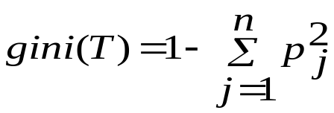
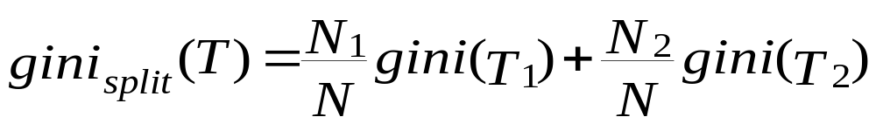
Gini Index (IBM IntelligentMiner)
If a data set T contains examples from n classes, gini index, gini (T) is defined as
where p_{j} is the relative frequency of class j in T.
If a data set T is split into two subsets T₁ and T₂ with sizes N₁ and N₂ respectively, the gini index of the split data contains examples from n classes, the gini index gini(T) is defined as
The attribute provides the smallest gini_{split}(T) is chosen to split the node (need to enumerate all possible splitting points for each attribute).

Slide 25
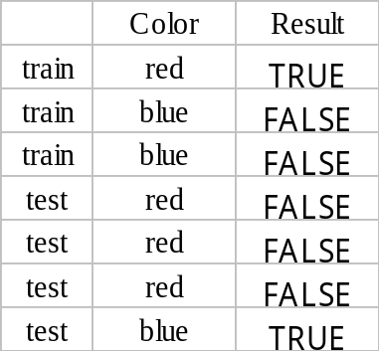
Advance Decision Tree
- C4.5 Extensions -
Continuous : If the attribute A (A₁,A₂,…,A_{n}) , we evaluate all A_{j} . Let Aj be a separator to separate the dataset into two part (<=A_{j} , >A_{j}). We choose the A_{x} which be with the largest Gain value.
Pruning Decision Trees : Prune some subtree with error rate greater than single node.
Deriving Rule Sets : Each path can be a rule
Color
Color
prune
red
blue
True
False
False
通通摃龜

Slide 26
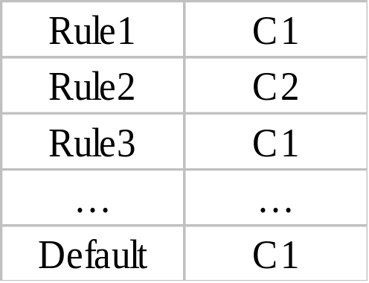
CBA – Classification Based on Association
Count class label after doing Apriori.
Use a large itemset and its class count to be a classification rule.
A,B,D [C₁:0.3 , C₂: 0.5 , C₃:0.2]
A,B,D → C₂
We predict new data with rules, if no rule can predict new data , then we predict it to be default class.

Slide 27
The k-Nearest Neighbor Algorithm (KNN)
All instances correspond to points in the n-D space.
The nearest neighbor are defined in terms of Euclidean distance.
The target function could be discrete- or real- valued.
For discrete-valued, the k-NN returns the most common value among the k training examples nearest to xq.
_
_
_
.
+
_
+
_
xq
+
_
+

Slide 28
Neural Network
Dataset
Target
Feedback
Neuron(s)
or
Neural Net
result
Features
train
Neural Net Classifier

Slide 29




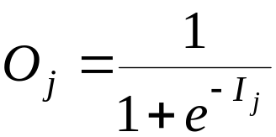
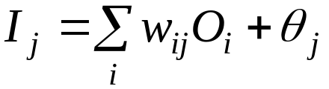
Neural Network (cont.)
Output vector
Output nodes
Hidden nodes
w_{ij}
Input nodes
Input vector: x_{i}

Slide 30
Support Vector Machine (SVM)
SVM
General for 2 Class , High Accuracy
w^{T}x + b = 0
w^{T}x + b > 0
Optimal hyperplane
f(x) = sign(w^{T}x + b)
w^{T}x + b < 0

Slide 31
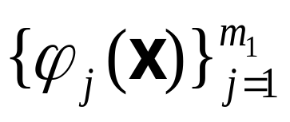
SVM : Data Mapping (cont.)
Dimension: m₀ Dimension: m₁
ϕ(x_{i})
Nonlinear mapping
x_{i}
Input (data) space
Feature space

Slide 32
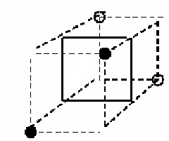
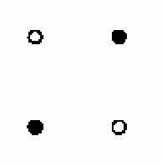
SVM (cont.)
General idea: the original feature space can always be mapped to some higher-dimensional feature space where the training set is separable:
Φ: x → φ(x)

Slide 33
Summary
Classification is an extensively studied problem (mainly in statistics, machine learning & neural networks)
Classification is probably one of the most widely used data mining techniques with a lot of extensions
Scalability is still an important issue for database applications: thus combining classification with database techniques should be a promising topic
Research directions: classification of non-relational data, e.g., text, spatial, multimedia, etc..

Slide 34
收工啦!作業 ^^~
Classification的方法越來越多, 不過在data mining領域中大部份都還是以Decision Tree為主, 所以此投影片對於其它方法也是點到為止
正所謂師父領進門 修行在個人 更深入的研究 就得靠自己啦!
最後送給各位一個小禮
  C4.5 實作練習 (至少要能寫到ID3的要求)
  http://dbserver.csie.ncku.edu.tw/~tsengsm/COURSE/DM/DM-04-Term-Proj.htm
  http://www.cis.temple.edu/~ingargio/cis587/readings/id3-c45.html
  Data Set
  http://dbserver.csie.ncku.edu.tw/~tsengsm/COURSE/DM/customer.zip
  http://dbserver.csie.ncku.edu.tw/~tsengsm/COURSE/DM/dataset/

