Slide 1

Homework 3
Speaker：陳昱成
Advisor: 蔡佩璇教授

Slide 2
Homework 3
Target: Compiler for C , C++
Deadline: 6/25(四) 23:59
DEMO: 6/26(五)(下午上課時間至晚上)
Upload your file to moodle
A zipped file(.rar, .zip, .7z, …) contain your source code and readme
Filename: StudentID
Ex: F74001234.rar
Post your problems on moodle

Slide 3
llvm
基本分
Symbol table 10%
Type checking (warning) 10%
print 10%
基本運算 10% (含type轉換)
BinOp 所有運算子
陣列 + 陣列運算10%
function 10%
進階分
基本運算優先權 10%
if else 10%
while 10%
其他
問問題 10%

Slide 4
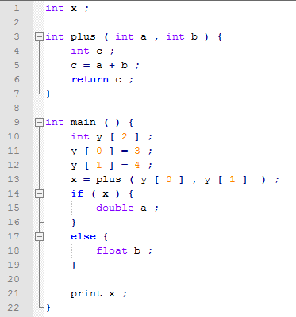
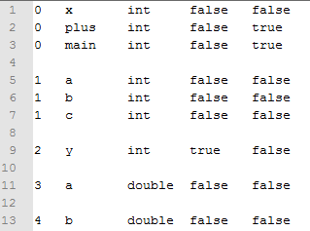
Symbol table
Scope 0
scope
Symbol
type
array
function
Scope 1
Scope 2
Scope 3
Scope 4

Slide 5
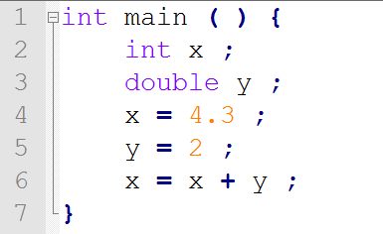
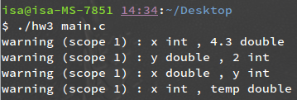
Type checking
Command line
warning (scope 1) : x int , 4.3 double
warning (scope 1) : y double , 2 int
warning (scope 1) : x double , y int
warning (scope 1) : x int , temp double

Slide 6
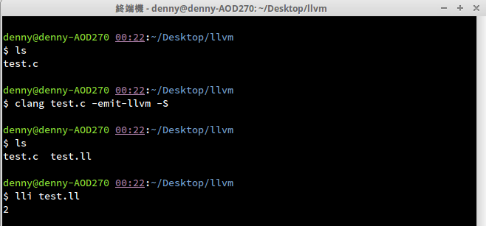
llvm install
安裝: sudo apt-get install clang llvm
執行: lli test.ll
把C code變成LLVM IR
用interpreter執行LLVM IR

Slide 7
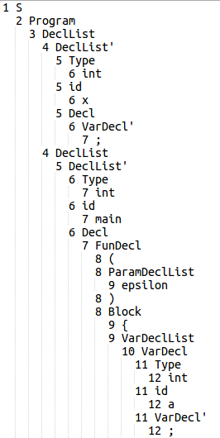
llvm
@x = global i32 0
define i32 @main() {
%a = alloca i32
........

Slide 8
stmtList
Def Expr(){
id = Id();
{op,t1} = ExprIdTail();
print (%t2 = load i32* %id);
print (%t3 = op %t1 %t2);
return t3
}
Def Expr’(){
If (epsilon)
return eplison
Else
t = Expr()
op = BinOp
Return {op,t}
}
stmt
Expr
id
ExprIdTail
a
=
Expr
id
ExprIdTail
b
Expr’
Def ExprIdTail(){
{op,t} = Expr’()
If({op,t} == epsilon)return epilson
Else return {op,t}
}
BinOp
Expr
*
id
ExprIdTail
c
Expr’
epsilon

Slide 9
llvm
@.str = private constant[4 x i8] c"%d\0A\00"
@x = global i32 0
declare i32 @printf(i8*, ...)
define i32 @main(){
%a = alloca i32
%b = alloca i32
%c = alloca i32
store i32 3, i32* %a
store i32 4, i32* %b
%1 = load i32* %a
%2 = load i32* %b
%3 = add i32 %1, %2
store i32 %3, i32* %c
%4 = load i32* %c
call i32 (i8*, ...)* @printf(i8* getelementptr inbounds ([4 x i8]* @.str, i32 0, i32 0), i32 %4)
ret i32 0
}
int x = 0;
int main ( )
{
int a ;
int b ;
int c ;
a = 3 ;
b = 4 ;
c = a + b ;
print c;
return 0 ;
}

Slide 10
LLVM reference
http://llvm.org/docs/LangRef.html
http://aosabook.org/en/llvm.html
http://en.wikipedia.org/wiki/LLVM

Slide 11
MIPS (超過100分以100分計)
基本分
Symbol table 10%
Type checking (warning) 10%
print 10%
基本運算 10% (不含type轉換)
BinOp 所有運算子
if else 20%
進階分
基本運算優先權 10%
陣列 10%
function 20%
while 20%
其他
問問題 10%

Slide 12
SPIM: A MIPS32 Simulator
http://spimsimulator.sourceforge.net/
Download SPIM
qtspim_9.1.12_linux64.deb
Command
sudo apt-get install qttools5-dev-tools qt4-dev-tools
sudo dpkg -i qtspim_9.1.12_linux64.deb
qtspim

Slide 13
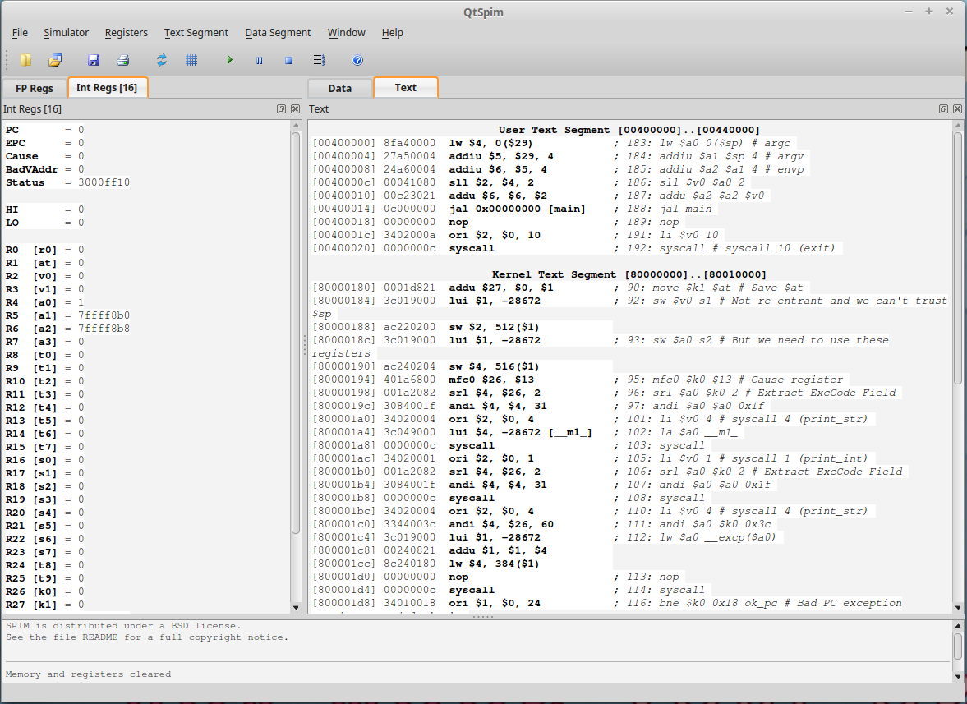

Slide 14
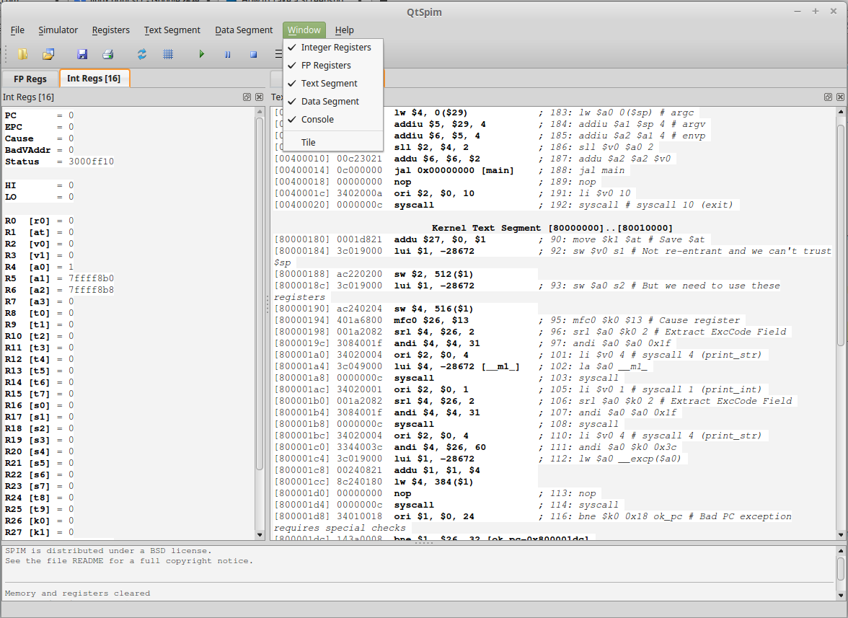

Slide 15
Sample code
variable
.data
var1: .word 10
.text
main:
lw $t0, var1
li $t1, 5
add $t2, $t0, $t1
li $v0, 1 # $system call code for print_int
move $a0, $t2 # $integer to print
syscall # print it
jr $ra # return
instruction

Slide 16
Sample code
.data
var1: .word 10
.text
main:
lw $t0, var1
li $t1, 5
add $t2, $t0, $t1
li $v0, 1 # $system call code for print_int
move $a0, $t2 # $integer to print
syscall # print it
jr $ra # return
Begin at main
End in return

Slide 17
Sample code
.data
var1: .word 10
.text
main:
lw $t0, var1
li $t1, 5
add $t2, $t0, $t1
li $v0, 1 # $system call code for print_int
move $a0, $t2 # $integer to print
syscall # print it
jr $ra # return
Use syscall to print

Slide 18
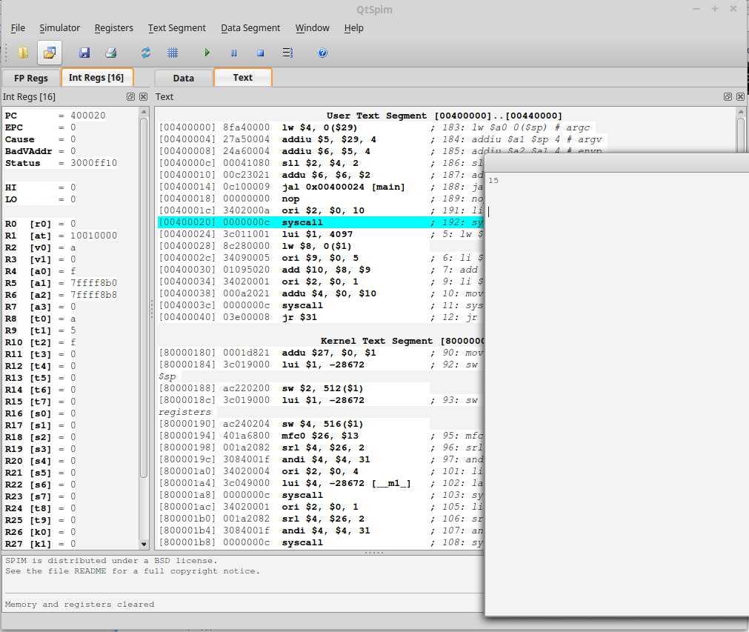
Reinitialize and Load File

Slide 19
play
result

Slide 20
Environment : Linux
不允許使用3rd-party函式庫
Input
main.c
grammar.txt
Output
main.ll or main.asm
symbol_table.txt
print warning on terminal (Type checking)

Slide 21
Reference
https://www.cs.tcd.ie/John.Waldron/itral/spim_ref.html
http://logos.cs.uic.edu/366/notes/mips%20quick%20tutorial.htm
http://www.mrc.uidaho.edu/mrc/people/jff/digital/MIPSir.html
http://students.cs.tamu.edu/tanzir/csce350/reference/syscalls.html

