Slide 1

1z0-809.examcollection.premium.exam.207q
Number: 1z0-809 Passing Score: 800 Time Limit: 120 min File Version: 10.0
1z0-809
Java SE 8 Programmer II Version 10.0

Slide 2
Exam A
QUESTION 1
Given the definition of the Vehicle class:
Class Vehicle { int distance;
Vehicle (int x) {
this distance = x;
}
public void increSpeed(int time) { int timeTravel = time;
//line n3
class Car {
int value = 0;
//line n1
public void speed () {
value = distance /timeTravel; //line n2 System.out.println (“Velocity with new speed”+value+”kmph”);
}
}
speed();
//line n3
}
}
and this code fragment:
Vehicle v = new Vehicle (100); v.increSpeed(60);
What is the result?
Velocity with new speed 1 kmph
A compilation error occurs at line n1.
A compilation error occurs at line n2.
A compilation error occurs at line n3.
Correct Answer: A => D Section: (none) Explanation
Explanation/Reference:
QUESTION 2
Given:
IntStream stream = IntStream.of (1,2,3); IntFunction<Integer> inFu= x -> y -> x*y; IntStream newStream = stream.map(inFu.apply(10)); newStream.forEach(System.output::print);
//line n1
//line n2
Which modification enables the code fragment to compile?
A. Replace line n1 with:
IntFunction<UnaryOperator> inFu = x -> y -> x*y;
B. Replace line n1 with:
IntFunction<IntUnaryOperator> inFu = x -> y -> x*y;
C. Replace line n1 with:
BiFunction<IntUnaryOperator> inFu = x -> y -> x*y;

Slide 3
D. Replace line n2 with:
IntStream newStream = stream.map(inFu.applyAsInt (10));
Correct Answer: B Section: (none) Explanation
Explanation/Reference:
QUESTION 3
Given the code fragment:
List<Integer> values = Arrays.asList (1, 2, 3); values.stream ()
.map(n -> n*2) //line n1
.peek(System.out::print) //line n2
.count();
What is the result?
A. 246
The code produces no output.
A compilation error occurs at line n1.
A compilation error occurs at line n2.
Correct Answer: A Section: (none) Explanation
Explanation/Reference:
QUESTION 4
Given the code fragment:
public class Foo {
public static void main (String [ ] args) { Map<Integer, String> unsortMap = new HashMap< unsortMap.put (10, “z”);
unsortMap.put (5, “b”);
unsortMap.put (1, “d”);
unsortMap.put (7, “e”);
unsortMap.put (50, “j”);
> ( );
Map<Integer, String> treeMap = new TreeMap <Integer, String> (new Comparator<Integer> ( ) {
@Override public int compare (Integer o1, Integer o2) {return
o2.compareTo (o1); } } );
treeMap.putAll (unsortMap);
for (Map.Entry<Integer, String> entry : treeMap.entrySet () ) { System.out.print (entry.getValue () + “ “);
}
}
}

Slide 4
What is the result?
A compilation error occurs.
d b e z j
C. j z e b d
D. z b d e j
Correct Answer: C Section: (none) Explanation
Explanation/Reference:
QUESTION 5
Which two reasons should you use interfaces instead of abstract classes? (Choose two.)
You expect that classes that implement your interfaces have many common methods or fields, or require access modifiers other than public.
You expect that unrelated classes would implement your interfaces.
You want to share code among several closely related classes.
You want to declare non-static on non-final fields.
You want to take advantage of multiple inheritance of type.
Correct Answer: BE Section: (none) Explanation
Explanation/Reference:
Reference: https://books.google.com.br/books?id=nS2tBQAAQBAJ&pg=PT235&lpg=PT235&dq=You+want+to
+share+code+among+several+closely+related+classes.&source=bl&ots=3oYOu2XXN- &sig=uVFS0KB15BqyEgghXnnjJSUdcrE&hl=pt-BR&sa=X&ved=0ahUKEwjlsKe- n6baAhVEhZAKHeiEDTgQ6AEIMDAB#v=onepage&q=You%20want%20to%20share%20code%20among% 20several%20closely%20related%20classes.&f=false
QUESTION 6
Given:
public class Counter {
public static void main (String[ ] args) { int a = 10;
int b = -1;
assert (b >=1) : “Invalid Denominator”; int с = a / b;
System.out.println (c);
}
}
What is the result of running the code with the –ea option? A. -10
0
An AssertionError is thrown.
A compilation error occurs.

Slide 5
Correct Answer: C Section: (none) Explanation
Explanation/Reference:
QUESTION 7
Given:
class Bird {
public void fly () { System.out.print(“Can fly”); }
}
class Penguin extends Bird public void fly () {
}
{
System.out.print(“Cannot fly”); }
and the code fragment:
class Birdie {
public static void main (String [ ] args) { fly( ( ) -> new Bird ( ));
fly (Penguin : : new);
}
/* line n1 */
}
Which code fragment, when inserted at line n1, enables the Birdie class to compile?
static void fly (Consumer<Bird> bird) { bird :: fly ();
}
static void fly (Consumer<? extends Bird> bird) { bird.accept( ) fly ();
}
static void fly (Supplier<Bird> bird) { bird.get( ) fly ();
}
static void fly (Supplier<? extends Bird> bird) { bird::fly();
}
Correct Answer: C Section: (none) Explanation
Explanation/Reference:
QUESTION 8
Given:
1. abstract class Shape {
2.
3.
4. }
Shape ( ) { System.out.println (“Shape”); }
protected void area ( ) { System.out.println (“Shape”);
}
5.
6. class Square extends Shape {
7.
8.
int side;
Square int side {

Slide 6
9.
10.
11.
12.
/* insert code here */ this.side = side;
}
public void area ( ) { System.out.println (“Square”);
}
13. }
14. class Rectangle extends Square {
15.
16.
17.
18.
int len, br;
Rectangle (int x, int y) {
/* insert code here */ len = x, br = y;
19. }
20. void area ( ) { System.out.println
21. }
(“Rectangle”);
}
Which two modifications enable the code to compile? (Choose two.)
At line 1, remove abstract
At line 9, insert super ( );
At line 12, remove public
At line 17, insert super (x);
At line 17, insert super (); super.side = x;
At line 20, use public void area ( ) {
Correct Answer: DF
Section: (none) Explanation
Explanation/Reference:
QUESTION 9
Given:
class Sum extends RecursiveAction { static final int THRESHOLD_SIZE = 3; int stIndex, lstIndex;
int [ ] data;
public Sum (int [ ]data, int start, int end) { this.data = data;
this stIndex = start;
this. lstIndex = end;
}
//line n1
protected void compute ( ) { int sum = 0;
if (lstIndex – stIndex <= THRESHOLD_SIZE) {
for (int i = stIndex; i < lstIndex; i++) { sum += data [i];
}
System.out.println(sum);
} else {
new Sum (data, stIndex + THRESHOLD_SIZE, lstIndex).fork( ); new Sum (data, stIndex,
Math.min (lstIndex, stIndex + THRESHOLD_SIZE)
).compute ();
}
}
}
and the code fragment:

Slide 7
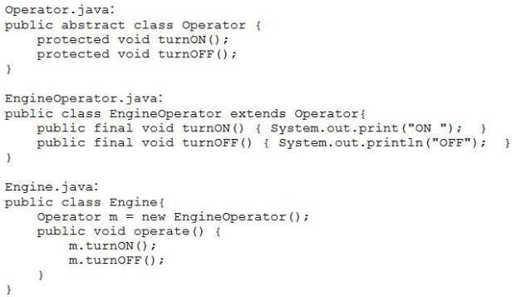

ForkJoinPool fjPool = new ForkJoinPool ( ); int data [ ] = {1, 2, 3, 4, 5, 6, 7, 8, 9, 10}
fjPool.invoke (new Sum (data, 0, data.length));
and given that the sum of all integers from 1 to 10 is 55. Which statement is true?
The program prints several values that total 55.
The program prints 55.
A compilation error occurs at line n1.
The program prints nothing.
Correct Answer: A
Section: (none) Explanation
Explanation/Reference:
QUESTION 10
Given the content of Operator.java, EngineOperator.java, and Engine.java files:
and the code fragment:
What is the result?
The Engine.java file fails to compile.
The EngineOperator.java file fails to compile.

Slide 8
C. The Operator.java file fails to compile.
D. ON OFF
Correct Answer: A => C Section: (none) Explanation
Explanation/Reference:
QUESTION 11
Given the code fragment:
Stream<List<String>> iStr= Stream.of ( Arrays.asList (“1”, “John”),
Arrays.asList (“2”, null));
Stream<<String> nInSt = iStr.flatMapToInt ((x) -> x.stream ()); nInSt.forEach (System.out :: print);
What is the result?
1John2null
12
A NullPointerException is thrown at run time.
A compilation error occurs.
Correct Answer: D Section: (none) Explanation
Explanation/Reference:
QUESTION 12
Given the code fragment:
Path file = Paths.get (“courses.txt”);
// line n1
Assume the courses.txt is accessible.
Which code fragment can be inserted at line n1 to enable the code to print the content of the courses.txt
file?
List<String> fc = Files.list(file); fc.stream().forEach (s - > System.out.println(s));
Stream<String> fc = Files.readAllLines (file); fc.forEach (s - > System.out.println(s));
List<String> fc = readAllLines(file); fc.stream().forEach (s - > System.out.println(s));
Stream<String> fc = Files.lines (file); fc.forEach (s - > System.out.println(s));
Correct Answer: D Section: (none) Explanation
Explanation/Reference:

Slide 9
QUESTION 13
Given the code fragment:
public void recDelete (String dirName) throws IOException { File [ ] listOfFiles = new File (dirName) .listFiles(); if (listOfFiles ! = null && listOfFiles.length >0) {
for (File aFile : listOfFiles) {
if (aFile.isDirectory ()) {
recDelete (aFile.getAbsolutePath ());
}
else {
if (aFile.getName ().endsWith (“.class”)) aFile.delete ();
}
}
}
}
Assume that Projects contains subdirectories that contain .class files and is passed as an argument to the recDelete () method when it is invoked.
What is the result?
The method deletes all the .class files in the Projects directory and its subdirectories.
The method deletes the .class files of the Projects directory only.
The method executes and does not make any changes to the Projects directory.
The method throws an IOException.
Correct Answer: A Section: (none) Explanation
Explanation/Reference:
QUESTION 14
Given the code fragments:
4. { 5. | void doStuff() throws ArithmeticException, NumberFormatException, if (Math.random() >-1 throw new Exception (“Try again”); | Exception
6. | }
and
24. | try {
25. | doStuff ( ):
26. | } catch (ArithmeticException | NumberFormatException | Exception | e) {
27. | System.out.println (e.getMessage()); }
28. | catch (Exception e) {
29. | System.out.println (e.getMessage()); }
30. | }
Which modification enables the code to print Try again?
Comment the lines 28, 29 and 30.
Replace line 26 with:
} catch (Exception | ArithmeticException | NumberFormatException e) {
Replace line 26 with:

Slide 10
} catch (ArithmeticException | NumberFormatException e) {
D. Replace line 27 with:
throw e;
Correct Answer: C Section: (none) Explanation
Explanation/Reference:
QUESTION 15
Given the definition of the Country class:
public class country {
public enum Continent {ASIA, EUROPE} String name;
Continent region;
public Country (String na, Continent reg) { name = na, region = reg;
}
public String getName () {return name;}
public Continent getRegion () {return region;}
}
and the code fragment:
List<Country> couList = Arrays.asList (
new Country (“Japan”, Country.Continent.ASIA), new Country (“Italy”, Country.Continent.EUROPE),
new Country (“Germany”, Country.Continent.EUROPE));
Map<Country.Continent, List<String>> regionNames = couList.stream ()
.collect(Collectors.groupingBy (Country ::getRegion, Collectors.mapping(Country::getName, Collectors.toList()))));
System.out.println(regionNames);
{EUROPE = [Italy, Germany], ASIA = [Japan]}
{ASIA = [Japan], EUROPE = [Italy, Germany]}
{EUROPE = [Germany, Italy], ASIA = [Japan]}
{EUROPE = [Germany], EUROPE = [Italy], ASIA = [Japan]}
Correct Answer: B Section: (none) Explanation
Explanation/Reference:
QUESTION 16
Given the code fragment:
Map<Integer, String> books = new TreeMap<>(); books.put (1007, “A”);
books.put (1002, “C”);
books.put (1001, “B”);
books.put (1003, “B”); System.out.println (books);
What is the result?

Slide 11
A. {1007 | = | A, | 1002 | = | C, | 1001 | = | B, | 1003 | = | B}
B. {1001 | = | B, | 1002 | = | C, | 1003 | = | B, | 1007 | = | A}
C. {1002 | = | C, | 1003 | = | B, | 1007 | = | A}
D. {1007 | = | A, | 1001 | = | B, | 1003 | = | B, | 1002 | = | C}
Correct Answer: B Section: (none) Explanation
Explanation/Reference:
Reference:
TreeMap inherits SortedMap and automatically sorts the element's key
QUESTION 17
Given:
class Book {
int id; String name;
public Book (int id, String name) {
this.id = id; this.name = name;
}
public boolean equals (Object obj) { boolean output = false;
Book b = (Book) obj;
if (this.name.equals(b name))} output = true;
}
return output;
}
}
//line n1
and the code fragment:
Book b1 = new Book (101, “Java Programing”); Book b2 = new Book (102, “Java Programing”); System.out.println (b1.equals(b2));
//line n2
Which statement is true?
The program prints true.
The program prints false.
A compilation error occurs. To ensure successful compilation, replace line n1 with:
boolean equals (Book obj) {
A compilation error occurs. To ensure successful compilation, replace line n2 with:
System.out.println (b1.equals((Object) b2));
Correct Answer: A Section: (none) Explanation
Explanation/Reference:
QUESTION 18
Given the content of /resourses/Message.properties:

Slide 12
welcome1=”Good day!”
and given the code fragment:
Properties prop = new Properties ();
FileInputStream fis = new FileInputStream (“/resources/Message.properties”); prop.load(fis);
System.out.println(prop.getProperty(“welcome1”));
System.out.println(prop.getProperty(“welcome2”, “Test”));//line n1 System.out.println(prop.getProperty(“welcome3”));
What is the result?
Good day!
Test
followed by an Exception stack trace
Good day!
followed by an Exception stack trace
Good day! Test null
A compilation error occurs at line n1.
Correct Answer: C Section: (none) Explanation
Explanation/Reference:
QUESTION 19
Which action can be used to load a database driver by using JDBC3.0?
Add the driver class to the META-INF/services folder of the JAR file.
Include the JDBC driver class in a jdbc.properties file.
Use the java.lang.Class.forName method to load the driver class.
Use the DriverManager.getDriver method to load the driver class.
Correct Answer: C Section: (none) Explanation
Explanation/Reference:
QUESTION 20
Given the code fragment:
Path p1 = Paths.get(“/Pics/MyPic.jpeg”); System.out.println (p1.getNameCount() +
“:” + p1.getName(1) +
“:” + p1.getFileName());
Assume that the Pics directory does NOT exist. What is the result?
A. An exception is thrown at run time.

Slide 13
2:MyPic.jpeg: MyPic.jpeg
3:.:MyPic.jpeg
2:Pics: MyPic.jpeg
Correct Answer: B Section: (none) Explanation
Explanation/Reference:
QUESTION 21
Given the code fragments:
class MyThread implements Runnable {
private static AtomicInteger count = new AtomicInteger (0); public void run () {
int x = count.incrementAndGet();
System.out.print (x+” “);
}
}
and
Thread thread1 = new Thread(new MyThread()); Thread thread2 = new Thread(new MyThread()); Thread thread3 = new Thread(new MyThread());
Thread [] ta = {thread1, thread2, thread3}; for (int x= 0; x < 3; x++) {
ta[x].start();
}
Which statement is true?
The program prints 1 2 3 and the order is unpredictable.
The program prints 1 2 3.
The program prints 1 1 1.
A compilation error occurs.
Correct Answer: A Section: (none) Explanation
Explanation/Reference:
QUESTION 22
Given the code fragment:
public static void main (String [ ] args) throws IOException { BufferedReader br = new BufferedReader (new InputStremReader (System.in)); System.out.print (“Enter GDP: “);
//line 1
}
Which code fragment, when inserted at line 1, enables the code to read the GDP from the user?

Slide 14

int GDP = Integer.parseInt (br.readline());
int GDP = br.read();
int GDP = br.nextInt();
int GDP = Integer.parseInt (br.next());
Correct Answer: A Section: (none) Explanation
Explanation/Reference:
QUESTION 23
Assuming that the file /data/december/log.txt does not exist and given the code fragment:
What is the result?
A file with the name log.txt is created in the /data directory and the content of the /data/december/ log.txt file is copied to it.
The program executes successfully and does NOT change the file system.
A FileNotFoundException is thrown at run time.
A NoSuchFileException is thrown at run time.
Correct Answer: D Section: (none) Explanation
Explanation/Reference:
QUESTION 24
Given:
class Student {
String course, name, city;
public Student (String name, String course, String city) { this.course = course; this.name = name; this.city = city;
}
public String toString() {
return course + “:” + name + “:” + city;
}
and the code fragment:
List<Student> stds = Arrays.asList(
new Student (“Jessy”, “Java ME”, “Chicago”), new Student (“Helen”, “Java EE”, “Houston”), new Student (“Mark”, “Java ME”, “Chicago”));
stds.stream()
.collect(Collectors.groupingBy(Student::getCourse))
.forEach(src, res) -> System.out.println(scr));

Slide 15

What is the result?
[Java EE: Helen:Houston]
[Java ME: Jessy:Chicago, Java ME: Mark:Chicago]
Java EE Java ME
[Java ME: Jessy:Chicago, Java ME: Mark:Chicago] [Java EE: Helen:Houston]
A compilation error occurs.
Correct Answer: B Section: (none) Explanation
Explanation/Reference:
trinhduc.giang
2021-07-10 16:56:12
--------------------------------------------
pending
QUESTION 25
Given the code fragments:
interface CourseFilter extends Predicate<String> public default boolean test (String str)
return str.equals (“Java”);
}
}
{
{
and
List<String> strs = Arrays.asList(“Java”, “Java EE”, “Java ME”); Predicate<String> cf1 = s - > s.length() > 3;
Predicate cf2 = new CourseFilter() { //line n1
public boolean test (String s) { return s.contains (“Java”);
}
};
long c = strs.stream()
.filter(cf1)
.filter(cf2
.count(); System.out.println(c);
//line n2
What is the result?
2
3
A compilation error occurs at line n1.
A compilation error occurs at line n2.
Correct Answer: B Section: (none) Explanation
Explanation/Reference:
QUESTION 26
Given:

Slide 16
public class Emp { String fName; String lName;
public Emp (String fn, String ln) {
fName = fn; lName = ln;
}
public String getfName() { return fName; } public String getlName() { return lName; }
}
and the code fragment:
List<Emp> emp = Arrays.asList ( new Emp (“John”, “Smith”),
new Emp (“Peter”, “Sam”),
new Emp (“Thomas”, “Wale”)); emp.stream()
//line n1
.collect(Collectors.toList());
Which code fragment, when inserted at line n1, sorts the employees list in descending order of fName and then ascending order of lName?
A. .sorted (Comparator.comparing(Emp::getfName).reserved().thenComparing
(Emp::getlName))
.sorted (Comparator.comparing(Emp::getfName).thenComparing(Emp::getlName))
.map(Emp::getfName).sorted(Comparator.reverseOrder())
.map(Emp::getfName).sorted(Comparator.reverseOrder().map (Emp::getlName).reserved
Correct Answer: B Section: (none) Explanation
Explanation/Reference:
QUESTION 27
Given:
public enum USCurrency { PENNY (1),
NICKLE(5),
DIME (10), QUARTER(25);
private int value;
public USCurrency(int value) { this.value = value;
}
public int getValue() {return value;}
}
public class Coin {
public static void main (String[] args) { USCurrency usCoin =new USCurrency.DIME; System.out.println(usCoin.getValue()):
}
}

Slide 17
Which two modifications enable the given code to compile? (Choose two.)
Nest the USCurrency enumeration declaration within the Coin class.
Make the USCurrency enumeration constructor public.
Remove the new keyword from the instantion of usCoin.
Make the getValue() method public.
Add the final keyword in the declaration of value.
Correct Answer: BC Section: (none) Explanation
Explanation/Reference:
QUESTION 28
Given:
class ImageScanner implements AutoCloseable { public void close () throws Exception {
System.out.print (“Scanner closed.”);
}
public void scanImage () throws Exception { System.out.print (“Scan.”);
throw new Exception(“Unable to scan.”);
}
}
class ImagePrinter implements AutoCloseable { public void close () throws Exception {
System.out.print (“Printer closed.”);
}
public void printImage () {System.out.print(“Print.”);
}
}
and this code fragment:
try (ImageScanner ir = new ImageScanner(); ImagePrinter iw = new ImagePrinter()) {
ir.scanImage();
iw.printImage();
} catch (Exception e) { System.out.print(e.getMessage());
}
What is the result?
Scan.Printer closed. Scanner closed. Unable to scan.
Scan.Scanner closed. Printer closed.Unable to scan.
Scan. Unable to scan.
Scan. Unable to scan. Scanner closed.
Correct Answer: A Section: (none) Explanation
Explanation/Reference:

Slide 18
QUESTION 29
Given the structure of the STUDENT table:
Student (id INTEGER, name VARCHAR)
Given:
public class Test {
static Connection newConnection =null;
public static Connection get DBConnection () throws SQLException { try (Connection con = DriveManager.getConnection(URL, username,
password)) {
newConnection = con;
}
return newConnection;
}
public static void main (String [] args) throws SQLException { get DBConnection ();
Statement st = newConnection.createStatement();
st.executeUpdate(“INSERT INTO student VALUES (102, ‘Kelvin’)”);
}
}
Assume that:
The required database driver is configured in the classpath.
The appropriate database is accessible with the URL, userName, and passWord exists. The SQL query is valid.
What is the result?
The program executes successfully and the STUDENT table is updated with one record.
The program executes successfully and the STUDENT table is NOT updated with any record.
A SQLException is thrown as runtime.
A NullPointerException is thrown as runtime.
Correct Answer: C Section: (none) Explanation
Explanation/Reference:
QUESTION 30
Given the code fragments:
class Employee { Optional<Address> address;
Employee (Optional<Address> address) {
this.address = address;
}
public Optional<Address> getAddress() { return address; }
}
class Address {
String city = “New York”;
public String getCity { return city: } public String toString() {
return city;
}
}

Slide 19
and
Address address = null;
Optional<Address> addrs1 = Optional.ofNullable (address); Employee e1 = new Employee (addrs1);
String eAddress = (addrs1.isPresent()) ? addrs1.get().getCity() : “City Not
available”;
What is the result?
New York
City Not available
null
A NoSuchElementException is thrown at run time.
Correct Answer: B Section: (none) Explanation
Explanation/Reference:
QUESTION 31
Given the code fragment:
Stream<Path> files = Files.walk(Paths.get(System.getProperty(“user.home”)));
files.forEach (fName -> { try {
Path aPath = fName.toAbsolutePath();
System.out.println(fName + “:”
+ Files.readAttributes(aPath, Basic.File.Attributes.class).creationTime ());
} catch (IOException ex) {
ex.printStackTrace();
//line n1
//line n2
});
What is the result?
All files and directories under the home directory are listed along with their attributes.
A compilation error occurs at line n1.
The files in the home directory are listed along with their attributes.
A compilation error occurs at line n2.
Correct Answer: A Section: (none) Explanation
Explanation/Reference:
QUESTION 32
Given:
class Vehicle { int vno;

Slide 20
String name;
public Vehicle (int vno, String name) { this.vno = vno,;
this.name = name;
}
public String toString () { return vno + “:” + name;
}
}
and this code fragment:
Set<Vehicle> vehicles = new TreeSet <> (); vehicles.add(new Vehicle (10123, “Ford”)); vehicles.add(new Vehicle (10124, “BMW”)); System.out.println(vehicles);
What is the result?
10123 Ford 10124 BMW
10124 BMW 10123 Ford
A compilation error occurs.
A ClassCastException is thrown at run time.
Correct Answer: D Section: (none) Explanation
Explanation/Reference:
QUESTION 33
Given that course.txt is accessible and contains:
Course : : Java
and given the code fragment:
public static void main (String[ ] args) { int i;
char c;
try (FileInputStream fis = new FileInputStream (“course.txt”); InputStreamReader isr = new InputStreamReader(fis);) { while (isr.ready()) { //line n1
isr.skip(2);
i = isr.read (); c = (char) i;
System.out.print(c);
}
} catch (Exception e) { e.printStackTrace();
}
}
What is the result?
A. ur :: va

Slide 21
ueJa
The program prints nothing.
A compilation error occurs at line n1.
Correct Answer: B Section: (none) Explanation
Explanation/Reference:
QUESTION 34
Given:
public class Test<T> { private T t;
public T get () {
return t;
}
public void set (T t) this.t = t;
{
}
public static void main (String args [ ] )
{
Test<String> type = new Test<>(); Test type 1 = new Test ();
//line n1
type.set(“Java”);
type1.set(100); //line n2 System.out.print(type.get() + “ “ + type1.get());
}
}
What is the result?
Java 100
java.lang.string@<hashcode>java.lang.Integer@<hashcode>
A compilation error occurs. To rectify it, replace line n1 with:
Test<Integer> type1 = new Test<>();
A compilation error occurs. To rectify it, replace line n2 with:
type1.set (Integer(100));
Correct Answer: A Section: (none) Explanation
Explanation/Reference:
QUESTION 35
Given the definition of the Vehicle class:
class Vehicle { String name;
void setName (String name) {
this.name = name;
}
String getName() { return name;
}
}

Slide 22
Which action encapsulates the Vehicle class?
Make the Vehicle class public.
Make the name variable public.
Make the getName method public.
Make the name variable private.
Make the setName method private.
Make the getName method private.
Correct Answer: D Section: (none) Explanation
Explanation/Reference:
QUESTION 36
Given:
public class product { int id; int price;
public Product (int id, int price) {
this.id = id; this.price = price;
}
public String toString() { return id + “:” + price; }
}
and the code fragment:
List<Product> products = Arrays.asList(new Product(1, 10), new Product (2, 30),
new Product (3, 20));
Product p = products.stream().reduce(new Product (4, 0), (p1, p1.price+=p2.price;
return new Product (p1.id, p1.price);});
products.add(p); products.stream().parallel()
.reduce((p1, p2) - > p1.price > p2.price ? p1 : p2)
.ifPresent(System.out: :println);
p2) -> {
What is the result?
A. 2 : | 30
B. 4 : | 0
C. 4 : | 60
D. 4 : | 60
2 : | 30
3 : | 20
1 : | 10
E. The program prints nothing.
Correct Answer: C => sửa đề
Section: (none) Explanation

Slide 23
Explanation/Reference:
QUESTION 37
Given the code fragments:
public class Book implements Comparator<Book> { String name;
double price;
public Book () {}
public Book(String name, double price) this.name = name;
this.price = price;
}
public int compare(Book b1, Book b2) return b1.name.compareTo(b2.name);
}
{
{
public String toString() { return name + “:” + price;
}
}
and
List<Book>books = Arrays.asList ( new Book (“Beginning with Java”, 2), new book (“A Guide to Java Tour”, 3)
);
Collections.sort(books, new Book()); System.out.print(books);
What is the result?
A. [A Guide to Java Tour:3.0, Beginning with Java:2.0]
[Beginning with Java:2.0, A Guide to Java Tour:3.0]
A compilation error occurs because the Book class does not override the abstract method compareTo().
An Exception is thrown at run time.
Correct Answer: D => A
Section: (none) Explanation
Explanation/Reference:
Explanation:
If asList is changed to List, the output would be B, Beginning with java:2.0, A guide to Java Tour:3.0.
QUESTION 38
Given the code fragment:
List<String> listVal = Arrays.asList(“Joe”, “Paul”, “Alice”, “Tom”); System.out.println (
// line n1
);
Which code fragment, when inserted at line n1, enables the code to print the count of string elements whose length is greater than three?
listVal.stream().filter(x -> x.length()>3).count()
listVal.stream().map(x -> x.length()>3).count()

Slide 24
listVal.stream().peek(x -> x.length()>3).count().get()
listVal.stream().filter(x -> x.length()>3).mapToInt(x -> x).count()
Correct Answer: A Section: (none) Explanation
Explanation/Reference:
QUESTION 39
Given the code fragments:
class Caller implements Callable<String> { String str;
public Caller (String s) {this.str=s;}
public String call()throws Exception { return str.concat (“Caller”);}
}
class Runner implements Runnable { String str;
public Runner (String s) {this.str=s;}
public void run () { System.out.println (str.concat (“Runner”));}
}
and
public static void main (String[] args) InterruptedException, ExecutionException
{
ExecutorService es = Executors.newFixedThreadPool(2); Future f1 = es.submit (new Caller (“Call”));
Future f2 = es.submit (new Runner (“Run”));
String str1 = (String) f1.get();
String str2 = (String) f2.get(); //line n1 System.out.println(str1+ “:” + str2);
}
What is the result?
The program prints:
Run Runner
Call Caller : null
And the program does not terminate.
The program terminates after printing:
Run Runner
Call Caller : Run
A compilation error occurs at line n1.
An Execution is thrown at run time.
Correct Answer: A Section: (none) Explanation
Explanation/Reference:
QUESTION 40
Given:
public class Canvas implements Drawable {

Slide 25
public void draw () { }
}
public abstract class Board extends Canvas { } public class Paper extends Canvas {
protected void draw (int color) { }
}
public class Frame extends Canvas implements Drawable { public void resize () { }
}
public interface Drawable { public abstract void draw ();
}
Which statement is true?
Board does not compile.
Paper does not compile.
Frame does not compile.
Drawable does not compile.
All classes compile successfully.
Correct Answer: E Section: (none) Explanation
Explanation/Reference:
QUESTION 41
Given the code fragment:
List<String> str = Arrays.asList (“my”, “pen”, “is”, “your’, “pen”); Predicate<String> test = s -> {
int i = 0;
boolean result = s.contains (“pen”); System.out.print(i++) + “:”); return result;
};
str.stream()
.filter(test)
.findFirst()
.ifPresent(System.out ::print);
What is the result?
0 : 0 : pen
0 : 1 : pen
C. 0 : 0 : 0 : 0 : 0 : pen
D. 0 : 1 : 2 : 3 : 4 :
E. A compilation error occurs.
Correct Answer: A Section: (none) Explanation
Explanation/Reference:

Slide 26
QUESTION 42
Given the code fragment:
List<String> empDetails = Arrays.asList(“100, Robin, HR”,
“200, Mary, AdminServices”,
“101, Peter, HR”);
empDetails.stream()
.filter(s-> s.contains(“1”))
.sorted()
.forEach(System.out::println); //line n1
What is the result?
100, Robin, HR 101, Peter, HR
A compilation error occurs at line n1.
100, Robin, HR 101, Peter, HR
200, Mary, AdminServices
100, Robin, HR
200, Mary, AdminServices
101, Peter, HR
Correct Answer: A Section: (none) Explanation
Explanation/Reference:
QUESTION 43
Given:
interface Rideable {Car getCar (String name); }
class Car {
private String name; public Car (String name)
this.name = name;
}
}
{
Which code fragment creates an instance of Car?
Car auto = Car (“MyCar”): : new;
Car auto = Car : : new;
Car vehicle = auto : : getCar(“MyCar”);
Rideable rider = Car : : new;
Car vehicle = rider.getCar(“MyCar”);
Car vehicle = Rideable : : new : : getCar(“MyCar”);
Correct Answer: C Section: (none) Explanation
Explanation/Reference:

Slide 27
QUESTION 44
Which statement is true about the single abstract method of the java.util.function.Function
interface?
It accepts one argument and returns void.
It accepts one argument and returns boolean.
It accepts one argument and always produces a result of the same type as the argument.
It accepts an argument and produces a result of any data type.
Correct Answer: D Section: (none) Explanation
Explanation/Reference:
QUESTION 45
Which statement is true about the DriverManager class?
It returns an instance of database.
It executes SQL statements against the database.
It loads the database driver class mentioned in the jdbc.drivers property
it is written by different vendors for their specific database.
Correct Answer: A Section: (none) Explanation
Explanation/Reference:
Reference: https://javaconceptoftheday.com/drivermanager-class-in-java/
QUESTION 46
Given the code fragment:
List<Integer> nums = Arrays.asList (10, 20, 8): System.out.println (
//line n1
);
Which code fragment must be inserted at line n1 to enable the code to print the maximum number in the
nums list?
nums.stream().max(Comparator.comparing(a -> a)).get()
nums.stream().max(Integer : : max).get()
nums.stream().max()
nums.stream().map(a -> a).max()
Correct Answer: A Section: (none) Explanation
Explanation/Reference:
QUESTION 47

Slide 28
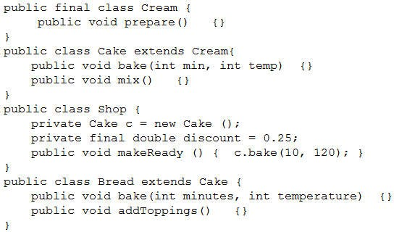
Given:
Which statement is true?
A compilation error occurs in Cream.
A compilation error occurs in Cake.
A compilation error occurs in Shop.
A compilation error occurs in Bread.
All classes compile successfully.
Correct Answer: E => B
Section: (none) Explanation
Explanation/Reference:
QUESTION 48
Which two statements are true about localizing an application? (Choose two.)
Support for new regional languages does not require recompilation of the code.
Textual elements (messages and GUI labels) are hard-coded in the code.
Language and region-specific programs are created using localized data.
Resource bundle files include data and currency information.
Language codes use lowercase letters and region codes use uppercase letters.
Correct Answer: AE Section: (none) Explanation
Explanation/Reference:
Reference: http://docs.oracle.com/javase/7/docs/technotes/guides/intl/

Slide 29
QUESTION 49
Which statement is true about java.util.stream.Stream?
A stream cannot be consumed more than once.
The execution mode of streams can be changed during processing.
Streams are intended to modify the source data.
A parallel stream is always faster than an equivalent sequential stream.
Stream operation accepts lambda expressions as its parameters.
Correct Answer: B Section: (none) Explanation
Explanation/Reference:
QUESTION 50
The data.doc, data.txt and data.xml files are accessible and contain text. Given the code fragment:
Stream<Path> paths = Stream.of (Paths. get(“data.doc”), Paths. get(“data.txt”),
Paths. get(“data.xml”));
paths.filter(s-> s.toString().contains(“data”)).forEach( s -> {
try {
Files.readAllLines(s)
.stream()
.forEach(System.out::println); //line n1
} catch (IOException e) { System.out.println(“Exception”);
}
}
);
What is the result?
The program prints the content of data.txt file.
The program prints:
Exception
<<The content of the data.txt file>>
<<The content of the data.xml file>>
A compilation error occurs at line n1.
D. The program prints the content of the three files.
Correct Answer: A => D
Section: (none) Explanation
Explanation/Reference:
QUESTION 51
Given:
final class Folder {
//line n2
//line n1

Slide 30
public void open () { System.out.print(“Open”);
}
}
public class Test {
public static void main (String [] args) throws Exception { try (Folder f = new Folder()) {
f.open();
}
}
}
Which two modifications enable the code to print Open Close? (Choose two.)
Replace line n1 with:
class Folder implements AutoCloseable {
Replace line n1 with:
class Folder extends Closeable {
Replace line n1 with:
class Folder extends Exception {
At line n2, insert:
final void close () { System.out.print(“Close”);
}
At line n2, insert:
public void close () throws IOException { System.out.print(“Close”);
}
Correct Answer: AE Section: (none) Explanation
Explanation/Reference:
QUESTION 52
You want to create a singleton class by using the Singleton design pattern. Which two statements enforce the singleton nature of the design? (Choose two.)
Make the class static.
Make the constructor private.
Override equals() and hashCode() methods of the java.lang.Object class.
Use a public reference to point to the single instance.
Implement the Serializable interface.
Make the single instance created static and final.
Correct Answer: BF Section: (none) Explanation
Explanation/Reference:
QUESTION 53
Given the code fragment:

Slide 31
Connection conn = DriveManager.getConnection(dbURL, userName, passWord);
String query = “SELECT id FROM Employee”;
try (Statement stmt = conn.createStatement()) {
12.
13.
14.
15.
16.
ResultSet rs = stmt.executeQuery(query);
stmt.executeQuery(“SELECT id FROM Customer”); while (rs.next()) {
//process the results
System.out.println(“Employee ID: “+ rs.getInt(“id”));
17. }
} catch (Exception e) {
System.out.println (“Error”);
20. }
Assume that:
The required database driver is configured in the classpath.
The appropriate database is accessible with the dbURL, userName, and passWord exists.
The Employee and Customer tables are available and each table has id column with a few records and the SQL queries are valid.
What is the result of compiling and executing this code fragment?
The program prints employee IDs.
The program prints customer IDs.
The program prints Error.
compilation fails on line 13.
Correct Answer: C => A
Section: (none) Explanation
Explanation/Reference:
QUESTION 54
Given the code fragment:
List<Integer> codes = Arrays.asList (10, 20); UnaryOperator<Double> uo = s -> s +10.0; codes.replaceAll(uo);
codes.forEach(c -> System.out.println(c));
What is the result?
A. 20.0
30.0
B. 10.0
20.0
A compilation error occurs.
A NumberFormatException is thrown at run time.
Correct Answer: C Section: (none) Explanation
Explanation/Reference:
QUESTION 55
Given:

Slide 32
public class Customer { private String fName; private String lName; private static int count;
public customer (String first, String last) {fName = first, lName = last;
++count;}
static { count = 0; }
public static int getCount() {return count; }
}
public class App {
public static void main (String [] args) { Customer c1 = new Customer(“Larry”, “Smith”); Customer c2 = new Customer(“Pedro”, “Gonzales”); Customer c3 = new Customer(“Penny”, “Jones”); Customer c4 = new Customer(“Lars”, “Svenson”); c4 = null;
c3 = c2;
System.out.println (Customer.getCount());
}
}
What is the result?
0
2
3
4
5
Correct Answer: D Section: (none) Explanation
Explanation/Reference:
QUESTION 56
Given:
Item table
ID, INTEGER: PK
DESCRIP, VARCHAR(100)
PRICE, REAL
QUANTITY< INTEGER
And given the code fragment:
try {
Connection conn = DriveManager.getConnection(dbURL, username, password);
11.
12.
13.
14.
15.
16.
17.
18.
String query = “Select * FROM Item WHERE ID = 110”; Statement stmt = conn.createStatement();
ResultSet rs = stmt.executeQuery(query);
while(rs.next()) {
System.out.println(“ID: “ + rs.getInt(“Id”));
System.out.println(“Description: “ + rs.getString(“Descrip”));
System.out.println(“Price: System.out.println(Quantity:
“ + rs.getDouble(“Price”));
“ + rs.getInt(“Quantity”));

Slide 33
19. }
} catch (SQLException se) {
System.out.println(“Error”);
22. }
Assume that:
The required database driver is configured in the classpath.
The appropriate database is accessible with the dbURL, userName, and passWord exists. The SQL query is valid.
What is the result?
An exception is thrown at runtime.
Compilation fails.
The code prints Error.
The code prints information about Item 110.
Correct Answer: D Section: (none) Explanation
Explanation/Reference:
QUESTION 57
Given:
class Worker extends Thread { CyclicBarrier cb;
public Worker(CyclicBarrier cb) { this.cb = cb; }
public void run () { try {
cb.await();
System.out.println(“Worker…”);
} catch (Exception ex) { }
}
}
class Master implements Runnable { //line n1 public void run () {
System.out.println(“Master…”);
}
}
and the code fragment:
Master master = new Master();
//line n2
Worker worker = new Worker(cb); worker.start();
You have been asked to ensure that the run methods of both the Worker and Master classes are executed. Which modification meets the requirement?
At line n2, insert CyclicBarrier cb = new CyclicBarrier(2, master);
At line n2, insert CyclicBarrier cb = new CyclicBarrier(1);
At line n2, insert CyclicBarrier cb = new CyclicBarrier(1, master);
At line n2, insert CyclicBarrier cb = new CyclicBarrier(master);

Slide 34
Correct Answer: C Section: (none) Explanation
Explanation/Reference:
QUESTION 58
Given the code fragment:
String str = “Java is a programming language”; ToIntFunction<String> indexVal = str: : indexOf; //line n1 int x = indexVal.applyAsInt(“Java”); //line n2 System.out.println(x);
What is the result?
0
1
A compilation error occurs at line n1.
A compilation error occurs at line n2.
Correct Answer: A Section: (none) Explanation
Explanation/Reference:
QUESTION 59
Given the code fragment:
List<String> codes = Arrays.asList (“DOC”, “MPEG”, “JPEG”); codes.forEach (c -> System.out.print(c + “ “));
String fmt = codes.stream()
.filter (s-> s.contains (“PEG”))
.reduce((s, t) -> s + t).get(); System.out.println(“\n” + fmt);
What is the result?
DOC MPEG JPEG MPEGJPEG
DOC MPEG MPEGJPEG MPEGMPEGJPEG
MPEGJPEG MPEGJPEG
java.util.NoSuchElementException is thrown.
Correct Answer: A Section: (none) Explanation
Explanation/Reference:
QUESTION 60
Given the code fragment:

Slide 35
List<String> nL = Arrays.asList(“Jim”, “John”, “Jeff”); Function<String, String> funVal = s -> “Hello : “.contact(s); nL.Stream()
.map(funVal)
.peek(System.out::print);
What is the result?
Hello : Jim Hello : John Hello : Jeff
Jim John Jeff
The program prints nothing.
A compilation error occurs.
Correct Answer: C Section: (none) Explanation
Explanation/Reference:
QUESTION 61
Given:
public interface Moveable<Integer> {
public default void walk (Integer distance) {System.out.println(“Walking”);) public void run(Integer distance);
}
Which statement is true?
Moveable can be used as below:
Moveable<Integer> animal = n - > System.out.println(“Running” + n); animal.run(100);
animal.walk(20);
Moveable can be used as below: Moveable<Integer> animal = n - > n + 10; animal.run(100);
animal.walk(20);
Moveable can be used as below:
Moveable animal = (Integer n1, Integer n2) -> n+ n2; animal.run(100);
animal.walk(20);
Movable cannot be used in a lambda expression.
Correct Answer: A Section: (none) Explanation
Explanation/Reference:
QUESTION 62
Which two code blocks correctly initialize a Locale variable? (Choose two.)
Locale loc1 = "UK";
Locale loc2 = Locale.getInstance("ru");

Slide 36
Locale loc3 = Locale.getLocaleFactory("RU");
Locale loc4 = Locale.UK;
Locale loc5 = new Locale ("ru", "RU");
Correct Answer: DE Section: (none) Explanation
Explanation/Reference:
QUESTION 63
Given:
class FuelNotAvailException extends Exception { class Vehicle {
void ride() throws FuelNotAvailException {
System.out.println(“Happy Journey!”);
}
}
}
//line n1
class SolarVehicle extends Vehicle {
public void ride () throws Exception { super ride ();
//line n2
}
}
and the code fragment:
public static void main (String[] args) throws FuelNotAvailException, Exception
{
Vehicle v = new SolarVehicle (); v.ride();
}
Which modification enables the code fragment to print Happy Journey!?
Replace line n1 with public void ride() throws FuelNotAvailException {
Replace line n1 with protected void ride() throws Exception {
Replace line n2 with void ride() throws Exception {
Replace line n2 with private void ride() throws FuelNotAvailException {
Correct Answer: B Section: (none) Explanation
Explanation/Reference:
QUESTION 64
Given the definition of the Emp class:
public class Emp
private String eName; private Integer eAge;
Emp(String eN, Integer eA) this.eName = eN; this.eAge = eA;
{

Slide 37
}
public Integer getEAge () {return eAge;} public String getEName () {return eName;}
}
and code fragment:
List<Emp>li = Arrays.asList(new Emp(“Sam”, 20), New Emp(“John”, 60), New Emp (“Jim”, 51));
Predicate<Emp> agVal = s -> s.getEAge() > 50; //line n1
li = li.stream().filter(agVal).collect(Collectors.toList()); Stream<String> names = li.stream()map.(Emp::getEName); //line n2 names.forEach(n -> System.out.print(n + “ “));
What is the result?
Sam John Jim
John Jim
A compilation error occurs at line n1.
A compilation error occurs at line n2.
Correct Answer: B Section: (none) Explanation
Explanation/Reference:
QUESTION 65
For which three objects must a vendor provide implementations in its JDBC driver? (Choose three.)
Time
Date
Statement
ResultSet
Connection
SQLException
DriverManager
Correct Answer: CDE Section: (none) Explanation
Explanation/Reference:
Explanation:
Database vendors support JDBC through the JDBC driver interface or through the ODBC connection. Each driver must provide implementations of java.sql.Connection, java.sql.Statement, java.sql.PreparedStatement, java.sql.CallableStatement, and java.sql.Re sultSet. They must also implement the java.sql.Driver interface for use by the generic java.sql.DriverManager interface.
QUESTION 66
Given the code fragment:
LocalDate valentinesDay =LocalDate.of(2015, Month.FEBRUARY, 14); LocalDate nextYear = valentinesDay.plusYears(1); nextYear.plusDays(15); //line n1
System.out.println(nextYear);

Slide 38
What is the result?
A. 2016-02-14
B. A DateTimeException is thrown.
C. 2016-02-29
D. A compilation error occurs at line n1.
Correct Answer: A Section: (none) Explanation
Explanation/Reference:
QUESTION 67
Given the code fragment:
BiFunction<Integer, Double, Integer> val = (t1, t2) -> t1 + t2; System.out.println(val.apply(10, 10.5));
//line n1
What is the result?
A. 20
B. 20.5
A compilation error occurs at line n1.
A compilation error occurs at line n2.
Correct Answer: C Section: (none) Explanation
Explanation/Reference:
QUESTION 68
Which statement is true about java.time.Duration?
It tracks time zones.
It preserves daylight saving time.
It defines time-based values.
It defines date-based values.
Correct Answer: C Section: (none) Explanation
Explanation/Reference:
Reference: http://tutorials.jenkov.com/java-date-time/duration.html#accessing-the-time-of-a-duration
QUESTION 69
Given the code fragment:
UnaryOperator<Integer> uo1 = s -> s*2; line n1 List<Double> loanValues = Arrays.asList(1000.0, 2000.0);

Slide 39

loanValues.stream()
.filter(lv -> lv >= 1500)
.map(lv -> uo1.apply(lv))
.forEach(s -> System.out.print(s + “ “)); //line 2
What is the result?
A. 4000.0
B. 4000
A compilation error occurs at line n1.
A compilation error occurs at line n2.
Correct Answer: D Section: (none) Explanation
Explanation/Reference:
QUESTION 70
You have been asked to create a ResourceBundle which uses a properties file to localize an application. Which code example specifies valid keys of menu1 and menu2 with values of File Menu and View Menu?
<key name = ‘menu1”>File Menu</key>
<key name = ‘menu2”>View Menu</key>
<key>menu1</key><value>File Menu</value>
<key>menu2</key><value>View Menu</value>
menu1, File Menu, menu2, View Menu Menu
menu1 = File Menu menu2 = View Menu
Correct Answer: D Section: (none) Explanation
Explanation/Reference:
QUESTION 71
Given the records from the Employee table:
and given the code fragment:
try {
Connection conn = DriverManager.getConnection (URL, userName, passWord); Statement st = conn.createStatement(ResultSet.TYPE_SCROLL_INSENSITIVE,
ResultSet.CONCUR_UPDATABLE);
st.execute(“SELECT*FROM Employee”); ResultSet rs = st.getResultSet(); while (rs.next()) {
if (rs.getInt(1) ==112) {
rs.updateString(2, “Jack”);

Slide 40
}
}
rs.absolute(2);
System.out.println(rs.getInt(1) + “ “ + rs.getString(2));
} catch (SQLException ex) { System.out.println(“Exception is raised”);
}
Assume that:
The required database driver is configured in the classpath.
The appropriate database accessible with the URL, userName, and passWord exists. What is the result?
A. The Employee table is updated with the row:
112 Jack
and the program prints:
112 Jerry
B. The Employee table is updated with the row:
112 Jack
and the program prints:
112 Jack
The Employee table is not updated and the program prints:
112 Jerry
The program prints Exception is raised.
Correct Answer: C Section: (none) Explanation
Explanation/Reference:
QUESTION 72
Given:
class RateOfInterest {
public static void main (String[] int rateOfInterest = 0; String accountType = “LOAN”; switch (accountType) {
case “RD”;
rateOfInterest = 5; break;
case “FD”;
rateOfInterest = 10; break;
args)
{
default:
assert false: “No interest for this account”; //line n1
}
System.out.println (“Rate of interest:” + rateOfInterest);
}
}
and the command:
java –ea RateOfInterest
What is the result?
A. Rate of interest: 0

Slide 41
An AssertionError is thrown.
No interest for this account
A compilation error occurs at line n1.
Correct Answer: B Section: (none) Explanation
Explanation/Reference:
QUESTION 73
Given the code fragment:
class CallerThread implements Callable<String> { String str;
public CallerThread(String s) {this.str=s;}
public String call() throws Exception { return str.concat(“Call”);
}
}
and
public static void main (String[] args) throws InterruptedException, ExecutionException
{
ExecutorService es = Executors.newFixedThreadPool(4); Future f1 = es.submit (newCallerThread(“Call”)); String str = f1.get().toString(); System.out.println(str);
//line n1
}
Which statement is true?
The program prints Call Call and terminates.
The program prints Call Call and does not terminate.
A compilation error occurs at line n1.
An ExecutionException is thrown at run time.
Correct Answer: B Section: (none) Explanation
Explanation/Reference:
QUESTION 74
Given the code fragment:
public class FileThread implements Runnable { String fName;
public FileThread(String fName) { this.fName = fName; }
public void run () System.out.println(fName);}
public static void main (String[] args) throws IOException, InterruptedException {
ExecutorService executor = Executors.newCachedThreadPool();
Stream<Path> listOfFiles = Files.walk(Paths.get(“Java Projects”)); listOfFiles.forEach(line -> {

Slide 42
()));
line n1
//
executor.execute(new FileThread(line.getFileName().toString
});
executor.shutdown(); executor.awaitTermination(5, TimeUnit.DAYS);
//
line n2
}
}
The Java Projects directory exists and contains a list of files. What is the result?
The program throws a runtime exception at line n2.
The program prints files names concurrently.
The program prints files names sequentially.
A compilation error occurs at line n1.
Correct Answer: B Section: (none) Explanation
Explanation/Reference:
QUESTION 75
Given:
class CheckClass {
public static int checkValue (String s1, String s2) { return s1 length() – s2.length();
}
}
and the code fragment:
String[] strArray = new String [] {“Tiger”, “Rat”, “Cat”, “Lion”};
//line n1
for (String s : strArray) { System.out.print (s + “ “);
}
Which code fragment should be inserted at line n1 to enable the code to print Rat Cat Lion Tiger?
Arrays.sort(strArray, CheckClass : : checkValue);
Arrays.sort(strArray, (CheckClass : : new) : : checkValue);
Arrays.sort(strArray, (CheckClass : : new).checkValue);
Arrays.sort(strArray, CheckClass : : new : : checkValue);
Correct Answer: A Section: (none) Explanation
Explanation/Reference:
QUESTION 76
Given the code fragments:

Slide 43
class TechName { String techName;
TechName (String techName) {
this.techName=techName;
}
}
and
List<TechName> tech = Arrays.asList ( new TechName(“Java-“),
new TechName(“Oracle DB-“),
new TechName(“J2EE-“)
);
Stream<TechName> stre = tech.stream();
//line n1
Which should be inserted at line n1 to print Java-Oracle DB-J2EE-?
stre.forEach(System.out::print);
stre.map(a-> a.techName).forEach(System.out::print);
stre.map(a-> a).forEachOrdered(System.out::print);
stre.forEachOrdered(System.out::print);
Correct Answer: B Section: (none) Explanation
Explanation/Reference:
QUESTION 77
Given that /green.txt and /colors/yellow.txt are accessible, and the code fragment:
Path source = Paths.get(“/green.txt);
Path target = Paths.get(“/colors/yellow.txt); Files.move(source, target, StandardCopyOption.ATOMIC_MOVE); Files.delete(source);
Which statement is true?
The green.txt file content is replaced by the yellow.txt file content and the yellow.txt file is deleted.
The yellow.txt file content is replaced by the green.txt file content and an exception is thrown.
The file green.txt is moved to the /colors directory.
A FileAlreadyExistsException is thrown at runtime.
Correct Answer: D => B
Section: (none) Explanation
Explanation/Reference:
QUESTION 78
Given:

Slide 44
interface Doable {
public void doSomething (String s);
}
Which two class definitions compile? (Choose two.)
A. public class Task implements Doable { public void doSomethingElse(String s)
}
{ }
public abstract class Work implements Doable { public abstract void doSomething(String s) public void doYourThing(Boolean b) { }
}
public abstract class Job implements Doable { public void doSomething(Integer i) { }
}
public class Action implements Doable {
{ }
public void doSomething(Integer i) { } public String doThis(Integer j) { }
}
E. public class Do implements Doable {
public void doSomething(Integer i) { } public void doSomething(String s) { } public void doThat (String s) { }
}
Correct Answer: AE
CE
Section: (none) Explanation
Explanation/Reference:
QUESTION 79
Given the code fragment:
List<Integer> list1 = Arrays.asList(10, 20); List<Integer> list2 = Arrays.asList(15, 30);
//line n1
Which code fragment, when inserted at line n1, prints 10 20 15 30?
Stream.of(list1, list2)
.flatMap(list -> list.stream())
.forEach(s -> System.out.print(s + “ “));
Stream.of(list1, list2)
.flatMap(list -> list.intStream())
.forEach(s -> System.out.print(s + “ “));
list1.stream()
.flatMap(list2.stream().flatMap(e1 -> e1.stream())
.forEach(s -> System.out.println(s + “ “));
Stream.of(list1, list2)
.flatMapToInt(list -> list.stream())
.forEach(s -> System.out.print(s + “ “));
Correct Answer: A Section: (none) Explanation

Slide 45
Explanation/Reference:
QUESTION 80
Given the code fragment:
public static void main (String[] args) throws IOException { BufferedReader brCopy = null;
try (BufferedReader br = new BufferedReader (new FileReader(“employee.txt”)))
{ // line n1
br.lines().forEach(c -> System.out.println(c));
brCopy = br; //line n2
}
brCopy.ready(); //line n3;
}
Assume that the ready method of the BufferedReader, when called on a closed BufferedReader, throws an exception, and employee.txt is accessible and contains valid text.
What is the result?
A compilation error occurs at line n3.
A compilation error occurs at line n1.
A compilation error occurs at line n2.
The code prints the content of the employee.txt file and throws an exception at line n3.
Correct Answer: D Section: (none) Explanation
Explanation/Reference:
QUESTION 81
Given:
Book.java:
public class Book {
private String read(String bname)
{ return “Read” + bname }
}
EBook.java:
public class EBook extends Book {
public String read (String url)
{ return “View” + url }
}
Test.java:
public class Test {
public static void main (String[] args) { Book b1 = new Book();
b1.read(“Java Programing”);
Book b2 = new EBook(); b2.read(“http://ebook.com/ebook”);
}
}
What is the result?
A. Read Java Programming
View http:/ ebook.com/ebook

Slide 46
Read Java Programming
Read http:/ ebook.com/ebook
The EBook.java file fails to compile.
The Test.java file fails to compile.
Correct Answer: D => A
Section: (none) Explanation
Explanation/Reference:
QUESTION 82
Given the code fragment:
ZonedDateTime depart = ZonedDateTime.of(2015, 1, 15, 3, 0, 0, 0, ZoneID.of(“UTC-
7”));
ZonedDateTime arrive = ZonedDateTime.of(2015, 1, 15, 9, 0, 0, 0, ZoneID.of(“UTC-
5”));
long hrs = ChronoUnit.HOURS.between(depart, arrive); //line n1 System.out.println(“Travel time is” + hrs + “hours”);
What is the result?
Travel time is 4 hours
Travel time is 6 hours
Travel time is 8 hours
An exception is thrown at line n1.
Correct Answer: A Section: (none) Explanation
Explanation/Reference:
QUESTION 83
Given the code fragment:
Path path1 = Paths.get(“/app/./sys/”); Path res1 = path1.resolve(“log”);
Path path2 = Paths.get(“/server/exe/”);
Path res1 = path1.resolve(“/readme/”); System.out.println(res1); System.out.println(res2);
What is the result?
/app/sys/log
/readme/server/exe
/app/log/sys
/server/exe/readme
/app/./sys/log
/readme
/app/./sys/log
/server/exe/readme

Slide 47
Correct Answer: C Section: (none) Explanation
Explanation/Reference:
QUESTION 84
Given the code fragment:
List<String> colors = Arrays.asList(“red”, “green”, “yellow”); Predicate<String> test = n - > {
System.out.println(“Searching…”);
return n.contains(“red”);
};
colors.stream()
.filter(c -> c.length() > 3)
.allMatch(test);
What is the result?
Searching...
Searching... Searching...
Searching... Searching... Searching...
A compilation error occurs.
Correct Answer: A Section: (none) Explanation
Explanation/Reference:
QUESTION 85
Given:
class UserException extends Exception { }
class AgeOutOfLimitException extends UserException { }
and the code fragment:
class App {
public void doRegister(String name, int age)
throws UserException, AgeOutOfLimitException { if (name.length () < 6) {
throw new UserException ();
} else if (age >= 60) {
throw new AgeOutOfLimitException ();
} else {
System.out.println(“User is registered.”);
}
}
public static void main(String[ ] args) throws UserException {
App t = new App (); t.doRegister(“Mathew”, 60);
}

Slide 48
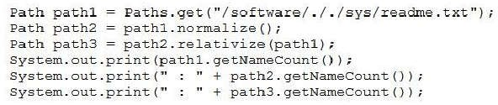
}
What is the result?
User is registered.
An AgeOutOfLimitException is thrown.
A UserException is thrown.
A compilation error occurs in the main method.
Correct Answer: B Section: (none) Explanation
Explanation/Reference:
QUESTION 86
Given the code fragment:
What is the result?
A. 5 : | 3 : | 6
B. 6 : | 5 : | 6
C. 3 : | 3 : | 4
D. 4 : | 4 : | 4
Correct Answer: D => A
Section: (none) Explanation
Explanation/Reference:
QUESTION 87
Given:

Slide 49
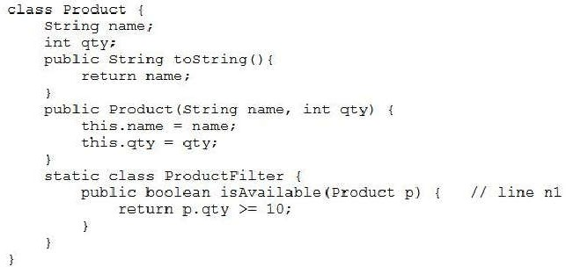
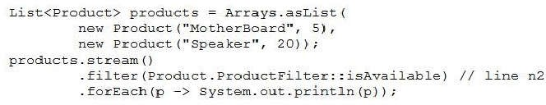
and the code fragment:
Which modification enables the code fragment to print Speaker?
Implement Predicate in the Product.ProductFilter class and replace line n2 with .filter (p
-> p.ProductFilter.test (p))
Replace line n1 with:
public static boolean isAvailable (Product p) {
Replace line n2 with:
.filter (p -> p.ProductFilter: :isAvailable (p))
Replace line n2 with:
.filter (p -> Product: :ProductFilter: :isAvailable ())
Correct Answer: B Section: (none) Explanation
Explanation/Reference:
QUESTION 88
Given the content:

Slide 50
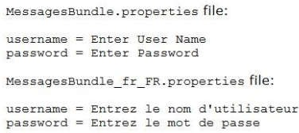
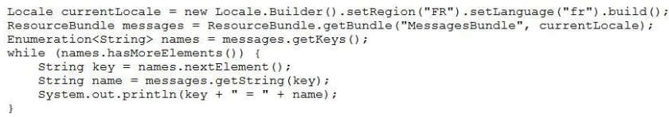
and the code fragment:
What is the result?
username = Entrez le nom d’utilisateur password = Entrez le mot de passe
username = Enter User Name password = Enter Password
A compilation error occurs.
The program prints nothing.
Correct Answer: A Section: (none) Explanation
Explanation/Reference:
QUESTION 89
Given:

Slide 51
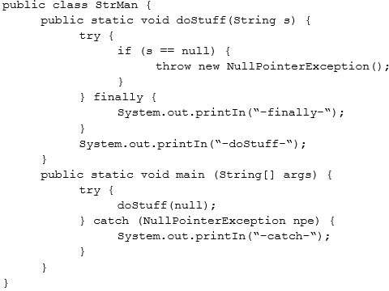
What is the result?
–catch-
-finally-
-dostuff-
–catch-
–finally-
-catch-
–finally
-dostuff-
-catch-
Correct Answer: C Section: (none) Explanation
Explanation/Reference:
Explanation:

Slide 52
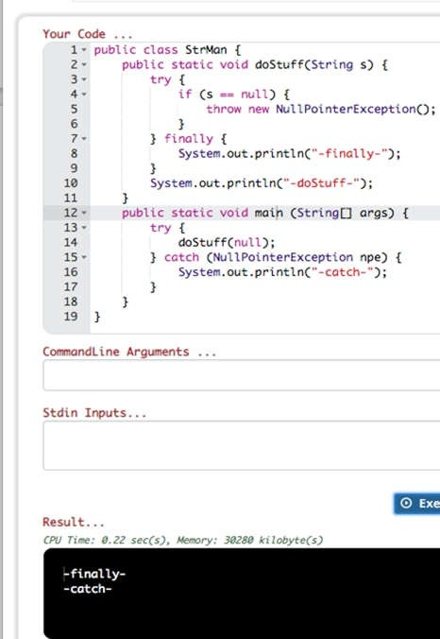
QUESTION 90
Given:

Slide 53
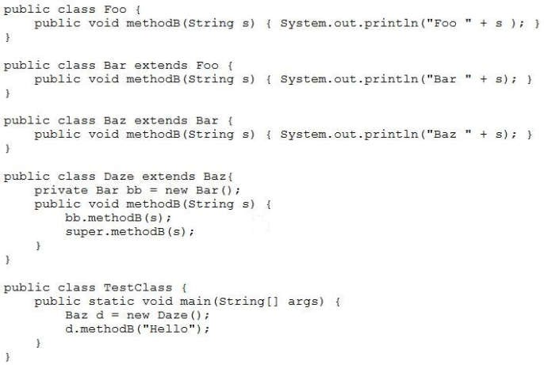
What is the result?
Bar Hello Foo Hello
Bar Hello Baz Hello
Baz Hello
A compilation error occurs in the Daze class.
Correct Answer: B Section: (none) Explanation
Explanation/Reference:
QUESTION 91
Given the content of the employee.txt file:
Every worker is a master.
Given that the employee.txt file is accessible and the file allemp.txt does NOT exist, and the code fragment:

Slide 54
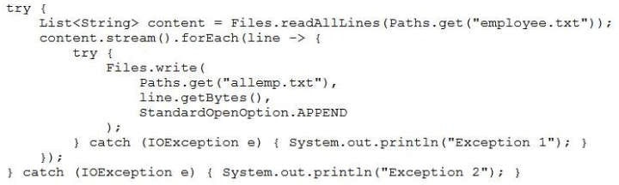
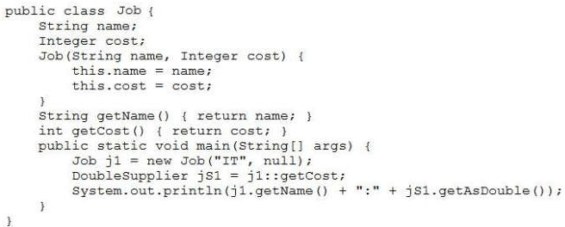
What is the result?
Exception 1
Exception 2
The program executes, does NOT affect the system, and produces NO output.
allemp.txt is created and the content of employee.txt is copied to it.
Correct Answer: A Section: (none) Explanation
Explanation/Reference:
QUESTION 92
Given:
What is the result?
IT:null
A NullPointerException is thrown at run time.
A compilation error occurs.
IT:0.0
Correct Answer: D => B
Section: (none)

Slide 55

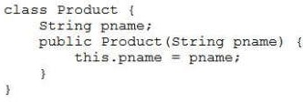

Explanation
Explanation/Reference:
QUESTION 93
Given the code fragment:
What is the result?
A compilation error occurs.
[Java, J2EE, J2ME, JSTL, JSP]
null
[Java, J2EE, J2ME, JSTL]
Correct Answer: D Section: (none) Explanation
Explanation/Reference:
QUESTION 94
Given:
and the code fragment:
What is the result?
true
true
false true
false
false

Slide 56
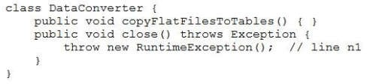

D. true
false
Correct Answer: D Section: (none) Explanation
Explanation/Reference:
QUESTION 95
Given:
and the code fragment:
What is the result?
A compilation error occurs at line n2.
A compilation error occurs because the try block doesn’t have a catch or finally block.
A compilation error occurs at line n1.
The program compiles successfully.
Correct Answer: B => A
Section: (none) Explanation
Explanation/Reference:
QUESTION 96
Given the code fragment:

Slide 57
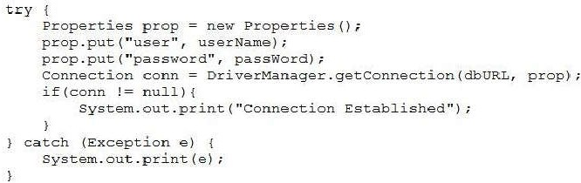
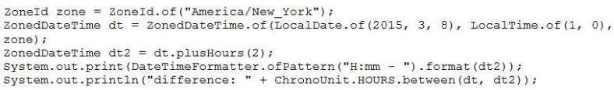
and the information:
The required database driver is configured in the classpath.
The appropriate database is accessible with the dbURL, username, and passWord exists.
What is the result?
A ClassNotFoundException is thrown at runtime.
The program prints nothing.
The program prints Connection Established.
A SQLException is thrown at runtime.
Correct Answer: C Section: (none) Explanation
Explanation/Reference:
QUESTION 97
In 2015, daylight saving time in New York, USA, begins on March 8th at 2:00 AM. As a result, 2:00 AM becomes 3:00 AM.
Given the code fragment:
Which is the result?
A. 3:00 | – difference: | 2
B. 2:00 | – difference: | 1
C. 4:00 | – difference: | 3
D. 4:00 | – difference: | 2
Correct Answer: D Section: (none) Explanation

Slide 58

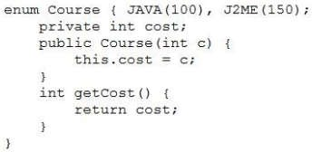
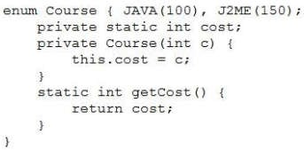
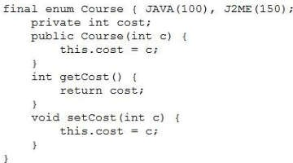
Explanation/Reference:
QUESTION 98
Given the code fragment:
Which is the valid definition of the Course enum?
A.
B.
C.

Slide 59
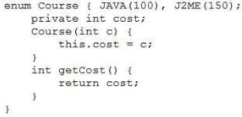
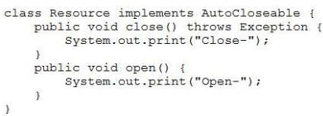
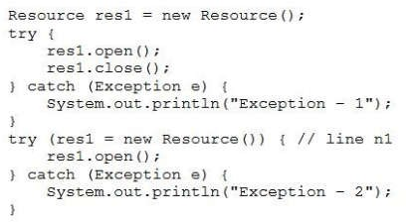
D.
Correct Answer: D Section: (none) Explanation
Explanation/Reference:
QUESTION 99
Given:
and this code fragment:
What is the result?
Open-Close– Exception – 1 Open–Close–
Open–Close–Open–Close–
A compilation error occurs at line n1.

Slide 60
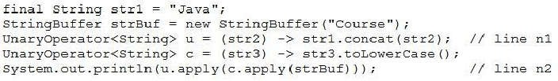
D. Open–Close–Open–
Correct Answer: C Section: (none) Explanation
Explanation/Reference:
QUESTION 100
Given the code fragment:
Which code fragment, when inserted at line n1, ensures false is printed?
boolean b = cs.stream() .findAny() .get() .equals(“Java”);
boolean b = cs.stream() .anyMatch (w -> w.equals (“Java”));
boolean b = cs.stream() .findFirst() .get() .equals(“Java”);
boolean b = cs.stream() .allMatch(w -> w.equals(“Java”));
Correct Answer: B => D
Section: (none) Explanation
Explanation/Reference:
QUESTION 101
Given the code fragment:
What is the result?
A compilation error occurs at line n1.
courseJava
Javacourse
A compilation error occurs at line n2.
Correct Answer: A => D
Section: (none) Explanation
Explanation/Reference:
QUESTION 102
Given:

Slide 61
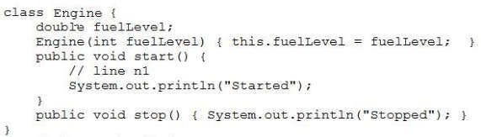

Your design requires that:
fuelLevel of Engine must be greater than zero when the start() method is invoked. The code must terminate if fuelLevel of Engine is less than or equal to zero.
Which code fragment should be added at line n1 to express this invariant condition?
assert (fuelLevel) : “Terminating…”;
assert (fuelLevel > 0) : System.out.println (“Impossible fuel”);
assert fuelLevel < 0: System.exit(0);
assert fuelLevel > 0: “Impossible fuel” ;
Correct Answer: C => D
Section: (none) Explanation
Explanation/Reference:
QUESTION 103
Given the code fragment:
What is the result?
Val:20 Val:40 Val:60
Val:10 Val:20 Val:30
A compilation error occurs.
Val: Val: Val:
Correct Answer: A Section: (none) Explanation
Explanation/Reference:
QUESTION 104
Given the code fragments:

Slide 62
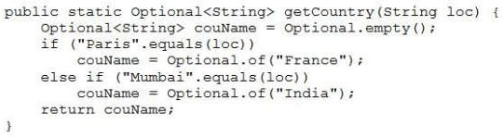
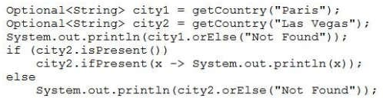

and
What is the result?
France
Optional[NotFound]
Optional [France] Optional [NotFound]
Optional[France] Not Found
France
Not Found
Correct Answer: D Section: (none) Explanation
Explanation/Reference:
QUESTION 105
Given the code fragment:
Which code fragment, when inserted at line n1, enables the code to print /First.txt?
Path iP = new Paths (“/First.txt”);
Path iP = Paths.toPath (“/First.txt”);
Path iP = new Path (“/First.txt”);
Path iP = Paths.get (“/”, “First.txt”);
Correct Answer: D

Slide 63
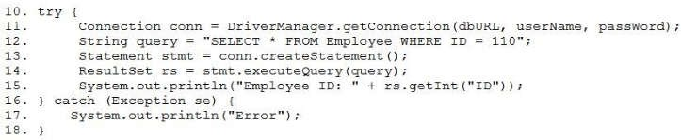

Section: (none) Explanation
Explanation/Reference:
QUESTION 106
Given the code fragment:
Assume that:
The required database driver is configured in the classpath.
The appropriate database is accessible with the dbURL, userName, and passWord exists The Employee table has a column ID of type integer and the SQL query matches one record.
What is the result?
Compilation fails at line 14.
Compilation fails at line 15.
The code prints the employee ID.
The code prints Error.
Correct Answer: A
D
Section: (none) Explanation
Explanation/Reference:
QUESTION 107
Given the code fragment:
What is the result?
A compilation error occurs at line n1.
A compilation error occurs at line n2.
The code reads the password without echoing characters on the console.
A compilation error occurs because the IOException isn’t declared to be thrown or caught?
Correct Answer: A => C
Section: (none)

Slide 64


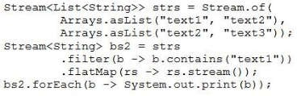
Explanation
Explanation/Reference:
QUESTION 108
and the code fragment?
What is the result?
A. $15.00
B. 15 $
USD 15.00
USD $15
Correct Answer: A Section: (none) Explanation
Explanation/Reference:
QUESTION 109
Given the code fragment:
What is the result?
text1text2
text1text2text2text3
text1
[text1, text2]
Correct Answer: A Section: (none) Explanation

Slide 65

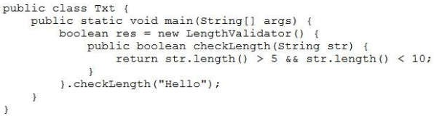
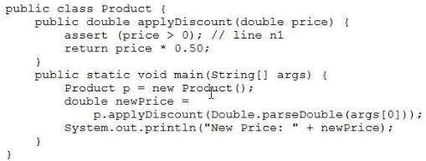
Explanation/Reference:
QUESTION 110
Given:
and
Which interface from the java.util.function package should you use to refactor the class Txt?
Consumer
Predicate
Supplier
Function
Correct Answer: C => B
Section: (none) Explanation
Explanation/Reference:
Reference: https://docs.oracle.com/javase/8/docs/api/java/util/function/package-summary.html
QUESTION 111
Given:
and the command:

Slide 66
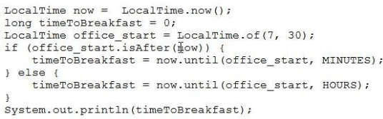
java Product 0
What is the result?
An AssertionError is thrown.
A compilation error occurs at line n1.
New Price: 0.0
A NumberFormatException is thrown at run time.
Correct Answer: C Section: (none) Explanation
Explanation/Reference:
QUESTION 112
Given the code fragment:
Assume that the value of now is 6:30 in the morning.
What is the result?
An exception is thrown at run time.
0
60
1
Correct Answer: C Section: (none) Explanation
Explanation/Reference:
QUESTION 113
Given the code fragments:

Slide 67
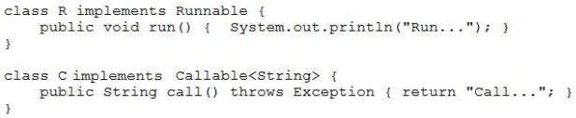

and
What is the result?
The program prints Run… and throws an exception.
A compilation error occurs at line n1.
Run…
Call…
A compilation error occurs at line n2.
Correct Answer: C Section: (none) Explanation
Explanation/Reference:
QUESTION 114
Which two are elements of a singleton class? (Choose two.)
a transient reference to point to the single instance
a public method to instantiate the single instance
a public static method to return a copy of the singleton reference
a private constructor to the class
a public reference to point to the single instance
Correct Answer: BD Section: (none) Explanation
Explanation/Reference:
QUESTION 115
Given the code fragment:

Slide 68
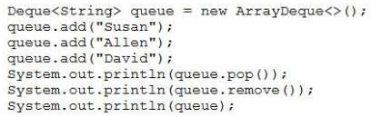
What is the result?
David
David
[Susan, Allen]
Susan
Susan
[Susan, Allen]
Susan
Allen [David]
David
Allen [Susan]
Susan
Allen
[Susan, David]
Correct Answer: C Section: (none) Explanation
Explanation/Reference:
Explanation:

Slide 69
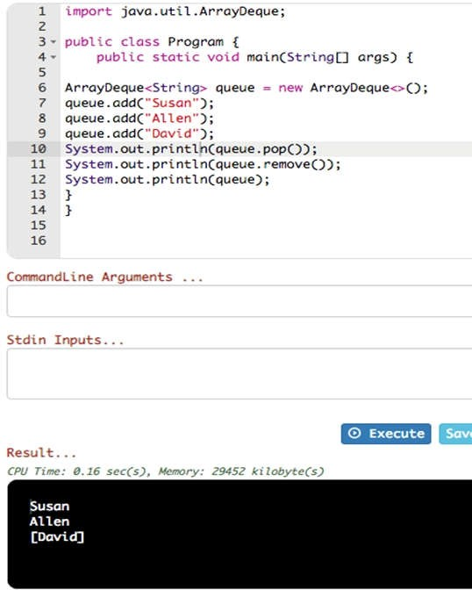
QUESTION 116
Given:

Slide 70
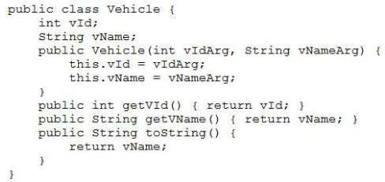
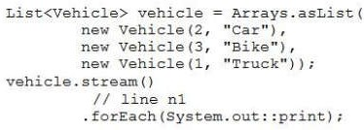

and the code fragment:
Which two code fragments, when inserted at line n1 independently, enable the code to print
TruckCarBike?
.sorted ((v1, v2) -> v1.getVId() < v2.getVId())
.sorted (Comparable.comparing (Vehicle: :getVName)).reversed ()
.map (v -> v.getVid())
.sorted ()
.sorted((v1, v2) -> Integer.compare(v1.getVId(), v2.getVid()))
.sorted(Comparator.comparing ((Vehicle v) -> v.getVId()))
Correct Answer: DE Section: (none) Explanation
Explanation/Reference:
QUESTION 117
Given the code fragment:
What is the result?

Slide 71
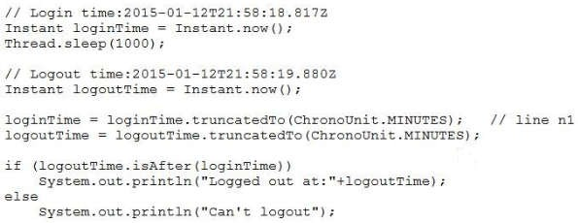
A compilation error occurs at line n2.
3
2
A compilation error occurs at line n1.
Correct Answer: A => B
Section: (none) Explanation
Explanation/Reference:
QUESTION 118
Given the code fragment:
What is the result?
A. A compilation error occurs at line n1.
B. Logged out at: 2015-01-12T21:58:19.880Z
C. Can’t logout
D. Logged out at: 2015-01-12T21:58:00Z
Correct Answer: D => C
Section: (none) Explanation
Explanation/Reference:
QUESTION 119
Given the code fragment:

Slide 72
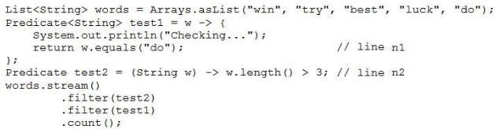

What is the result?
A compilation error occurs at line n1.
Checking…
Checking… Checking…
A compilation error occurs at line n2.
Correct Answer: A => D
Section: (none) Explanation
Explanation/Reference:
QUESTION 120
Assume customers.txt is accessible and contains multiple lines.
Which code fragment prints the contents of the customers.txt file?
Stream<String> stream = Files.find (Paths.get (“customers.txt”)); stream.forEach((String c) -> System.out.println(c));
Stream<Path> stream = Files.find (Paths.get (“customers.txt”)); stream.forEach( c) -> System.out.println(c));
Stream<Path> stream = Files.list (Paths.get (“customers.txt”)); stream.forEach( c) -> System.out.println(c));
Stream<String> lines = Files.lines (Paths.get (“customers.txt”)); lines.forEach( c) -> System.out.println(c));
Correct Answer: D Section: (none) Explanation
Explanation/Reference:
QUESTION 121
Given:

Slide 73
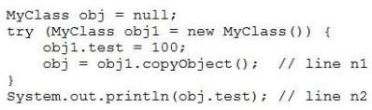
and the code fragment:
What is the result?
A. An exception is thrown at line n2.
B. 100
A compilation error occurs because the try block is declared without a catch or finally block.
A compilation error occurs at line n1.
Correct Answer: B Section: (none) Explanation
Explanation/Reference:
QUESTION 122
Which two methods from the java.util.stream.Stream interface perform a reduction operation? (Choose two.)
count ()
collect ()
distinct ()
peek ()
filter ()
Correct Answer: AB Section: (none) Explanation
Explanation/Reference:
Reference: https://docs.oracle.com/javase/8/docs/api/java/util/stream/package-summary.html
QUESTION 123
Which code fragment is required to load a JDBC 3.0 driver?
Connection con = Connection.getDriver (“jdbc:xyzdata://localhost:3306/EmployeeDB”);
Class.forName(“org.xyzdata.jdbc.NetworkDriver”);
Connection con = DriverManager.getConnection (“jdbc:xyzdata://localhost:3306/EmployeeDB”);
DriverManager.loadDriver (“org.xyzdata.jdbc.NetworkDriver”);
Correct Answer: B Section: (none) Explanation

Slide 74
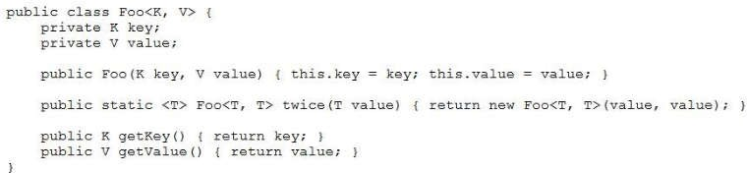
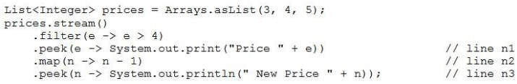
Explanation/Reference:
QUESTION 124
Given:
Which option fails?
Foo<String, Integer> mark = new Foo<String, Integer> (“Steve”, 100);
Foo<String, String> pair = Foo.<String>twice (“Hello World!”);
Foo<Object, Object> percentage = new Foo<String, Integer>(“Steve”, 100);
Foo<String, String> grade = new Foo <> (“John”, “A”);
Correct Answer: A => C
Section: (none) Explanation
Explanation/Reference:
QUESTION 125
Given the code fragment:
Which modification enables the code to print Price 5 New Price 4?
Replace line n2 with .map (n -> System.out.println (“New Price” + n –1)) and remove
line n3
Replace line n2 with .mapToInt (n -> n – 1);
Replace line n1 with .forEach (e -> System.out.print (“Price” + e))
Replace line n3 with .forEach (n -> System.out.println (“New Price” + n));
Correct Answer: D Section: (none) Explanation
Explanation/Reference:
QUESTION 126

Slide 75
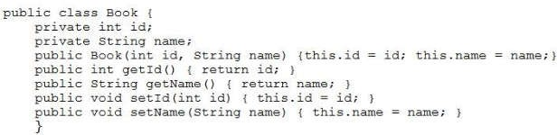




Given the definition of the Book class:
Which statement is true about the Book class?
It demonstrates encapsulation.
It is defined using the factory design pattern.
It is defined using the singleton design pattern.
It demonstrates polymorphism.
It is an immutable class.
Correct Answer: A Section: (none) Explanation
Explanation/Reference:
QUESTION 127
Given the code fragment:
You have been asked to define the ProductCode class. The definition of the ProductCode class must allow
c1 instantiation to succeed and cause a compilation error on c2 instantiation.
Which definition of ProductCode meets the requirement? A.
B.
C.

Slide 76

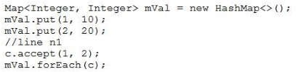

D.
Correct Answer: B Section: (none) Explanation
Explanation/Reference:
QUESTION 128
Given the code fragment:
Which statement can be inserted into line n1 to print 1,2; 1,10; 2,20;?
BiConsumer<Integer,Integer> c = (i, j) -> {System.out.print (i + “,” + j+ “; “);};
BiFunction<Integer, Integer, String> c = (i, j) –> {System.out.print (i + “,” + j+ “; “)};
BiConsumer<Integer, Integer, String> c = (i, j) –> {System.out.print (i + “,” + j+ “; “)};
BiConsumer<Integer, Integer, Integer> c = (i, j) –> {System.out.print (i + “,”
+ j+ “; “);};
Correct Answer: B => A
Section: (none) Explanation
Explanation/Reference:
Reference: https://www.concretepage.com/java/jdk-8/java-8-biconsumer-bifunction-bipredicate-example
QUESTION 129
Given the code fragment:
What is the result?
Java EEJava EESE
Java EESE
The program prints either:
Java EEJava SE

Slide 77
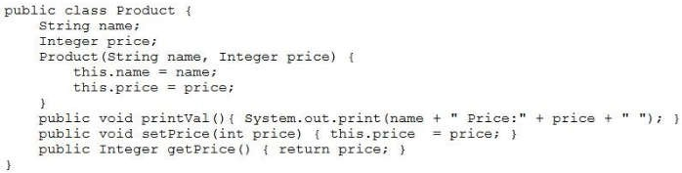

or
Java SEJava EE
D. Java EEJava SE
Correct Answer: D Section: (none) Explanation
Explanation/Reference:
QUESTION 130
Given the code fragments :
and
What is the result?
TV Price :1100 Refrigerator Price :2100
A compilation error occurs.
TV Price :1000 Refrigerator Price :2000
The program prints nothing.
Correct Answer: A Section: (none) Explanation
Explanation/Reference:
QUESTION 131
Given:

Slide 78
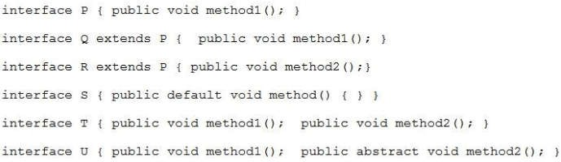
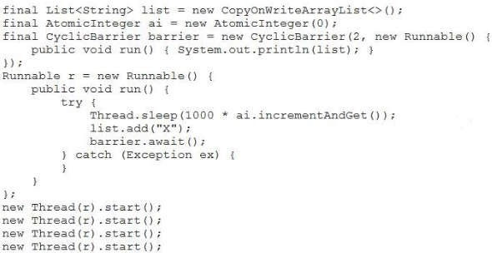
Which two interfaces can you use to create lambda expressions? (Choose two.)
T
R
P
S
Q
U
Correct Answer: CD => CE
Section: (none) Explanation
Explanation/Reference:
QUESTION 132
Given the code fragment:
What is the result ?
A. [X]
[X, X]

Slide 79


[X, X, X]
[X, X, X, X]
[X, X]
[X]
[X, X]
[X, X, X]
[X, X]
[X, X, X, X]
Correct Answer: A => D
Section: (none) Explanation
Explanation/Reference:
QUESTION 133
Given that these files exist and are accessible:
and given the code fragment:
Which code fragment can be inserted at line n1 to enable the code to print only /company/emp?
Stream<Path> stream = Files.list (Paths.get (“/company”));
Stream<Path> stream = Files.find( Paths.get (“/company”), 1,
(p,b) –> b.isDirectory (), FileVisitOption.FOLLOW_LINKS);
Stream<Path> stream = Files.walk (Paths.get (“/company”));
Stream<Path> stream = Files.list (Paths.get (“/company/emp”));
Correct Answer: B => A
Section: (none) Explanation
Explanation/Reference:
QUESTION 134
Given:

Slide 80
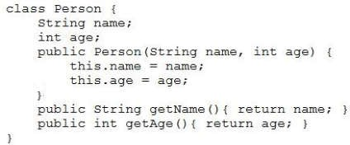
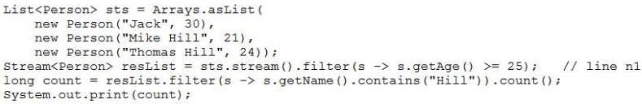
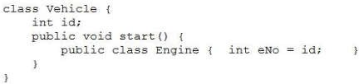

and the code fragment:
What is the result?
0
A compilation error occurs at line n1.
An Exception is thrown at run time.
2
Correct Answer: B => A
Section: (none) Explanation
Explanation/Reference:
QUESTION 135
Which class definition compiles?
A.
B.

Slide 81
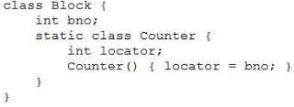


C.
D.
Correct Answer: B Section: (none) Explanation
Explanation/Reference:
QUESTION 136
Given the code fragment:
What is the result?
A. 4000 : | 2000
B. 4000 : | 1000
C. 1000 : | 4000
D. 1000 : | 2000
Correct Answer: B => A
Section: (none) Explanation
Explanation/Reference:
QUESTION 137
Given that version.txt is accessible and contains:
1234567890
and given the code fragment:

Slide 82


What is the result?
A. 121
B. 122
C. 135
D. The program prints nothing.
Correct Answer: B Section: (none) Explanation
Explanation/Reference:
QUESTION 138
What is the result?
A. A compilation error occurs at line 7.
B. 100
A compilation error occurs at line 8.
A compilation error occurs at line 15.
Correct Answer: A => B
Section: (none) Explanation
Explanation/Reference:

Slide 83


QUESTION 139
Given the content:
and given the code fragment:
Which two code fragments, when inserted at line 1 independently, enable the code to print “Wie geht’s?”
currentLocale = new Locale (“de”, “DE”);
currentLocale = new Locale.Builder ().setLanguage (“de”).setRegion (“DE”).build();
currentLocale = Locale.GERMAN;
currentlocale = new Locale(); currentLocale.setLanguage (“de”); currentLocale.setRegion (“DE”);
currentLocale = Locale.getInstance(Locale.GERMAN,Locale.GERMANY);
Correct Answer: BD => AB
Section: (none) Explanation
Explanation/Reference:
QUESTION 140
Given the code fragment:
What is the result?
Word: why what when
Word: why Word: why what Word: why what when
Word: why Word: what Word: when
Compilation fails at line n1.
Correct Answer: A Section: (none) Explanation

Slide 84


Explanation/Reference:
QUESTION 141
Given:
What is the result?
Hi Interface-2
A compilation error occurs.
Hi Interface-1
Hi MyClass
Correct Answer: D Section: (none) Explanation
Explanation/Reference:
QUESTION 142
Given:
and the code fragment:

Slide 85






Which definition of the ColorSorter class sorts the blocks list?
A.
B.
C.
D.
Correct Answer: C Section: (none) Explanation
Explanation/Reference:
QUESTION 143
Given the code fragment:
Which two code fragments, when inserted at line n1 independently, result in the output PEEK: Unix?

Slide 86

.anyMatch ();
.allMatch ();
.findAny ();
.noneMatch ();
.findFirst ();
Correct Answer: CE Section: (none) Explanation
Explanation/Reference:
QUESTION 144
Given the code fragments:
and
Which two modifications enable to sort the elements of the emps list? (Choose two.)
Replace line n1 with
class Person extends Comparator<Person>
At line n2 insert
public int compareTo (Person p) { return this.name.compareTo (p.name);
}
Replace line n1 with
class Person implements Comparable<Person>
At line n2 insert
public int compare (Person p1, Person p2) { return p1.name.compareTo (p2.name);
}
At line n2 insert:
public int compareTo (Person p, Person p2) { return p1.name.compareTo (p2.name);
}
Replace line n1 with
class Person implements Comparator<Person>
Correct Answer: BC Section: (none) Explanation

Slide 87


Explanation/Reference:
QUESTION 145
Given:
and the code fragment:
What is the result?
A. 0.0
B. 1500.0
C. A compilation error occurs.
D. 2000.0
Correct Answer: B Section: (none) Explanation
Explanation/Reference:
QUESTION 146
Given the code fragment:

Slide 88



Assume that dbURL, userName, and password are valid.
Which code fragment can be inserted at line n1 to enable the code to print Connection Established?
Properties prop = new Properties(); prop.put (“user”, userName); prop.put (“password”, password);
con = DriverManager.getConnection (dbURL, prop);
con = DriverManager.getConnection (userName, password, dbURL);
Properties prop = new Properties(); prop.put (“userid”, userName); prop.put (“password”, password); prop.put(“url”, dbURL);
con = DriverManager.getConnection (prop);
con = DriverManager.getConnection (dbURL); con.setClientInfo (“user”, userName); con.setClientInfo (“password”, password);
Correct Answer: A Section: (none) Explanation
Explanation/Reference:
QUESTION 147
Given the Greetings.properties file, containing:
and given:

Slide 89


What is the result?
Compilation fails.
GOODBY_MSG
Hello, everyone!
Goodbye everyone!
HELLO_MSG
Correct Answer: A Section: (none) Explanation
Explanation/Reference:
QUESTION 148
Given the code fragments:
and
What is the result?
null
A compilation error occurs.
DogCatMouse
[Dog, Cat, Mouse]
Correct Answer: D => B
Section: (none) Explanation
Explanation/Reference:
QUESTION 149
Given the records from the STUDENT table:

Slide 90



Given the code fragment:
Assume that the URL, username, and password are valid.
What is the result?
The STUDENT table is not updated and the program prints:
114 : John : john@uni.com
The STUDENT table is updated with the record:
: Jannet : jannet@uni.com
and the program prints:
: John : john@uni.com
The STUDENT table is updated with the record:
113 : Jannet : jannet@uni.com
and the program prints:
113 : Jannet : jannet@uni.com
D. A SQLException is thrown at run time.
Correct Answer: D
Section: (none) Explanation
Explanation/Reference:
QUESTION 150
Given the code fragment:
Which code fragment, when inserted at line 7, enables printing 100?

Slide 91
Function<Integer> funRef = e –> e + 10; Integer result = funRef.apply(value);
IntFunction funRef = e –> e + 10; Integer result = funRef.apply (10);
ToIntFunction<Integer> funRef = e –> e + 10; int result = funRef.applyAsInt (value);
ToIntFunction funRef = e –> e + 10; int result = funRef.apply (value);
Correct Answer: A => C
Section: (none) Explanation
Explanation/Reference:
QUESTION 151
Which two statements are true about the Fork/Join Framework? (Choose two.)
The RecursiveTask subclass is used when a task does not need to return a result.
The Fork/Join framework can help you take advantage of multicore hardware.
The Fork/Join framework implements a work-stealing algorithm.
The Fork/Join solution when run on multicore hardware always performs faster than standard sequential solution.
Correct Answer: AC => BC
Section: (none) Explanation
Explanation/Reference:
Reference: https://www.logicbig.com/tutorials/core-java-tutorial/java-multi-threading/fork-and-join.html
QUESTION 152
Which two statements are true about synchronization and locks? (Choose two.)
A thread automatically acquires the intrinsic lock on a synchronized statement when executed.
The intrinsic lock will be retained by a thread if return from a synchronized method is caused by an uncaught exception.
A thread exclusively owns the intrinsic lock of an object between the time it acquires the lock and the time it releases it.
A thread automatically acquires the intrinsic lock on a synchronized method’s object when entering that method.
Threads cannot acquire intrinsic locks on classes.
Correct Answer: AB => AC
Section: (none) Explanation
Explanation/Reference:
Reference: https://docs.oracle.com/javase/tutorial/essential/concurrency/locksync.html
QUESTION 153
Given the code fragment:

Slide 92



Which should be inserted into line n1 to print Average = 2.5?
IntStream str = Stream.of (1, 2, 3, 4);
IntStream str = IntStream.of (1, 2, 3, 4);
DoubleStream str = Stream.of (1.0, 2.0, 3.0, 4.0);
Stream str = Stream.of (1, 2, 3, 4);
Correct Answer: C = B
Section: (none) Explanation
Explanation/Reference:
QUESTION 154
Given the structure of the Student table:
Student (id INTEGER, name VARCHAR) Given the records from the STUDENT table:
Given the code fragment:
Assume that:
The required database driver is configured in the classpath.
The appropriate database is accessible with the dbURL, userName, and passWord exists.
What is the result?
The program prints Status: true and two records are deleted from the Student table.
The program prints Status: false and two records are deleted from the Student table.
A SQLException is thrown at runtime.
The program prints Status: false but the records from the Student table are not deleted.
Correct Answer: B
Section: (none) Explanation
Explanation/Reference:

Slide 93


QUESTION 155
Given the code fragments:
and
What is the result?
Video played.Game played.
A compilation error occurs.
class java.lang.Exception
class java.io.IOException
Correct Answer: C => B
Section: (none) Explanation
Explanation/Reference:
QUESTION 156
What is true about the java.sql.Statement interface?
It provides a session with the database.
It is used to get an instance of a Connection object by using JDBC drivers.
It provides a cursor to fetch the resulting data.
It provides a class for executing SQL statements and returning the results.
Correct Answer: D Section: (none) Explanation
Explanation/Reference:

Slide 94


Reference: https://docs.oracle.com/cd/E13222_01/wls/docs45/classdocs/java.sql.Statement.html
QUESTION 157
Given that data.txt and alldata.txt are accessible, and the code fragment:
What is required at line n1 to enable the code to overwrite alldata.txt with data.txt?
br.close();
bw.writeln();
br.flush();
bw.flush();
Correct Answer: D Section: (none) Explanation
Explanation/Reference:
QUESTION 158
Given:
and the code fragment:

Slide 95

What is the result?
[Java EE: Helen:Houston]
[Java ME: Jessy:Chicago, Java ME: Mark:Chicago]
Java EE Java ME
[Java ME: Jessy:Chicago, Java ME: Mark:Chicago] [Java EE: Helen:Houston]
A compilation error occurs.
Correct Answer: D => B
Section: (none) Explanation
Explanation/Reference:
Explanation:

Slide 96

QUESTION 159
Given:

Slide 97

From what threading problem does the program suffer?
race condition
deadlock
starvation
livelock
Correct Answer: B Section: (none) Explanation
Explanation/Reference:
QUESTION 160
Given the definition of the Employee class:

Slide 98


and this code fragment:
What is the result?
[sales:Ada, hr:Bob, sales:Bob, hr:Eva]
[Ada:sales, Bob:sales, Bob:hr, Eva:hr]
[hr:Eva, hr:Bob, sales:Bob, sales:Ada]
[hr:Bob, hr:Eva, sales:Ada, sales:Bob]
Correct Answer: A => D
Section: (none) Explanation
Explanation/Reference:
QUESTION 161
Given the code fragments:
class ThreadRunner implements Runnable {
public void run () { System.out.print (“Runnable”) ; }
}
class ThreadCaller implements Callable {
Public String call () throws Exception {return “Callable”; )
}
and

Slide 99
ExecutorService es = Executors.newCachedThreadPool (); Runnable r1 = new ThreadRunner ();
Callable c1 = new ThreadCaller ();
// line n1 es.shutdown();
Which code fragment can be inserted at line n1 to start r1 and c1 threads?
Future<String> f1 = (Future<String>) es.submit (r1); es.execute (c1);
es.execute (r1);
Future<String> f1 = es.execute (c1) ;
Future<String> f1 = (Future<String>) es.execute(r1); Future<String> f2 = (Future<String>) es.execute(c1);
es.submit(r1);
Future<String> f1 = es.submit (c1);
Correct Answer: D Section: (none) Explanation
Explanation/Reference:
QUESTION 162
Given the code fragment:
List<Double> doubles = Arrays.asList (100.12, 200.32); DoubleFunction funD = d –> d + 100.0;
doubles.stream (). forEach (funD); // line n1
doubles.stream(). forEach(e –> System.out.println(e)); // line n2
What is the result?
A. A compilation error occurs at line n2.
B. 200.12
300.32
C. 100.12
200.32
D. A compilation error occurs at line n1.
Correct Answer: A => D
Section: (none) Explanation
Explanation/Reference:
Explanation:

Slide 100

QUESTION 163
Given:
public class Product { int id; int price;
public Product (int id, int price) {
this.id = id; this.price = price;
}
Public String toString () { return id + “:” + price;)
}
and the code fragment:
List<Product> products = new ArrayList <> (Arrays.asList(new Product(1, 10), new Product (2, 30),
new Product (3, 20));
Product p = products.stream().reduce(new Product (4, 0), (p1, p2) -> { p1.price+=p2.price;
return new Product (p1.id, p1.price);});
products.add(p); products.stream().parallel()
.reduce((p1, p2) - > p1.price > p2.price ? p1 : p2)
.ifPresent(System.out: :println);
What is the result?
A. 4:60
B. 2:30
C. 4:60
2:30
3:20
1:10
D. 4:0
E. The program prints nothing

Slide 101
Correct Answer: C => A
Section: (none) Explanation
Explanation/Reference:
QUESTION 164
Given:
class Student {
String course, name, city;
public Student (String name, String course, String city) { this.course = course; this.name = name; this.city = city;
}
public String toString() {
return course + “:” + name + “:” + city;
}
public String getCourse() {return course;} public String getName() {return name;} public String getCity() {return city;}
and the code fragment:
List<Student> stds = Arrays.asList(
new Student (“Jessy”, “Java ME”, “Chicago”), new Student (“Helen”, “Java EE”, “Houston”), new Student (“Mark”, “Java ME”, “Chicago”));
stds.stream()
.collect(Collectors.groupingBy(Student::getCourse))
.forEach(src, res) -> System.out.println(scr));
What is the result?
A compilation error occurs.
Java EE Java ME
[Java EE: Helen:Houston]
[Java ME: Jessy:Chicago, Java ME: Mark:Chicago]
[Java ME: Jessy:Chicago, Java ME: Mark:Chicago] [Java EE: Helen:Houston]
Correct Answer: B Section: (none) Explanation
Explanation/Reference:
QUESTION 165
Given:

Slide 102


What change should you make to guarantee a single order of execution (printed values 1 -100 in order)?
Line 3: public synchronized void run() {
Line 1: class MyClass extends Thread {
Line 2: public volatile int value;
Line 2: public synchronized int value;
Correct Answer: B => A sửa : MyClass mc = new MyClass()
Section: (none) Explanation
QUESTION 166
Given:
and the code fragment:

Slide 103

The threads t1 and t2 execute asynchronously and possibly prints ABCA or AACB.
You have been asked to modify the code to make the threads execute synchronously and prints ABC.
Which modification meets the requirement?
start the threads t1 and t2 within a synchronized block.
Replace line n1 with:
private synchronized int count = 0;
Replace line n2 with:
public synchronized void run () {
Replace line n2 with:
volatile int count = 0;
Correct Answer: A => C
Section: (none) Explanation
Explanation/Reference:
QUESTION 167
Given that these files exist and are accessible:
/sports/info.txt
/sports/cricket/players.txt
/sports/cricket/data/ODI.txt
and given the code fragment:
int maxDepth =2;
Stream<Path> paths = Files.find(Paths.get(“/sports”), maxDepth,
(p, a) -> p.getFileName().toString().endsWith (“txt”),
FileVisitOption.FOLLOW_LINKS); Long fCount = paths.count(); System.out.println(fCount);
Assuming that there are NO soft-link/symbolic links to any of the files in the directory structure, what is the result?
1
2
3
An Exception is thrown at runtime.
Correct Answer: D => B
Section: (none) Explanation

Slide 104
Explanation/Reference:
QUESTION 168
Which statement is true about the single abstract method of the java.util.function.Predicate
interface?
It accepts one argument and returns void.
It accepts one argument and returns boolean.
It accepts one argument and always produces a result of the same type as the argument.
It accepts an argument and produces a result of any data type.
Correct Answer: B Section: (none) Explanation
Explanation/Reference:
Reference: https://www.javatpoint.com/java-predicate-interface
QUESTION 169
Given:
class FuelNotAvailException extends Exception { } class Vehicle {
void ride() throws FuelNotAvailException {
System.out.println(“Happy Journey!”);
}
}
//line n1
class SolarVehicle extends Vehicle {
public void ride () throws FuelNotAvailException { super ride ();
//line n2
}
}
and the code fragment:
public static void main (String[] args) throws Exception { Vehicle v = new SolarVehicle ();
v.ride();
}
Which modification enables the code fragment to print Happy Journey!?
Replace line n1 with public void ride() throws FuelNotAvailException {
Replace line n1 with protected void ride() throws Exception {
Replace line n2 with public void ride()throws FuelNotAvailException, Exception {
Replace line n2 with private void ride() throws FuelNotAvailException {
Correct Answer: C => A
Section: (none) Explanation
Explanation/Reference:
QUESTION 170
Given:

Slide 105

public class Counter {
public static void main (String[ ] args) { int a = 10;
int b = -1;
assert (b >=1) : “Invalid Denominator”; int с = a / b;
System.out.println (c);
}
}
What is the result of running the code with the –da option? A. -10
0
An AssertionError is thrown.
A compilation error occurs.
Correct Answer: A Section: (none) Explanation
Explanation/Reference:
QUESTION 171
Given records from the Player table:
and given the code fragment:
try {
Connection conn = DriverManager.getConnection(URL, username, password); Statement st= conn.createStatement(
ResultSet.TYPE_SCROLL_SENSITIVE,
ResultSet.CONCUR_UPDATABLE);
st.execute (“SELECT * FROM Player”); st.setMaxRows(2);
ResultSet rs = st.getResultSet();
rs.absolute(3); while (rs.next ()) {
System.out.println(rs.getInt(1) + “ “ + rs.getString(2));
}
} catch (SQLException ex) { System.out.print(“SQLException is thrown.”);
}
Assume that:
The required database driver is configured in the classpath.
The appropriate database is accessible with URL, username, and password.
The SQL query is valid.
What is the result?
A. 2 Jack

Slide 106
3 Sam
The program prints nothing.
3 Sam
SQLException is thrown.
Correct Answer: D > B
Section: (none) Explanation
Explanation/Reference:
QUESTION 172
Given:
Item table
ID, INTEGER: PK
DESCRIP, VARCHAR(100)
PRICE, REAL
QUANTITY< INTEGER
And given the code fragment:
9. try {
10.
11.
12.
13.
14.
15.
16.
17.
18.
Connection conn = DriveManager.getConnection(dbURL, username, password); String query = “Select * FROM Item WHERE ID = 110”;
Statement stmt = conn.createStatement();
ResultSet rs = stmt.executeQuery(query); while(rs.next()) {
System.out.println(“ID: “ + rs.getString(1));
System.out.println(“Description: “ + rs.getString(2));
System.out.println(“Price: System.out.println(Quantity:
“ + rs.getString(3));
“ + rs.getString(4));
19. }
} catch (SQLException se) {
System.out.println(“Error”);
22. }
Assume that:
The required database driver is configured in the classpath.
The appropriate database is accessible with the dbURL, userName, and passWord exists. The SQL query is valid.
What is the result?
An exception is thrown at runtime.
Compilation fails.
The code prints Error.
The code prints information about Item 110.
Correct Answer: B => D
Section: (none) Explanation
Explanation/Reference:

Slide 107
QUESTION 173
Given the code fragments:
interface CourseFilter extends Predicate<String> {
public default boolean test (String str) return str.contains (“Java”);
}
{
}
and
List<String> strs = Arrays.asList(“Java”, “Java EE”, “Embedded Java”); Predicate<String> cf1 = s - > s.length() > 3;
Predicate cf2 = new CourseFilter() { public boolean test (String s) {
return s.startsWith (“Java”);
}
};
long c = strs.stream()
.filter(cf1)
.filter(cf2)
.count(); System.out.println(c);
//line n1
//line n2
What is the result?
2
3
A compilation error occurs at line n1.
A compilation error occurs at line n2.
Correct Answer: D => A
Section: (none) Explanation
Explanation/Reference:
QUESTION 174
Given:
Which option fails?
Foo<String, Integer> mark = new Foo<Object, Object> (“Steve”, 100);
Foo<String, String> pair = Foo.<String>twice (“Hello World!”);
Foo<Object, Object> percentage = new Foo<Object, Object>(“Steve”, 100);
Foo<String, String> grade = new Foo <> (“John”, “A”);

Slide 108
Correct Answer: C >=A
Section: (none) Explanation
Explanation/Reference:
QUESTION 175
Given the code fragment:
Map<Integer, String> books = new TreeMap<>(); books.put (1007, “A”);
books.put (1002, “C”);
books.put (1003, “B”);
books.put (1003, “B”); System.out.println (books);
What is the result?
A. {1007=A, 1003=B, 1002=C}
B. {1007=A, 1003=B, 1003=B, 1002=C}
C. {1007=A, 1002=C, 1003=B, 1003=B}
D. {1002=C, 1003=B, 1007=A}
Correct Answer: D Section: (none) Explanation
Explanation/Reference:
QUESTION 176
Given:
public class Canvas implements Drawable { public void draw () { }
}
public abstract class Board extends Canvas { } public class Paper extends Canvas {
protected void draw (int color) { }
}
public class Frame extends Canvas implements Drawable { public void resize () { }
abstract void open ();
}
public interface Drawable { public abstract void draw ();
}
Which statement is true?
Board does not compile.
Paper does not compile.
Frame does not compile.
Drawable does not compile.
All classes compile successfully.

Slide 109
Correct Answer: C Section: (none) Explanation
Explanation/Reference:
QUESTION 177
Given the code fragment:
UnaryOperator<Double> uo1 = s -> s*2; //line n1 List<Double> loanValues = Arrays.asList(1000.0, 2000.0); loanValues.stream()
.filter(lv -> lv >= 1500)
.map(lv -> uo1.apply(lv)) //line n2
.forEach(s -> System.out.print(s + “ “));
What is the result?
A. 4000.0
B. 4000
A compilation error occurs at line n1.
A compilation error occurs at line n2.
Correct Answer: D => A
Section: (none) Explanation
Explanation/Reference:
QUESTION 178
Given the code fragment:
Path path1 = Paths.get(“/app/./sys/”); Path res1 = path1.resolve(“log”);
Path path2 = Paths.get(“/server/exe/”);
Path res1 = path2.resolve(“/readme/”); System.out.println(res1); System.out.println(res2);
What is the result?
/app/sys/log
/readme/server/exe
/app/log/sys
/server/exe/readme
/app/./sys/log
/readme
/app/./sys/log
/server/exe/readme
Correct Answer: D => C
Section: (none) Explanation
Explanation/Reference:

Slide 110
QUESTION 179
Given the code fragment:
List<String> nL = Arrays.asList(“Jim”, “John”, “Jeff”); Function<String, String> funVal = s -> “Hello : “.concat(s); nL.Stream()
.map(funVal)
.forEach(s-> System.out.print (s));
What is the result?
Hello : Jim Hello : John Hello : Jeff
Jim John Jeff
The program prints nothing.
A compilation error occurs.
Correct Answer: C =>
Section: (none) Explanation
Explanation/Reference:
Explanation:
The program prints nothing because the method is concat.
QUESTION 180
Given the code fragment:
List<String> colors = Arrays.asList(“red”, “green”, “yellow”); Predicate<String> test = n - > {
System.out.println(“Searching…”);
return n.contains(“red”);
};
colors.stream()
.filter(c -> c.length() >= 3)
.allMatch(test);
What is the result?
Searching…
Searching… Searching…
Searching… Searching… Searching…
A compilation error occurs.
Correct Answer: C => B
Section: (none) Explanation
Explanation/Reference:
QUESTION 181
Given the definition of the Emp class:

Slide 111
public class Emp
private String eName; private Integer eAge;
Emp(String eN, Integer eA) this.eName = eN; this.eAge = eA;
{
}
public Integer getEAge () {return eAge;} public String getEName () {return eName;}
}
and code fragment:
List<Emp>li = Arrays.asList(new Emp(“Sam”, 20), New Emp(“John”, 60), New Emp (“Jim”, 51));
Predicate<Emp> agVal = s -> s.getEAge() <= 60; //line n1
li = li.stream().filter(agVal).collect(Collectors.toList()); Stream<String> names = li.stream()map.(Emp::getEName); //line n2 names.forEach(n -> System.out.print(n + “ “));
What is the result?
Sam John Jim
John Jim
A compilation error occurs at line n1.
A compilation error occurs at line n2.
Correct Answer: C => A
Section: (none) Explanation
Explanation/Reference:
QUESTION 182
Given:
class Book {
int id;
String name;
public Book (int id, String name) {
this.id = id; this.name = name;
}
public boolean equals (Object obj) { boolean output = false;
Book b = (Book) obj;
if (this.id = = b.id) { output = true;
}
return output;
}
//line n1
}
and the code fragment:
Book b1 = new Book (101, “Java Programing”); Book b2 = new Book (102, “Java Programing”); System.out.println (b1.equals(b2));
//line n2

Slide 112
Which statement is true?
The program prints true.
The program prints false.
A compilation error occurs. To ensure successful compilation, replace line n1 with:
boolean equals (Book obj) {
A compilation error occurs. To ensure successful compilation, replace line n2 with:
System.out.println (b1.equals((Object) b2));
Correct Answer: B Section: (none) Explanation
Explanation/Reference:
QUESTION 183
Given the code fragment:
LocalDate valentinesDay =LocalDate.of(2015, Month.FEBRUARY, 14); LocalDate next15days = valentinesDay.plusDays (15);
LocalDate nextYear = next15days.plusYears(1); // line n1
System.out.println(nextYear);
What is the result?
A. 2016-03-01
B. A DateTimeException is thrown.
C. 2016-02-29
D. A compilation error occurs at line n1.
Correct Answer: D => A
Section: (none) Explanation
Explanation/Reference:
QUESTION 184
Given:
class UserException extends Exception { }
class AgeOutOfLimitException extends UserException { }
and the code fragment:
class App {
public void doRegister(String name, int age)
throws UserException, AgeOutOfLimitException { if (name.length () <= 60) {
throw new UserException ();
} else if (age > 60) {
throw new AgeOutOfLimitException ();
} else {
System.out.println(“User is registered.”);
}
}

Slide 113
public static void main(String[ ] args) throws UserException {
App t = new App (); t.doRegister(“Mathew”, 60);
}
}
What is the result?
User is registered.
An AgeOutOfLimitException is thrown.
A UserException is thrown.
A compilation error occurs in the main method.
Correct Answer: C Section: (none) Explanation
Explanation/Reference:
QUESTION 185
Given the code fragment:
public class Foo {
public static void main (String [ ] args) { Map<Integer, String> unsortMap = new HashMap< unsortMap.put (10, “z”);
unsortMap.put (5, “b”);
unsortMap.put (1, “d”);
unsortMap.put (7, “e”);
unsortMap.put (50, “j”);
> ( );
Map<Integer, String> treeMap = new TreeMap <Integer, String> (new Comparator<Integer> ( ) {
@Override public int compare (Integer o1, Integer o2) {return
o2.compareTo (o1); } } );
treeMap.putAll (unsortMap);
for (Map.Entry<Integer, String> entry : treeMap.entrySet () ) { System.out.print (entry.getValue () + “ “);
}
}
}
What is the result?
A compilation error occurs.
d b e z j
j z e b d
z b d e j
Correct Answer: D => C
Section: (none) Explanation
Explanation/Reference:

Slide 114
QUESTION 186
Given the code fragments:
class Caller implements Callable<String> { String str;
public Caller (String s) {this.str=s;}
public String call()throws Exception { return str.concat (“Caller”);}
}
class Runner implements Runnable { String str;
public Runner (String s) {this.str=s;}
public void run () { System.out.println (str.concat (“Runner”));}
}
and
public static void main (String[] args) throws InterruptedException, ExecutionException {
ExecutorService es = Executors.newFixedThreadPool(2);
Future f1 = es.submit (new Caller (“Call”)); Future f2 = es.submit (new Runner (“Run”)); String str1 = (String) f1.get();
String str2 = (String) f2.get(); System.out.println(str1+ “:” + str2); es.shutdown();
//line n1
}
What is the result?
The program prints:
Run Runner
Call Caller : null
And the program does not terminate.
The program terminates after printing:
Run Runner
Call Caller : Run
A compilation error occurs at line n1.
An ExecutionException is thrown at run time.
Correct Answer: D => A (bỏ es.shutdown())
Section: (none) Explanation
Explanation/Reference:
QUESTION 187
Given:
class Vehicle
int vno; String name;
implements Comparable<Vehicle>{
public Vehicle (int vno, String name) { this.vno = vno,;
this.name = name;
}
public String toString () {

Slide 115
return vno + “:” + name;
}
public int compareTo(Vehicle o) { return this.name.compareTo(o.name);
}
and this code fragment:
Set<Vehicle> vehicles = new TreeSet <> (); vehicles.add(new Vehicle (10123, “Ford”)); vehicles.add(new Vehicle (10124, “BMW”)); System.out.println(vehicles);
What is the result?
A. [10123:Ford, 10124:BMW]
B. [10124:BMW, 10123:Ford]
A compilation error occurs.
A ClassCastException is thrown at run time.
Correct Answer: A => B
Section: (none) Explanation
Explanation/Reference:
QUESTION 188
Given that course.txt is accessible and contains:
Course : : Java
and given the code fragment:
public static void main (String[ ] args) { int i;
char c;
try (FileInputStream fis = new FileInputStream (“course.txt”); InputStreamReader isr = new InputStreamReader(fis);) { while (!isr.close()) { //line n1
isr.skip(2);
i = isr.read (); c = (char) i;
System.out.print(c);
}
} catch (Exception e) { e.printStackTrace();
}
}
What is the result?
ur :: va
ueJa
The program prints nothing.
A compilation error occurs at line n1.
Correct Answer: C => D

Slide 116
Section: (none) Explanation
Explanation/Reference:
QUESTION 189
Given the code fragment:
ZonedDateTime depart = ZonedDateTime.of(2015, 1, 15, 1, 0, 0, 0, ZoneID.of(“UTC-
7”));
ZonedDateTime arrive = ZonedDateTime.of(2015, 1, 15, 9, 0, 0, 0, ZoneID.of(“UTC-
5”));
long hrs = ChronoUnit.HOURS.between(depart, arrive); //line n1 System.out.println(“Travel time is” + hrs + “hours”);
What is the result?
Travel time is 4 hours
Travel time is 6 hours
Travel time is 8 hours
An exception is thrown at line n1.
Correct Answer: C => B
Section: (none) Explanation
Explanation/Reference:
QUESTION 190
Given the code fragment:
Path file = Paths.get (“courses.txt”);
// line n1
Assume the courses.txt is accessible.
Which code fragment can be inserted at line n1 to enable the code to print the content of the courses.txt
file?
List<String> fc = Files.list(file); fc.stream().forEach (s -> System.out.println(s));
Stream<String> fc = Files.readAllLines (file); fc.forEach (s - > System.out.println(s));
List<String> fc = Files.readAllLines(file); fc.stream().forEach (s -> System.out.println(s));
Stream<String> fc = Files.list (file); fc.forEach (s -> System.out.println(s));
Correct Answer: C Section: (none) Explanation
Explanation/Reference:
QUESTION 191
Given the code fragment:

Slide 117
Stream<Path> files = Files.list(Paths.get(System.getProperty(“user.home”)));
files.forEach (fName -> { try {
Path aPath = fName.toAbsolutePath();
System.out.println(fName + “:”
+ Files.readAttributes(aPath, Basic.File.Attributes.class).creationTime ());
} catch (IOException ex) {
ex.printStackTrace();
//line n1
//line n2
});
What is the result?
All files and directories under the home directory are listed along with their attributes.
A compilation error occurs at line n1.
The files and folders in the home directory are listed along with their attributes.
A compilation error occurs at line n2.
Correct Answer: C Section: (none) Explanation
Explanation/Reference:
QUESTION 192
Given the code fragment:
BiFunction<Integer, Double, Integer> val = (t1, t2) -> t1 + t2;
//line n2 System.out.println(val.apply(10, 10.5));
//line n1
What is the result?
A. 20
B. 20.5
A compilation error occurs at line n1.
A compilation error occurs at line n2.
Correct Answer: D => C
Section: (none) Explanation
Explanation/Reference:
QUESTION 193
Given:
class Student {
String course, name, city;
public Student (String name, String course, String city) { this.course = course; this.name = name; this.city = city;
}
public String toString() {

Slide 118
return course + “:” + name + “:” + city;
}
public String getCourse() {return course;} public String getName() {return name;} public String getCity() {return city;}
and the code fragment:
List<Student> stds = Arrays.asList(
new Student (“Jessy”, “Java ME”, “Chicago”), new Student (“Helen”, “Java EE”, “Houston”), new Student (“Mark”, “Java ME”, “Chicago”));
stds.stream()
.collect(Collectors.groupingBy(Student::getCourse))
.forEach(src, res) -> System.out.println(res));
What is the result?
A compilation error occurs.
Java EE Java ME
[Java EE: Helen:Houston]
[Java ME: Jessy:Chicago, Java ME: Mark:Chicago]
[Java ME: Jessy:Chicago, Java ME: Mark:Chicago] [Java EE: Helen:Houston]
Correct Answer: B => C
Section: (none) Explanation
Explanation/Reference:
QUESTION 194
Given the code fragments:
class Employee { Optional<Address> address;
Employee (Optional<Address> address) {
this.address = address;
}
public Optional<Address> getAddress() { return address; }
}
class Address {
String city = “New York”;
public String getCity { return city: } public String toString() {
return city;
}
}
and
Address address = new Address;
Optional<Address> addrs1 = Optional.ofNullable (address); Employee e1 = new Employee (addrs1);
String eAddress = (addrs1.isPresent()) ? addrs1.get().getCity() : “City Not
available”; System.out.println(eAddress);

Slide 119
What is the result?
New York
City Not available
null
A NoSuchElementException is thrown at run time.
Correct Answer: C => A
Section: (none) Explanation
Explanation/Reference:
QUESTION 195
Given the code fragment:
public void recDelete (String dirName) throws IOException { File [ ] listOfFiles = new File (dirName) .listFiles(); if (listOfFiles ! = null && listOfFiles.length >0) {
for (File aFile : listOfFiles) {
if (!aFile.isDirectory ()) {
if (aFile.getName ().endsWith (“.class”)) aFile.delete ();
}
}
}
}
Assume that Projects contains subdirectories that contain .class files and is passed as an argument to the recDelete () method when it is invoked.
What is the result?
The method deletes all the .class files in the Projects directory and its subdirectories.
The method deletes the .class files of the Projects directory only.
The method executes and does not make any changes to the Projects directory.
The method throws an IOException.
Correct Answer: B Section: (none) Explanation
Explanation/Reference:
QUESTION 196
Given the code fragment:
List<String> empDetails = Arrays.asList(“100, Robin, HR”, “200, Mary, AdminServices”,“101, Peter, HR”);
empDetails.stream()
.filter(s-> s.contains(“r”))
.sorted()
.forEach(System.out::println); //line n1
What is the result?
A. 100, Robin, HR

Slide 120


101, Peter, HR
E. A compilation error occurs at line n1.
101, Peter, HR
200, Mary, AdminServices
100, Robin, HR
200, Mary, AdminServices
101, Peter, HR
Correct Answer: D => C
Section: (none) Explanation
Explanation/Reference:
QUESTION 197
Given the EMPLOYEE table:
Given the code fragment:
Assuming the database supports scrolling and updating, what is the result?
The program throws a runtime exception at Line 1.
A compilation error occurs.
A new record is inserted and Employee Id: 102, Employee Name: Peter is displayed.
A new record is inserted and Employee Id: 104, Employee Name: Michael is displayed.
Correct Answer: D Section: (none) Explanation
Explanation/Reference:
QUESTION 198

Slide 121


Given the code fragment:
What is the result?
ACBD // in random order
ABCD
ABCD // in random order
ABCD // in random order
ABCD // in random order
BCAD
A compile time error occurs.
Correct Answer: B => C
Section: (none) Explanation
Explanation/Reference:
QUESTION 199
Given the information: Emp table has 10 records.
Given the code fragment:
Which code fragment, inserted at Line n1, helps you determine the number of records in ResultSet?
ResultSetMetaData rsmd = rs.getMetaData(); int totRows = rsmd.getRowCount();
int totRows=0; while(rs.next()){
totRows++;
}
rs.last();
int totRows = rs.getRowCount();
rs.last();
int totRows = rs.getRowId(1);
Correct Answer: A => B
Section: (none) Explanation
Explanation/Reference:

Slide 122

QUESTION 200
Given:
Which code fragment can be inserted to print: Peacock is eating?
BirdInt b = new::Bird(“Peacock”);
BirdInt b1 = Bird::new;
Bird b = b1.getBird(“Peacock”);
BirdInt b = new Bird (“Peacock”);
Bird b = Bird::new(“Peacock”);
Correct Answer: B Section: (none) Explanation
Explanation/Reference:
Explanation:

Slide 123


QUESTION 201
Given:
and the code fragment:

Slide 124





Which code fragment can be inserted to print 13?
A.
B.
C.
D.
Correct Answer: B Section: (none) Explanation
Explanation/Reference:
QUESTION 202
Given the code fragment:

Slide 125


Assume that:
The required database driver is configured in the classpath.
The appropriate database is accessible with the dbURL, userName, and passWord exists.
The Employee and Customer tables are available and each table has id column with a few records and the SQL queries are valid.
What is the result of compiling and executing this code fragment?
The program prints employee IDs.
The program prints customer IDs.
The program prints Exception.
compilation fails on line 13.
Correct Answer: C =>B
Section: (none) Explanation
Explanation/Reference:
QUESTION 203
Given the code fragment:
What is the result?
0 : 0 : pen
0 : 1 : pen
0 : pen
D. 0 : 1 : 2 : 3 : 4 :

Slide 126


E. A compilation error occurs.
Correct Answer: E => C
Section: (none) Explanation
Explanation/Reference:
Explanation:
QUESTION 204
Given:
and the code fragment:
What is the result?
User is registered.
An AgeOutOfLimitException is thrown.

Slide 127

A UserException is thrown.
A compilation error occurs in the doRegister method.
Correct Answer: B => A
Section: (none) Explanation
Explanation/Reference:
QUESTION 205
Given the definition of the Vehicle class:
Which action encapsulates the Vehicle class?
Make the Vehicle class private.
Make the name variable public.
Make the getName() and setName() method public.
Make the name variable private.
Make the getName() and setName() method private.
Correct Answer: B => D
Section: (none) Explanation
Explanation/Reference:
QUESTION 206
Given the code fragment:
Path path1 = Paths.get(“/app/./sys/”); Path res1 = path1.resolve(“log”);
Path path2 = Paths.get(“/server/exe/”);
Path res2 = path2.resolve(“/readme/”); System.out.println(res1); System.out.println(res2);
What is the result?
/app/sys/log
/readme/server/exe
/app/log/sys
/server/exe/readme

Slide 128
/app/./sys/log
/readme
/app/./sys/log
/server/exe/readme
Correct Answer: B => C
Section: (none) Explanation
Explanation/Reference:
QUESTION 207
Given the code fragment:
public class Foo {
public static void main (String [ ] args) { Map<Integer, String> unsortMap = new HashMap< unsortMap.put (10, “z”);
unsortMap.put (5, “b”);
unsortMap.put (1, “d”);
unsortMap.put (7, “e”);
unsortMap.put (50, “j”);
> ( );
Map<Integer, String> treeMap = new TreeMap <Integer, String> (new Comparator<Integer> ( ) {
@Override public int compare (Integer o1, Integer o2) {return
o1.compareTo (o2); } } );
treeMap.putAll (unsortMap);
for (Map.Entry<Integer, String> entry : treeMap.entrySet () ) { System.out.print (entry.getValue () + “ “);
}
}
}
What is the result?
A compilation error occurs.
d b e z j
j z e b d
z b d e j
Correct Answer: B Section: (none) Explanation
Explanation/Reference:

