Slide 1
Java Secure Coding
For Web Applications
Presentation by
- Yifan Liu
Notes:
Security is a very big topic
Today we are going to focus on web applications only
I’ll show you a few attacks and how to defence them by couple of demos

Slide 2
Contents
I don’t need a password
Cookies
Hey, this is Bob
An Important Email
The Real world

Slide 3
I don’t need a password
SQL Injection
Do not concatenate Strings
Notes:
userA’ or ’a’ = ‘a
UserA’;insert into tblUser values(‘hacker’, ‘123’);select * from tblUser where Password = ‘abc’

Slide 4
Cookies
Cross Site Scripting
Not only cookies
Notes:
Without XssFilter
<script>alert(‘hi’);</script>
<script>console.info(document.cookie);</script>
<h2>title</h2>
4. Log on as another user
Enable XssFilter
Try the above step again
Introduce input validation in CALMS:

Slide 5
Hey, this is Bob
Men in the middle
You’re actually using it
Notes:
There are few different ways to do man in the middle: sniffing, acting as a proxy(D-F key exchange, SSL striping), phishing(show it later)
Explain Alice and Bob’s certificate exchange in a secure conversation
Put a man, Eve, in the middle pretending Bob
Use a https site to show that Fiddler2 is actually a man in the middle
To protect this vulnerability, we need exchange
Want to know more? Come to the training session on 20th

Slide 6
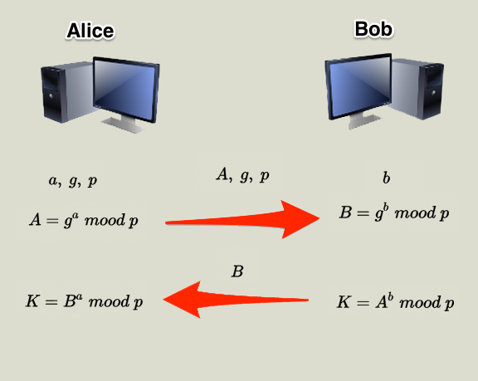
Diffie-Hellman Key Exchange
Notes:
symmetric encryption have to send the key out, which is extremely insecure
asymmetric encryption using key exchange protocol to void exposing encrypt key on the internet, a lot more secure

Slide 7
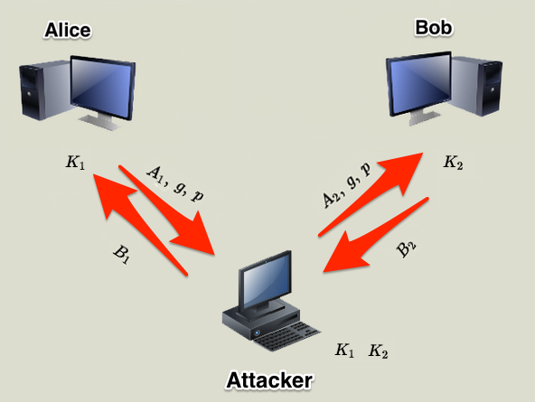
Diffie-Hellman Key Exchange
Notes:
D-H key is not secure enough because it lacks of authentication
The attacker can generate k1 and k2 against Alice and Bob
That’s why

Slide 8
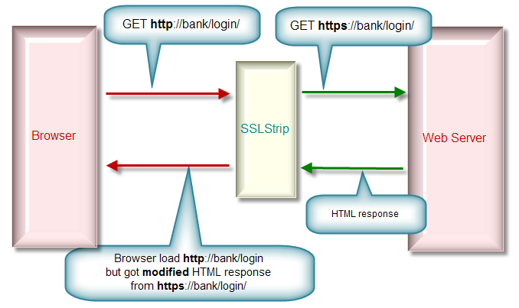
SSL Strip

Slide 9
An Important Email
Phishing BIF’s dealers
We can fix it
Notes:
Show the step of phishing a victim to visit my fake site
Ask how to resolve it
Suggest to use 2-factor authentication (OTP or other 2nd factors)

Slide 10
The Real World
Bank Of IRL project
Download XML as a dealer
Log plain text password
Weak/Static passwords
Phishing emails
Notes:
SHA-1 not safe any more, must be changed!!!
In CALMS, some ajax handler lack of authentication, e.g. xml downloading
Must add 2nd factor when logging on

