Slide 1
Telegram Bot{
Telebot-Workshop.html
workshop.css
By Yi Hao;
}
Programming Language

Slide 2
Table Of ‘Contents’ {
01
02
03
Telebot-Workshop.html
workshop.css
Introduction
Installation Guide
BotFather
04
Notification Bot
05
Chat vs Notification Bot
06
Receiving Updates
}
Programming Language

Slide 3
Table Of ‘Contents’ {
07
08
09
Telebot-Workshop.html
workshop.css
Handlers
Keyboards
Inline Mode
10
Bonus - Deployment
}
Programming Language

Slide 4
01 {
[Theory Lesson]
forbeginners.html
workshop.css
< You can enter a subtitle here if you need it >
}
Programming Language

Slide 5
Concepts < /1 > {
forbeginners.html
workshop.css
< Mercury is the closest planet to the Sun and the smallest one in the Solar System—it’s only a bit larger than the Moon >
}
Concepts < /2 > {
< Venus has a beautiful name and is the second planet from the Sun. It’s hot and has a poisonous atmosphere >
}
Programming Language

Slide 6
Introduction; {
forbeginners.html
workshop.css
‘Here you can give a brief description of the topic you want to talk about’
<p For example, if you want to talk about Mercury, you can say that it’s the smallest planet in the entire Solar System >
</p>
}
Programming Language

Slide 7
What Is this ‘Topic About ?’ {
forbeginners.html
workshop.css
Languages
Html
60%
Css
40%
< Mercury is the smallest planet in the entire Solar System >
< The Earth is the only one that harbors life in the Solar System >
Create a web page
Venus has a nice name
Mars is a cold place
Jupiter is a gas giant
}
Programming Language

Slide 8
Features of ‘the Topic’ {
forbeginners.html
workshop.css
Step 01
Mercury is the closest planet to the Sun and the smallest one
Step 02
Saturn is a gas giant and has several rings
Step 03
The Earth is the only planet that harbors life
Step 04
Venus has a beautiful name and is the second planet from the Sun
}
Programming Language

Slide 9
Recommendations; {
forbeginners.html
workshop.css
Mercury
< Mercury is the closest planet to the Sun and the smallest one in the Solar System >
Saturn
< It was named after the Roman god of wealth and agriculture >
Jupiter
< Jupiter is a gas giant and the biggest planet in the Solar System >
}
Programming Language

Slide 10
Examples About ‘The Topic’{
forbeginners.html
workshop.css
Mercury
Jupiter
< Mercury is the closest planet to the Sun >
< Jupiter is a gas giant and the biggest planet >
Saturn
Venus
< Saturn is a gas giant and has several rings >
< Venus has a nice name and high temperatures >
}
Programming Language

Slide 11
Practical Exercise {
< /1 >
< /2 >
forbeginners.html
workshop.css
< Saturn is the fourth-largest object by diameter in the Solar System >
Mercury is the smallest planet
The Earth is the planet we live on
Saturn is made of oxygen and helium
Jupiter is a gas giant
Venus has high temperatures
Neptune is very far away from the Sun
}
Programming Language

Slide 12
9h 55m 23s {
333,000.000
386,000 km
forbeginners.html
workshop.css
< Is Jupiter's rotation period >
< Earths fit in the Sun’s mass >
< Distance between the Moon and the Earth >
}
Programming Language

Slide 13
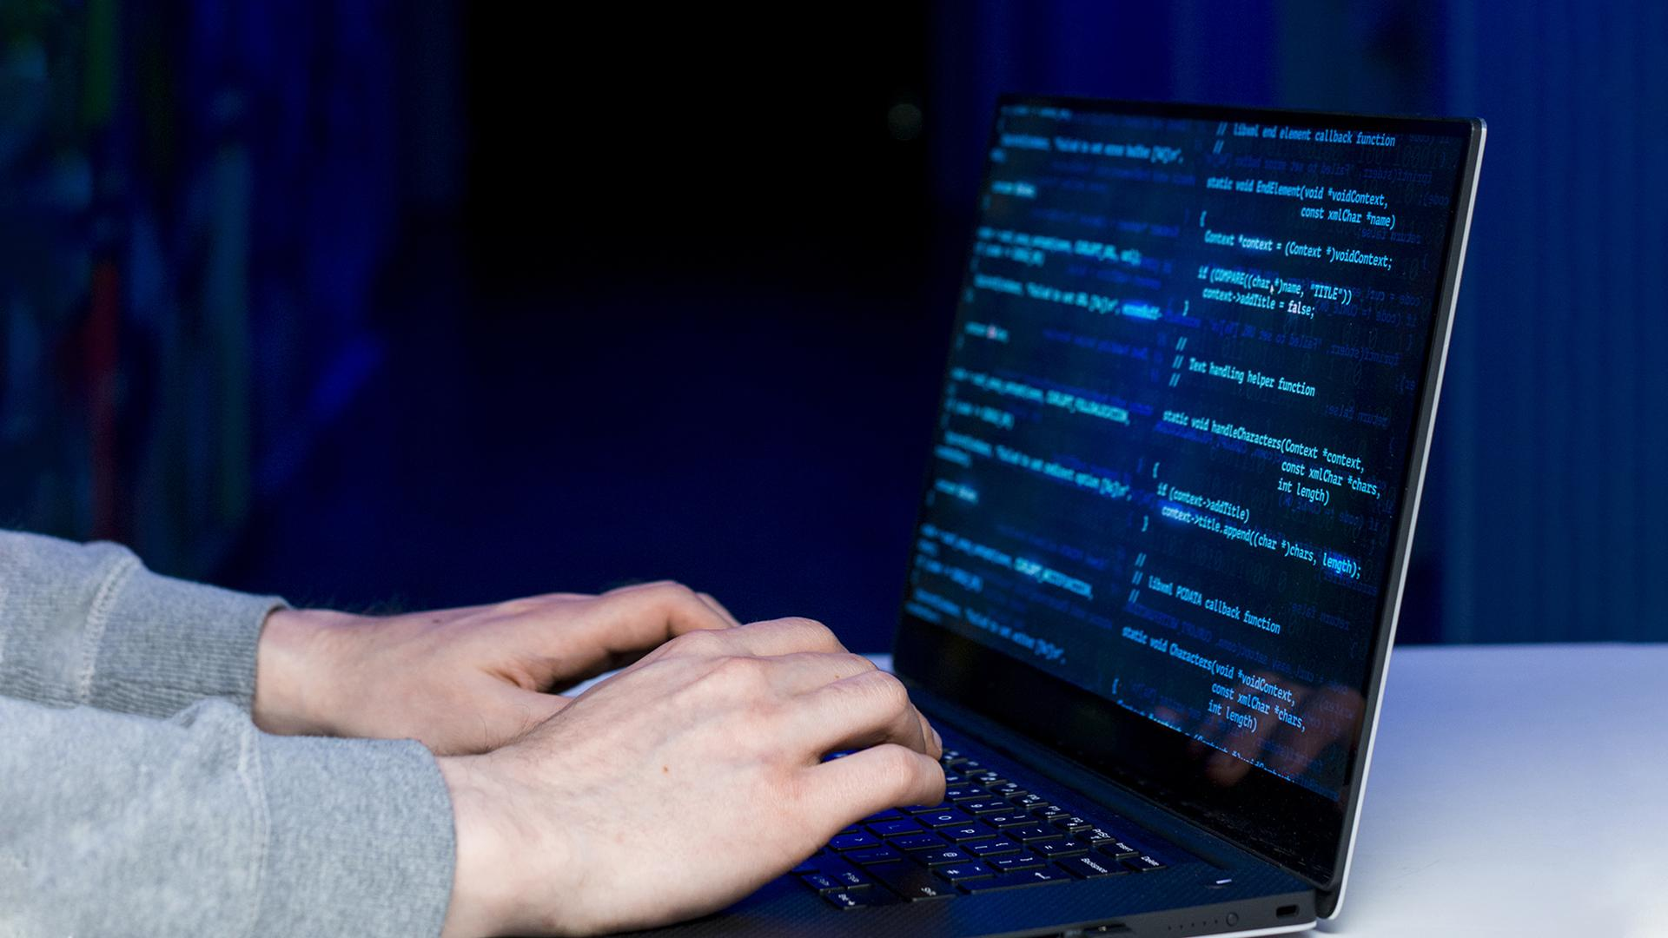
A ‘Picture’ Is { Worth a Thousand Words
}

Slide 14
Awesome { Words;
forbeginners.html
workshop.css
}
Programming Language

Slide 15
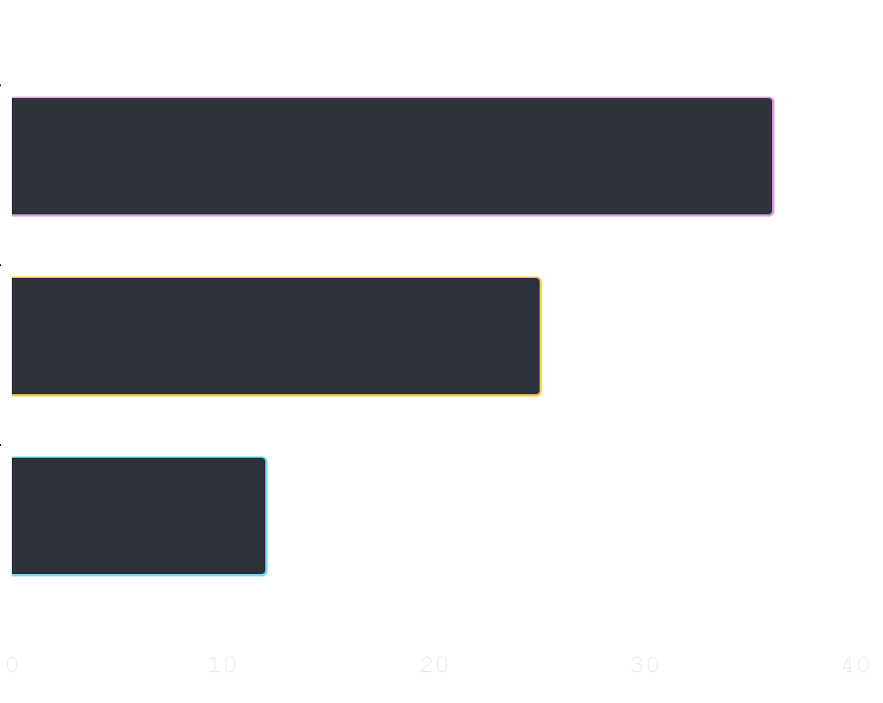
Did You Know ‘This ?’ {
forbeginners.html
workshop.css
36.00
Mercury is the smallest planet of the Solar System
25.00
Venus has a beautiful name and high temperatures
12.00
Despite being red, Mars is actually a cold place
}
Follow the link in the graph to modify its data and then paste the new one here. For more info, click here
Programming Language

Slide 16

A ‘Picture’ Always Reinforces The Concept {
forbeginners.html
workshop.css
< Images reveal large amounts of data, so remember: use an image instead of a long text. Your audience will appreciate it >
}
Programming Language

Slide 17
150,005,630 {
forbeginners.html
workshop.css
< Big numbers catch your audience’s attention >
}
Programming Language

Slide 18
— Someone ‘Famous’
forbeginners.html
workshop.css
< “This is a quote, words full of wisdom that someone important said and can make the reader get inspired.” >
Programming Language

Slide 19
Review ‘Concepts’ {
forbeginners.html
workshop.css
< Mercury is the closest planet to the Sun and the smallest one in the Solar System >
Venus
Ceres
Saturn
}
Programming Language

Slide 20
Planning of ‘September’{
forbeginners.html
workshop.css
M | T | W | T | F | S | S
 |  | 01 | 02 | 03 | 04 | 05
06 | 07 | 08 | 09 | 10 | 11 | 12
13 | 14 | 15 | 16 | 17 | 18 | 19
20 | 21 | 22 | 23 | 24 | 25 | 26
27 | 28 | 29 | 30
Mercury is the smallest planet
Venus has a beautiful name
The Earth is the third planet
Mars is actually a cold place
Jupiter is a gas giant
}
Programming Language

Slide 21
JavaScript For ‘Beginners’ {
forbeginners.html
workshop.css
Mercury
Mars
It is the closest planet to the Sun
Despite being red, Mars is a cold place
Jupiter
Venus
Jupiter is the biggest planet
Venus is the second planet from the Sun
Saturn
Neptune
Saturn is a gas giant and has several rings
Neptune is very far from the Earth
}
Programming Language

Slide 22
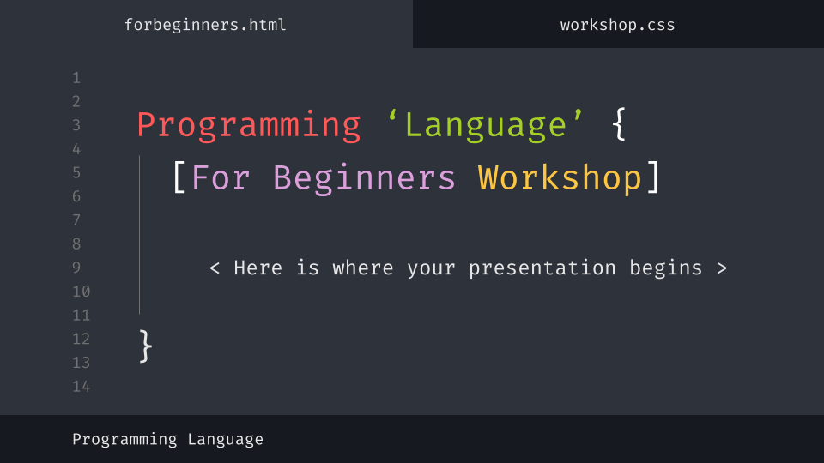
Desktop Software {
forbeginners.html
workshop.css
You can replace the image on the screen with your own work. Just delete this one, add yours and center it properly
}
Programming Language

Slide 23
Thanks; {
forbeginners.html
workshop.css
‘Do you have any questions?’
youremail@freepik.com
+91 620 421 838
yourcompany.com
< Please keep this slide for attribution >
}
Programming Language

Slide 24
Web ‘Design’
forbeginners.html
workshop.css
Programming Language

Slide 25
Alternative ‘Resources’ {
forbeginners.html
workshop.css
Here’s an assortment of alternative resources whose style fits the one of this template
Photos:
Portrait hacker I
Portrait hacker II
}
Programming Language

Slide 26
Resources {
forbeginners.html
workshop.css
Did you like the resources on this template? Get them for free at our other websites:
Photos:
Close up hacker
Medium shot woman working computer
Icons:
Web design
}
Programming Language

