Slide 1
Lesson 0: Background
Jesus and Satan have an argument as to who is the better programmer. This goes on for a few hours until they come to an agreement to hold a contest with God as the judge. They set themselves before their computers and begin. They type furiously, lines of code streaming up the screen, for several hours straight.
Seconds before the end of the competition, a bolt of lightning strikes, taking out the electricity. Moments later, the power is restored, and God announces that the contest is over. He asks Satan to show his work. Visibly upset, Satan cries and says, “I have nothing. I lost it all when the power went out.”
“Very well,” says God, “let us see if Jesus has fared any better.”
Jesus presses a key, and the screen comes to life in vivid display, the voices of an angelic choir pour forth from the speakers.
Satan is astonished. He stutters, “B-b-but how?! I lost everything, yet Jesus’ program is intact! How did he do it?”
God chuckles, “Everybody knows Jesus saves.”
Yi Jin Liew
140218

Slide 2
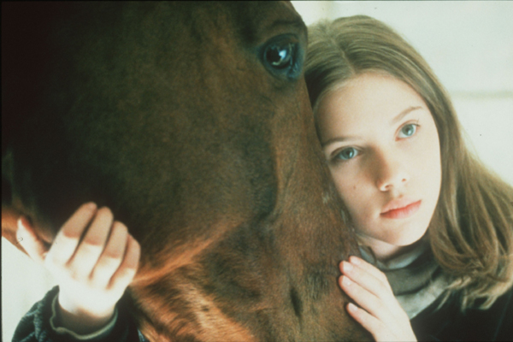
What is programming?

Slide 3

What is programming?

Slide 4
What is programming?

Slide 5
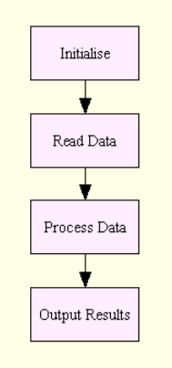
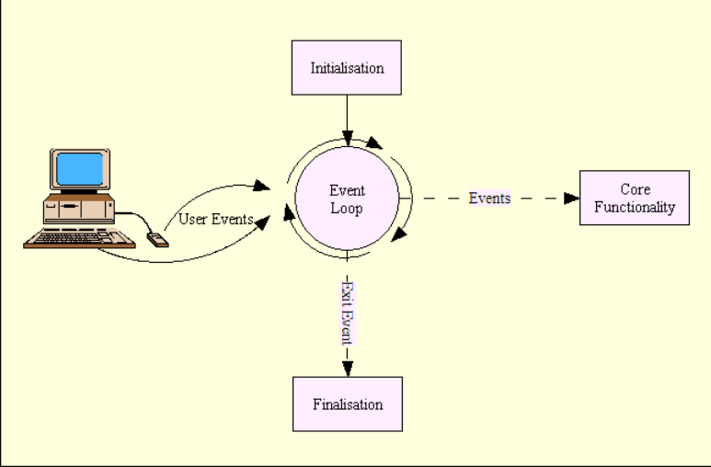
Types of code
http://www.alan-g.me.uk/l2p/index.htm
Procedural
Event-driven

Slide 6
Low-level programming languages
Machine code
Processor-specific, i.e. you’re whispering directly at microprocessor level
8B542408 83FA0077 06B80000 0000C383
FA027706 B8010000 00C353BB 01000000
B9010000 008D0419 83FA0376 078BD98B
C84AEBF1 5BC3
Assembly
Still processor-specific, BUT easier to write!
mov edx, [esp+8]
cmp edx, 0
ja @f
mov eax, 0
ret

Slide 7
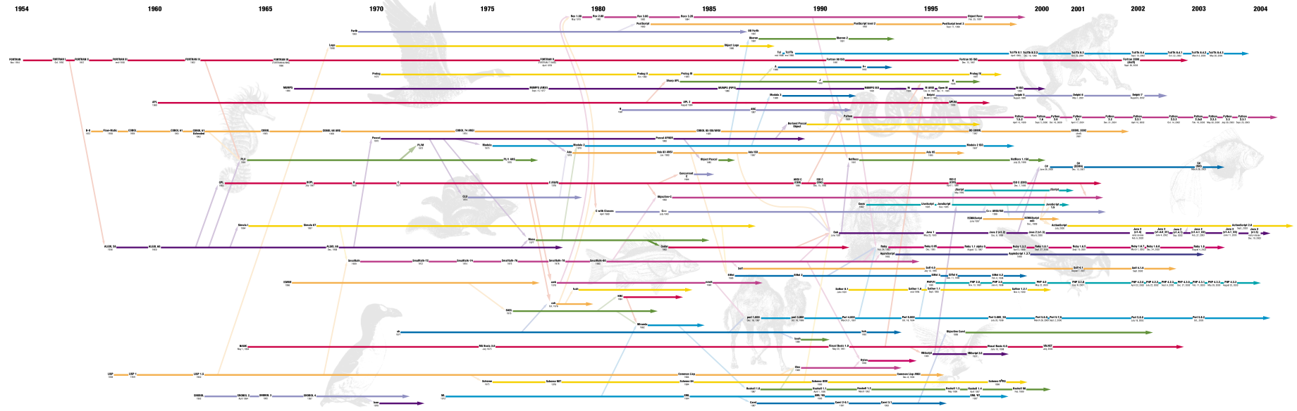
High-Level Programming languages
Modern programming languages: ideas written in English, then “reverse translated” all the way back into machine code.

Slide 8
High-Level Programming Languages
Difference between C and Python:
TL;DR: C = performance, Python = simplicity
Computer science terms | Equine explanation
C is closer to the metal | Python: “walk”, “trot”, “canter” C: “lift left limbs 1 metre, breathe in…”
Python handles garbage collection automatically, while C does not | What was for dinner five months ago? C: “453 grams of grass and 3 carrots, duh.” Python: “Err, ran out of memory, so unnecessary stuff were erased…”
Python is a dynamic language | If water enters the lungs of a horse… Python: “Hmmm… lungs = water. OK.” C: “ERROR! ERROR! Lungs can only contain air!”

Slide 9
Compiling a program
Python
C
Assembly (x86-64 Linux)
print (“Hello, world!”)
printf (“Hello, world!\n”)
string: .ascii “Hello, world!\n” _start:
moveq $string, %rcx

Slide 10
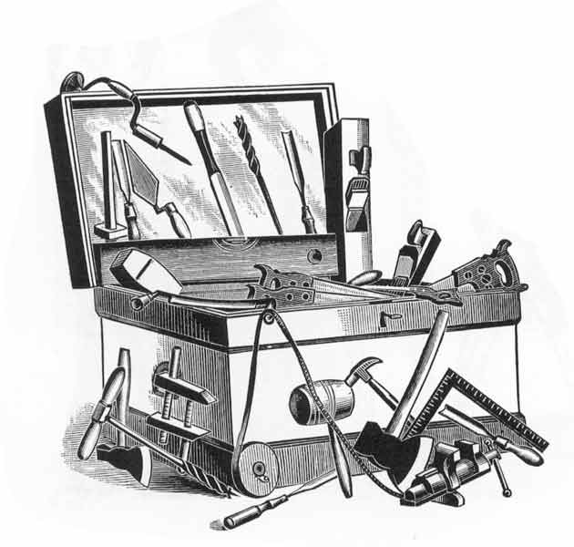
Which Programming Language is best?
Optimise program performance
FORTRAN, C, C++
Widest reach possible
Java, Javascript
Simplest to write
Tcl, Perl, Python
Take advantage of others’ stuff (Bioinformatics)
R, Perl, Python
Don’t hammer nails with sledgehammers!

Slide 11
Turing-completeness
A proper “programming language” is “Turing-complete”
Turing-complete languages can perform any calculation that any other language can
Non-Turing-complete languages
HTML
CSS
These languages store data (i.e. HTML = content of website; CSS = style websites), but cannot do complex stuff like if-then-else / for-loops.

Slide 12

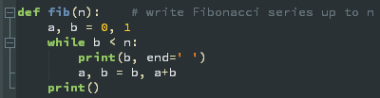




Python: Introduction
Why Python?
Widely used in bioinformatics
Lots of libraries (on par with Perl’s) – “batteries included”
Mature (23 yo), but keeps on improving
Minimalist design, intended to be highly readable language
Version 2 vs. 3: 3 is recommended
Used in/by

Slide 13
Main features of python
Code blocks organised by curly braces
Python
if stomach == “empty”: if wallet >= 25: go_to_linas() wallet = wallet – 25 else: go_to_diner() wallet = wallet – 16 else: continue_working()
Perl
if ($stomach == “empty”) { if ($wallet >= 25) { go_to_linas() $wallet = $wallet – 25 } else { go_to_diner() $wallet = $wallet – 16 } } else { continue_working() }
Code blocks organised by whitespace (1TAB/ 4 SPACE)

Slide 14
Main features of python
Python
if stomach == “empty”: if wallet >= 25: go_to_linas() wallet = wallet – 25 else: go_to_diner() wallet = wallet – 16 else: continue_working()
Perl
if ($stomach == “empty”) { if ($wallet >= 25) { go_to_linas() $wallet = $wallet – 25 } else { go_to_diner() $wallet = $wallet – 16 } } else { continue_working() }

Slide 15
Python: Getting started
Linux: comes pre-installed. Go to command line, type “python” or “python3”
Windows: nuh-uh, have to install yourself. http://www.python.org/download/
OS X: also pre-installed, but version is usually outdated. Go to Terminal, type “python”. Same link as above to get newer versions.
Online:
http://ideone.com (change “Java” to “Python 3” in the select language box)
http://pythonfiddle.com/
http://repl.it/languages/Python
Online interpreters will suffice in learning Python basics, but note that they cannot save programs, nor read data from disk.

Slide 16
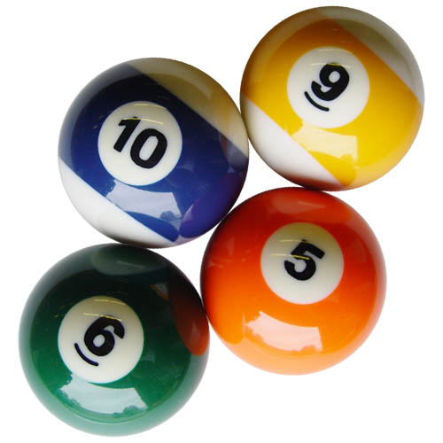

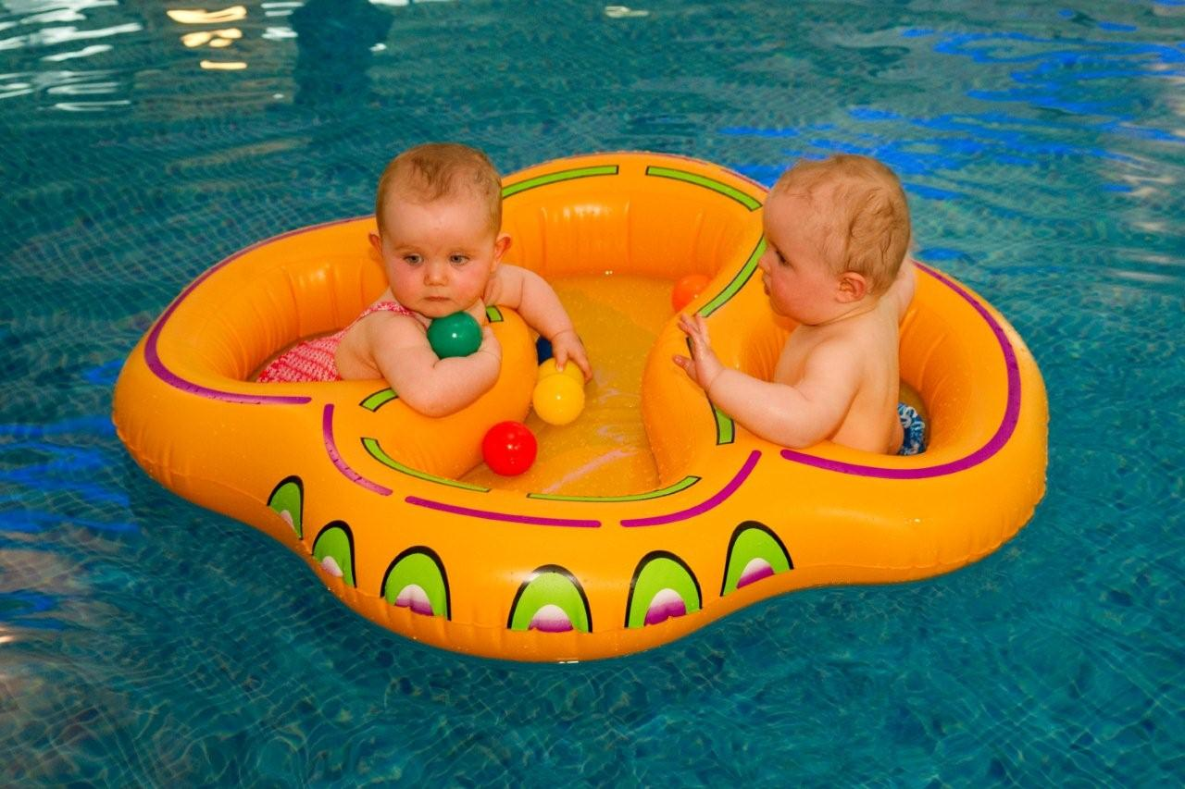
data types
Data can be stored in three main forms:
(sizes of images correspond to memory required)
Integer
String
Float

Slide 17
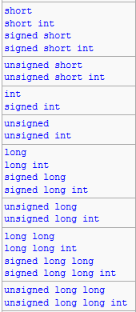
data types
C integer types
Data can be stored in three main forms:
String: “Mary’s lamb” / ‘Mary said, “lamb!”’
In Python, ‘ ’ or “ ” can be used to denote strings
Integers: …, -2, -1, 0, 1, 2, …
In Python 3, no max/min integers
In C, integers have a max, depending on what type it belonged to
Floats: 3.14159…
Python 3: up to 55 decimal points, usually
As computers count in binary, floats are very hard to store “properly”, thus the increased memory usage relative to integers
These data are stored in variables
… this is why we’re not learning C :)

Slide 18
Variables
In Python, variables do not need to pre-declare what type they are – the interpreter guesses what type they belong to when you store data to it:
pi = “apple” pi = 3 pi = 3.1415926 STRING INTEGER FLOAT
Variables need to have values stored to it before it can be used
pi = 3; print (pi) → OK
print (pi); pi = 3 → “NameError: name 'pi' is not defined”
Variables cannot be named after some special keywords
and assert break class continue def del elif
else except exec finally for from global if
import in is lambda not or pass print
raise return try while yield

Slide 19
Variable Naming Conventions
Do:
Give variables logical names
price = 3.50
welcome_message = ‘How are you?’
Stick to naming conventions recommended by the programming language. For Python:
Normal variables: all_small_caps
Function names: all_small_caps
Class names: UpperCamelCase
Constants: ALL_LARGE_CAPS
Related variables should be named similarly
x_coords = 19.223; y_coords = 10.211
caffeine_coffee = 0.005; caffeine_pepsi = 0.0003
Don’t:
Use spaces in variable names; use underscores instead
food price = 16.00 x
food_price = 16.00 ✓
Inconsistent capitalisation
price = 16.00; print (Price) → NameError
Use too many single-character variables, gets impossible to track in larger programs!
Good naming conventions allow for easy understanding of your code!

Slide 20
Homework
Use one of the offline/online Python interpreters (e.g. http://pythonfiddle.com/), and execute these statements:
print (“Hello world!”)
print (1234 * 3)
print (“1234” * 3)
print (1234 / 3)
Why the difference in output between 2nd and 3rd lines?
What’s the output type for each line?
Get comfortable with your Python interpreter, because you’ll be using it more often from now on!
NOTE: if you’re using extremely old interpreters, they hate brackets around print statements. Remove the brackets.

Slide 21
Next week…
Think like a computer!
Write your first script!
Control statements!
For loops
If-elif-else

