Slide 1
Lesson 1: If Happy; clap_hands()
Three programmers walk into a bar. The bartender asks them if they all would like a beer.
I don't know, the first programmer replies.
I don't know, chimes the second programmer.
Yes, says the third programmer.
Yi Jin Liew
140225

Slide 2
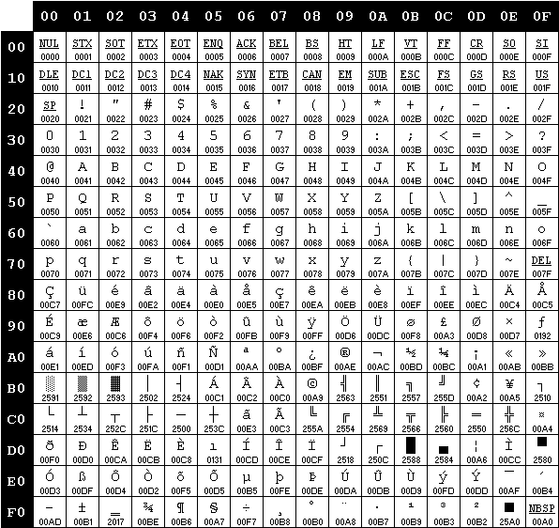
Character encodings
IBM 850 (Western Europe)
1963: ASCII – 7 bit per character, 2⁷ = 128 characters
Americans happy… but Français? Español?
1980s: Code pages – 8 bit per character (2⁸ possible)
ASCII + 128 chars depending on your location
Europeans happy… but 白人看不懂
1980s: Entirely different encodings – 16 bits per character (e.g. Shift-JIS / GB2312 / Big5)
Asians finally happy
1990s: Unicode – 32 bits per character
Aim to cover ALL characters, including symbols e.g. ♠ ♥ ♦ ♣
Entire world happy
Python: contents of strings can be Unicode, but programming must be done in ASCII.

Slide 3
Manipulating variables
Input | Output
wallet = 100 print (wallet) | 100
wallet = 100 wallet = wallet - 16 print (wallet) | 84
wallet = 100 wallet += 25 print (wallet) | 125 (note: “+=” is a shortcut for wallet = wallet + 25)
wallet = “100” wallet += 25 print (wallet) | TypeError. Cannot add strings to integers.
wallet = 100.00 wallet += 25 print (wallet) | 125.0 (note: float + integer produces a float test by setting wallet to 100, and add 25.00 to it)

Slide 4
Manipulating variables
Rule of thumb for Python: if any line of code is ambiguous, it’s gonna crash.
e.g. what’s the output of “5” + 6?
Allowable operations [+, -, *, /, **]:
 | String | Integer | Floats
String | + | only string * integer (for now, treat is as an exception) | none allowed
Integer |  | all allowed | all allowed
Float |  |  | all allowed

Slide 5
Type casting
Problem: how to join string and integers, to print out “I am 18 years old”?
age = 18 “I am” + age + “years old” → TypeError!

Slide 6
Type casting
Problem: how to join string and integers, to print out “I am 18 years old”?
age = 18 “I am” + age + “years old” → TypeError!
Solution: type casting – changing the type of one variable to another type
str(18) produces “18”
int(“18”) produces 18
float(“18”) or float(18) produces 18.0
Guess what int(“this is a string”) produces?
Answer: ValueError – strings don’t have “values”.

Slide 7
Operator Precedence
Order (highest first) | Python | Microsoft Excel
Stuff placed in brackets
Exponents (a^{b}) | a ** b | a ^ b
Multiplication and division | a * b; a / b | a * b; a / b
Addition and subtraction | a + b; a - b | a + b; a – b
So what is… EXTRA CREDIT
1 * 2 + 3 1 * 2 ** 3 ** 2
1 + 2 * 3 1 ** 2 ** 3 ** 4 ** 5 ** 6
(1 + 2) * 3 3 ** 0
1 + 2 * 3 ** 2 0 ** 3
1 + (2 * 3) ** 2 2 / 0

Slide 8
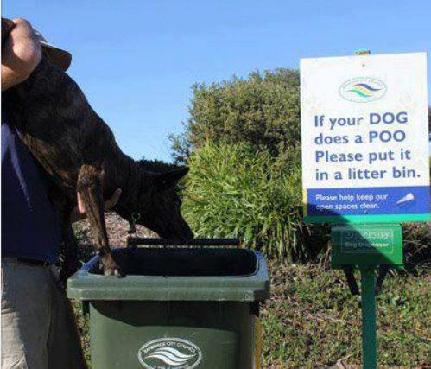
If Statements

Slide 9
If Statements
A programmer is heading out to the grocery store, so his wife tells him "get a gallon of milk, and if they have eggs, get a dozen." He returns with 13 gallons of milk.

Slide 10
Python: If-elif-elsE
# denotes the start of comments.
Anything after # is ignored by Python.
if condition_1: do_stuff() elif condition_2: # executes only if condition_1 is not met do_other_stuff() elif condition_3: # executes only if _1 and _2 are not met do_other_other_stuff() else: # executes only if _1, _2, and _3 are not met do_other_other_other_stuff()

Slide 11
Python: If-elif-elsE
BE CAREFUL WITH YOUR IF STATEMENTS!
(sample pseudocode) if age > 0: watch_disney_films() elif age >= 18: watch_R_rated_films() else: print (“you’re an unborn foetus!”)
What happens when you’re older than 18?

Slide 12
Python: If-elif-elsE
Make sure your if doesn’t catch everything that your elif is supposed to catch.
(sample pseudocode) if age >= 18: watch_R_rated_films() elif age > 0: watch_disney_films() else: print (“you’re an unborn foetus!”)
… awesome, now you can watch R rated films if you’re above 18 years old.

Slide 13
Python: If-elif-elsE
Better still: make sure your if and elif catch non-overlapping conditions.
(sample pseudocode) if age >= 18: watch_R_rated_films() elif age > 0 and age < 18: watch_disney_films() else: print (“you’re an unborn foetus!”)
Defensive programming – minimise chance of errors happening!

Slide 14
Conditions
Comparing integers/floats:
a > b greater than
a < b less than
a >= b greater or equal (note that “=>” is not valid)
a <= b less than or equal (note that “=<” is not valid)
a == b equals
a != b not equal
Operator chaining
a < b < c b is between a and c
a > b > c b is between a and c
a < b > c b is larger than both a and c (NOT RECOMMENDED)
a > b < c b is smaller than both a and c (NOT RECOMMENDED)
Can be used to compare string1 vs. string2
Recommended
b > a and b > c
b > max(a, c)

Slide 15
Python: If-elif-else PRACTICE!
n = 10 if <test whether n is positive>: <print something about n being positive> elif <test whether n is negative>: <print something about n being negative> else: <print something about n being zero>
Based on template above, write a script that prints out whether a number is “positive”, “negative”, or “is zero”, for different values of n.
Test your script produces expected output by changing n = 10 to n = -9 / n = 0.

Slide 16
Python: If-elif-else PRACTICE!
Solution for question posed in previous slide
n = 10 if n > 0: print (n, “is positive!”) elif n < 0: print (n, “is negative!”) else: print (n, “is zero!”)

Slide 17
Homework
Write a script to determine whether n is an even or odd number.
Assume that n is an integer (i.e. no need to test whether it’s a string, or float).
Test using n = 10, n = -9, and n = 0 (fyi: 0 is an even number).
Hint on how to check a number is even/odd:
print (13 % 10)
print (15 % 10)
Extra credit
Think of more ways on how to determine whether a number is even or odd (there are at least two other methods!)

Slide 18
Appendix
Why do I have lines with () at the end, and some without?
The difference between blabla and blabla(): blabla is a variable (store data) blabla() is a function.
A function is an extra chunk of code, for instance…
def display_welcome_message(): print (“Hello and welcome!”) user = “new” if user != “experienced”: display_welcome_message()
Program logic: if user is not experienced, it will execute code in display_welcome_message().
def is the keyword used to define a function

Slide 19
Next week…
The wonderful world of arrays!
Iterate through arrays with for loops!
Terminate loops with conditions!

