Slide 1
Bioinformatics, statistics & transcriptomics
Yi Jin LIEW Aranda Lab
080218

Slide 2
Outline
Morning session
9.00—10.00
Intro to bioinformatics
Why use Linux?
Why you shouldn’t fear the command line
10.20—12.10
Statistics in transcriptomics
Q & A
Lunch!
Afternoon session (1330—1700)

Slide 3
Outline
Afternoon session (make sure you have a functioning terminal!)
Process raw sequencing reads: 1 hour
Read mapping and quantification with kallisto: 30 mins
Intermission II: 10 mins
Normalisation with sleuth: 30 mins
Functional enrichment with topGO: 50 mins

Slide 4
Part 0: ... bioinformatics?

Slide 5
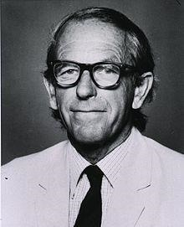
Bioinformatics (= computational biology)
Using computers to understand biological data
Earliest bioinformatics problems were:
Aligning protein sequences (protein sequencing pioneered 1950s)
Studying bacteriophage genomes (DNA sequencing pioneered 1970s), reinforced concepts of codons, open reading frames etc.
Fred Sanger (1918 – 2013)

Slide 6
Bioinformatics (= computational biology)
Data
Hypothesis
Experiments
Data-driven hypothesis

Slide 7
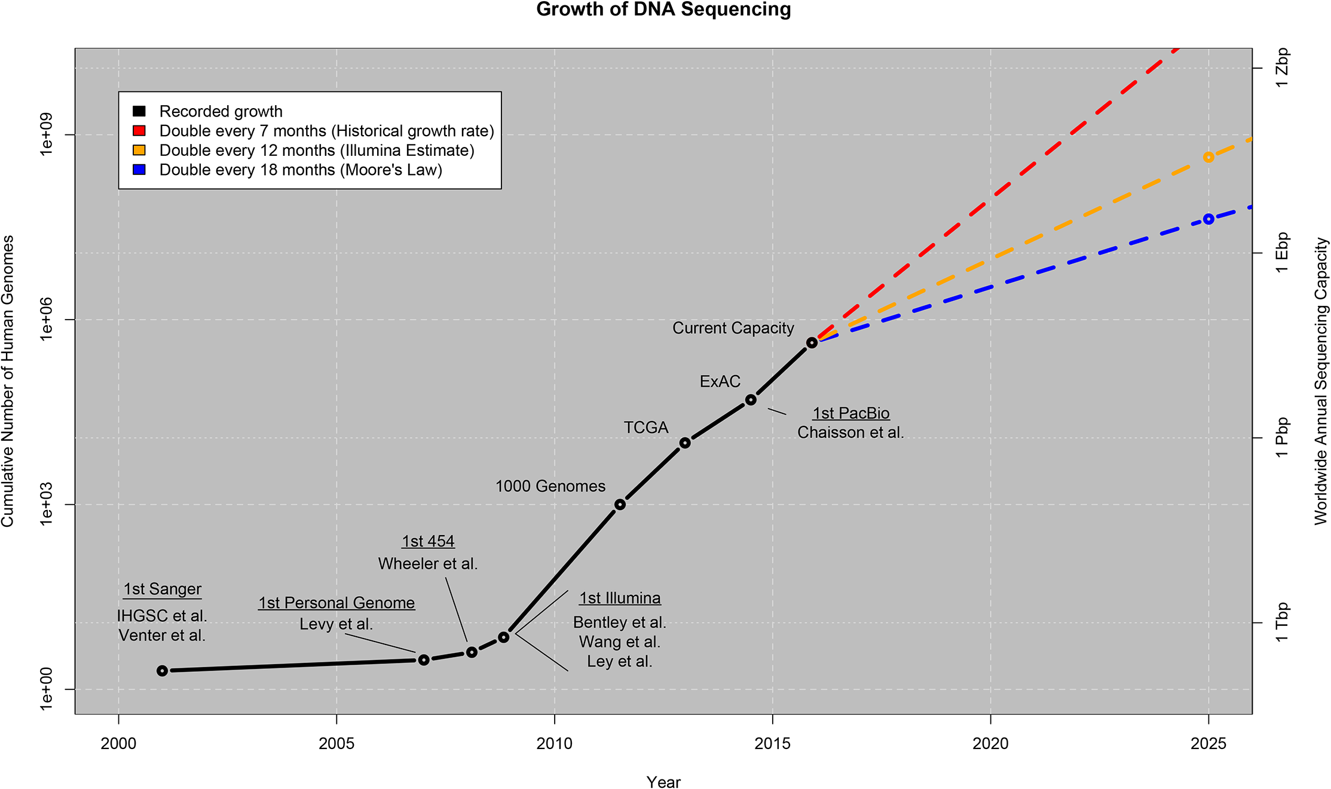
Explosive growth in data

Slide 8
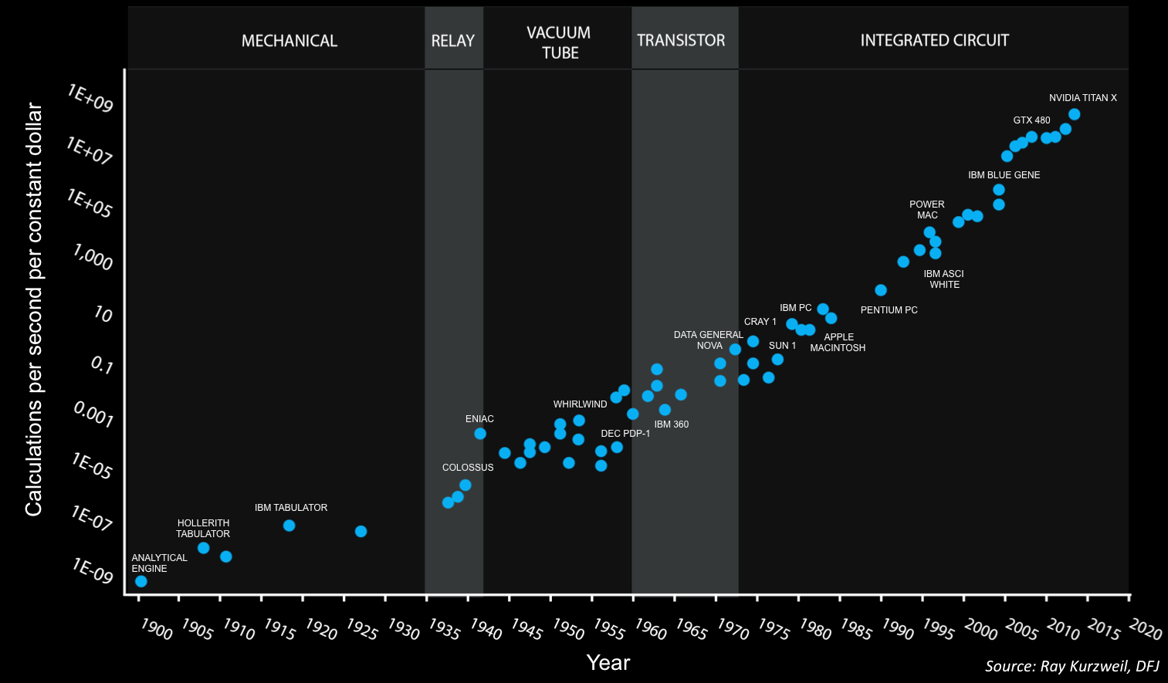
Exponential growth in computing power

Slide 9
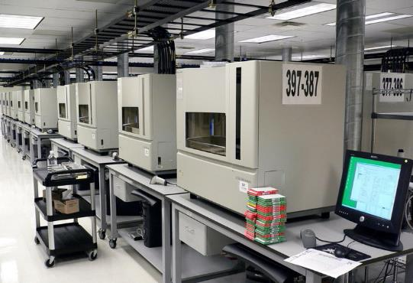
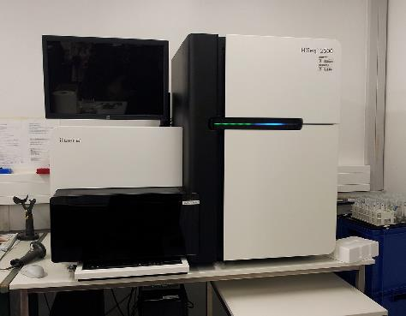
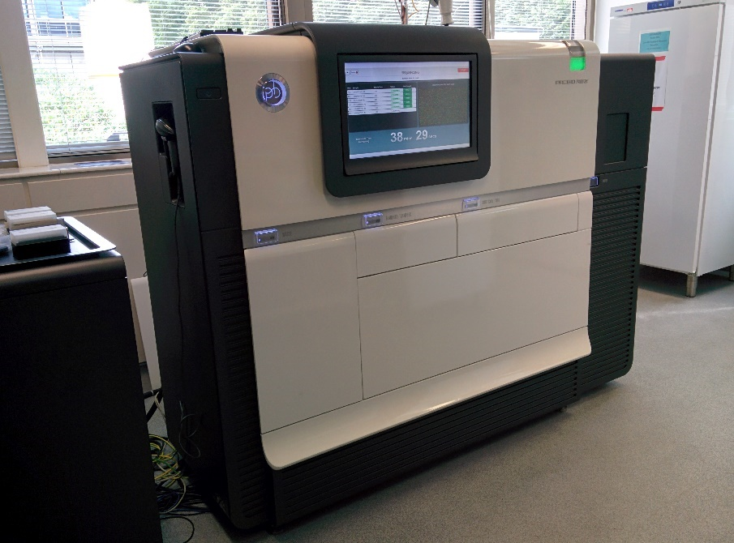
New sequencing technologies
Sanger sequencer
Next-generation sequencing (Illumina / SOLiD / 454)
Single molecule sequencing (Pacific Bio / Ion Torrent)

Slide 10
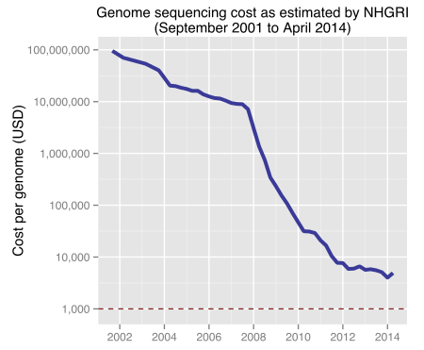
New sequencing technologies

Slide 11
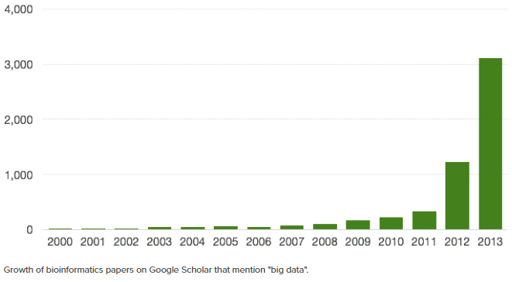
Explosive growth in papers

Slide 12
Modern examples of bioinformatics
Sequence analysis
Sequence searches: infer function of unknown DNA sequence
Comparative genomics: infer evolutionary trees from conserved proteins
Evolutionary biology: detect gene duplication / horizontal gene transfer
Mutational analysis: detect predisposition to diseases via SNP patterns
Expression studies
Microarrays / RNA-seq: detect upregulated or downregulated genes
Protein mass spectrometry: deduce function, quantify expression
Structural studies
Protein X-ray crystallography: calculate most likely structure of enzymes

Slide 13
Modern examples of bioinformatics
Systems biology
“Interactome”: deduce key proteins from map of protein interactions
Pathway analysis: deduce presence/absence of conserved pathways in new genomes
Image analysis
Track movement of cells, flies, fish, humans…
Data mining
IBM’s “Watson” supercomputer chomps thru medical literature, helps provide diagnosis and detect whether drug combinations have bad side effects

Slide 14
Part I: Why Linux?

Slide 15
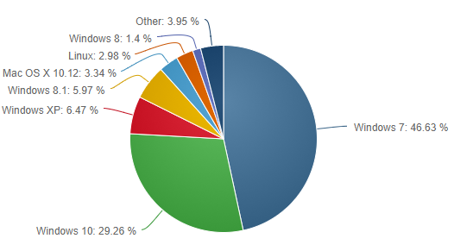
Popular Operating Systems

Slide 16
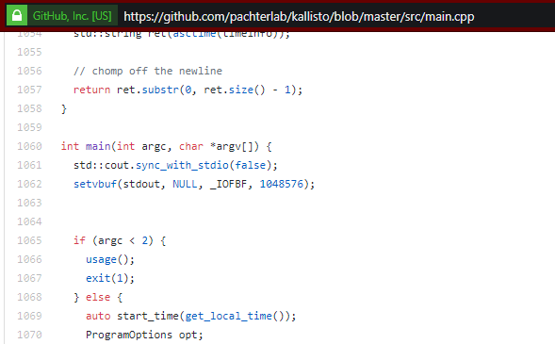
Bioinformaticians are the 3%
Bioinformatics programs are PREDOMINANTLY written for Linux
Why?
Openness: anyone can read source code of bioinformatics software

Slide 17
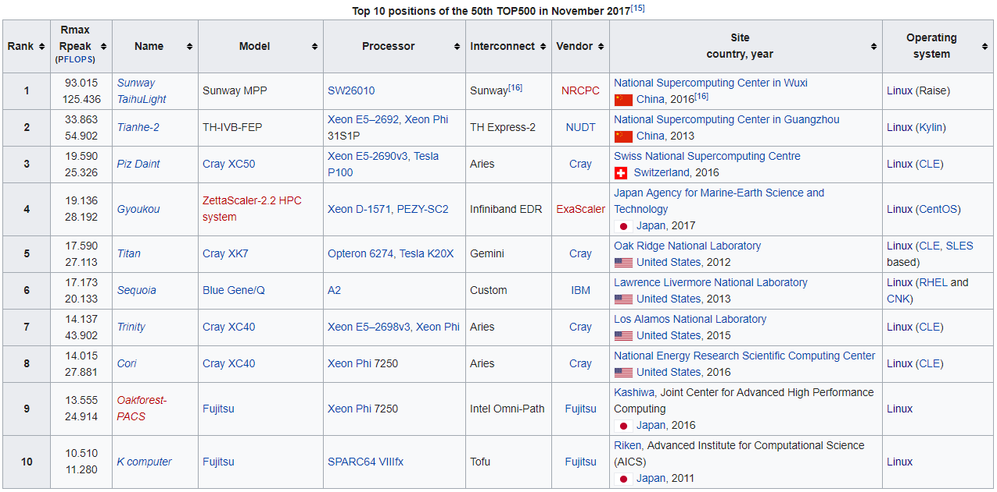
Bioinformaticians are the 3%
Bioinformatics programs are PREDOMINANTLY written for Linux
Why?
Server architecture: most large servers in universities run Linux

Slide 18
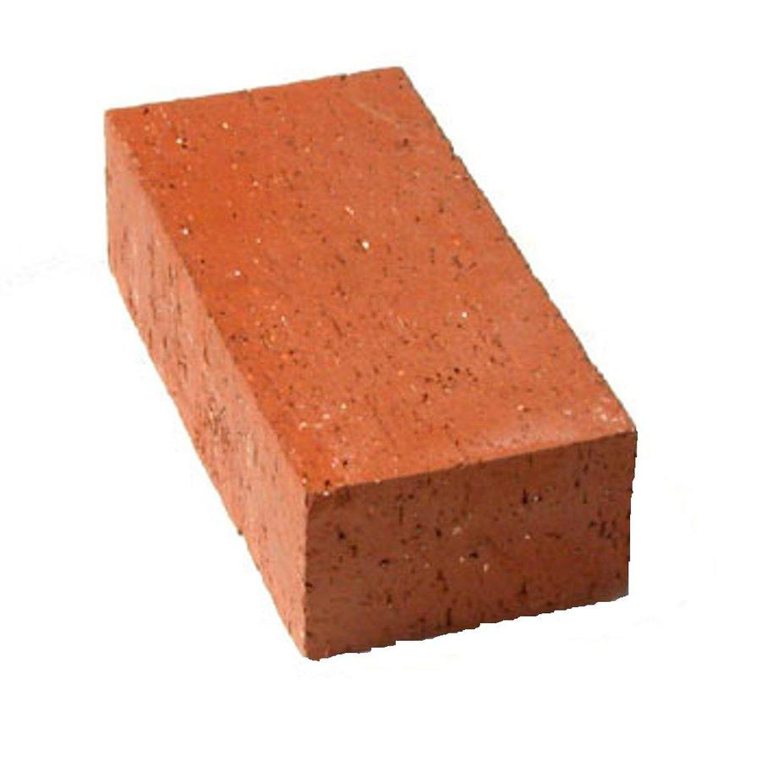
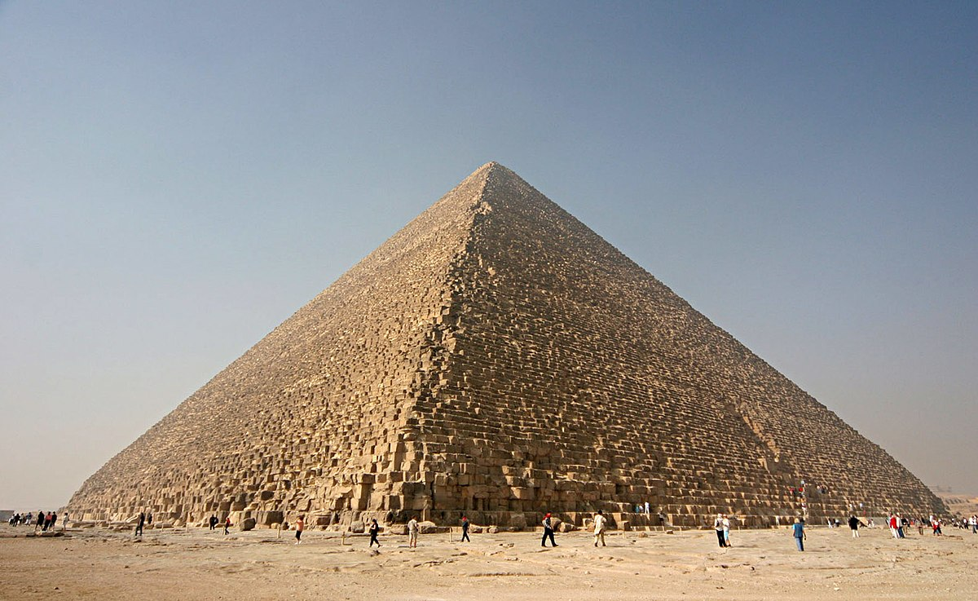
Bioinformaticians are the 3%
Bioinformatics programs are PREDOMINANTLY written for Linux
Why?
Ease at manipulating large files: nowadays, files > 1 GB are extremely common. Handling large files in Windows/OS X is extremely clunky!
Programming philosophy: modular vs monolithic
Linux
Windows/OS X

Slide 19
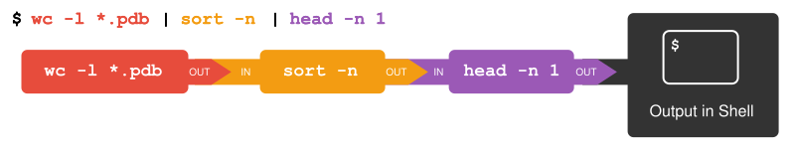
Bioinformaticians are the 3%
Bioinformatics programs are PREDOMINANTLY written for Linux
Why?
Text input/output, not silly proprietary filetypes (try opening a Word document in TextEdit/Notepad)
Piping: output of a tool can be “piped” as the input into another tool
When bioinformaticians put several programs together to produce the desired output, they say they’ve built a “pipeline”

Slide 20
Part II: Command-line-o-philia

Slide 21
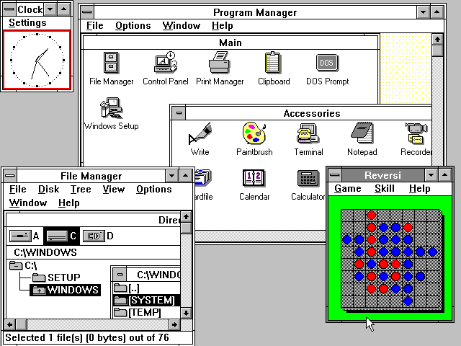
Command-line vs. GUI
GUIs used to be launched from the command-line
Command-lines are now launched from GUIs

Slide 22
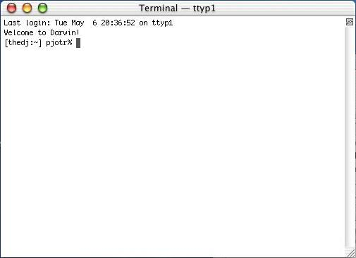
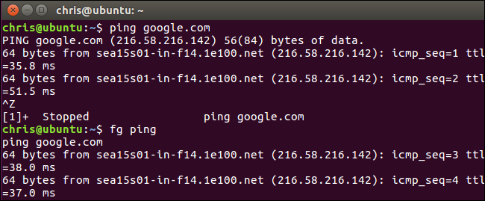
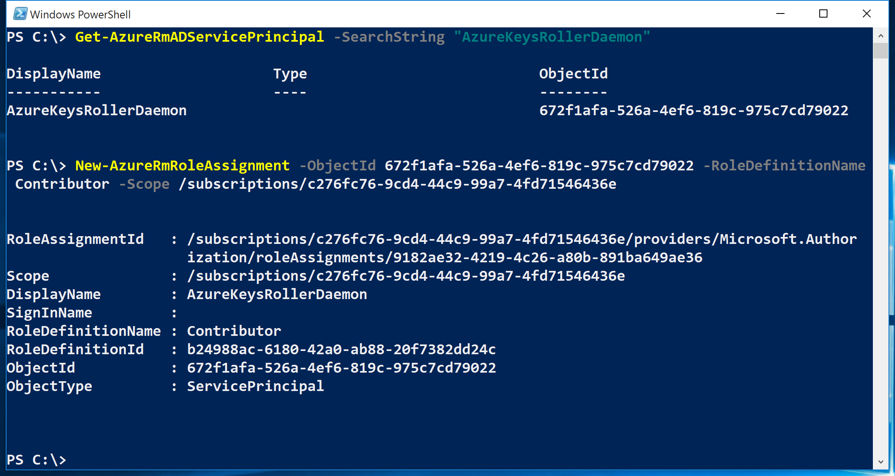
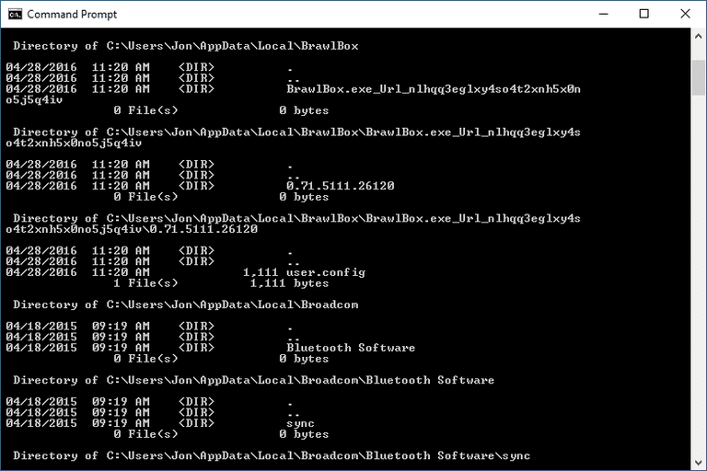

Slide 23
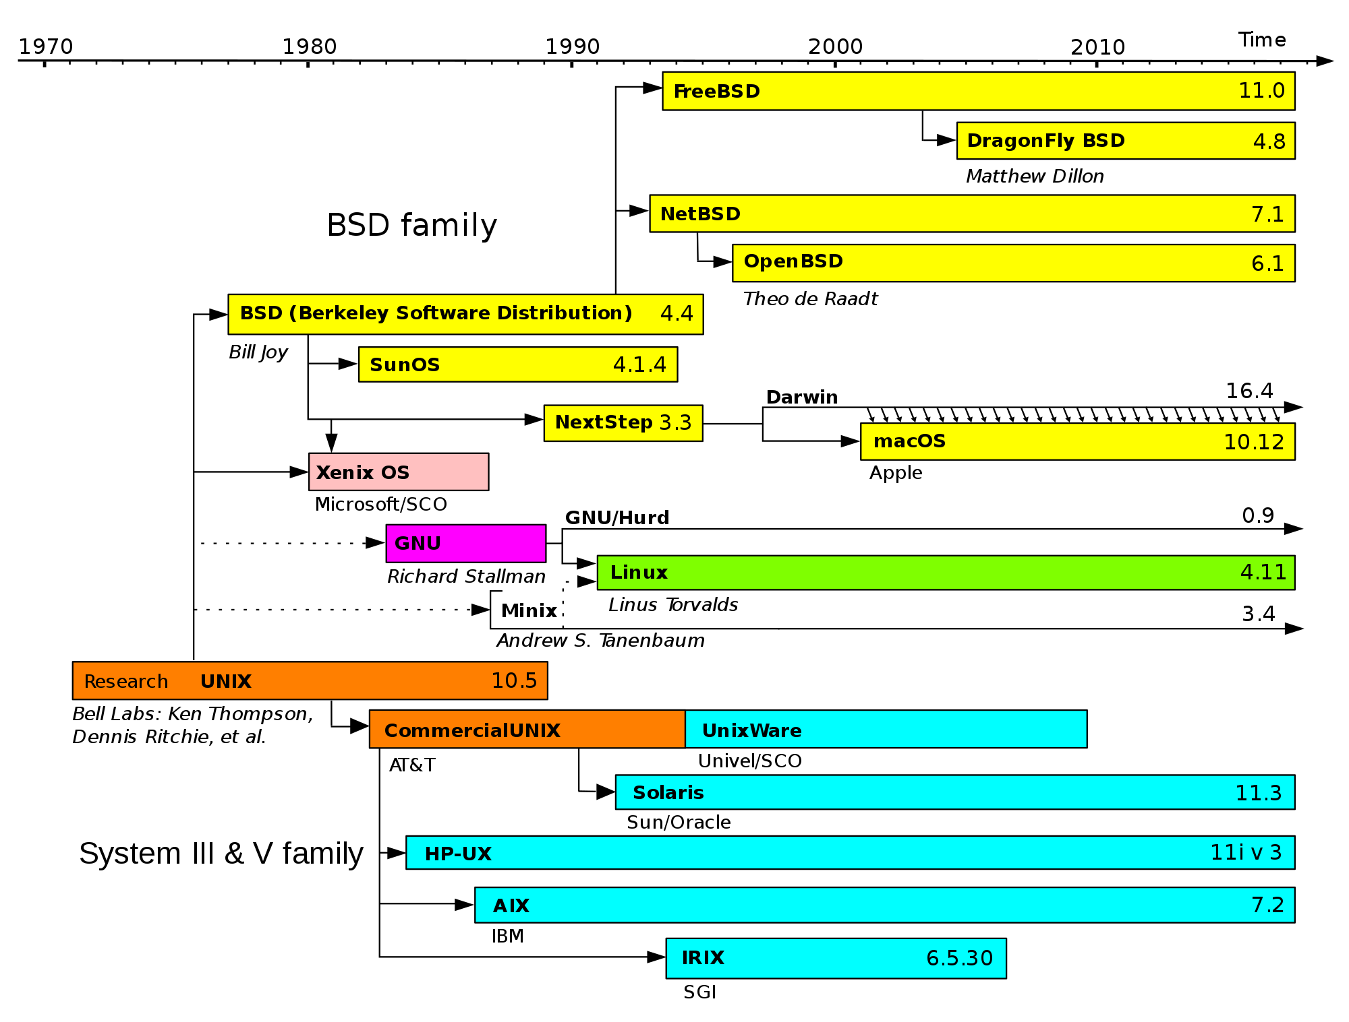
Command-lines are different!
OS X and Linux have similar command lines
Windows command lines are very different
cmd: more UNIX-like
PowerShell: manipulates objects instead of text

Slide 24
Mini-demo
Commands covered:
Command | Function
ls | List files
cd | Change directory
cat | Concatenate files, print to standard output
less | View contents of a file
nano | Edit contents of a file

Slide 25
Intermission I: Questions? CGP Grey - How Machines Learn https://www.youtube.com/watch?v=R9OHn5ZF4Uo

Slide 26
Part III: Statistics in transcriptomics

Slide 27
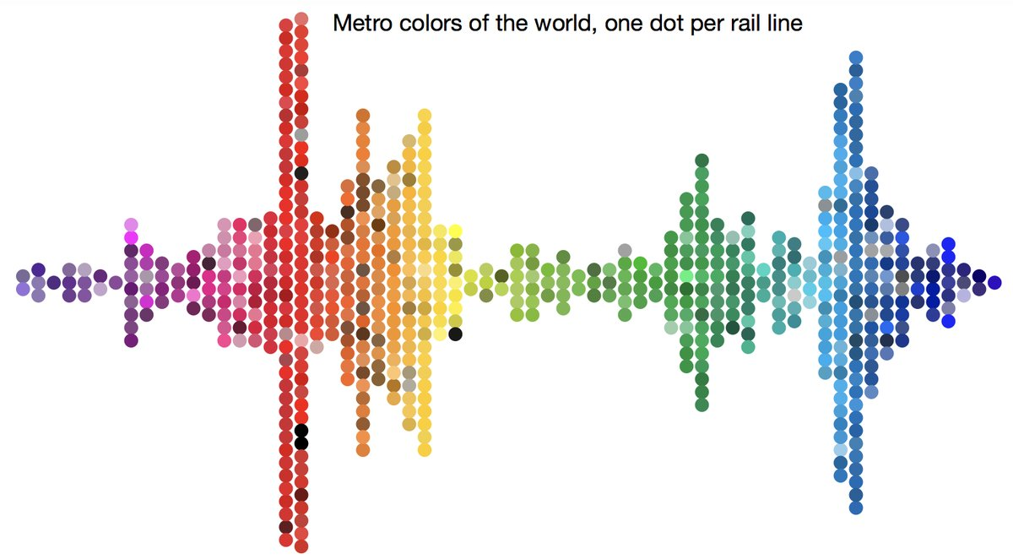
Statistics: why learn it?
Allows one to quantify whether data is interesting!

Slide 28
Understand your data!
Is this parametric, or non-parametric?

Slide 29
Why use normal data?
Allows the use of parametric tests:
Student’s t-test
ANOVAs
Pearson correlation (r²)
z-scores
While not compulsory,
PCAs are more meaningful
Prettier graphs
Much much easier to imagine normally-distributed data!

Slide 30
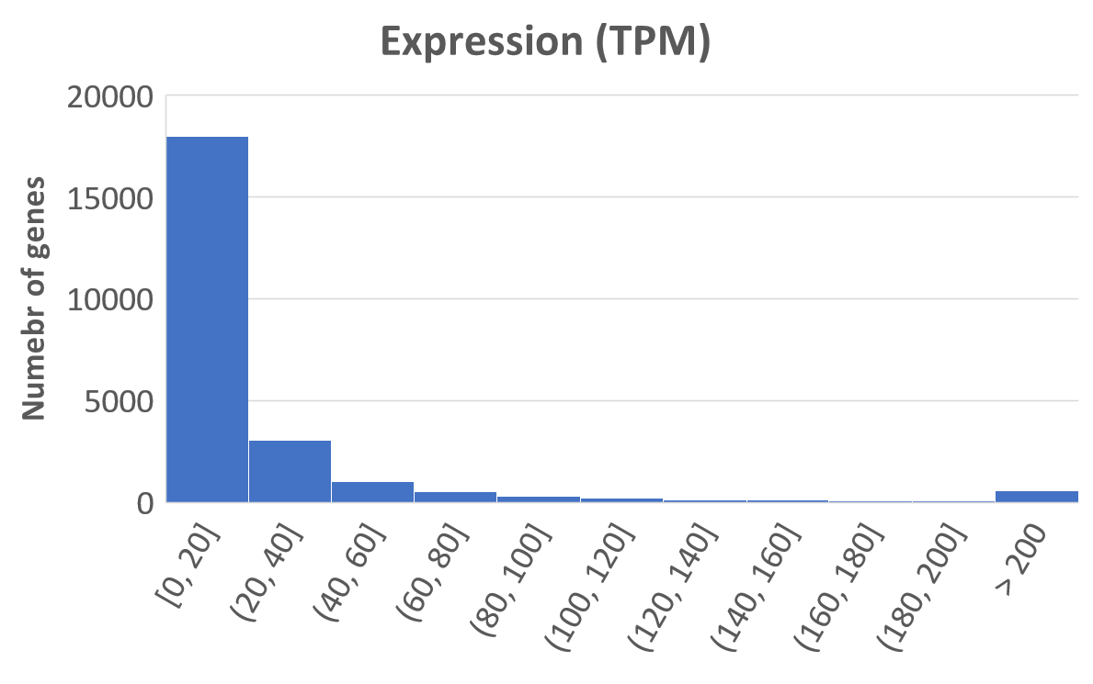
Do I need to transform my data?
Especially for expression data, raw values tend to not be normal

Slide 31
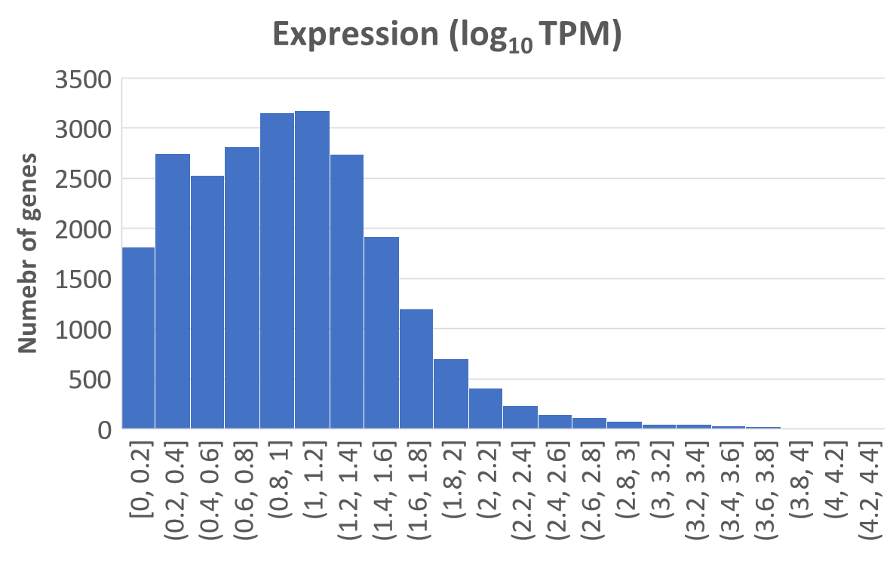
Do I need to transform my data?
After log-transformation:
This implies original data was log-normal!

Slide 32
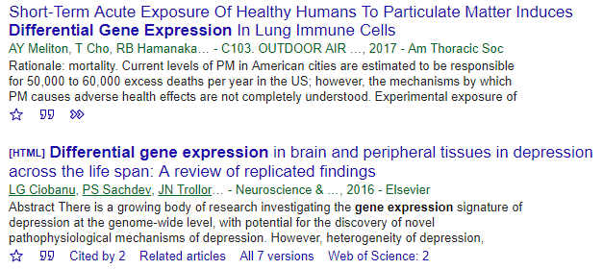
“Differential”
If a gene is said to be “differentially expressed under heat stress relative to control”, what does it mean? What about numerically?
Also think about the corollary: how do you know the gene is NOT differentially expressed?

Slide 33
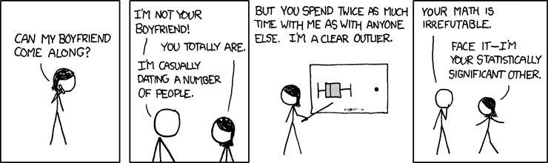
“significant”
“p < 0.05”: what do the p values mean?
Can you think of situations where heat stress values are very different from control, yet not considered statistically significant?

Slide 34
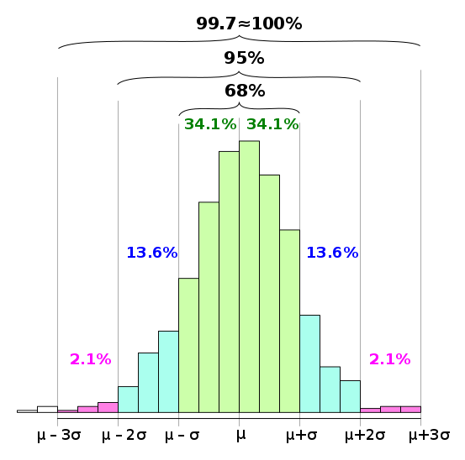
68-95-99 rule
p < 0.05 implies data point is 2 SD outside of the mean
e.g. IQ scores: 100 ± 15 (s.d.)
(at what IQ is one significantly smarter than the general pop?)

Slide 35
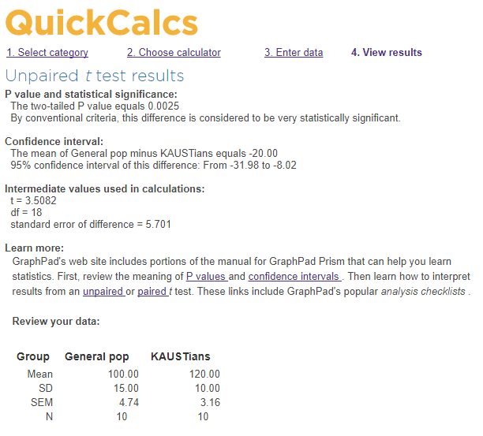
Student’s t-test (two-sample, two-tailed)
Tests whether observations have a significantly different mean from an expected baseline
e.g. IQ of sampled KAUSTians (n = 10) are 120 ± 10 (s.d.)
Is our IQ significantly different to that of a random sample (n = 10) from the population?

Slide 36
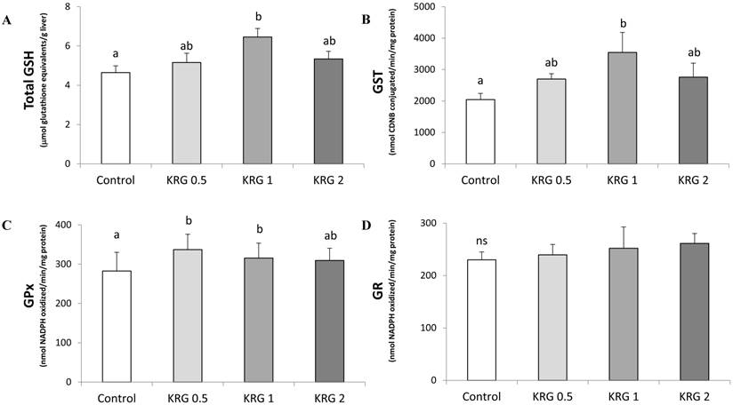
Student’s t-test
Very commonly done in scientific papers!

Slide 37
Student’s t-test
Alternative tests with the same idea
Testing something, but with preconceived idea of which direction the effect should be in? One-tailed t-test
Testing something, but against a fixed value instead of another distribution? One-sample t-test
More than two groups? ANOVA
Non-parametric data? Mann-Whitney U

Slide 38

Fisher’s exact test
Is this observation statistically significant?

Slide 39


Fisher’s exact test
... depends on which bag of M&Ms you used!
p < 0.05 p > 0.05

Slide 40
Fisher’s exact test
For the heck of it, let’s calculate some p values:
M&M website says that pack has ~50 candies
There are 5 colours, R G Y B O
We expect 10 green per packet
Cookie has 10 green M&Ms
Set up Fisher’s exact table
 | Green M&M | Non-green M&M
Cookie | 10 | 0
Not-on-cookie | 0 | 40

Slide 41
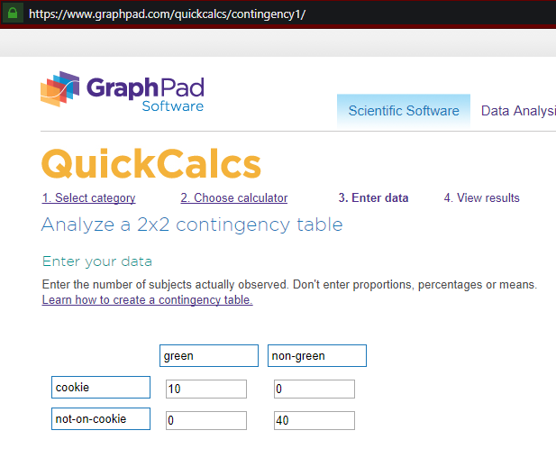
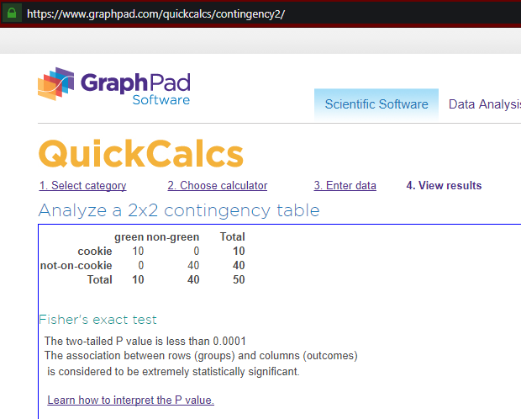
Fisher’s exact test

Slide 42
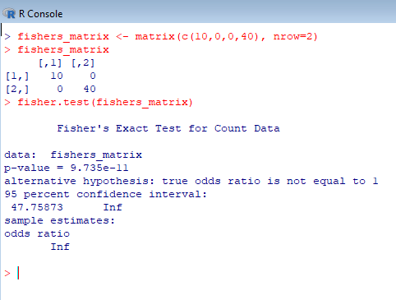
Fisher’s exact test
If we want precise p values, we can use R:

Slide 43
Fisher’s exact test
Let’s look at a more biological example
Perform a heat stress experiment
Obtain genes that were upregulated under stress
Check GO terms associated with these genes
p = ?
 | Genes with GO:0016209 | Genes without GO:0016209
Upregulated | 10 | 0
Not upregulated | 0 | 40

Slide 44
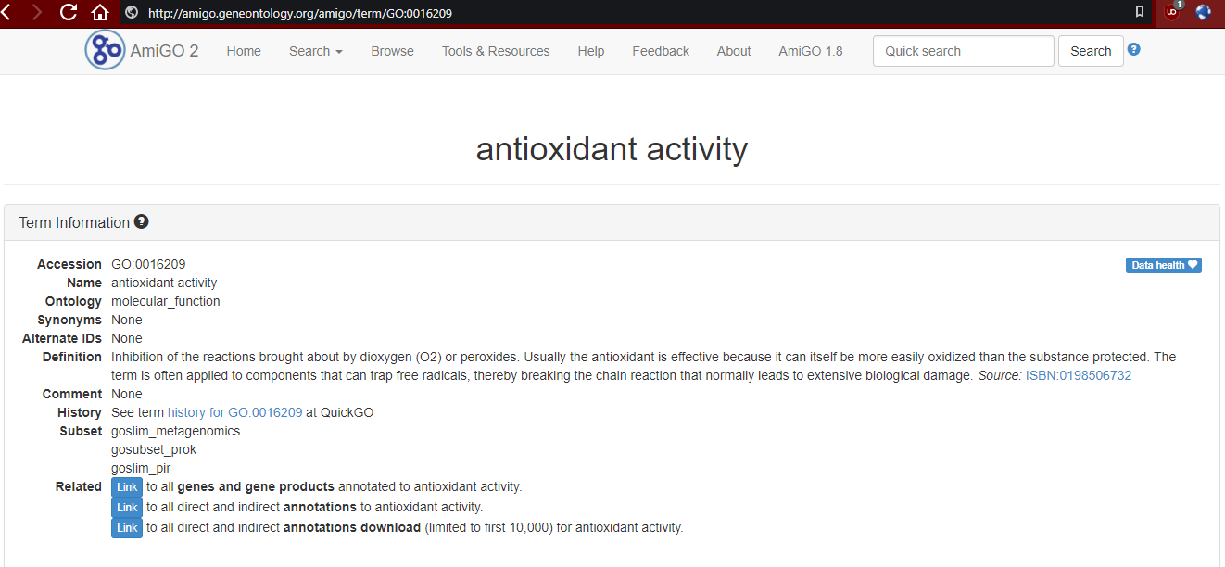
... GO:0016209?

Slide 45
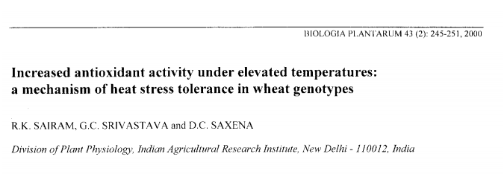
... GO:0016209?

Slide 46
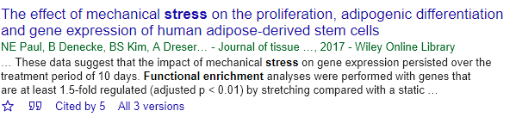
Fisher’s exact test
In academic-ese, what I showed is termed “functional enrichment”
Also known as “GO term enrichment analysis”

Slide 47
Fisher’s exact test
Back in plain English: Fisher’s exact tests calculates the probability of observing something, given that the overall distribution (i.e. universe) has a quantifiable distribution
Alternative tests with the same idea
More than 2x2 table? Chi-squared
2x2, but values are absurdly large? Chi-squared
Proportions of universe known, but not exact values? Binomial test

Slide 48
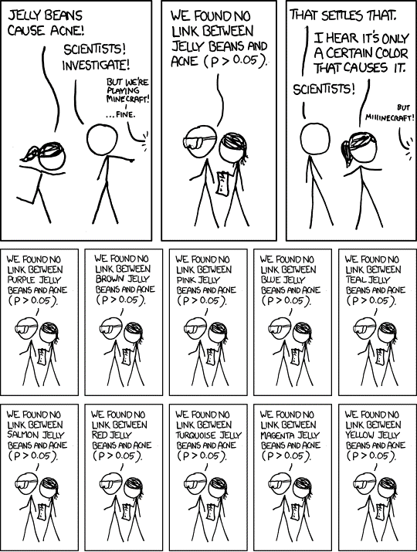
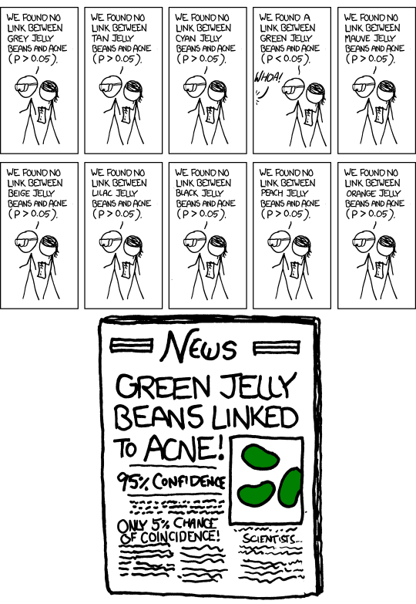
Multiple testing correction

Slide 49
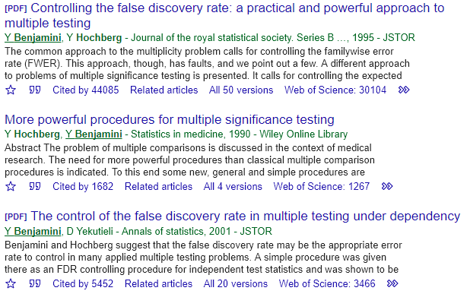
Multiple testing correction
Benjamini-Hochberg (1995)
How to correct p value
Benjamini-Yekutieli (2001)
How to make sure corrected list have the same ranking as the uncorrected one

Slide 50
Multiple testing correction
R: p.adjust()
Manually:
Gene | Uncorrected p | Correction factor | Corrected p
F | 0.0001 | x 6 / 1 | 0.0006
E | 0.001 | x 6 / 2 | 0.003
C | 0.01 | x 6 / 3 | 0.02
A | 0.04 | x 6 / 4 | 0.06
B | 0.08 | x 6 / 5 | 0.096
D | 0.2 | x 6 / 6 | 0.2

Slide 51
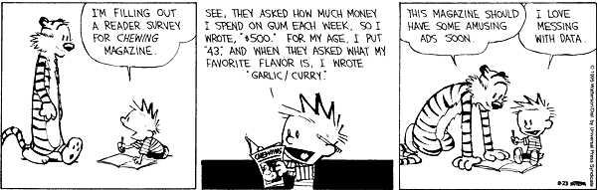
End of morning session: Questions?

